Slide 1
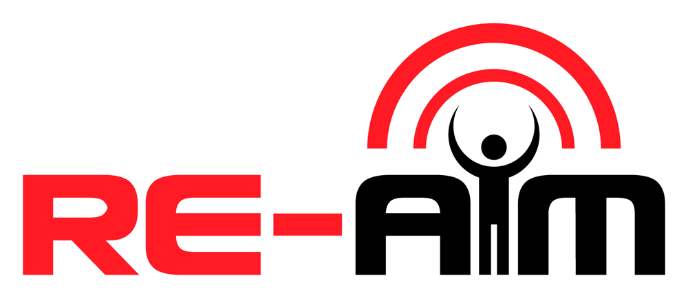
Name, Credentials
Affiliation
Location
Date

Slide 2
Presentation
Overview
What is the problem?
What is Dissemination and Implementation Science?
What is RE-AIM?
What is an example of using RE-AIM?
What are common misconceptions?
How has RE-AIM evolved over the last 20 years?
Notes:
NOTE TO PRESENTER: YOU CAN ADAPT THIS LIST (e.g., perhaps remove slides 6-8 if already talking to a well-verse implementation science audience)
We’ll cover several topics in today’s presentation.
We’ll start by discussing what is the problem? In other words, why do we need RE-AIM?
Then we’ll review background information on Dissemination and Implementation Science, specifically pragmatic Dissemination and Implementation Science.
Then we’ll move into explaining RE-AIM, including technical and pragmatic definitions of each RE-AIM dimension.
After we’ve clarified the dimensions, we’ll look at an example of how to use RE-AIM.
Then we’ll look at four common misconceptions about RE-AIM.
Finally, we’ll consider how RE-AIM has evolved over the last 20 years, including lessons learned.

Slide 3
What is the problem?
Research-Practice Gap
Only 18% of administrators and practitioners report using evidence-based practices frequently.
It takes 17 years for research to reach practice.
Only 14% of research reaches a target recipient.
Balas EA, Boren, SA. Managing clinical knowledge for healthcare improvement. In Yearbook of Medical Informatics. 2000.
Chagnon F, et al. Comparison of determinants of research knowledge utilization by practitioners and administrators in the field of child and family social services. Implementation Science. 2010:5:41.
Notes:
The problem is that there is research-practice gap. What we’re learning in science is not reaching the community. We need to find better, faster ways to translate research findings to public health benefit. For example:
It takes 17 years for research to reach practice.
And only 14% of that research reaches a patient.
Plus, only 18% of administrators and practitioners report using evidence-based practices frequently.

Slide 4
Traditional, highly-controlled RCTs versus real-world settings.
“Voltage drop” of effectiveness.
What is most relevant to the stakeholders?
Even if 100% effective, impact depends on:
(1) Adoption
(2) Training
(3) Fidelity (Implementation)
(4) Access (Reach)
(5) Sustainability (Maintenance)
50% threshold for each step=
.5*.5*.5*.5*.5=
3% benefit
Rothwell PM. External validity of randomised controlled trials. Lancet 2005;365:82-93.
Notes:
One of the key problems with this research-practice gap is that even if an intervention is 100% effective, it is only as good as whether:
It is adopted,
Practitioners are trained to deliver it,
Trained practitioners deliver it with fidelity,
Eligible populations have access to it, and
It can be sustained.
If we assume a 50% threshold for each of these steps, that 100% effective intervention has only 3% benefit.
This formula illustrates several issues.
First, the highly controlled setting of randomized controlled trials is very different from real-world settings that do not have scientific control.
Second, even when we do implement a tested intervention into everyday clinical practice, we often see what’s known as a “voltage drop” or dramatic decrease in effectiveness.
Finally, the most common reason that evidence-based interventions are not adopted is that they are not seen as relevant by stakeholders such as patients, healthcare providers, and administrators.
Clearly, we need to find a way to produce rigorous results that are relevant to stakeholders.

Slide 5
What is Dissemination and Implementation Science?
Dissemination: Information sharing
Implementation: Intervention integration
Pragmatic: Under “usual” conditions – relevant to stakeholders AND rigorous.
Illustration by Dave Cutler
Notes:
That is where Dissemination and Implementation Science comes in. Dissemination and Implementation Science—or D&I Science—is the systematic study of how evidence-based interventions, practices, and policies can be integrated into health care and community settings.
Dissemination is information sharing.
Implementation is intervention, practice, or policy integration.
Pragmatic refers to studying an intervention, practice, or policy under “usual” conditions instead of highly-controlled research conditions. The purpose of a pragmatic approach to D&I Science is to produce results that are relevant to stakeholders AND rigorous.

Slide 6
Theories
Frameworks
Models
Tabak RG et al. Bridging Research and Practice: Models for Dissemination and Implementation Research Am J Prev Med, 2012, 43: 337-350.
Notes:
Within D&I Science, researchers have developed over 150 theories, frameworks, and models.
Theories refer to a systematic way of understanding events or behaviors. Theories explain or predict phenomena by specifying relationships between variables.
Frameworks are strategic models that provide an actionable, systematic way to develop and evaluate interventions.
Models is a broad term used to describe theories and frameworks collectively.
The next slide explains more about models.

Slide 7
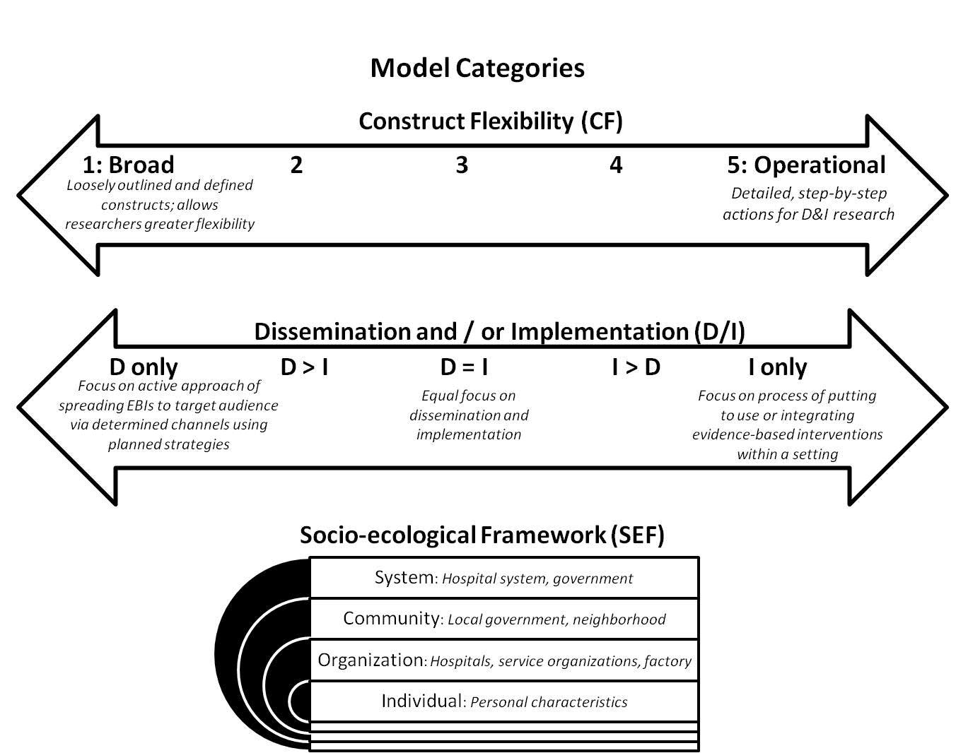
https://www.cdc.gov/prc/stories-prevention-research/stories/dissemination-and-implementation.htm
Notes:
One approach to models is to categorize them across three dimensions:
The first dimension is construct flexibility and is shown in the top arrow. Constructs can range from broad to operational. Broad models have loosely defined constructs and operational models have detailed, step-by-step constructs.
The second dimension of models is whether they’re intended for dissemination, implementation, or both. This dimension is shown in the second arrow and, as you can see, there’s a range.
The third dimension of models is how it falls within the Socio-ecological Framework. This dimension is shown in the bottom figure. Models may depict events, behaviors, or phenomena at the system level, community level, organization level, or individual level.

Slide 8
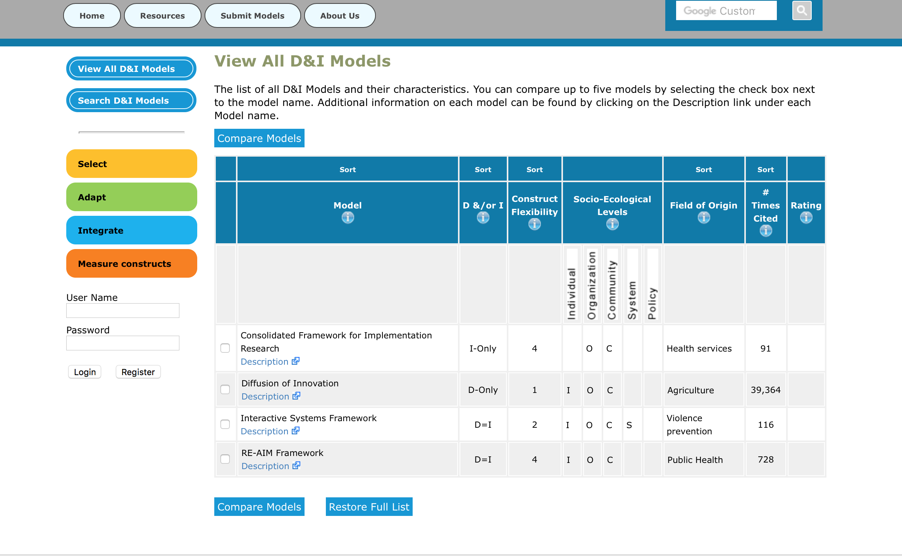
Where to find D&I models
www.dissemination-implementation.org
Notes:
You can find models categorized by these three dimensions at www.dissemination-implementation.org. There are various search options to select, adapt, integrate, and measure constructs at this website.

Slide 9
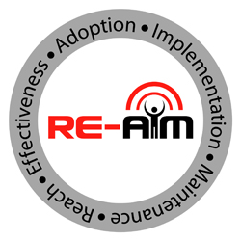
What is RE-AIM?
Notes:
Within this sea of D&I theories, frameworks, and models, RE-AIM has emerged as one of the most popular frameworks.
RE-AIM was first published in 1999 as a commentary.
It was first used to evaluate prevention and health behavior change programs.
And, as a bit of D&I trivia, RE-AIM was originally going to be called ARIEM.

Slide 10
RE-AIM
Facilitate translation of research to practice.
Balance internal and external validity.
Emphasize representativeness.
Address multi-level factors: individual, organizational, system: experimental and observational.
Notes:
RE-AIM optimizes external validity and pragmatic criteria which are often ignored. By optimizing these crucial elements, RE-AIM serves several purposes:
First, RE-AIM facilitates the translation of research to practice. It helps identify all the pieces to the puzzle.
Second, RE-AIM balances internal and external validity so that results are empirically rigorous and practically meaningful.
Third, RE-AIM emphasizes representativeness and issues related to access.
Fourth, RE-AIM allows researchers to address multi-level factors. It captures implementation at the individual and organizational levels through experimental and observational methods.

Slide 11
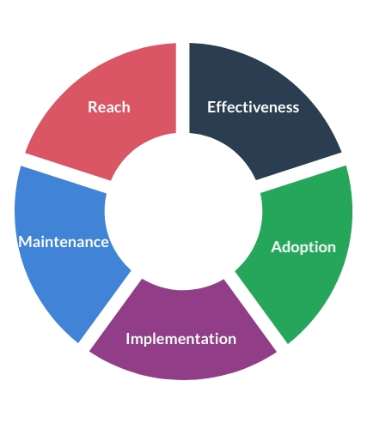
RE-AIM
Intervention + Implementation Goals
Adopted broadly.
Sustained implementation at reasonable cost.
Reaches large numbers of people.
Replicable and long-lasting outcomes.
Notes:
The goals of RE-AIM intervention and implementation is to develop and translate programs that can:
Be adopted, adapted, and delivered broadly.
Have the ability for sustained and consistent implementation at reasonable cost.
Reach large numbers of people, especially those who can most benefit.
Produce replicable and long-lasting change, including implementation outcomes and population outcomes.
Now that we’ve reviewed the purpose and goals of RE-AIM, we’ll look at each dimension.

Slide 12
Technical Definition
The absolute number, proportion, and representativeness of individuals willing to participate in a given initiative, and the reasons why (qualitative).
Pragmatic Use
WHO is intended to benefit and who actually participates or is exposed to the initiative?
REACH
Glasgow RE, Estabrooks PE. Pragmatic Applications of RE-AIM for Health Care... Prev Chronic Dis 2018;15:170271. DOI: http://dx.doi.org/10.5888/pcd15.17027
Notes:
For each of the RE-AIM dimensions, there is a technically correct definition and a “who, what, where, how, and when” question to guide pragmatic use.
The first dimension is Reach which refers to the absolute number, proportion, and representativeness of individuals who are willing to participate in a given initiative, program, or intervention. For reach, the key pragmatic priority to consider is WHO is or was intended to benefit and actually participate or be exposed to the intervention?

Slide 13
Technical Definition
The impact of an initiative on outcomes, including potential negative effects, heterogeneity, quality of life, and economic outcomes as well as the reasons why (qualitative).
Pragmatic Use
WHAT is the most important benefit you are trying to achieve and what is the likelihood of negative outcomes?
EFFECTIVENESS
Glasgow RE, Estabrooks PE. Pragmatic Applications of RE-AIM for Health Care... Prev Chronic Dis 2018;15:170271. DOI: http://dx.doi.org/10.5888/pcd15.17027
Notes:
The second dimension of RE-AIM is Effectiveness, which is the impact of an initiative, program, intervention, or policy on important outcomes, including potential negative effects, quality of life, and economic outcomes. The key pragmatic consideration is WHAT is or was the most important benefit you are trying to achieve and what is or was the likelihood of negative outcomes?

Slide 14
Technical Definition
The absolute number, proportion, and representativeness of settings and agents willing to initiate a program, and the reasons why (qualitative).
Pragmatic Use
WHERE is the program applied and
WHO applied it?
ADOPTION
Glasgow RE, Estabrooks PE. Pragmatic Applications of RE-AIM for Health Care... Prev Chronic Dis 2018;15:170271. DOI: http://dx.doi.org/10.5888/pcd15.17027
Notes:
The third dimension of RE-AIM is adoption which is defined as the absolute number, proportion, and representativeness of settings and intervention agents who are willing to initiate a program. Pragmatically, the question for adoption is Where is the program applied and who applied it?

Slide 15
Technical Definition
Fidelity to the intervention protocol, and including adaptations, time, and cost as well as the reasons why (qualitative).
Pragmatic Use
HOW consistently was the program delivered, how was it adapted, how much did it cost, and WHY did the results come about?
IMPLEMENTATION
Glasgow RE, Estabrooks PE. Pragmatic Applications of RE-AIM for Health Care... Prev Chronic Dis 2018;15:170271. DOI: http://dx.doi.org/10.5888/pcd15.17027
Notes:
The fourth dimension of RE-AIM is implementation. At the setting level, implementation refers to the intervention agents’ fidelity to the various elements of an intervention’s protocol. This includes consistency of delivery as intended, adaptations made, and the time and cost of the intervention. The key pragmatic considerations are How consistently is or was the program or policy delivered? How will or was it be adapted? How much will it cost? And why did will or did the results come about?

Slide 16
Technical Definition
The extent to which a program becomes institutionalized at the setting level or sustained at an individual level as well as the reasons why (qualitative).
Pragmatic Use
WHEN was the program operational and how long are the results sustained?
MAINTENANCE
Glasgow RE, Estabrooks PE. Pragmatic Applications of RE-AIM for Health Care... Prev Chronic Dis 2018;15:170271. DOI: http://dx.doi.org/10.5888/pcd15.17027
Notes:
The last dimension of RE-AIM is maintenance which is defined as the extent to which a program or policy becomes institutionalized or part of the routine organizational practices and policies. Maintenance in the RE-AIM framework also has referents at the individual level based on sustained changes and long-term outcomes. The key pragmatic consideration for maintenance is When will (or did) the initiative become operational and how long are the results sustained at the setting level and individual level?

Slide 17
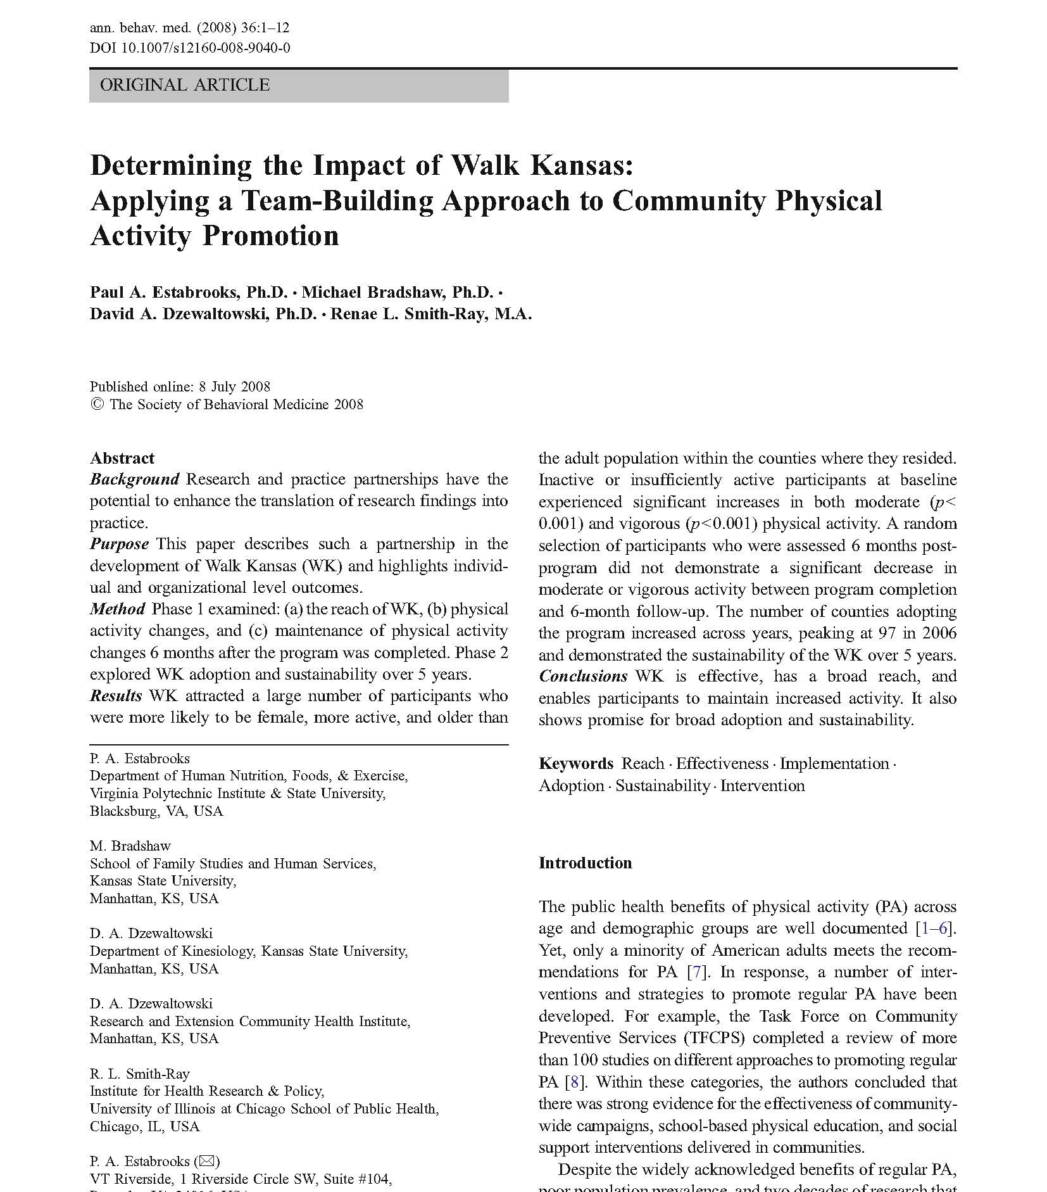
What’s an example of using RE-AIM?
Notes:
Now that we’ve defined the dimensions, let’s look at an example of applying RE-AIM. This is an example of applying RE-AIM to community-based physical activity promotion.

Slide 18
Design=Quasi-experimental trial (n=5911) in cooperative extension system
Target population=Adults with no contraindications for moderate PA
Intervention=8-week group dynamics program
Control=Participants served as own control
Estabrooks et al. Determining the Impact of Walk Kansas. ABM, 2008, 36: 1-12
Notes:
This slide illustrates background information about research on the impact of Walk Kansas.
The research design was a quasi-experimental trial in a statewide cooperative extension system.
The target population was adults with no contraindications for engaging in moderate intensity physical activity.
The intervention was an 8-week group dynamics program with group goals, self-monitoring, and feedback via 9 weekly newsletters.
Finally, participants served as their own controls.

Slide 19
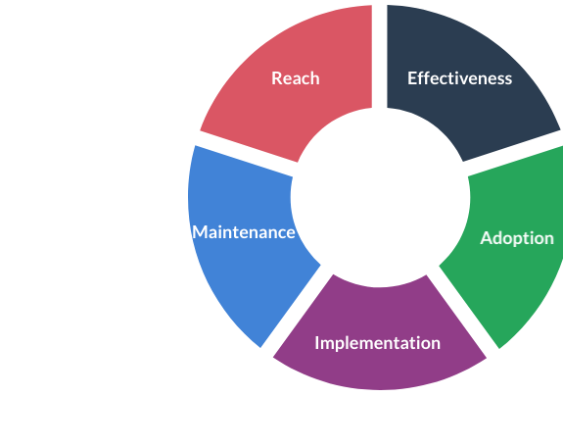
5911 adults participated in Walk Kansas
590,372 adults in participating counties
1% of eligible population
Participants more likely to be:
Women
Older
Meeting PA recommendations
Estabrooks et al. Determining the Impact of Walk Kansas. ABM, 2008, 36: 1-12
Notes:
Let’s start by looking at Reach. To calculate reach, researchers divided the total number of adults in participating counties (which was 590,372) by the number of adults who participated in the program (which was 5911). This calculation showed that the program reached 1% of the eligible population. In addition, researchers described representativeness and found that participants were more likely to be women, older, and meeting physical activity recommendations compared to the general population.

Slide 20
Per week
+ 177 min
+ 107 min
Estabrooks et al. Determining the Impact of Walk Kansas. ABM, 2008, 36: 1-12
Notes:
In terms of effectiveness, researchers found that previously inactive participants increased their physical activity by 177 minutes per week—that’s an increase of nearly 3 hours per week. In addition, insufficiently active participants increased their physical activity by 107 minutes per week.

Slide 21
105 eligible counties.
Year 1: 48 counties participated.
By year 5: +41 counties participated.
Initially, counties with agents not meeting PA recommendations were less likely to adopt.
Estabrooks et al. Determining the Impact of Walk Kansas. ABM, 2008, 36: 1-12
Notes:
For adoption, there were 105 counties that could have adopted the program.
In year 1, 48 counties adopted the program.
By year 5, an additional 41 counties adopted the program.
In the initial year, counties with extension agents who were not meeting PA recommendations were less likely to adopt the program.

Slide 22
No data reported but refers to consistent delivery and/or adaptations across counties.
Estabrooks et al. Determining the Impact of Walk Kansas. ABM, 2008, 36: 1-12
Notes:
In this study, researchers did not explicitly report implementation data. In this study, implementation refers to consistent delivery across counties.

Slide 23
Individual Level:
Sustained an increase of moderate PA
6 months after program was complete.
Setting Level:
Sustained delivery for subsequent 4 years.
Estabrooks et al. Determining the Impact of Walk Kansas. ABM, 2008, 36: 1-12
Notes:
Researchers measured maintenance at the individual level and the setting level.
At the individual level, researchers found that previously inactive and insufficiently active participants sustained an increase of moderate physical activity of 134 and 101 minutes per week 6 months after the program was completed, respectively.
At the setting level, researchers found that all counties that adopted the program in the initial year sustained delivery for the subsequent 4 years. Each county that adopted the program in years 2-4 also delivered the program in subsequent years,

Slide 24
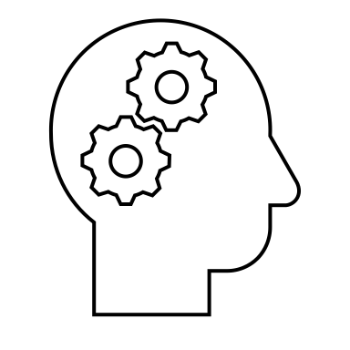
What are common misconceptions?
#1: Only for evaluation
#2: Only for quantitative
#3: Mandates that all dimensions are equally important
#4: Rigid
timepoints
for maintenance
Notes:
As you can see from the previous example, there are various options for applying RE-AIM.
There are also various misconceptions about RE-AIM.
The four most common misconceptions are:
#1: RE-AIM is for evaluation only.
#2: RE-AIM is for quantitative data only.
#3: RE-AIM dimensions are equally important in all context.
#4: Maintenance should always be assessed at 6 months for individual-level outcomes and 2 years for setting or staff level outcomes.
In this presentation, we will review each of these misconceptions.

Slide 25
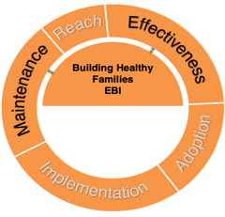
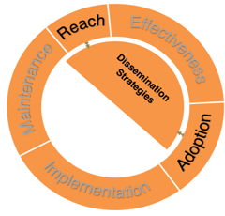
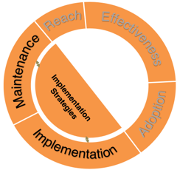
#1: Only for evaluation
Mapping Strategies
to RE-AIM Outcomes
CDC 1 U18DP (Heelan/Hill MPI)
Notes:
RE-AIM can be used for more than just evaluation.
RE-AIM can be used for planning, dissemination, and implementation.
For example, Heelan and colleagues used RE-AIM to develop an evidence-based intervention, dissemination strategies, and implementation strategies to scale up childhood obesity treatment plans in rural areas.
These three figures show what strategies mapped to what RE-AIM outcomes. For example, dissemination strategies mapped to Reach, Effectiveness, and Adoption outcomes, while implementation strategies mapped to Implementation and Maintenance outcomes.
To summarize, a common misconception is that RE-AIM can be used only for evaluation. However, RE-AIM can be useful in the planning, dissemination, and implementation of a project.

Slide 26
#2: Only for quantitative
“Qualitative methods can help researchers look ‘under the hood’…”
--Holtrop, et al. 2018
doi.org/10.1186/s12913-018-2938-8
Notes:
A second common misconception is that RE-AIM can be used only for quantitative research.
Actually, RE-AIM encourages the use of qualitative data and mixed-methods approaches.
Qualitative data and mixed-methods approaches provide a rich description of implementation processes and results, including how those results came about.
Holtrop and colleagues published a paper on how to use a qualitative approach to RE-AIM and wrote that “Qualitative methods can help researchers look under the hood” to understand the reasons for different outcomes across RE-AIM dimensions.

Slide 27
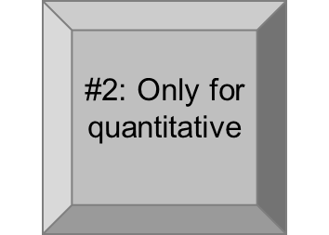
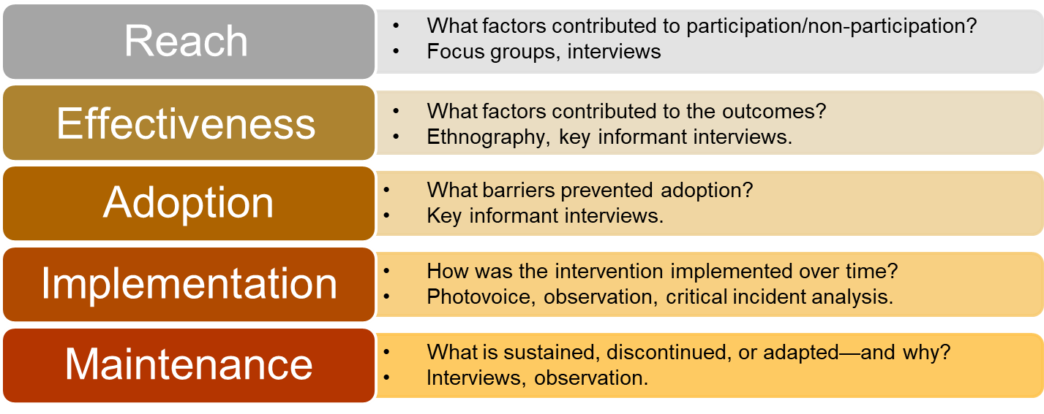
Qualitative Approach
to RE-AIM
Holtrop, Rabin, & Glasgow. 2017. Qualitative approaches to use of the RE-AIM framework: rationale and methods.
Notes:
In fact, the Holtrop and colleagues paper is an excellent resource to apply qualitative methods to all RE-AIM dimensions.
This table is an adaptation of the table in the Holtop paper.
The first bullet point in each block provides an example question for each RE-AIM dimension.
The second bullet point in each block provides a qualitative method to capture outcomes in each RE-AIM dimension.
Overall, it’s clear that RE-AIM can be used for qualitative and mixed-methods approaches in addition to quantitative approaches.

Slide 28
#3: Mandates all dimensions equally important
“Practical application of selected RE-AIM dimensions can be done by specifying in advance what impact and outcomes are most important and by providing a rationale for the dimensions that are and are not addressed.”
--Glasgow and Estabrooks, 2018, Prev Chronic Dis 2018;15:170271. DOI: http://dx.doi.org/10.5888/pcd15.17027
Notes:
The third misconception about RE-AIM is that all dimensions are considered equally important in all contexts.
All dimensions ARE important and should be considered to measure and maximize public health impact.
However, all dimensions are not EQUALLY important in ALL contexts.
As Glasgow and Estabrooks wrote in their 2018 paper, research team members should specify in advance what impact and outcomes are more important and provide a rationale for which dimensions are and are not address.
Practical issues such as financial resources may be a justifiable reason for reducing data collection for a dimension, but overlooking key issues is not a justifiable reason.

Slide 29
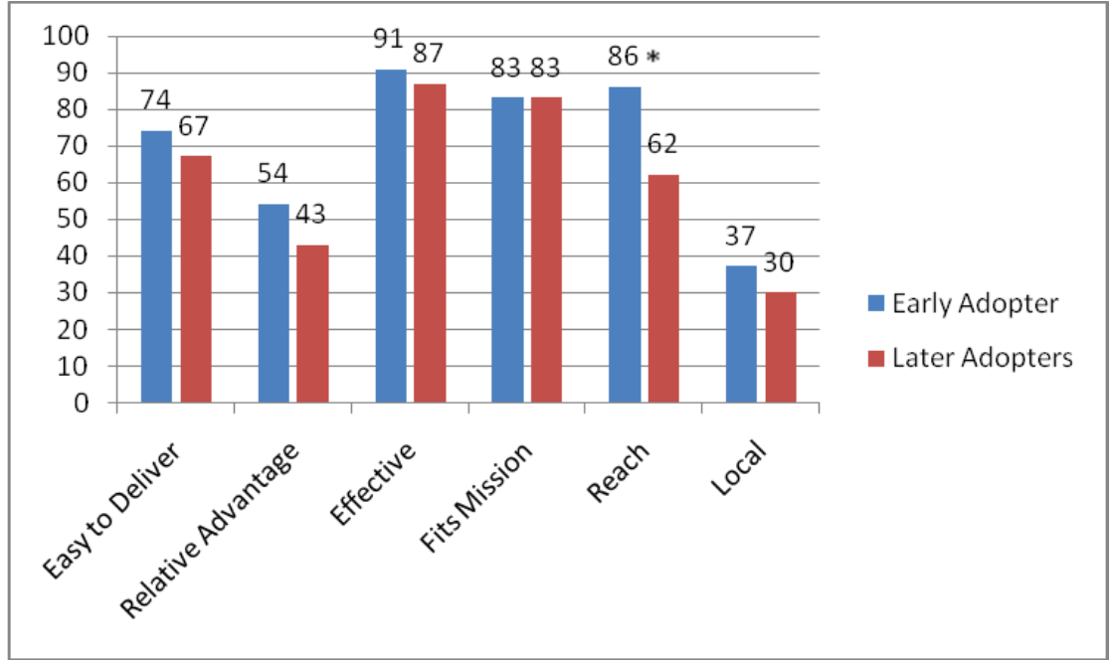
#3: Mandates all dimensions equally important
Relative Importance
Downey et al. 2012. Adoption Decisions and Implementation of a Community-Based Physical Activity Program : A Mixed-Methods Study
Notes:
One way to think about the RE-AIM dimensions is their RELATIVE importance in a specific project or competence.
For example, Downey and colleagues provide a good example of the relative importance of Reach and Effectiveness when considering early and late adopters of a physical activity program.
As this figure shows, perceptions of Reach was the primary distinguishing factor between early and late adopters.

Slide 30
#4: Rigid timepoints for maintenance
THEN
NOW
6 months for individual level outcomes.
2 years for setting or staff level outcomes.
Operationalize in different ways.
Align w/intervention and research question.
Continual updates + advancement
Notes:
The fourth and final misconception relates to maintenance outcomes.
Specifically, this misconception reflects the initial temporal timeframes published back in 1999.
In that first RE-AIM publication, assessment for maintenance was 6 months post intervention or initial implementation for individual level outcomes and 2 years post intervention or initial implementation for setting or staff level outcomes.
Since then, Maintenance outcomes have been operationalized in various ways from sustained implementation immediately after grant funding ceases to 5 years after initial implementation.
Overall, maintenance does not have to be assessed at the rigid timepoints of 6 months and 2 years; however, there should be a clearly specified rationale for the timepoints chosen.
The timepoints should align with the temporal nature of the intervention and with the research question.
We are continually working to advance approaches to maintenance.
Overall, RE-AIM continues to evolve.

Slide 31
How has RE-AIM evolved over the last 20 years?
Costs and resources
Adaptations
Patient-centered outcomes research
700+ articles
2,400+ citations
New content areas
.
Glasgow, RE, et al. Front Public Health. 2020;7, 64.
Holtrop et al. BMC Health Serv Res. 2018 Mar 13;18(1):177.
Gaglio et al. The RE-AIM Framework…AJPH. 2013;103:38-46
Notes:
RE-AIM has evolved in many ways over the last 20 years.
RE-AIM is applicable to many different content areas.
Over 600 articles have been published about RE-AIM, and RE-AIM has been cited over 2,400 times.
New content areas include costs and resources, adaptations, and patient-centered outcomes research.

Slide 32
More complexity and creativity
More transparent reporting on all items, especially adaptations and unintended consequences.
Increase study of relationships among outcomes on different RE-AIM dimensions.
Use mixed methods to fully understand implementation issues and combine results on multiple dimensions to provide estimates of overall impact.
Collect data on representativeness and reason for participation/nonparticipation at both the individual (reach) and setting (adoption) levels.
Notes:
Over its 20 year evolution, RE-AIM has been used with increasing complexity and creativity.
For example, data collection on representativeness and reason for participation/nonparticipation has developed at both the individual level with reach and setting level with adoption.
In addition, the use of mixed methods and qualitative methods has helped researchers fully understand implementation results and combine results on multiple dimensions to provide estimates of overall impact.
There has been an increased study of the relationships among outcomes on different RE-AIM dimensions.
Finally, there is more transparency reporting on all items, especially on unintended consequences and on adaptations made during or following evaluation

Slide 33
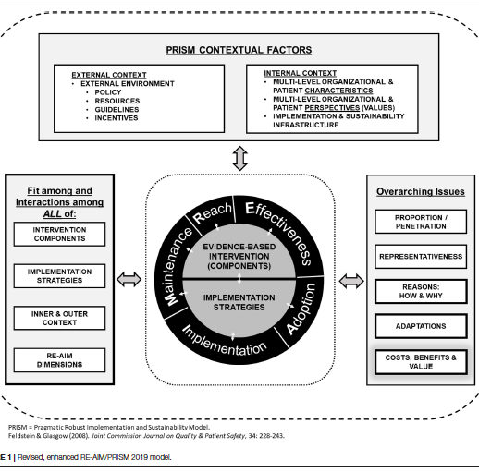
Combining RE-AIM with other models, especially Pragmatic, Robust, Implementation and Sustainability (PRISM) Model- to assess relevant contextual factors
Notes:
Another aspect of evolution is the combination of RE-AIM with other models such as PRISM.
PRISM stands for Pragmatic Robust Implementation and Sustainability Model.
PRISM captures changing internal and external contexts, the fit and interaction among various factors, and overarching issues.
Combining RE-AIM with PRISM allows researchers to capture a more complete, rich portrait of the implementation process and outcomes.

Slide 34
Evolution:
Lessons Learned
One of the most widely used frameworks.
Often mandated by funders.
Expanded the original model to focus on adaptions and sustainability.
Emphasize qualitative methods to understand “how” and “why.”
Capture costs.
Understand health equity issues.
Encourage pragmatic use.
Package RE-AIM for use by non-researchers.
Integrate RE-AIM with other models.
Glasgow et al. RE-AIM Planning and Evaluation Framework: Adapting to New Science and Practice with a 20-Year Review. Front Public Health. 2019;7:64.
Notes:
Over this 20-year journey, we have learned many lessons. Here are just a few:
RE-AIM is one of the most common Dissemination and Implementation frameworks, and it is often mandated by funders.
We’ve learned to expand the original model to focus on adaptations and long-term sustainability.
There’s a growing emphasis on qualitative methods to more fully explore and understand the “how” and “why” of results.
We need to capture costs and consider health equity issues.
We’ve learned to encourage pragmatic use of the RE-AIM dimensions, and we continue to seek better ways to package RE-AIM so that’s useful and meaningful for diverse stakeholders, particularly non-researchers.
Finally, we see the value of integrating RE-AIM with other models such as PRISM.

Slide 35
Summary
Outcomes framework.
For planning, implementation, dissemination, evaluation.
Observational, efficacy, effectiveness, and implementation projects.
Evolution: new issues and challenges
Notes:
To summarize:
RE-AIM is an outcomes framework.
RE-AIM can be used for planning, implementation, dissemination, and evaluation.
RE-AIM can be used for observational, efficacy, effectiveness, and implementation research projects.
RE-AIM is constantly evolving to address new issues and challenges such as rapid analysis, predictive modeling, and perspectives of diverse stakeholders.

Slide 36
Glasgow RE, Vogt TM, Boles SM. Evaluating the public health impact…the RE-AIM framework. Am J Public Health. 1999 Sep;89(9):1322-7.
Estabrooks PA, Glasgow RE. Translating effective clinic-based physical activity... Am J Prev Med. (2006) 31 (4 Suppl.):S45–56. doi: 10.1016/j.amepre.2006.06.019
Shoup JA, et al. Network analysis of REAIM framework. Transl Behav Med. (2015) 5:216–32. doi: 10.1007/s13142-014-0300-1
Ory MG, et al. Perceived utility of the RE-AIM framework…for older adults... Front Public Health. (2015) 2:143. doi: 10.3389/fpubh.2014.00143
Gaglio B, Shoup JA, Glasgow RE. The RE-AIM framework: a systematic review of use over time. Am J Public Health. (2013) 103:e38–46.doi: 10.2105/AJPH.2013.301299
Harden, et al. Fidelity to and comparative results across behavioral interventions…: a systematic review. Syst Rev. (2015) 4:155. doi: 10.1186/s13643-015-0141-0
Glasgow RE, Estabrooks PE. Pragmatic Applications of RE-AIM for Health Care... Prev Chronic Dis 2018;15:170271. DOI: http://dx.doi.org/10.5888/pcd15.170271
Glasgow, RE, et al. (2019). RE-AIM Planning and Evaluation Framework: 20-Year Review. Front Public Health, 7, 64. doi:10.3389/fpubh.2019.00064
Key RE-AIM References
Special issue on RE-AIM in Frontiers of Public Health in 2020: Contains >13 articles.
Notes:
Here are eight key RE-AIM references.

Slide 37
Additional Resources at www.re-aim.org
FAQ’s
Guidance on application
Searchable list of 700+ article abstracts.
Calculators, checklists, tools.
Webinars, upcoming events, blogs.
Notes:
Many additional resources are available at re-aim.org. At re-aim.org you can find:
FAQ’s,
Guidance on applying RE-AIM, including quantitative and qualitative approaches.
A searchable list of 600+ RE-AIM article abstracts, plus a list of over 40 key publications.
Various tools including calculators and checklists.
Links to webinars, upcoming events, and blogs.

Slide 38
Discussion or expansion for your specific presentation needs.

