Slide 1
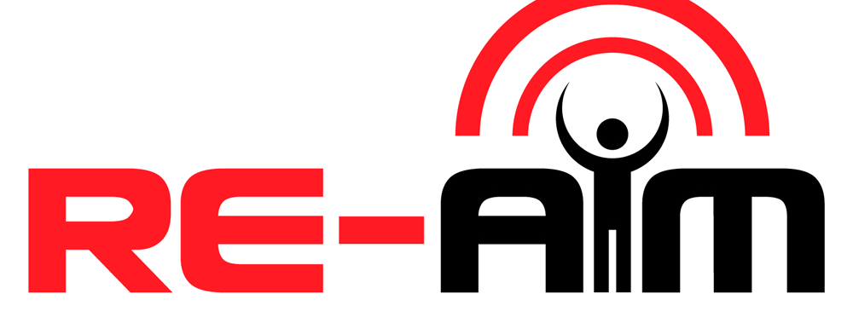
Name, Credentials
Affiliation
Location
Date

Slide 2
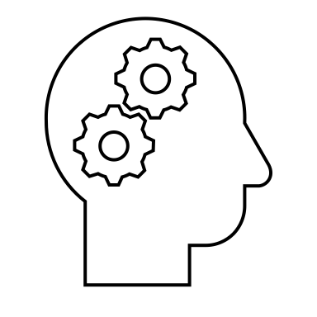
What are common misconceptions?
#1: Only for evaluation
#2: Only for quantitative
#3: Mandates that all dimensions are equally important
#4: Rigid
timepoints
for maintenance
Notes:
As you can see from the previous example, there are various options for applying RE-AIM.
There are also various misconceptions about RE-AIM.
The four most common misconceptions are:
#1: RE-AIM is for evaluation only.
#2: RE-AIM is for quantitative data only.
#3: RE-AIM dimensions are equally important in all context.
#4: Maintenance should always be assessed at 6 months for individual-level outcomes and 2 years for setting or staff level outcomes.
In this presentation, we will review each of these misconceptions.

Slide 3
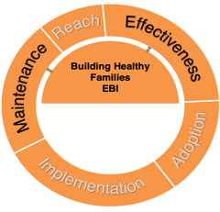
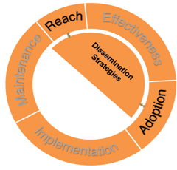
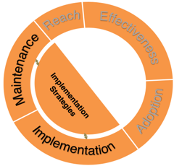
#1: Only for evaluation
Mapping Strategies
to RE-AIM Outcomes
CDC 1 U18DP (Heelan/Hill MPI)
Notes:
RE-AIM can be used for more than just evaluation.
RE-AIM can be used for planning, dissemination, and implementation.
For example, Heelan and colleagues used RE-AIM to develop an evidence-based intervention, dissemination strategies, and implementation strategies to scale up childhood obesity treatment plans in rural areas.
These three figures show what strategies mapped to what RE-AIM outcomes. For example, dissemination strategies mapped to Reach, Effectiveness, and Adoption outcomes, while implementation strategies mapped to Implementation and Maintenance outcomes.
To summarize, a common misconception is that RE-AIM can be used only for evaluation. However, RE-AIM can be useful in the planning, dissemination, and implementation of a project.

Slide 4
#2: Only for quantitative
“Qualitative methods can help researchers look ‘under the hood’…”
--Holtrop, et al. 2018
doi.org/10.1186/s12913-018-2938-8
Notes:
A second common misconception is that RE-AIM can be used only for quantitative research.
Actually, RE-AIM encourages the use of qualitative data and mixed-methods approaches.
Qualitative data and mixed-methods approaches provide a rich description of implementation processes and results, including how those results came about.
Holtrop and colleagues published a paper on how to use a qualitative approach to RE-AIM and wrote that “Qualitative methods can help researchers look under the hood” to understand the reasons for different outcomes across RE-AIM dimensions.

Slide 5
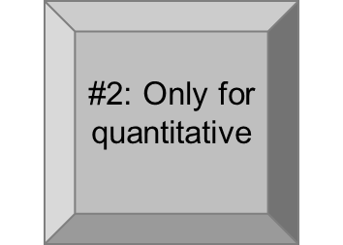
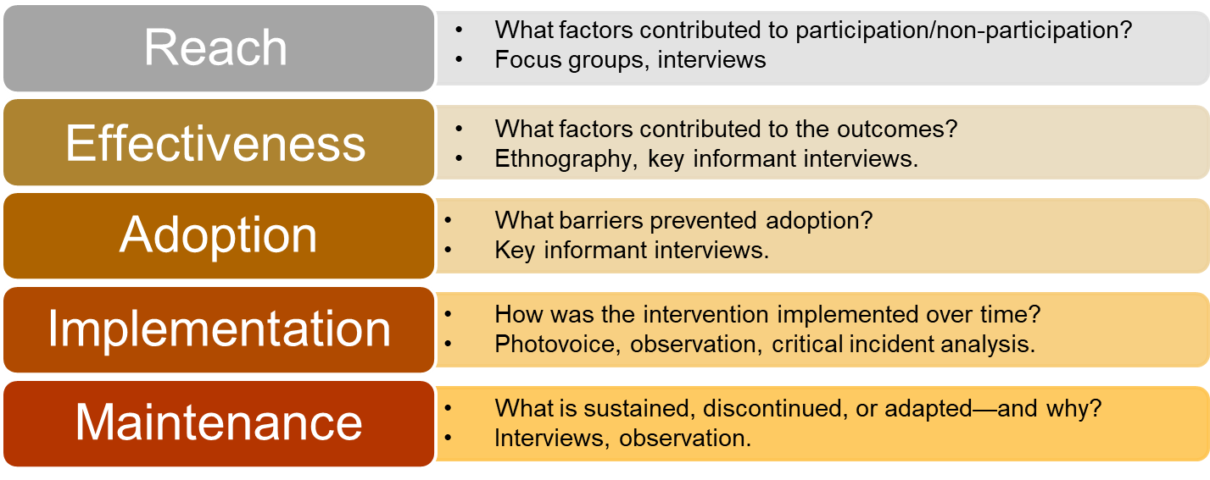
Qualitative Approach
to RE-AIM
Holtrop, Rabin, & Glasgow. 2017. Qualitative approaches to use of the RE-AIM framework: rationale and methods.
Notes:
In fact, the Holtrop and colleagues paper is an excellent resource to apply qualitative methods to all RE-AIM dimensions.
This table is an adaptation of the table in the Holtop paper.
The first bullet point in each block provides an example question for each RE-AIM dimension.
The second bullet point in each block provides a qualitative method to capture outcomes in each RE-AIM dimension.
Overall, it’s clear that RE-AIM can be used for qualitative and mixed-methods approaches in addition to quantitative approaches.

Slide 6
#3: Mandates all dimensions equally important
“Practical application of selected RE-AIM dimensions can be done by specifying in advance what impact and outcomes are most important and by providing a rationale for the dimensions that are and are not addressed.”
--Glasgow and Estabrooks, 2018, Prev Chronic Dis 2018;15:170271. DOI: http://dx.doi.org/10.5888/pcd15.17027
Notes:
The third misconception about RE-AIM is that all dimensions are considered equally important in all contexts.
All dimensions ARE important and should be considered to measure and maximize public health impact.
However, all dimensions are not EQUALLY important in ALL contexts.
As Glasgow and Estabrooks wrote in their 2018 paper, research team members should specify in advance what impact and outcomes are more important and provide a rationale for which dimensions are and are not address.
Practical issues such as financial resources may be a justifiable reason for reducing data collection for a dimension, but overlooking key issues is not a justifiable reason.

Slide 7
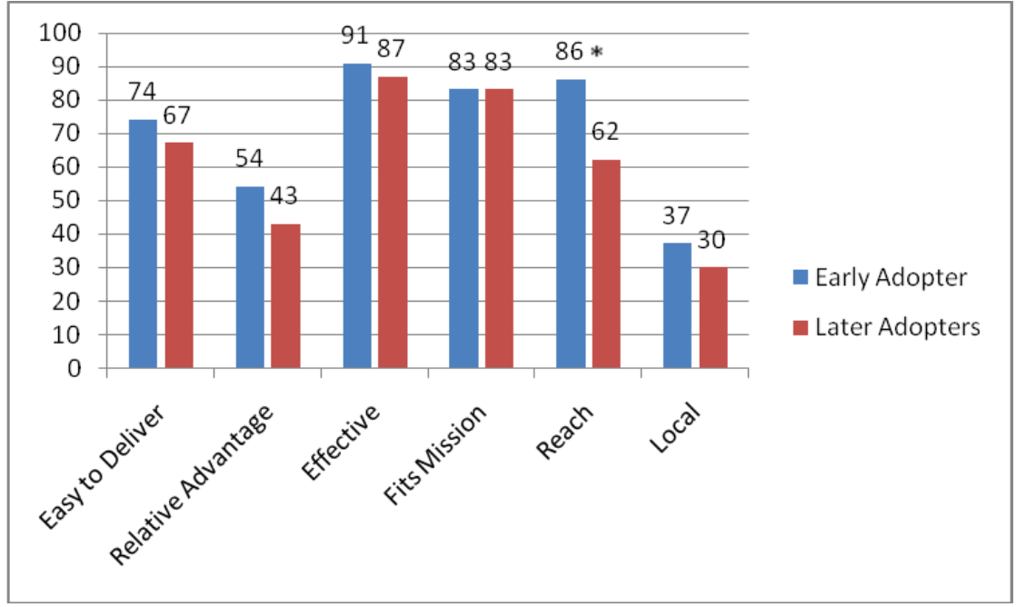
#3: Mandates all dimensions equally important
Relative Importance
Downey et al. 2012. Adoption Decisions and Implementation of a Community-Based Physical Activity Program : A Mixed-Methods Study
Notes:
One way to think about the RE-AIM dimensions is their RELATIVE importance in a specific project or competence.
For example, Downey and colleagues provide a good example of the relative importance of Reach and Effectiveness when considering early and late adopters of a physical activity program.
As this figure shows, perceptions of Reach was the primary distinguishing factor between early and late adopters.

Slide 8
#4: Rigid timepoints for maintenance
THEN
NOW
6 months for individual level outcomes.
2 years for setting or staff level outcomes.
Operationalize in different ways.
Align w/intervention and research question.
Continual updates + advancement
Notes:
The fourth and final misconception relates to maintenance outcomes.
Specifically, this misconception reflects the initial temporal timeframes published back in 1999.
In that first RE-AIM publication, assessment for maintenance was 6 months post intervention or initial implementation for individual level outcomes and 2 years post intervention or initial implementation for setting or staff level outcomes.
Since then, Maintenance outcomes have been operationalized in various ways from sustained implementation immediately after grant funding ceases to 5 years after initial implementation.
Overall, maintenance does not have to be assessed at the rigid timepoints of 6 months and 2 years; however, there should be a clearly specified rationale for the timepoints chosen.
The timepoints should align with the temporal nature of the intervention and with the research question.
We are continually working to advance approaches to maintenance.
Overall, RE-AIM continues to evolve.

Slide 9
How has RE-AIM evolved over the last 20 years?
Costs and resources
Adaptations
Patient-centered outcomes research
700+ articles
2,400+ citations
New content areas
.
Glasgow, RE, et al. Front Public Health. 2020;7, 64.
Holtrop et al. BMC Health Serv Res. 2018 Mar 13;18(1):177.
Gaglio et al. The RE-AIM Framework…AJPH. 2013;103:38-46
Notes:
RE-AIM has evolved in many ways over the last 20 years.
RE-AIM is applicable to many different content areas.
Over 600 articles have been published about RE-AIM, and RE-AIM has been cited over 2,400 times.
New content areas include costs and resources, adaptations, and patient-centered outcomes research.

Slide 10
More complexity and creativity
More transparent reporting on all items, especially adaptations and unintended consequences.
Increase study of relationships among outcomes on different RE-AIM dimensions.
Use mixed methods to fully understand implementation issues and combine results on multiple dimensions to provide estimates of overall impact.
Collect data on representativeness and reason for participation/nonparticipation at both the individual (reach) and setting (adoption) levels.
Notes:
Over its 20 year evolution, RE-AIM has been used with increasing complexity and creativity.
For example, data collection on representativeness and reason for participation/nonparticipation has developed at both the individual level with reach and setting level with adoption.
In addition, the use of mixed methods and qualitative methods has helped researchers fully understand implementation results and combine results on multiple dimensions to provide estimates of overall impact.
There has been an increased study of the relationships among outcomes on different RE-AIM dimensions.
Finally, there is more transparency reporting on all items, especially on unintended consequences and on adaptations made during or following evaluation

Slide 11
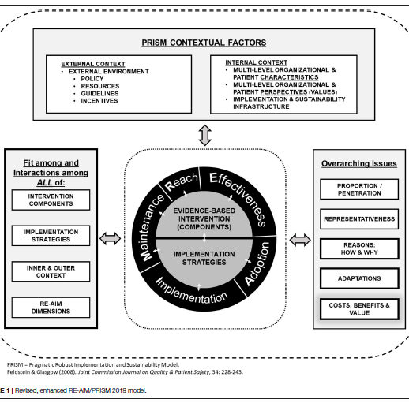
Combining RE-AIM with other models, especially Pragmatic, Robust, Implementation and Sustainability (PRISM) Model- to assess relevant contextual factors
Notes:
Another aspect of evolution is the combination of RE-AIM with other models such as PRISM.
PRISM stands for Pragmatic Robust Implementation and Sustainability Model.
PRISM captures changing internal and external contexts, the fit and interaction among various factors, and overarching issues.
Combining RE-AIM with PRISM allows researchers to capture a more complete, rich portrait of the implementation process and outcomes.

Slide 12
Evolution:
Lessons Learned
One of the most widely used frameworks.
Often mandated by funders.
Expanded the original model to focus on adaptions and sustainability.
Emphasize qualitative methods to understand “how” and “why.”
Capture costs.
Understand health equity issues.
Encourage pragmatic use.
Package RE-AIM for use by non-researchers.
Integrate RE-AIM with other models.
Glasgow et al. RE-AIM Planning and Evaluation Framework: Adapting to New Science and Practice with a 20-Year Review. Front Public Health. 2019;7:64.
Notes:
Over this 20-year journey, we have learned many lessons. Here are just a few:
RE-AIM is one of the most common Dissemination and Implementation frameworks, and it is often mandated by funders.
We’ve learned to expand the original model to focus on adaptations and long-term sustainability.
There’s a growing emphasis on qualitative methods to more fully explore and understand the “how” and “why” of results.
We need to capture costs and consider health equity issues.
We’ve learned to encourage pragmatic use of the RE-AIM dimensions, and we continue to seek better ways to package RE-AIM so that’s useful and meaningful for diverse stakeholders, particularly non-researchers.
Finally, we see the value of integrating RE-AIM with other models such as PRISM.

Slide 13
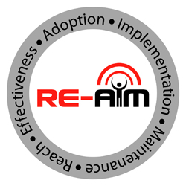
Summary
Outcomes framework.
For planning, implementation, dissemination, evaluation.
Observational, efficacy, effectiveness, and implementation projects.
Evolution: new issues and challenges
Notes:
To summarize:
RE-AIM is an outcomes framework.
RE-AIM can be used for planning, implementation, dissemination, and evaluation.
RE-AIM can be used for observational, efficacy, effectiveness, and implementation research projects.
RE-AIM is constantly evolving to address new issues and challenges such as rapid analysis, predictive modeling, and perspectives of diverse stakeholders.

Slide 14
Glasgow RE, Vogt TM, Boles SM. Evaluating the public health impact…the RE-AIM framework. Am J Public Health. 1999 Sep;89(9):1322-7.
Estabrooks PA, Glasgow RE. Translating effective clinic-based physical activity... Am J Prev Med. (2006) 31 (4 Suppl.):S45–56. doi: 10.1016/j.amepre.2006.06.019
Shoup JA, et al. Network analysis of REAIM framework. Transl Behav Med. (2015) 5:216–32. doi: 10.1007/s13142-014-0300-1
Ory MG, et al. Perceived utility of the RE-AIM framework…for older adults... Front Public Health. (2015) 2:143. doi: 10.3389/fpubh.2014.00143
Gaglio B, Shoup JA, Glasgow RE. The RE-AIM framework: a systematic review of use over time. Am J Public Health. (2013) 103:e38–46.doi: 10.2105/AJPH.2013.301299
Harden, et al. Fidelity to and comparative results across behavioral interventions…: a systematic review. Syst Rev. (2015) 4:155. doi: 10.1186/s13643-015-0141-0
Glasgow RE, Estabrooks PE. Pragmatic Applications of RE-AIM for Health Care... Prev Chronic Dis 2018;15:170271. DOI: http://dx.doi.org/10.5888/pcd15.170271
Glasgow, RE, et al. (2019). RE-AIM Planning and Evaluation Framework: 20-Year Review. Front Public Health, 7, 64. doi:10.3389/fpubh.2019.00064
Key RE-AIM References
Special issue on RE-AIM in Frontiers of Public Health in 2020: Contains >13 articles.
Notes:
Here are eight key RE-AIM references.

Slide 15
Additional Resources at www.re-aim.org
FAQ’s
Guidance on application
Searchable list of 700+ article abstracts.
Calculators, checklists, tools.
Webinars, upcoming events, blogs.
Notes:
Many additional resources are available at re-aim.org. At re-aim.org you can find:
FAQ’s,
Guidance on applying RE-AIM, including quantitative and qualitative approaches.
A searchable list of 600+ RE-AIM article abstracts, plus a list of over 40 key publications.
Various tools including calculators and checklists.
Links to webinars, upcoming events, and blogs.

