Slide 1
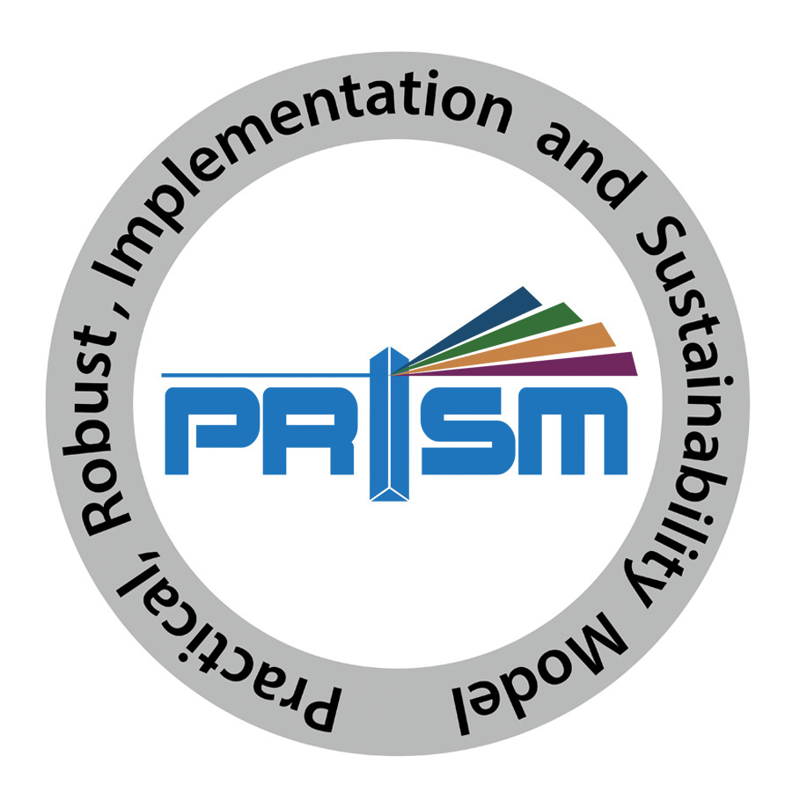
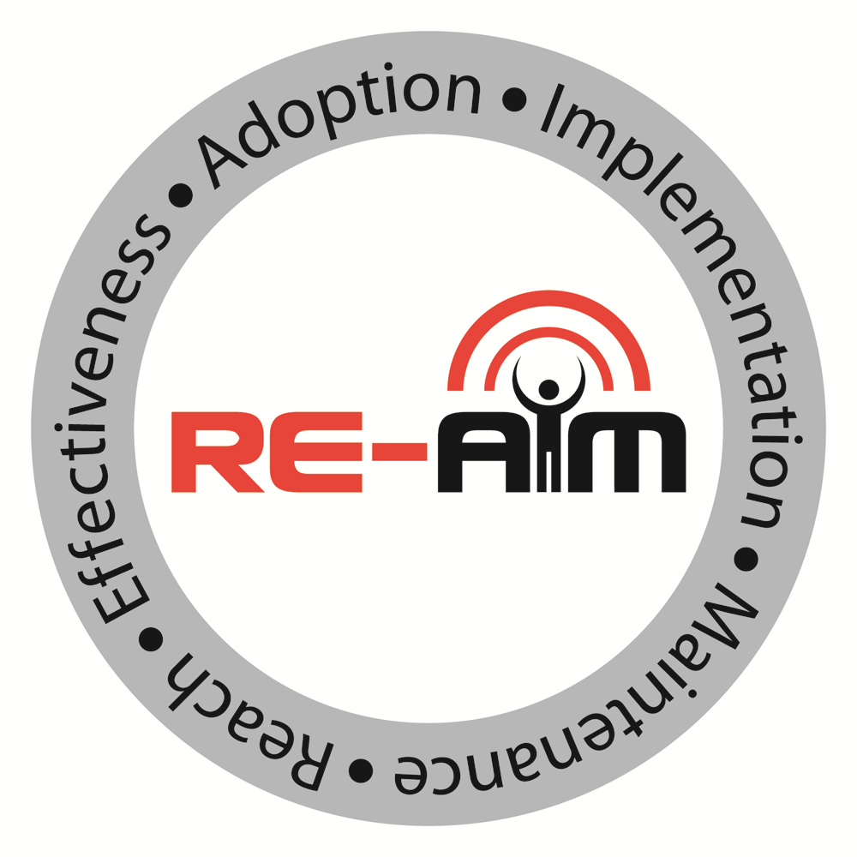
PRISM Contextual factors and RE-AIM outcomes
RE-AIM and PRISM guide users to plan, implement, evaluate, and sustain programs with contextual factors in mind, increasing equity and public health relevance
www.re-aim.org
Notes:
NOTE TO PRESENTER: YOU CAN ADAPT THIS LIST (e.g., perhaps remove slides 6-8 if already talking to a well-verse implementation science audience)

Slide 2
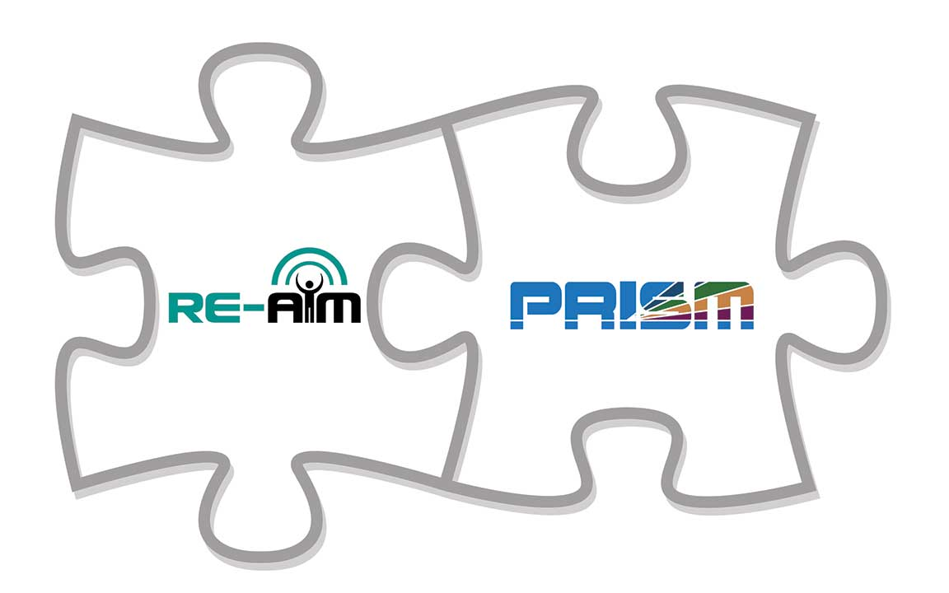
What’s Available in this Slide Deck
RE-AIM and PRISM in one slide
Core issues in Understanding RE-AIM
How RE-AIM evolved into PRISM
Frequent misunderstandings and clarifying issues
How does RE-AIM address health equity?
Notes:
NOTE TO PRESENTER: YOU CAN ADAPT THIS LIST (e.g., perhaps remove slides 6-8 if already talking to a well-verse implementation science audience)

Slide 3
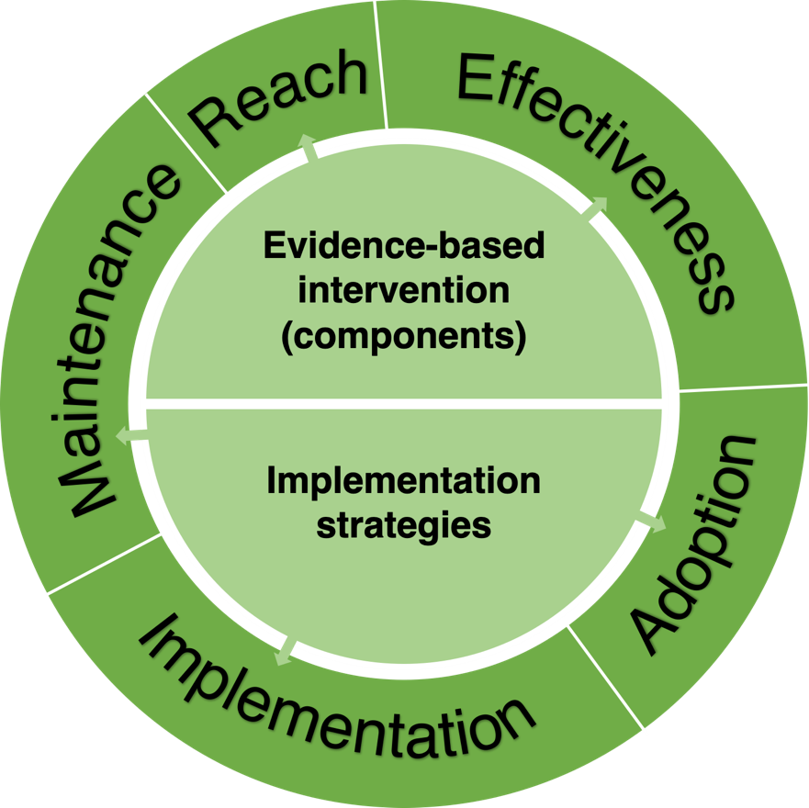
PRISM =
Practical, Robust Implementation and Sustainability Model
What is PRISM video here or click icon to left:
https://www.youtube.com/watch?v=6qlWtzdxcSo
Changing External Context
Fit Among
Intervention components
Implementation strategies
Inner and outer context
RE-AIM dimensions
Cross Cutting Issues
Proportion who benefit
Representativeness of who benefits
Reasons: how and why they benefit
Adaptations made
Costs incurred
Introduced in 2008, PRISM expands RE-AIM to consider context.
Changing Internal Context
Feldstein & Glasgow (2008). Joint Commission J on Qual. & Patient Safety, 34: 228-43.; Glasgow, RE, et al. RE-AIM Planning and Evaluation Framework: 20- Year Review. Front Public Health 2019 7, 64. doi:10.3389/fpubh.2019.00064
Notes:
This slides contains a LOT of information, but lets break it down into its component parts and then we can ‘put it back together again and help explain the important interrelationships involved’
FIRST in the center of the figure we have the program or policy that is being studies or implemented; and immediately below it the set of implementation strategies that are used- at least initially
SECOND- in the circle around these elements are the 5 RE-AIM implementation outcomes impacted by the INT and Imp strategies
NEXT- at the top are the PRISM contextual factors that influence these outcomes. They are divided into:
-External factors outside the immediate implementation setting such as relevant policies, guidelines, national priorities
Internal context consists of both characteristics of both the setting, staff and patients or students, etc.
-Importantly and unique about PRISM it also include structures and resources to support implementation and sustainability
THEN the rectangle n the right hand side summarizes key or overarching issues that apply across all RE-AIM and PRISM dimensions- these include a focus on what percent of people or settings participate; equity issues around how representative they are; adaptations that are made before during and after an intervention, and the costs involved.
FINALLY- the rectangle on the left reminds us that these various factors do not exist in isolation…but rather the key to success is the alignment among Tx, imp strategy, context and RE-AIM outcomes prioritized

Slide 4
What are the Core Issues In Understanding RE-AIM and PRISM?
Purpose
Definitions
Why all dimensions are important
Pragmatic use
Next few slides illustrate:

Slide 5

RE-AIM
Facilitate translation of research to practice.
Balance internal and external validity.
Emphasize representativeness and equity.
Address multi-level contextual factors: individual, organizational, system: experimental and observational.
Notes:
RE-AIM optimizes external validity and pragmatic criteria which are often ignored. By optimizing these crucial elements, RE-AIM serves several purposes:
First, RE-AIM facilitates the translation of research to practice. It helps identify all the pieces to the puzzle.
Second, RE-AIM balances internal and external validity so that results are empirically rigorous and practically meaningful.
Third, RE-AIM emphasizes representativeness and issues related to access.
Fourth, RE-AIM allows researchers to address multi-level factors. It captures implementation at the individual and organizational levels through experimental and observational methods.

Slide 6
RE-AIM Story about Implementing An Evidence-Based Program (or Obesity Tx ; or COVID-19 Vaccine)
Even if 100% effective... is only so good as how and whether:
It is adopted widely, including in low resource settings
Local stakeholders and delivery staff choose to deliver it
It can be implemented consistently with quality
Intended recipients, including those at highest risk receive it
It can be sustained
If we optimistically assume 70% success for each step above…
.7x
.7x
.7x
.7x
.7x
Overall Impact: = 17% benefit to society
Glasgow RE, Vogt TM, Boles SM. Am J Public Health. 1999;89(9):1322
Glasgow RE, et al. Frontiers Public Health 2019 7:64. doi: 10.3389/fpubh.2019.00064
Notes:
To illustrate, lets take a hypothetical example that we call ‘the RE-AIM story’… imagine that tomorrow morning you read a new definite multi-site RCT study that found an intervention in your areas was 100% effective- worked for every single individual in the study.
Now lets walk through the steps involved for this 100% effective intervention to have impact on population health……… read or paraphrase lines

Slide 7
Pragmatic Use of RE-AIM- What is Feasible?
RE-AIM Dimension | Key Pragmatic Definitions and Priorities to Consider and Answer
Reach | WHO is (was) intended to benefit and who actually participates or is exposed to the intervention (intervention = program, policy, practice, pill, policies, principles, procedures, or product)
Effectiveness | WHAT is (was) the most important benefit you are trying to achieve and what is (was) the likelihood of negative outcomes?
Adoption | WHERE is (was) the intervention applied WHO applied it?
Implementation | HOW consistently is (was) the intervention delivered? HOW will (was) it be adapted? HOW much will (did) it cost? WHY will (did) the results come about?
Maintenance | WHEN will (was) the intervention become operational; how long will (was) it be sustained (setting level); and how long are the results sustained (individual level)?
Glasgow RE & Estabrooks, P. Preventing Chronic Disease, 2018; 15: E02
Notes:
There are detailed technical definitions of the various RE-AIM dimensions and components elsewhere in this website and an example on the next slide, but it is lso important for pragmatic use with research terms, non scientists community members that he key parts of PRISM > RE-AIM can be understood using more everyday language.
To address this we have developed the practical definitions above- using the familiar who, what, when, where, how questions

Slide 8
Each RE-AIM Dimension has both Technical (research) and Pragmatic (user friendly) definitions. For example:
Technical Definition
The absolute number, proportion, and representativeness of settings and agents willing to initiate a program, and the reasons why (qualitative).
Pragmatic Use
WHERE is the program applied and
WHO applied it?
ADOPTION
Glasgow RE, Estabrooks PE. Pragmatic Applications of RE-AIM for Health Care... Prev Chronic Dis 2018;15:170271. DOI: http://dx.doi.org/10.5888/pcd15.17027
Notes:
Now for an example lets take The third dimension of RE-AIM is adoption which is defined as the absolute number, proportion, and representativeness of settings and intervention agents who are willing to initiate a program. Pragmatically, the question for adoption is Where is the program applied and who applied it?

Slide 9
How has RE-AIM evolved into PRISM?
Lessons learned from different outcomes across settings
Changing and additional emphases over time (especially adaptations, costs, equity, sustainability, and context)
What is PRISM video here or click icon to left:
https://www.youtube.com/watch?v=6qlWtzdxcSo
RE-AIM.org
Glasgow RE, Vogt TM, Boles SM. Am J Public Health. 1999;89(9):1322
Glasgow RE, et al. Frontiers Public Health 2019 7:64. doi: 10.3389/fpubh.2019.00064
Notes:
The next 2 slides summarize key changes in PRISM > RE-AIM over its 20 years… it is important remember when referencing RE-AIM to refer to the website and to cite papers on RE-AIM- especially the 2 listed here…. And NOT just the original 1999 paper

Slide 10
Summary of Evolution
Research from 2000 – 2006 using RE-AIM in different settings observed different outcomes both across and within types of settings- e.g. worksites, primary care, dental offices, community settings
This despite evaluating the exact same intervention, often delivered by similar or same staff with high fidelity to protocol
PRISM drew from existing models:
-Diffusion of Innovations
-Model for Health Care Improvement
-Chronic Care Model
Feldstein & Glasgow (2008). Joint Commission J on Qual. & Patient Safety, 34: 228-43.

Slide 11

Where are we today?
One of the most widely used frameworks.
Often mandated by funders.
Expanded the original model to focus on adaptions and sustainability.
Emphasize qualitative methods to understand “how” and “why.”
Capture costs.
Understand health equity issues.
Encourage pragmatic use.
Package RE-AIM for use by non-researchers.
Integrate RE-AIM with other models.
Glasgow et al. RE-AIM Planning and Evaluation Framework: Adapting to New Science and Practice with a 20-Year Review. Front Public Health. 2019;7:64.
Notes:
Over this 20-year journey, we have learned many lessons. Here are just a few:
RE-AIM is one of the most common Dissemination and Implementation frameworks, and it is often mandated by funders.
We’ve learned to expand the original model to focus on adaptations and long-term sustainability.
There’s a growing emphasis on qualitative methods to more fully explore and understand the “how” and “why” of results.
We need to capture costs and consider health equity issues.
We’ve learned to encourage pragmatic use of the RE-AIM dimensions, and we continue to seek better ways to package RE-AIM so that’s useful and meaningful for diverse stakeholders, particularly non-researchers.
Finally, we see the value of integrating RE-AIM with other models such as PRISM.

Slide 12
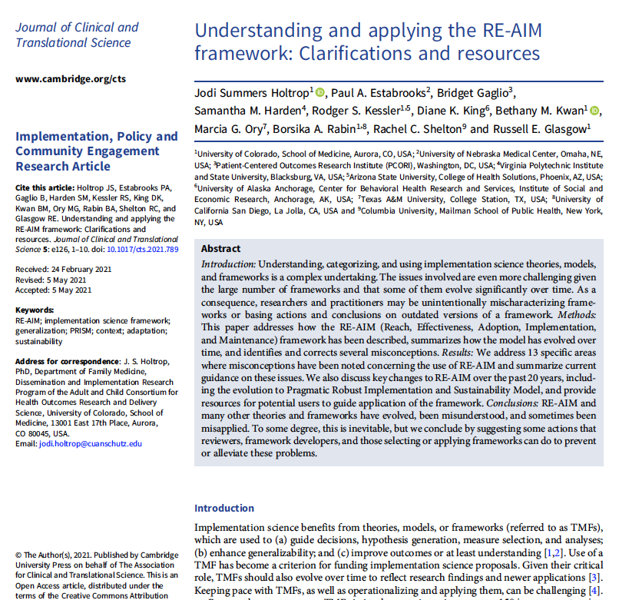
Common misconceptions about RE-AIM and PRISM
Only for evaluation
Only quantitative
Mandates that all dimensions are equally important
Does not address health equity
Common misconceptions video here or click icon to left:
https://www.youtube.com/watch?v=-kwbiPVy2kk

Slide 13
RE-AIM—Health Equity Implications
RE-AIM Issue | Disparity | Overall Impact
Reach | 30% | 70% benefit
Effectiveness | 0 (equal) | 70% benefit
Adoption | 30% | 49% benefit
Implementation | 30% | 34% benefit
Maintenance | 30% | 24% benefit
Take Home Message: Equity issues at EACH STAGE of RE-AIM
Notes:
This slide uses hypothetical data to illustrate the importance of broad thinking about outcomes. The importance of focusing on all five dimensions of RE-AIM – effectiveness is not the only important factor, especially in disparities.
Basically it show that even- as if often reported- an intervention produces identical effects among participants of different characteristics… there can still be large inequities if there are disparities in the other RE-AIM outcomes- as can be seen….
Note if one only focused on effectiveness, one would likely conclude there were no health disparities associated with this program or policy; but in fact in this scenario the intervention would actually only produce less than ¼ of the long terms benefit for some groups as for others

Slide 14
RE-AIM
Outcomes Cascade
ADOPTION
# and type of settings that participate
Tailor to and engage leaders, stakeholders and address history
Make implementation simple, low cost and burden, and provide support
IMPLEMENTATION
Consistently deliver intervention and resources with quality
Multiple and diverse tailored promotion channels and increased access
REACH
(equity)
# and type of citizens and families that participate
Utilize evidence-based resources and strategies; make data-based adaptations
RE-AIM steps in cascade
EFFECTIVENESS
(equity)
# and type of citizen and families that benefit
(on what outcomes)
Gaps or steps where impact is lost
MAINTENANCE
Long-term implementation and effectiveness
Provide ongoing feedback, support and resources for implementation
Potential ways to minimize drop-off
Notes:
This final slide illustrates what we are now calling the ‘RE-AIM cascade; it show- in the order in which new programs, policies or products ae usually rolled out- e.g. adopted in certain settings, implemented by certain staff in certain ways, and reaches certain members of the target audience.
This should sound familiar by now… but the point of this slide is that if one tracks what is happening and pays attention to RE-AIM outcomes- from the beginning and periodically during a program, steps can be taken to enhance the overall impact and the equity of a program……
The bottom line is each step in this cascade provides an opportunity to reduce inequities and increase impact
We hope that you will find these slides of use when discussing RE-AIM with others and welcome your feedback on them

Slide 15
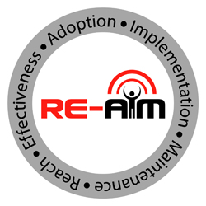
Summary
Outcomes framework (RE-AIM) and Context framework (PRISM).
For planning, implementation, dissemination, sustainment, equity, and evaluation.
Has and will evolve to address new issues and challenges
RE-AIM outcomes and PRISM contextual factors
Notes:
To summarize:
RE-AIM is an outcomes framework.
RE-AIM can be used for planning, implementation, dissemination, and evaluation.
RE-AIM can be used for observational, efficacy, effectiveness, and implementation research projects.
RE-AIM is constantly evolving to address new issues and challenges such as rapid analysis, predictive modeling, and perspectives of diverse stakeholders.

Slide 16
Glasgow RE, Vogt TM, Boles SM. Evaluating the public health impact…the RE-AIM framework. Am J Public Health. 1999 Sep;89(9):1322-7.
Estabrooks PA, Glasgow RE. Translating effective clinic-based physical activity... Am J Prev Med. 2006 31 (4 Suppl.):S45–56. doi: 10.1016/j.amepre.2006.06.019
Feldstein AC, Glasgow RE. A practical, robust implementation and sustainability model (PRISM) for integrating research findings into practice. Jt Comm J Qual Patient Saf. 2008 Apr;34(4):228-43. doi: 10.1016/s1553-7250(08)34030-6. PMID: 18468362.
Shoup JA, et al. Network analysis of REAIM framework. Transl Behav Med. 2015 5:216–32. doi: 10.1007/s13142-014-0300-1
Ory MG, et al. Perceived utility of the RE-AIM framework…for older adults... Front Public Health. 2015 2:143. doi: 10.3389/fpubh.2014.00143
Harden, et al. Fidelity to and comparative results across behavioral interventions…: a systematic review. Syst Rev. 2015 4:155. doi: 10.1186/s13643-015-0141-0
Glasgow RE, Estabrooks PE. Pragmatic Applications of RE-AIM for Health Care... Prev Chronic Dis 2018;15:170271. DOI: http://dx.doi.org/10.5888/pcd15.170271
Glasgow, RE, et al. RE-AIM Planning and Evaluation Framework: 20-Year Review. Front Public Health 2019 7, 64. doi:10.3389/fpubh.2019.00064
Holtrop JS, Estabrooks P, Harden SM, Gaglio B, Kessler R, King D, Kwan BM, Ory M, Rabin B, Shelton RC, Glasgow RE. Understanding and Applying the RE-AIM Framework: Misconceptions, Clarifications, and Future Directions. . Journal of Clinical and Translational Science. 2021 5: e126, 1–10. doi: 10.1017/cts.2021.789
Key RE-AIM References
Special issue on RE-AIM in Frontiers of Public Health in 2020: Contains 21 articles.
Notes:
Here are eight key RE-AIM references. And we especially refer you to the special issue noted at the bottom

Slide 17

FAQ’s
Guidance on application
Searchable list of 700+ article abstracts.
Calculators, checklists, tools.
Webinars, upcoming events, blogs.
Tour of full website here:
https://www.youtube.com/watch?v=opkSz4OyvzM&t=5s
Notes:
Many additional resources are available at re-aim.org. At re-aim.org you can find:
FAQ’s,
Guidance on applying RE-AIM, including quantitative and qualitative approaches.
A searchable list of 600+ RE-AIM article abstracts, plus a list of over 40 key publications.
Various tools including calculators and checklists.
Links to webinars, upcoming events, and blogs.

