Slide 1

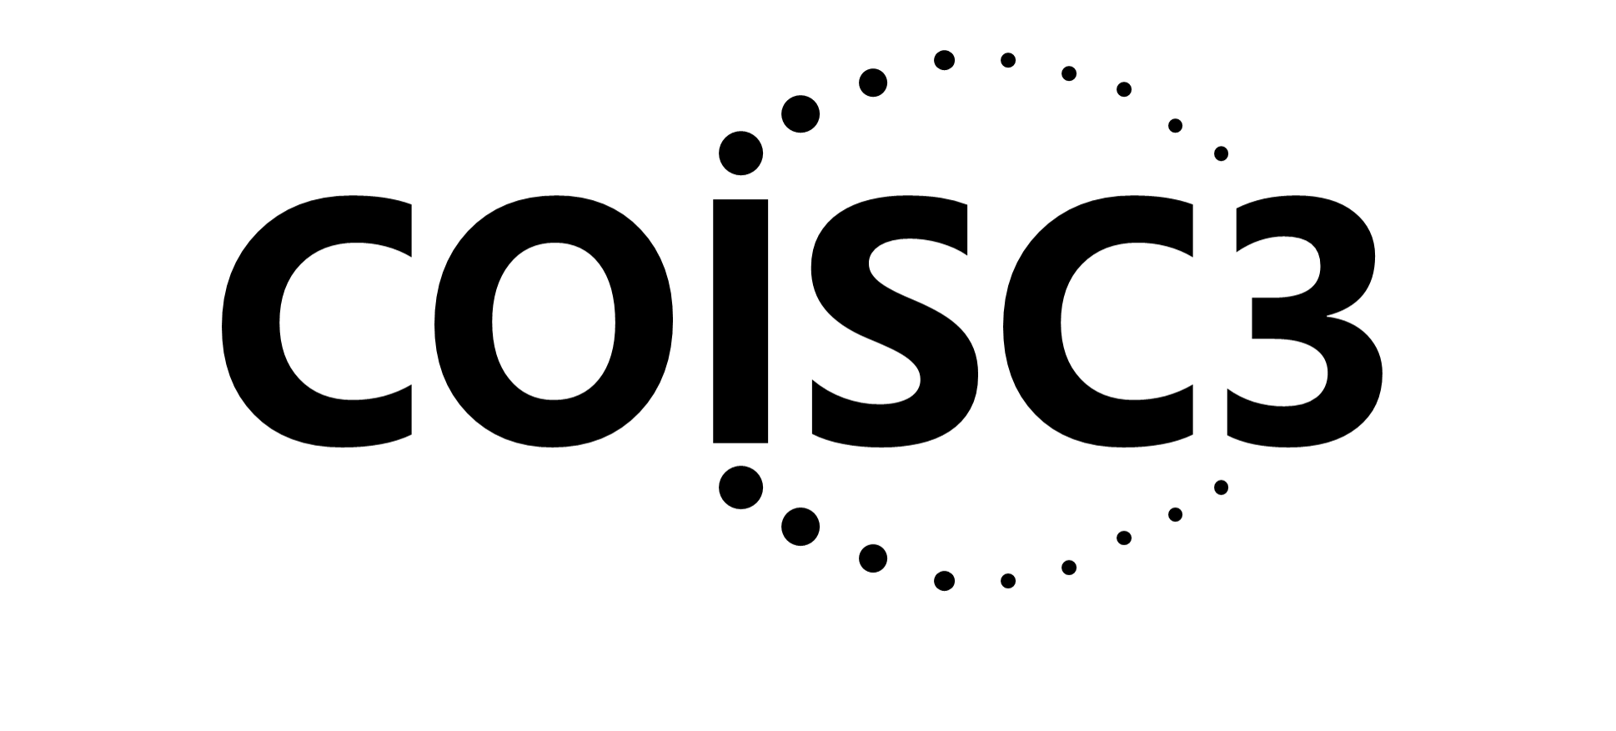

Use of the PRISM- RE-AIM Framework to
Address Health Equity
Russell E. Glasgow, PhD
University of Colorado School of Medicine and
Eastern Colorado VHA QUERI and GRECC programs
Society for Prevention Research May 2022
Acknowledgments
Our Implementation Science Center, Jodi Holtrop, Borsika Rabin, Amy Huebschmann, Paul Estabrooks, Ross Brownson, Meredith Fort and the other great researchers cited throughout this talk

Slide 2
Objectives
Discuss rationale for and review basics of RE-AIM for planning, implementation, evaluation and sustainment
Summarize the evolution of RE-AIM to PRISM; and to produce population impact and address context
Describe and illustrate and how to use PRISM to address Health Equity

Slide 3
Population Impact of “100% Effective Intervention”
Adopted
Implemented
Maintained
.7
X
.7
X
.7
X
.7
X
.7
Trained
Reached
Overall population benefit to target population = 17%

Slide 4

All ‘steps’ or dimensions are important for population health*
Research needs to devote attention to ALL steps in the process to affect impact*
At each step, there are both threats to and opportunities for health equity
*Not just effectiveness

Slide 5
How Can RE-AIM/PRISM (and other D&I Science Frameworks) Help Address Health Equity?
Broaden Focus on All Steps and Outcomes Necessary for Population and Equity Impact
Focus Attention on Issues of Representation and Representativeness
Address Systems Issues and Unintended Consequences
Understand Context and Guide Tailoring and Adaptation to Context and Population
D4D CBPR DCD PRECIS-2PS RCR RROD CER

Slide 6
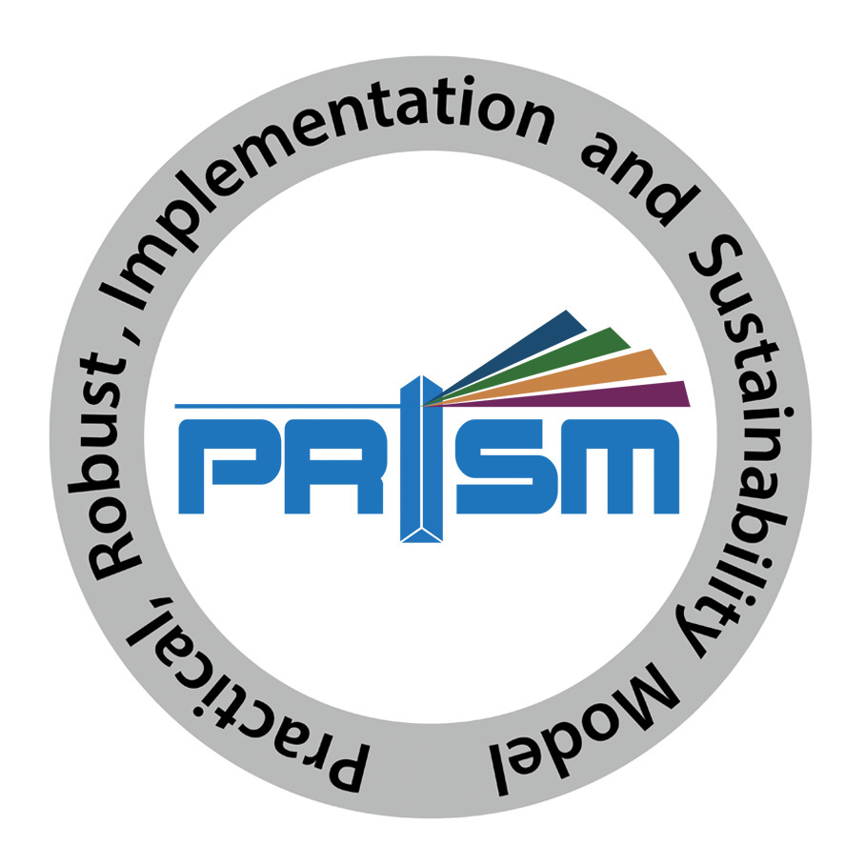
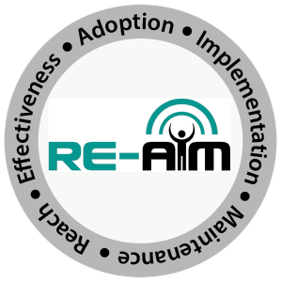
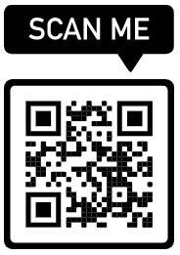
RE-AIM and PRISM = RE-AIM in Context
To
One Partial Solution to 17-year lag and 17% Impact
www.re-aim.org

Slide 7
Purpose and History
Intended to facilitate transparency and translation of research to practice, policy and real-world application
Balance internal and external validity, and emphasizes representativeness and equity
Individual (RE) and Multi-level Setting (AIM) factors- community, organization, staff
Ultimate Impact depends on all elements (reach x effectiveness, etc.)
Glasgow RE et al. RE-AIM at 20. Frontiers Public Health. 2019: 7: 64
Glasgow et al. Amer J Public Health. 1999; 89: 1322-1327
www.re-aim.org

Slide 8
Pragmatic Use of RE-AIM with community partners:
What is Priority; What is Feasible? Do not need to do it all
RE-AIM Dimension | Key Pragmatic Priorities to Consider and Answer
Reach (Individual Level) | WHO is (was) intended to benefit and who actually participates or is exposed to the ‘program’ or policy?
Effectiveness (Individual Level) | WHAT is (was) the most important benefit you are trying to achieve and what is (was) the likelihood of negative outcomes?
Adoption (Setting Levels) | WHERE is (was) the program or policy applied WHO applied it- and who did not?
Implementation (Setting Levels) | HOW consistently is (was) the program or policy delivered? HOW will (was) it be adapted? HOW much will (did) it cost? WHY will (did) the results come about?
Maintenance (Individual and Setting Levels) | WHEN will (was) the program become operational; how long will (was) it be sustained (setting level); and how long are the results sustained (individual level)?
Glasgow RE & Estabrooks, P. Preventing Chronic Disease, 2018; 15: E02
Notes:
Program, policy, product. Intervention, innovation, assessment

Slide 9
RE-AIM—Health Equity Implications
RE-AIM Issue | Disparity | Overall Impact
Effectiveness | 0 (equal) | 100% benefit
Reach | 30% | 70% benefit
Adoption | 30% | 49% benefit
Implementation | 30% | 34% benefit
Maintenance | 30% | 24% benefit
www.re-aim.org
Notes:
This slide uses hypothetical data to illustrate the importance of broad thinking about outcomes. The importance of focusing on all five dimensions of RE-AIM – effectiveness is not the only important factor, especially in disparities. Note if one only focused on effectiveness, one would likely conclude there were no health disparities associated with this program or policy

Slide 10
ADOPTION
# and type of settings that participate
Tailor to and engage leaders, stakeholders and address history
RE-AIM Outcomes
Cascade
Make implementation simple, low cost and burden, and provide support
IMPLEMENTATION
Consistently deliver intervention and resources with quality
Multiple and diverse tailored promotion channels and increased access
REACH
(equity)
# and type of citizens and families that participate
Utilize evidence-based resources and strategies; make data-based adaptations
RE-AIM steps in cascade
EFFECTIVENESS
(equity)
# and type of citizen and families that benefit
(on what outcomes)
Provide ongoing feedback, support and resources for implementation
Gaps or steps where impact is lost
MAINTENANCE
Long-term implementation and effectiveness
Potential ways to minimize drop-off

Slide 11

Context is Everything
Context is multi-level and dynamic - not just places, but also history and relationships (trust, etc.)
Addressed through PRISM extension of RE-AIM Outcomes: RE-AIM in context
PRISM = Practical Robust Implementation and Sustainability Model
Key PRISM domains are:
  recipient (organizational, staff, consumer) characteristics
  recipient perspectives about the intervention,
  external environment, and
  implementation and sustainability infrastructure
Shelton RC et al. An extension of RE-AIM….Front Public Health 2020 8:134
Chambers, D et al. The dynamic sustainability framework. Implement Sci. (2013) 8:117.

Slide 12
PRISM CONTEXTUAL DOMAINS
RE-AIM
OUTCOMES
Feldstein AC, Glasgow RE. A practical, robust implementation and sustainability model (PRISM) for integrating research findings into practice. Jt Comm J Qual Patient Saf. 2008 Apr;34(4):228-43.

Slide 13
How PRISM (and RE-AIM Outcomes) Address Equity Issues
PRISM Factors
Multi-level/Multi-sector Perspectives
External Environment – Drivers of inequities
Many Perspectives Represented
Address Context
Multi-level Partner Characteristics
Implementation & Sustainability Infrastructure
Fit &
Co-creation
Intervention, Program or Policy
Implementation Strategies
RE-AIM Outcomes
    Reach – and representativeness of participants
    Effectiveness – and subgroup effects/unintended consequences
    Adoption – which settings and staff participate/do not participate
    Implementation – fidelity, feasibility, cost, and adaptations
    Maintenance – sustainability
Equity/
Representativeness across all dimensions
Systems Issues
Cost & Feasibility
Adaptation

Slide 14
Use of PRISM for Planning, Tailoring, and Evaluation of weight loss and hypertension control program in FQHCs
Intervention = culturally adapted web-based intervention and digital follow-up support
Representation and Engagement of clinic staff, decision makers and patients in planning and eval. to address Context
Addressed Reach and Implementation by brief low-cost intervention, no added clinic visits, minimal burden on staff and patients
Evaluated representativeness of results across all RE-AIM dimensions
Adapted from Glasgow et al. (2013). Translational Behavioral Medicine, June 1; 3(2):200-210.

Slide 15
Use of PRISM Framework for Planning and Tailoring of weight loss and hypertension control in FQHCs (cont.)
Focused on Adaptations to local low-resource settings and African American population; no staff expertise required, use of graphics, low-literacy and culturally appropriate materials, participant choice of follow-up modalities
Evaluated multiple (RE-AIM) implementation outcomes with focus on dissemination, equity and population impact
Planned and designed for equity (tailored food choices, activities, examples) but not for sustainment
Adapted from Glasgow et al. (2013). Translational Behavioral Medicine, June 1; 3(2):200-210.

Slide 16
Equity Issues in Evidence-Based Research: Ask “Evidence on What?”
External Validity/Pragmatic Criteria, Often Ignored:
  Community partner representation
  Multi-level context
  Participant, setting and staff representativeness
  Adaptation/change in intervention and implementation strategies
  Costs and burden
  What outcomes for whom over what time period
  Reasons for participation and drop out
  Realist Bottom line: What works for whom, under what conditions, for what outcomes, and how much does it cost

Slide 17
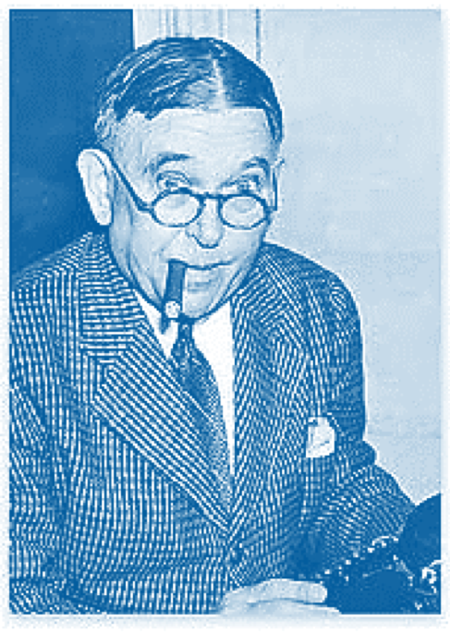
Your Questions and Comments: and Remember
All Models (and Methods) Are Wrong…Some Are Useful
“To every complex question,
there is a simple answer…
and it is wrong.”
~H. L. Mencken

Slide 18
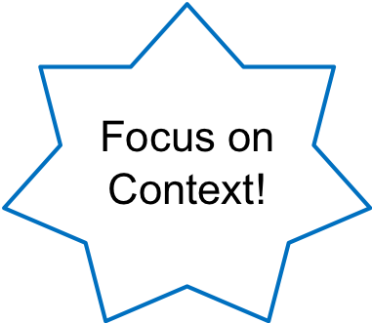
Evolution of RE-AIM
Used pragmatically with practitioners and community partners
Includes both adaptations and costs
Greater focus on sustainability
Providing more guidance on application
Explicit focus on health equity and representativeness (previously under reported)
Systems science and realist perspective
NEW AREAS
Cost and resources
Adaptation
Iterative Use
Qualitative RE-AIM assessments
Glasgow RE et al. RE-AIM at 20. Frontiers Public Health. 2019: 7: 64
Gaglio, et al. The RE-AIM framework….AJPH 2013; 103:38-46.
Notes:
Kjf
Asfjjf
asfjlkfj

Slide 19
There are equity issues at EACH STAGE of the RE-AIM process: Representation and Representativeness
Reach
Effectiveness
Adoption
Implementation
Maintenance

Slide 20
Implementing An Evidence-Based Product (or Prevention Program; or COVID-19 Vaccine) Story
Even if 100% effective...is only so good as how and whether:
It is adopted widely, including in low resource settings
Local stakeholders and delivery staff choose to deliver it
It can be implemented consistently with quality
It reaches intended recipients, including those at highest risk receive it
It can be maintained or sustained
If we assume 70% success for each step above…….
Glasgow RE, Vogt TM, Boles SM. Am J Public Health. 1999;89(9):1322.
Glasgow RE, et al. Frontiers Public Health 2019 7:64. doi: 10.3389/fpubh.2019.00064
www.re-aim.org

Slide 21
Systems and Realist Perspectives
Systems Issues
The 5 RE-AIM dimensions are not independent and interact dynamically
Maximizing or ‘perturbing’ one dimension will likely have consequences, some predicted and often some unintended on other dimensions
Realist issues
Moving away from assessing overall impact on key outcome
Toward answering realist type question of: “What intervention components using what implementation strategies will produce what outcomes for what populations under what conditions, and how does this come about?”

Slide 22
Types of Adaptations – Cultural; Resources; AND Local: ALL WITH AND DRIVEN BY STAKEHOLDERS
Focus of Adaptation | Timing of Adaptation (point in the project)
 | Planning | During | Sustainment- Dissemination
Intervention
Implementation Strategy
Setting
Key RE-AIM issues related to assessing adaptations include:
Purpose of an adaption (increase reach, adoption, implementation, etc.)
Impact of the adaptation on RE-AIM outcomes

Slide 23
RE-AIM Summary Points
RE-AIM is not a theory, but it tells you where to look; where things often break down (remember the ‘Cascade’ slide)
RE-AIM is a framework that can be used for planning and evaluation....and iteratively
Each dimension is an opportunity for intervention
It has- and will continue- to evolve- check www.re-aim.org for latest updates and references
It is meant for pragmatic application; not dogmatic application
There are ways to address most challenges that may come up in application
www.re-aim.org

Slide 24

Brief explainer videos
FAQ’s and examples
Guidance on application
Searchable list of 700+ article abstracts
Calculators, checklists, tools
Recommended slides
Webinars, upcoming events, blogs
Additional Resources at www.re-aim.org
Glasgow et al (2019). RE-AIM Planning and Evaluation Framework: 20-Year Review. Front Public Health, 7, 64. doi:10.3389
Holtrop et al. (2021) Understanding and applying the RE-AIM framework J Clinical Translat Sci, page 1 of 10. doi: 10.1017/cts.2021.789
Special issue Front PH- 13 articles https://www.frontiersin.org/research-topics/10170/
Notes:
Many additional resources are available at re-aim.org. At re-aim.org you can find:
FAQ’s,
Guidance on applying RE-AIM, including quantitative and qualitative approaches.
A searchable list of 600+ RE-AIM article abstracts, plus a list of over 40 key publications.
Various tools including calculators and checklists.
Links to webinars, upcoming events, and blogs.

