Slide 1
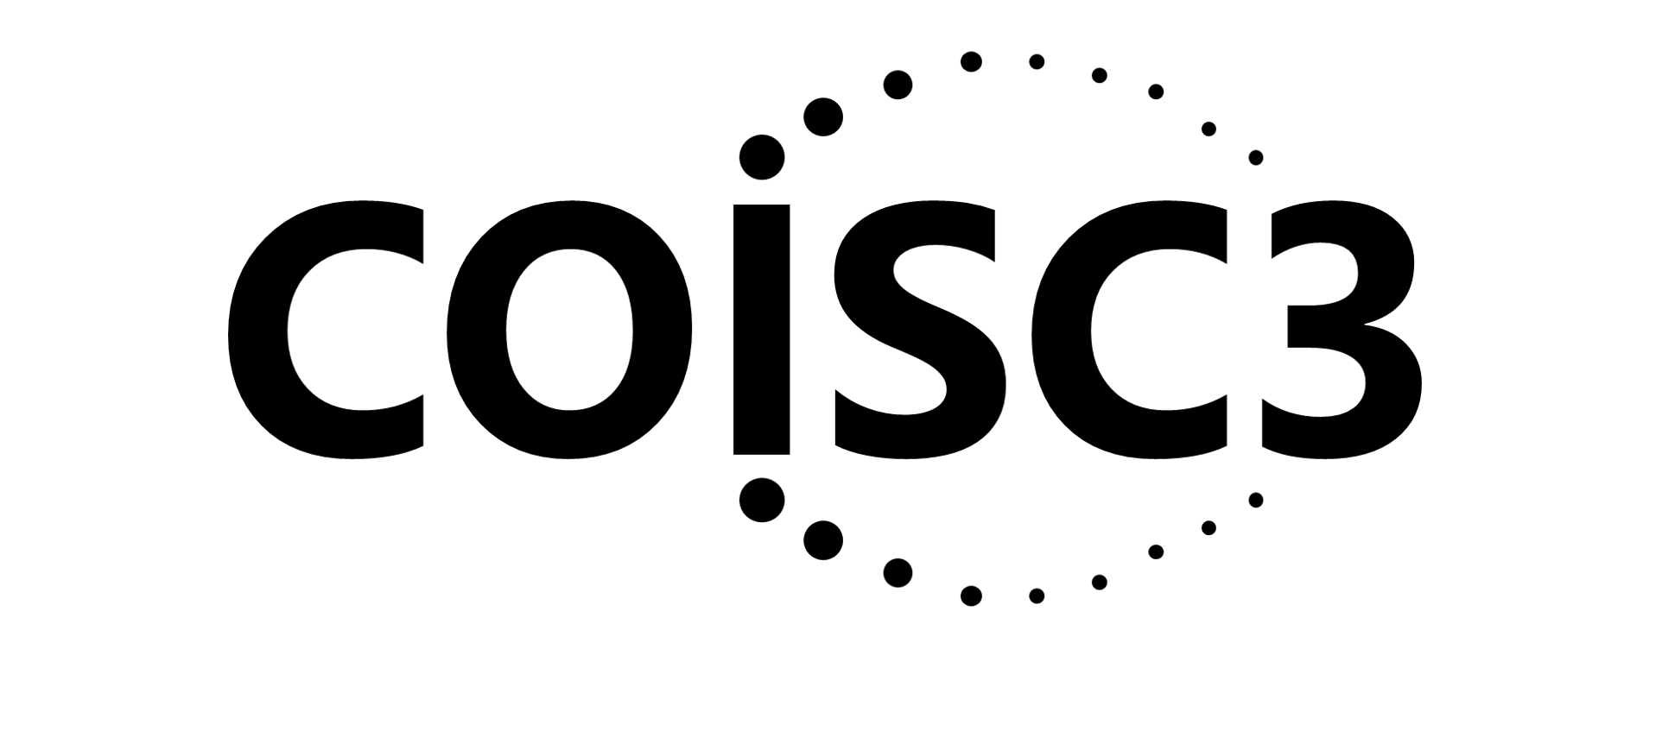
Pragmatic models, methods, and evolution
in Implementation Science: The example of PRISM and RE-AIM
Russell E. Glasgow, PhD
Research Professor, Department of Family Medicine
Director, ACCORDS Dissemination and Implementation Science Program University of Colorado School of Medicine
https://bit.ly/2BnJzuk
September 25, 2023
Acknowledgments:
Our Colorado Implementation Science Center,
Borsika Rabin, Katy Trinkley, Meredith Fort, Paul Estabrooks, Bryan Ford, and the other great researchers cited throughout this talk

Slide 2
About Me
Old white male with limited, U.S. perspective
Trained as behavioral scientist; gravitated to larger context interventions (worksites, community-based prevention)
Gradually adopted public health and population-based perspective and developed RE-AIM in 1998
Worked in variety of settings: psychology department; Veterans Administration; integrated healthcare (HMO); behavioral research institute; National Institutes of Health official; school of medicine – all in the U.S.

Slide 3
Plan for today
Public Health Need
Overview and Evolution of RE-AIM
New applications for RE-AIM: health equity, iterative application
Overview of PRISM
New and Future Directions for PRISM: accessibility and sustainability
General Discussion

Slide 4
Too often, we have assumed, “If you publish it…”
Thought Exercise

Slide 5
Public Health Need Thought Exercise
Implementing An Evidence-Based Obesity Tx (or Disparities Reduction Program; or COVID-19 Vaccine) Story
Even if 100% effective...is only so good as how and whether:
It is adopted widely, including in low resource settings
Local stakeholders and delivery staff choose to deliver it
It can be implemented consistently with quality
It reaches intended recipients, including those at highest risk receive it
It can be maintained or sustained
If we assume 70% success for each step above…….
Glasgow RE, Vogt TM, Boles SM. Am J Public Health. 1999;89(9):1322.
Glasgow RE, et al. Frontiers Public Health 2019 7:64. doi: 10.3389/fpubh.2019.00064
www.re-aim.org

Slide 6
Impact
Adopted
Implemented
Maintained
.7
X
.7
X
.7
X
.7
X
.7
Delivered
Reached
What is the moral of this story?
Overall population benefit to target population = 17%

Slide 7
All ‘steps’ or dimensions are important for population health*
Research needs to devote attention to ALL steps in the process to affect impact*
It’s about the ‘denominator’
At each step, there are both threats to and opportunities for health equity
*Not just effectiveness

Slide 8
Overview and Evolution of RE-AIM
Addressing These Issues of Population Health was Initial Purpose of RE-AIM Framework and Outcomes
www.re-aim.org
Developed in 1999- before implementation science was recognized as a field

Slide 9
Purpose and History of RE-AIM Framework
Intended to facilitate translation of research to practice, policy and real-world application
Balance internal and external validity, and emphasizes representativeness and equity
Individual (RE) and Multi-level Setting (AIM) factors- community, organization, staff
Ultimate Impact depends on all elements (reach x effectiveness, etc.)
Glasgow RE et al. RE-AIM at 20. Frontiers Public Health. 2019: 7: 64
Glasgow et al. Amer J Public Health. 1999; 89: 1322-1327
www.re-aim.org

Slide 10
Pragmatic Use of RE-AIM- What is Feasible?
RE-AIM Dimension | Key Pragmatic Priorities to Consider and Answer
Reach (Individual Level) | WHO is (was) intended to benefit and who actually participates or is exposed to the ‘program’ or policy?
Effectiveness (Individual Level) | WHAT is (was) the most important benefit you are trying to achieve and what is (was) the likelihood of negative outcomes?
Adoption (Setting Levels) | WHERE is (was) the program or policy applied WHO applied it?
Implementation (Setting Levels) | HOW consistently is (was) the program or policy delivered? HOW will (was) it be adapted? HOW much will (did) it cost? WHY will (did) the results come about?
Maintenance (Individual and Setting Levels) | WHEN will (was) the program become operational; how long will (was) it be sustained (setting level); and how long are the results sustained (individual level)?
Glasgow RE & Estabrooks, P. Preventing Chronic Disease, 2018; 15: E02

Slide 11
Why Should You Cost Your Implementation?
Often the first and key question potential adopting settings will ask
Decision-makers want to know what it will cost them to implement
Is itself a key outcome- both Proctor et al. and RE-AIM outcomes
Cost is a key determinant of adoption, implementation (success and adaptations, sustainment and dissemination
Increasingly required in proposals
More and more costing guidance, resources, and examples
Pragmatic Research
Eisman, A. et al. (2021) 16:75 https://doi.org/10.1186/s13012-021-01143-x

Slide 12
Adaptations Happen (and can be bad or good, even necessary)
Evaluating complex interventions: Confronting and guiding (vs. ignoring and suppressing) heterogeneity and adaptation
Brian S. Mittman, PhD Oct. 2018
Department of Research and Evaluation, Kaiser Permanente Southern California
**Also see PCORI Methods Guidance; and ADAPT Guidance (Moore et al. BMJ 2021;374:n1679)

Slide 13
Adaptation – the deliberate or accidental (i.e., drift) modification of the program (or implementation strategies), including:
deletions or additions (enhancements) of components
refinements in the nature of included components
adjustments in the manner/intensity of the administration of program components (called for in the program manual, curriculum or core components analysis)
cultural and other modifications due to local circumstances
Moore G. et al. BMJ 2021;374:n1679 http://dx.doi.org/10.1136/bmj.n1679
Miller C. et al. The FRAME-IS. Implementation Science (2021) 16:36 https://doi.org/10.1186/s13012-021-01105-3

Slide 14
Types of Adaptations – Cultural; Resources; AND Local: ALL WITH AND DRIVEN BY MULTI-LEVEL PARTNERS
Focus of Adaptation | Timing of Adaptation (point in the project)
 | Planning | During | Sustainment- Dissemination
Intervention
Implementation Strategy
Setting
RE-AIM and PRISM can help guide adaptations
Rabin BA, et al. Systematic, multimethod assessment of adaptations across four diverse health systems interventions. Front Public Health. 2018;6(APR). https:// doi. org/ 10. 3389/ FPUBH. 2018. 00102.
Notes:
Russ

Slide 15
New applications for RE-AIM
Health equity
Equity issues at each RE-AIM dimension
Prioritizing outcomes
Choosing strategies
Iterative application
Project lifecycle
Team summary, discussion, and action planning

Slide 16
Health Equity Issues at Each RE-AIM Dimension
RE-AIM Dimension | Disparity | Overall Impact
Reach | 30% | 70% benefit
Effectiveness | 0 (equal) | 70% benefit
Adoption | 30% | 49% benefit
Implementation | 30% | 34% benefit
Maintenance | 30% | 24% benefit

Slide 17
RE-AIM Equity Outcomes
Cascade
ADOPTION
# and type of settings that participate
IMPLEMENTATION
Consistently deliver intervention and resources with quality
REACH
(equity)
# and type of citizens and families that participate
EFFECTIVENESS
(equity)
# and type of citizen and families that benefit
(on what outcomes)
Equity issues and potential for loss of impact and inequities at each stage
MAINTENANCE
Long-term implementation and effectiveness

Slide 18
ADOPTION
# and type of settings that participate
Tailor to and engage leaders, stakeholders and address history
RE-AIM Equity Outcomes
Cascade
FIXES
Make implementation simple, low cost and burden, and provide support
IMPLEMENTATION
Consistently deliver intervention and resources with quality
Multiple and diverse tailored promotion channels and increased access
REACH
(equity)
# and type of citizens and families that participate
Utilize evidence-based resources and strategies; make data-based adaptations
EFFECTIVENESS
(equity)
# and type of citizen and families that benefit
(on what outcomes)
Provide ongoing feedback, support
and resources for implementation
Example actions to prevent or minimize ‘drop off’ and inequities at each step
MAINTENANCE
Long-term implementation and effectiveness

Slide 19
Resource Sheet 1 – Select/Prioritize the RE-AIM dimension(s)
RE-AIM Dimension | Key Pragmatic Priorities to Consider and Answer
Reach (Individual Level) | WHO is (was) intended to benefit and who actually participates or is exposed to the ‘program’ or policy?
Effectiveness (Individual Level) | WHAT is (was) the most important benefit you are trying to achieve and what is (was) the likelihood of negative outcomes?
Adoption (Setting Levels) | WHERE is (was) the program or policy applied WHO applied it?
Implementation (Setting Levels) | HOW consistently is (was) the program or policy delivered? HOW will (was) it be adapted? HOW much will (did) it cost? WHY will (did) the results come about?
Maintenance (Individual and Setting Levels) | WHEN will (was) the program become operational; how long will (was) it be sustained (setting level); and how long are the results sustained (individual level)?
Glasgow RE & Estabrooks, P. Preventing Chronic Disease, 2018; 15: E02

Slide 20
Resource Sheet 2- Select strategies and specific evaluation questions
Dimensions for Dissemination | Questions to Ask of Potential Programs | Strategies to Enhance Future Translation and Dissemination
Reach (individual level) | What percentage of the target population would come in contact with your program? Will you reach the most in need? Will research participants reflect the targeted population? | Formative evaluation with potential users and nonusers Small-scale recruitment studies to enhance methods Identify and reduce participation barriers Use multiple channels of recruitment
Effectiveness (individual level) | Will the intervention likely affect key targeted outcomes? What unintended adverse consequences may occur? How will impact on quality of life be assessed? | Incorporate tailoring to individuals Reinforce messages via repetition, multiple modalities, social support and systems change Consider stepped care approaches Evaluate adverse outcomes and quality of life for program revision and cost-to-benefit analysis
Adoption (setting or organizational level) | What percentage of target settings and organizations will use the program? Do organizations include high-risk or underserved populations? Does program fit with organizational goals and capacities? | Conduct formative evaluation with adoptees and non-adoptees Recruit settings that have contact with the target audience Develop recruitment materials outlining program benefits and required resources Provide various cost options and customization of the intervention
Implementation (setting or organizational level) | Can different levels of staff successfully deliver the program? What proportion of staff within a setting will agree to program delivery? What is the likelihood that various components will be delivered as intended? | Provide delivery agents with training and technical assistance Provide clear intervention protocols Consider automating all/part of the program Monitor and provide staff feedback and recognition for implementation
Maintenance (individual and setting levels) | Does the program produce long-term individual behavior change? Will organizations sustain the program over time? What are characteristics of persons and settings showing maintenance? | Minimize level of resources required Incorporate “natural environmental” and community supports Conduct follow-up assessments and interviews to characterize success at both individual and setting levels Consider incentives and policy supports

Slide 21
The Need for Speed: Rationale for Iterative RE-AIM
D&I frameworks are often cited
But frequently NOT used throughout a project lifecycle
Almost always for planning or evaluation
RE-AIM has been used most for evaluation, but also successfully for planning
Neither RE-AIM (or PRISM) nor most other D&I models have been used iteratively to guide adaptations at key points
A major limitation to D&I models and methods is that they are much slower than needed by partners
Glasgow, RE .... & Rabin B. Making implementation science more rapid. (2020) Frontiers Public Health. 8: 194

Slide 22
Key Functions of Iterative RE-AIM Strategy Bundle
Education on key issues and dimensions in RE-AIM (or PRISM) so team members have a conceptual understanding of and can utilize the RE-AIM dimensions to set priorities and evaluate progress
Obtain independent input and perspectives from each team member; then summarize results in visual displays
Team analyzes, reflects on, and discusses progress and priorities a that time point*
Specify 1–2 team RE-AIM priority areas and adaptations for next implementation period*
Implement and evaluate the delivery and impact of adaptations
Learn from iterations and repeat as appropriate over time
Glasgow RE, Battaglia C et al. Use of the RE-AIM framework to guide iterative adaptations: Applications, lessons learned, and future directions. Front Health Serv. 2022;2:959565. doi:10.3389/frhs.2022.959565

Slide 23
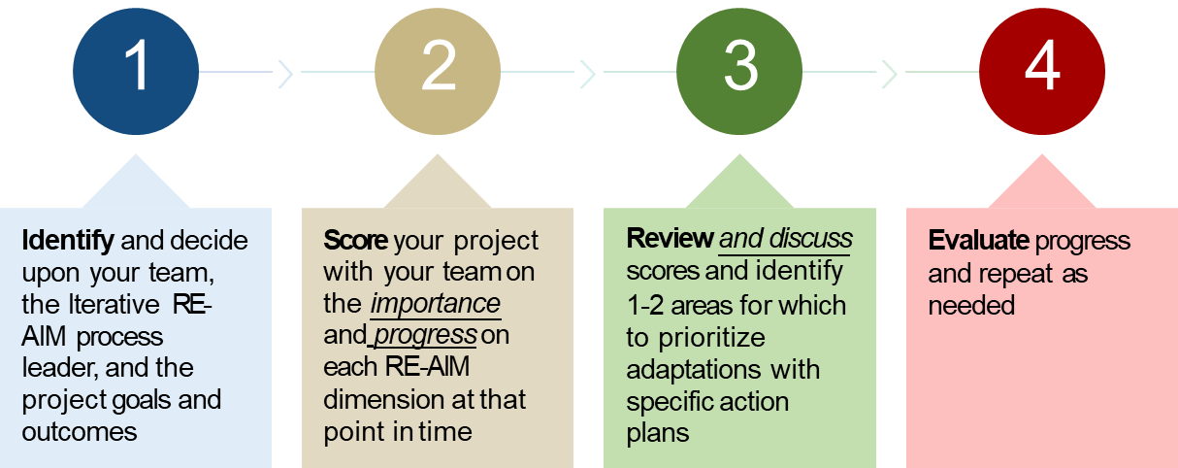
How do you use iterative RE-AIM?

Slide 24
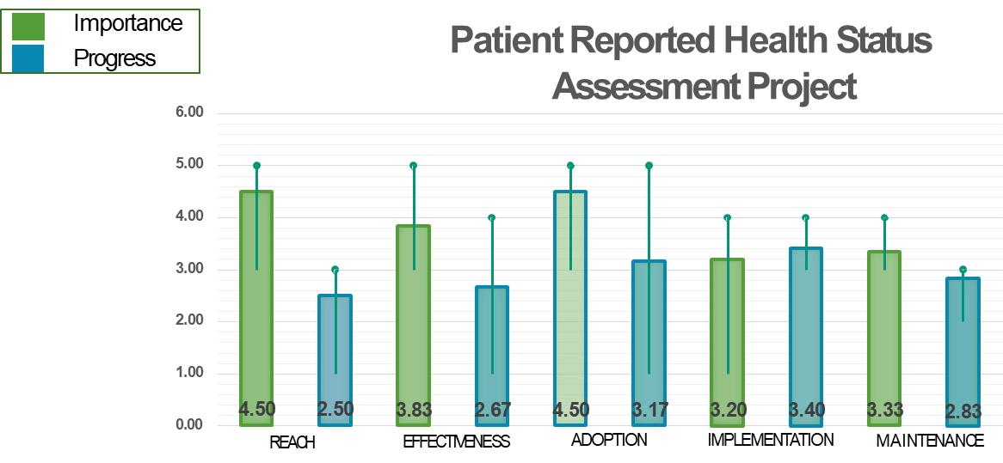
Sample “Gap” Analysis

Slide 25
Iterative RE-AIM: Key Findings, Challenges, Next Steps
Key Findings
Feasible and applicable across different projects, content areas and teams
Challenges
Limited by frequency and quality of data, especially when few or no ‘objective data’
Next Steps
Apply in 1) global health hypertension and 2) hospital lung ultrasound projects
Method works to promote team discussion, reflection and action planning
Exploring number of iterative sessions and level of facilitation needed
Use real-time EHR data and biweekly meetings for rapid iterations
Finding a way to integrate PRISM issues
Developing web-based version (using PRISM)
Glasgow, RE .... & Rabin B. Making implementation science more rapid. (2020) Frontiers Public Health. 8: 194

Slide 26
RE-AIM
Purpose and Uses
Intended to facilitate transparency and translation of research to practice, policy and population impact
Balances internal and external validity, and emphasizes representativeness and equity
Multi-level:
Adoption vs. Reach
Representativeness for all dimensions
Ultimate Impact depends on all elements (reach x effectiveness, etc.)
Glasgow RE et al. RE-AIM at 20. Frontiers Public Health. 2019: 7: 64
Glasgow et al. Amer J Public Health. 1999; 89: 1322-1327

Slide 27
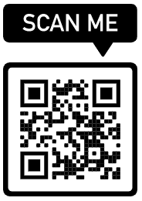
Also chapters on PRISM and RE-AIM in Per et al forthcoming book
Brief explainer videos
FAQ’s and examples
Guidance on application
Searchable list of 700+ article abstracts
Calculators, checklists, tools
Recommended slides
Webinars, upcoming events, blogs
Additional Resources at www.re-aim.org
Glasgow et al (2019). RE-AIM Planning and Evaluation Framework: 20-Year Review. Front Public Health, 7, 64. doi:10.3389
Holtrop et al. (2021) Understanding and applying the RE-AIM framework J Clinical Translat Sci, page 1 of 10. doi: 10.1017/cts.2021.789
Special issue Front Public Health- 13 articles https://www.frontiersin.org/research-topics/10170/

Slide 28
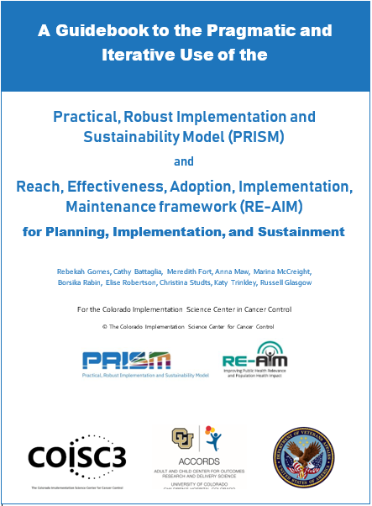
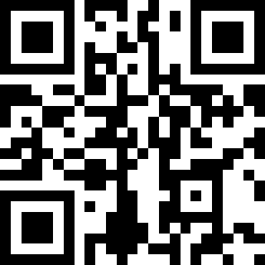
Purposes:
Briefly discuss key conceptual issues in PRISM and RE-AIM
Provide guidance, examples, and recommendations for pragmatic use of these frameworks
Provide survey items for different project phases and tables of strategies to enhance RE-AIM outcomes
https://tinyurl.com/4fmvf7kr
© COISC3 2023

Slide 29
Other Things You Wanted to Know About RE-AIM?
Whew, let’s take a break…

Slide 30
Application Challenges Issue How Addressed
Distinguishing Reach vs. Adoption
‘Denominator’ or characteristics of nonparticipants not known
Reach is at Individual (recipient) level
Adoption is at the Setting…AND the Staff/implementer levels
May not have reach measure in all projects; often have multiple adoption levels
Transparently report the recruitment or implementation situation
Provide both a conservative and an upper bound estimate (e.g., sensitivity analysis)
Use public or admin. records data to describe target population- e.g., census, employee or organizational data
Notes:
These next 2 look a little bleak …. put in a ‘table???

Slide 31
Application Challenges Issue How Addressed
How to determine ‘Overall’ Outcome or total impact
Trouble determining representativeness
Convert each dimension measured to a 0-1 scale (or 1- 100) and multiply the results
During planning identify with and from stakeholders which RE-AIM outcomes are highest priority and make those primary
Compare ‘participants’ to either the overall intended population (e.g., all patients in EHR) or to those who decline
Identify a priori a small number of factors most likely to be related to key outcomes (e.g., SDOH, risk score, motivation)

Slide 32
Overview of PRISM
Context is Everything
Context is multi-level and dynamic - not just places, but also history and relationships (trust, etc.)
Addressed through PRISM extension of RE-AIM Outcomes: “RE-AIM in context”
Nilsen P, Bernhardsson S. Context matters in implementation science: BMC Health Serv Res. 2019;19(1):189.
Shelton, RC et al. An extension of RE-AIM….Front Public Health 2020 8:134
Chambers, D et al. The dynamic sustainability framework. Implement Sci. (2013) 8:117.

Slide 33
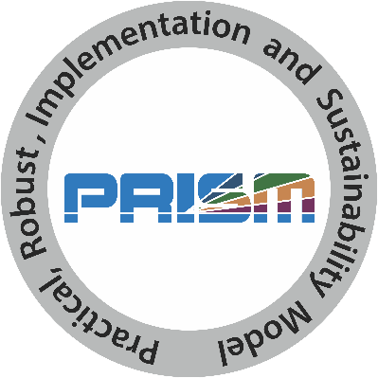
What is PRISM?
Practical, Robust Implementation and Sustainability Model
Contextually expanded RE-AIM
Has been used as a:
Determinant framework
Process framework
Implementation framework
Evaluation framework

Slide 34
PRISM figure (newly imagined)
PRISM Contextual Factors
Multi-level/Multi-sector
Perspectives on Intervention
External Environment – (Structural Drivers of Equity)
Multi-level Partner Characteristics
Implementation and Sustainability Infrastructure
Intervention, Program or Policy
Implementation Strategies
RE-AIM Outcomes
Reach
Effectiveness
Adoption
Implementation
Maintenance

Slide 35
REPEAT AFTER ME……….
PRISM contains RE-AIM (they are not different or competing frameworks)
PRISM contains RE-AIM (is the contextually expanded RE-AIM)
PRISM Includes RE-AIM

Slide 36
Common Misconceptions
1. Only for evaluation
2. Only quantitative or qualitative
3. Mandates that all dimensions are used and equally important
4. Does not address context or determinants
See video of Dr. Holtrop discussing: re-aim.org/resources-and-tools/recommended-re-aim-slides/

Slide 37
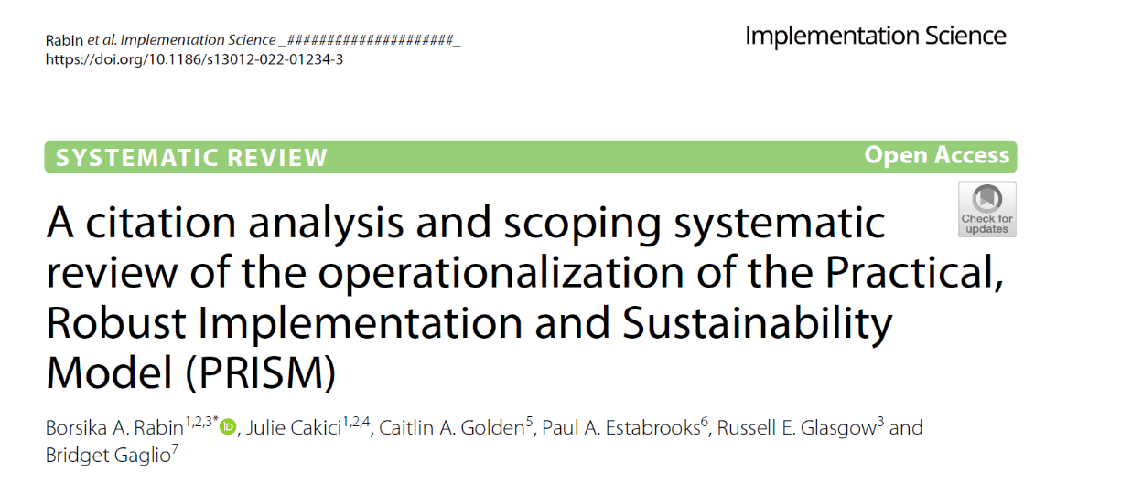
Original reference: Feldstein, AC, & Glasgow, RE. PRISM for integrating research findings into practice.
Jt Comm J Qual Patient Saf. (2008) 34:228–43. doi: 10.1016/S1553-7250(08)34030-6

Slide 38
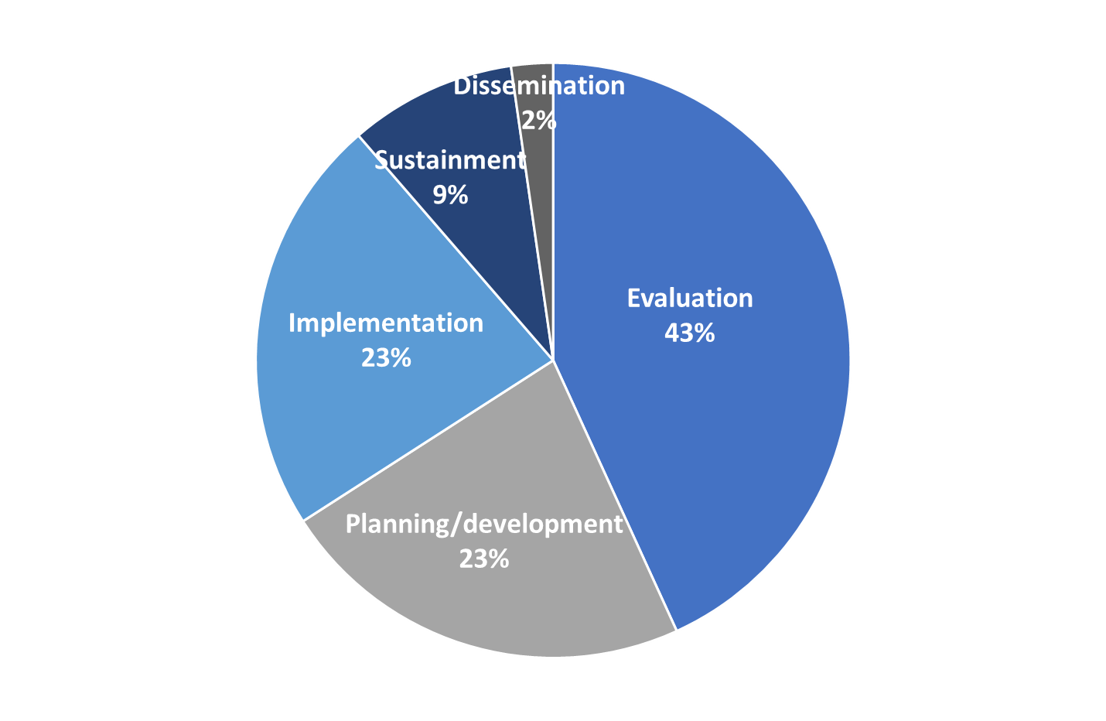
Results
How/when has PRISM been used?
180 total articles reviewed:
Increasing # publications per year:
2 in 2009
31 in 2019

Slide 39
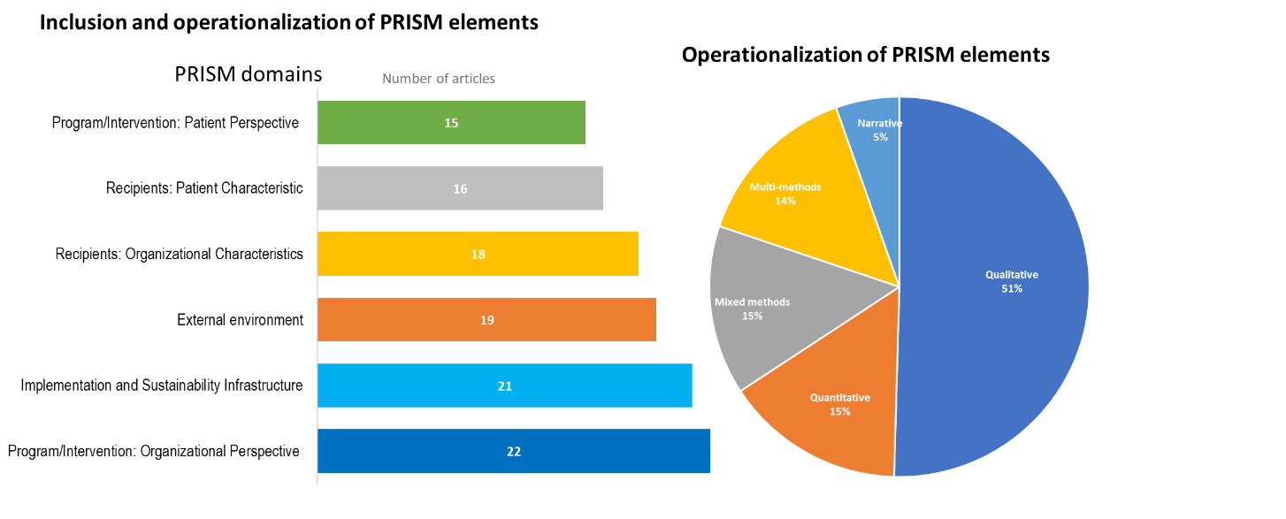
Results: Number and percent of 180 articles meeting inclusion criteria
Perspectives at 2 levels- patient and organizational; characteristics at 2 levels- patient and organizational

Slide 40
Key Findings
PRISM has been primarily used in outpatient clinical settings and in the US
It has been used to study a variety of issues and conditions using a wide range of experimental designs and often using mixed methods
Most studies have reported on half or more of the PRISM domains and over half of the studies reported on at least 5 of the 6 domains
Most frequently assessed were Organizational perspectives on the Program/Intervention, and Implementation and Sustainability Infrastructure
PRISM contextual components were most frequently operationalized using qualitative methods
Implementation and Maintenance were most reported RE-AIM outcomes
Notes:
Borsika

Slide 41
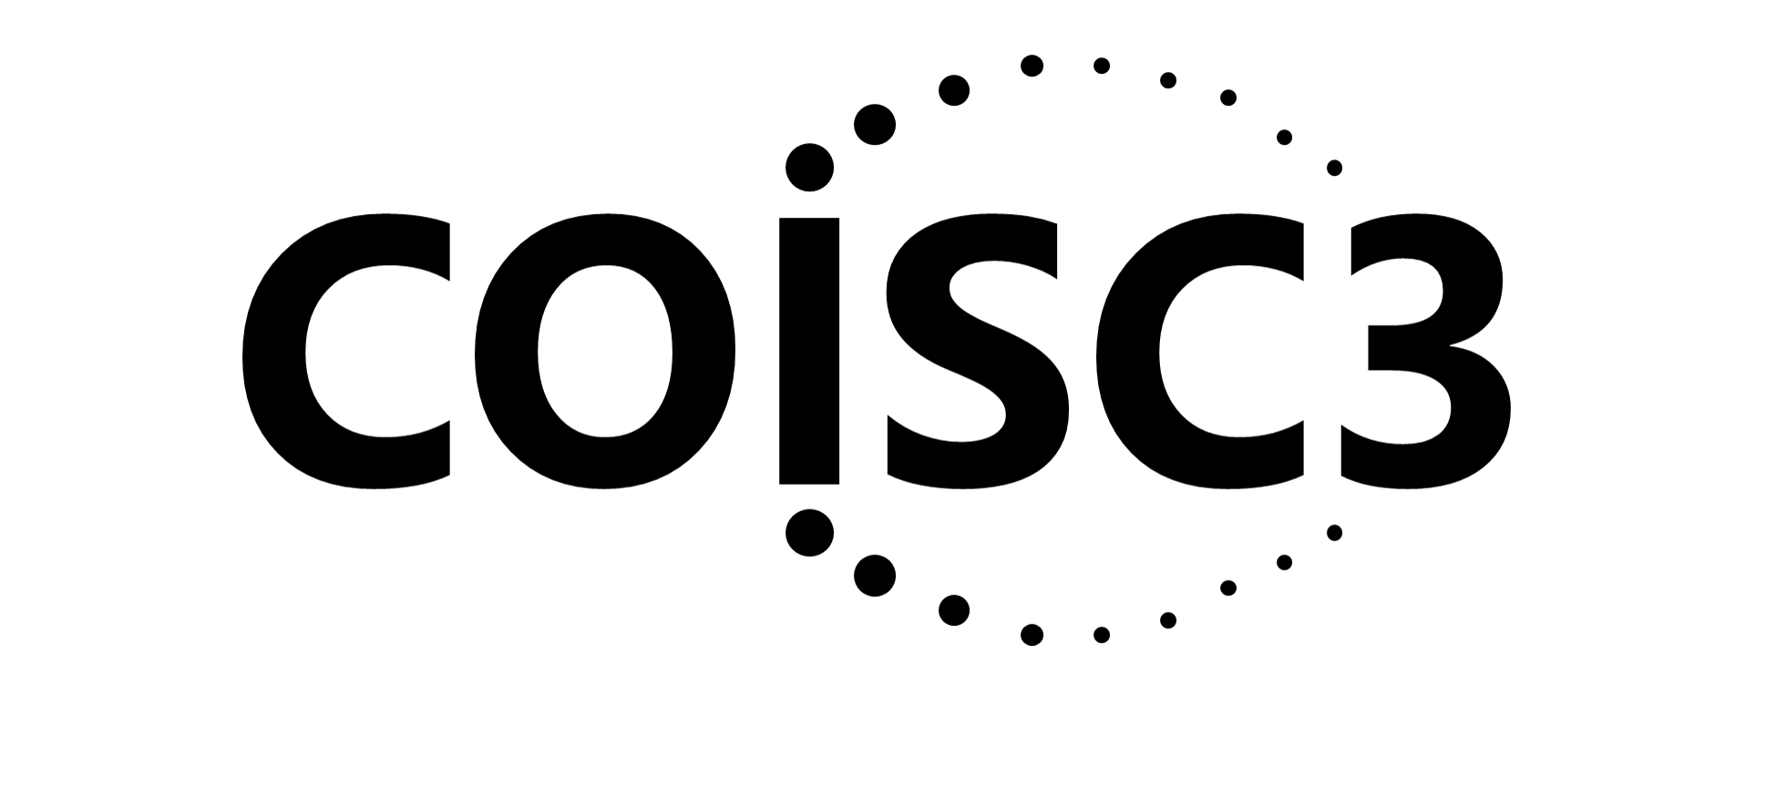
Use of the PRISM Framework to
Address Health Equity
Russell E. Glasgow, PhD
Meredith Fort, PhD
Acknowledgments
Our Implementation Science Center, Borsika Rabin, Amy Huebschmann, Paul Estabrooks, Ross Brownson, and the other great researchers cited throughout this talk

Slide 42
How PRISM (and RE-AIM Outcomes) Address Equity Issues
PRISM Contextual Factors
Multi-level/Multi-sector
Perspectives on Intervention
External Environment – Drivers of Equity
Many Perspectives Represented
Address Context
Implementation and Sustainability Infrastructure
Multi-level Partner Characteristics
Fit and Co-creation
Intervention, Program or Policy
Planning to ensure equity is addressed
Implementation Strategies
Interactions among outcomes
RE-AIM Outcomes
Equity/ Representativeness across outcomes
Reach
Effectiveness
Adaptation
Adoption
Implementation
Maintenance
Unintended Consequences
Cost and Feasibility
Fort MP, Manson SM and Glasgow RE (2023). Applying an equity lens… Front. Health Serv. 3:1139788. doi10.3389/frhs.2023.1139788

Slide 43
How Can PRISM (and other D&I Science Frameworks) Help Address Health Equity?
Broaden Focus on All Steps and Outcomes Necessary for Population and Equity Impact
Focus Attention on Issues of Representation and Representativeness*
Address Systems Issues and Unintended Consequences
Understand Context and Guide Tailoring and Adaptation to Context* and Population
Methods and tools: Integrate with other frameworks including those on equity

Slide 44
EXAMPLE: Use of PRISM for Planning, Tailoring, and Evaluation of weight loss and hypertension control program in community health centers
Intervention = culturally adapted web-based intervention and digital follow-up support
Population: 71% African American; 12% Spanish speaking; 54%< $25k income
Designing for Reach, Adoption, Implementation and Equity using PRISM:
Representation and Engagement of clinic staff, decision makers and patients in planning and evaluation to address Context
Addressed Reach and Implementation by brief low-cost intervention, no added clinic visits, minimal burden on staff and patients
Evaluated representativeness of results across all RE-AIM dimensions
Adapted from Glasgow et al. (2013). Translational Behavioral Medicine, June 1; 3(2):200-210.

Slide 45
Use of PRISM Framework for Planning and Tailoring of weight loss and hypertension control in FQHCs (cont.)
Focused on Adaptations to local low-resource settings and African American population; no staff expertise required, use of graphics, low-literacy and culturally appropriate materials, participant choice of follow-up modalities
Evaluated multiple (RE-AIM) implementation outcomes with focus on reach, equity and population impact
RESULTS:
Intervention produced high reach (60% of patients) and modest (but significantly more) weight loss and BP reduction than usual care
Outcomes generally robust and no moderation effects of race, educ., income or gender
Glasgow et al. (2013). Translational Behavioral Medicine, June 1; 3(2):200-210.

Slide 46
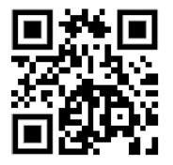
Most Recent: Iterative PRISM
To increase accessibility and use by diverse groups
Use for (choice of): Planning; guiding implementation/adaptations, or sustainment
Automated, real time data collection, analysis and feedback
** Trinkley et al. The iPRISM webtool. Implementation Science Communications (2023) 4:116 https://doi.org/10.1186/s43058-023-00494-4
prismtool.org

Slide 47
Purpose
Simplify implementation science - using PRISM
For diverse researchers and implementation teams
Support rapid learning health systems
Guide and prompt users to iteratively
Assess context
Align project with context
Assess progress on key outcomes
Develop feasible and impactful strategies/adaptations
Create action plans
Trinkley KT, et al. Acad Med. 2022;97:1447 (primary care & cardiology decision aid)
Maw A, et al. Implement Sci Commun. 2022;3:89 (hospital based EHR dashboard)
prismtool.org

Slide 48
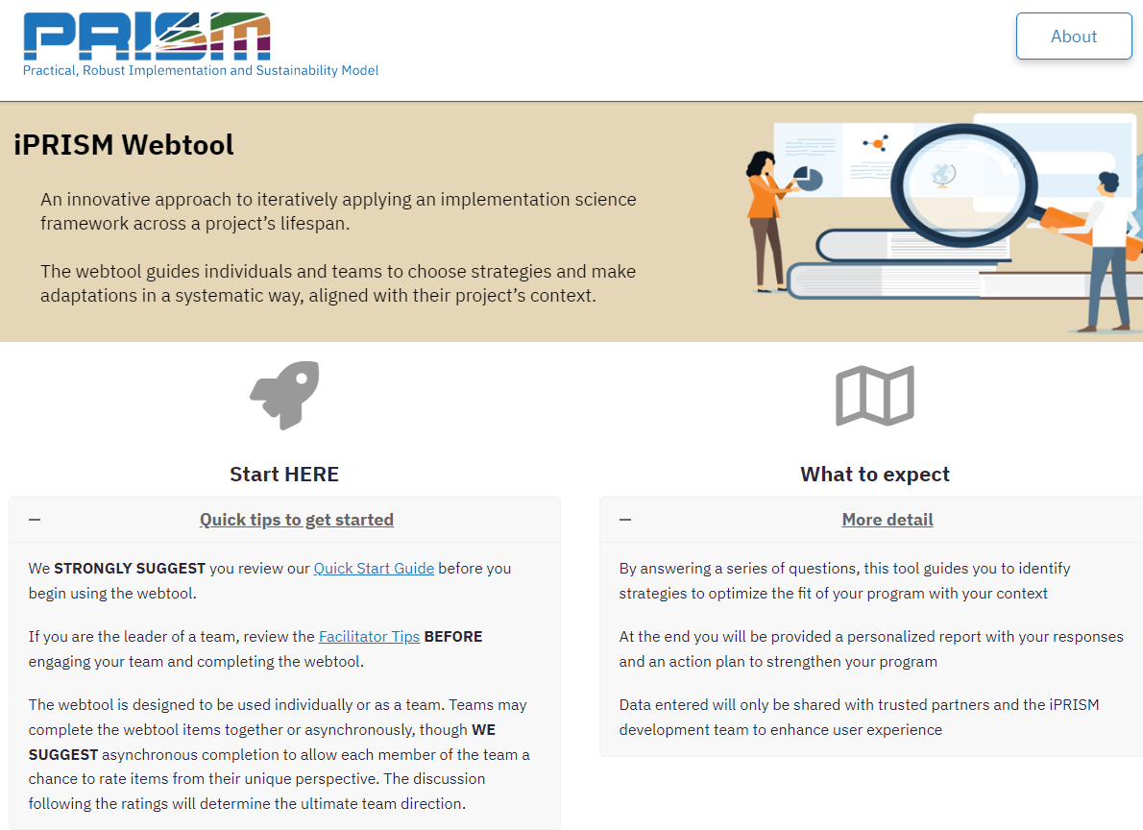

Slide 49
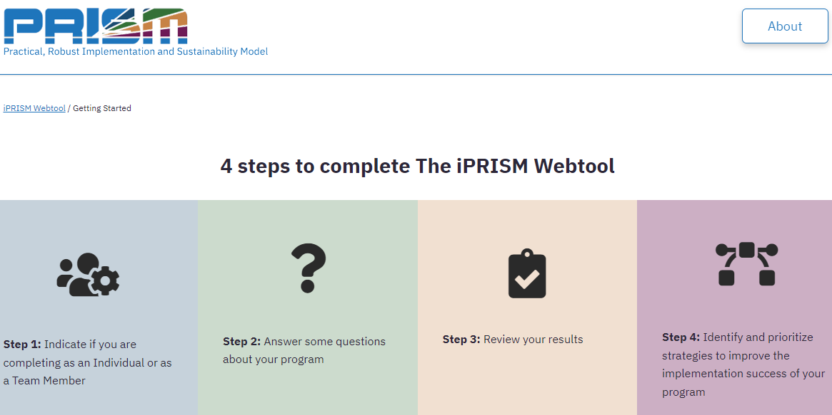

Slide 51
Graphical display of responses

Slide 52
Prioritize strategies
Prismtool.org

Slide 53
Evolution of RE-AIM -> PRISM: Lessons Learned
One of the most widely used frameworks.
Often recommended by funders.
Expanded the original model to focus on adaptions and sustainability.
Emphasize qualitative methods to understand “how” and “why.”
Capture costs.
Understand and address health equity issues.
Encourage pragmatic and iterative use.
Package for use by non-researchers.
Integrate with other models.
Glasgow et al. RE-AIM Planning and Evaluation Framework: Adapting to New Science and Practice with a 20-Year Review. Front Public Health. 2019;7:64.

Slide 54
Future Directions for PRISM Research and Practice
Development and validation of more quantitative survey measures of PRISM, especially those that meet pragmatic and the PAPERS criteria.
Standardized PRISM and RE-AIM outcomes survey items and examples of mixed methods research will be available soon the re-aim.org website.
For pragmatic use it is not necessary to use all PRISM components or to use PRISM at all program time points (i.e., pre-implementation, implementation, sustainment.
When not feasible, authors should briefly and transparently state why certain components were not used or why PRISM was only used at one time point
Investigation of relationships within and between PRISM domains, RE-AIM outcomes, and other implementation and service outcomes
.

Slide 55
And Remember:
All Models (and Methods) Are Wrong…
Some Are Useful
“To every complex question,
there is a simple answer…
and it is wrong.”
~H. L. Mencken

Slide 56
Questions and Comments

Slide 57
Thank you
Russell E. Glasgow, PhD
russell.glasgow@cuanschutz.edu
https://bit.ly/2BnJzuk
Twitter: @RussGlasgow

Slide 58
The 5 Rs to Enhance Pragmatism and Likelihood of Translation
Research that is:
Relevant
Rapid and Recursive
Redefines Rigor
Reports Resources Required
Replicable
Peek, C.J, et al. (2014). The 5 Rs: An Emerging Bold Standard for Conducting Relevant Research in a Changing World. Annals Of Family Medicine, 12(5), 447-55. doi:10.1370/afm.1688
deGruy, F.V, et al. (2015). A plan for useful and timely family medicine and primary care research. Family Medicine, 47(8), 636-42.

Slide 59
PRISM Contextual Factors
Multi-level/Multi-sector
Perspectives on Intervention
External Environment –
Structural Drivers of Inequity
Multi-level Partner Characteristics
Implementation and Sustainability Infrastructure
Intervention, Program, or Policy
Implementation Strategies
RE-AIM Outcomes
Reach
Effectiveness
Adoption
Implementation
Maintenance

Slide 60
Equity Issues in Evidence-Based Research: Evidence on What? (take home point)
External Validity/Pragmatic Criteria, Often Ignored
Participant representativeness
Setting and staff representativeness
Multi-level context
Adaptation/change in intervention and implementation strategies
What outcomes for whom over what time period
Reasons for participation and drop out
Bottom line: What works for whom, under what conditions, for what outcomes, how much does it cost

Slide 61
Comparison of Two Different Types of Programs
Glasgow et al 1999

Slide 62
RE-AIM Framework Application Exercise

Slide 63
Directions:
Print out or refer to handout on separate screen for forms, resources and tip sheet
Guided exercise in applying RE-AIM…which is one IS framework
Work on your own for 15 minutes; then discuss
Please use Chat liberally
Example Use Case (next slide) -- or use your own

Slide 64
Resource Sheet 1 – Select/Prioritize the RE-AIM dimension(s)
RE-AIM Dimension | Key Pragmatic Priorities to Consider and Answer
Reach (Individual Level) | WHO is (was) intended to benefit and who actually participates or is exposed to the ‘program’ or policy?
Effectiveness (Individual Level) | WHAT is (was) the most important benefit you are trying to achieve and what is (was) the likelihood of negative outcomes?
Adoption (Setting Levels) | WHERE is (was) the program or policy applied WHO applied it?
Implementation (Setting Levels) | HOW consistently is (was) the program or policy delivered? HOW will (was) it be adapted? HOW much will (did) it cost? WHY will (did) the results come about?
Maintenance (Individual and Setting Levels) | WHEN will (was) the program become operational; how long will (was) it be sustained (setting level); and how long are the results sustained (individual level)?
Glasgow RE & Estabrooks, P. Preventing Chronic Disease, 2018; 15: E02

Slide 65
Resource Sheet 2- Select strategies and specific evaluation questions
Dimensions for Dissemination | Questions to Ask of Potential Programs | Strategies to Enhance Future Translation and Dissemination
Reach (individual level) | What percentage of the target population would come in contact with your program? Will you reach the most in need? Will research participants reflect the targeted population? | Formative evaluation with potential users and nonusers Small-scale recruitment studies to enhance methods Identify and reduce participation barriers Use multiple channels of recruitment
Effectiveness (individual level) | Will the intervention likely affect key targeted outcomes? What unintended adverse consequences may occur? How will impact on quality of life be assessed? | Incorporate tailoring to individuals Reinforce messages via repetition, multiple modalities, social support and systems change Consider stepped care approaches Evaluate adverse outcomes and quality of life for program revision and cost-to-benefit analysis
Adoption (setting or organizational level) | What percentage of target settings and organizations will use the program? Do organizations include high-risk or underserved populations? Does program fit with organizational goals and capacities? | Conduct formative evaluation with adoptees and non-adoptees Recruit settings that have contact with the target audience Develop recruitment materials outlining program benefits and required resources Provide various cost options and customization of the intervention
Implementation (setting or organizational level) | Can different levels of staff successfully deliver the program? What proportion of staff within a setting will agree to program delivery? What is the likelihood that various components will be delivered as intended? | Provide delivery agents with training and technical assistance Provide clear intervention protocols Consider automating all/part of the program Monitor and provide staff feedback and recognition for implementation
Maintenance (individual and setting levels) | Does the program produce long-term individual behavior change? Will organizations sustain the program over time? What are characteristics of persons and settings showing maintenance? | Minimize level of resources required Incorporate “natural environmental” and community supports Conduct follow-up assessments and interviews to characterize success at both individual and setting levels Consider incentives and policy supports

Slide 66
Case Study: Adapt an Evidence-Based Chronic Pain Management Program Among Veterans
Goal: Improve chronic pain management by leveraging data and engaging VA primary care to define multimodal pain care, identify, and address gaps in pain management
Intervention and implementation approach: Educational program delivered via video teleconferencing to VA primary care teams using a multimodal pain care curriculum comprised of case-based presentations and didactics at eight sites across the country
Results: Identified trends and variation in delivering multimodal pain care across VA. Found an overall significant decrease in opioid treatments, but multimodal pain care varied widely across sites

Slide 67
Application Activity #1
Apply the case study intervention (or your case study) to your setting using RE-AIM to plan, design, and evaluate your program
Select one RE-AIM dimension (using Resource Sheet 1) to enhance. Which dimension will be most challenging in your setting?
Identify ONE pragmatic strategy to enhance implementation of the program (using Resource Sheet 2)
RE-AIM Dimension ____________________
Strategy to Try ________________________

Slide 68
Application Activity #2
Use the SAME RE-AIM dimension and specify the evaluation approach you will use to assess the program on that dimension (using Resource Sheet 2)
RE-AIM Dimension________________________
Evaluation Approach:

Slide 69
Let’s Debrief
Which RE-AIM dimension did you select?
Reach?
Effectiveness?
Adoption (setting or staff)?
Implementation?
Maintenance (individual or sustainability of program)?
What evaluation strategy did you use to assess your program outcome(s)?
What questions or comments do you have?

