Slide 1

Using RE-AIM and PRISM to advance implementation science: recent developments and applications
Borsika Rabin, PhD, MPH, PharmD
Associate Professor, Herbert Wertheim School of Public Health and Human Longevity Sciences
Co-Director, UCSD ACTRI Dissemination and Implementation Science Center
Co-Director, San Diego CFAR Implementation Science Hub
University of California San Diego
Co-Director, ACCORDS Dissemination and Implementation Science Graduate Certificate Program
University of Colorado School of Medicine
March 14, 2024
Acknowledgments:
Russ Glasgow, Katy Trinkley, Meredith Fort, Paul Estabrooks, James Pittman, Rebecca Guerin, Julie Cakici, Bryan Ford, and the members of the National RE-AIM Consortium and other great researchers cited throughout this talk
Notes:
We can change the front slide as needed. I was not sure what to write on this and perhaps we want something less La Jolla like or we can add all the different locations we are all from????

Slide 2
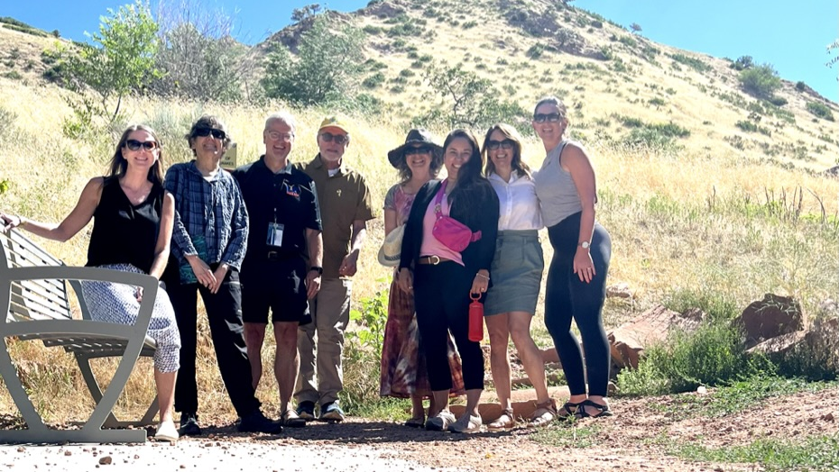

Slide 3
Plan for today
Public Health Need
Overview and Evolution of RE-AIM and PRISM
New(er) applications for RE-AIM and PRISM
Future Directions for RE-AIM and PRISM

Slide 4
Dissemination and Implementation Science (DIS) Theories, Models, and Frameworks: Defined
Theories are generally specific and predictive, with directional relationships between concepts making them suitable for hypothesis testing.
Models are specific, more often prescriptive, strategic or action-planning to provide a systematic way to develop, manage, and evaluate interventions.
Frameworks organize, explain, or describe information and the range and relationships between concepts, including some which delineate processes, and therefore are useful for communication.
Tabak RG et al, Bridging Research and Practice: Models for Dissemination and Implementation Research Am J Prev Med, 2012, 43: 337-350.
Rycroft-Malone J, Bucknall T. Theory, frameworks, and models: laying down the groundwork. In: Rycroft-Malone J, Bucknall T, editors. Models and frameworks for implementing evidence-based practice: Linking evidence to action. Oxford: Wiley-Blackwell; 2010. p. 23–50.
Notes:
Could remove

Slide 5

IS Theories, Models, and Frameworks: What can they do?
Provides a systematic structure for the development, implementation, and evaluation of programs
Creates a natural linkage between study aims, data collection, and analytic approaches
Helps expand or narrow the scope of the study
Creates a structure for presenting findings and sharing with various partners and audiences
Supports the interpretation of study findings
Ensures that key implementation strategies are considered
Important component of DIS proposals
Notes:
Could remove

Slide 6
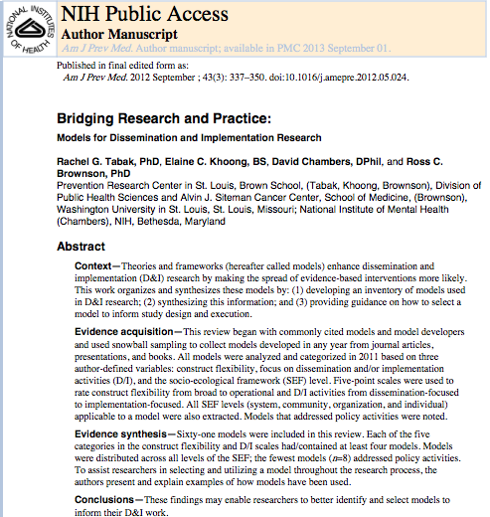
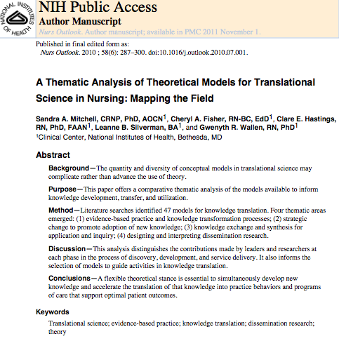
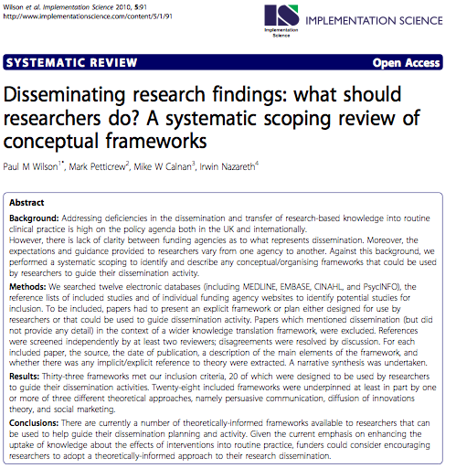
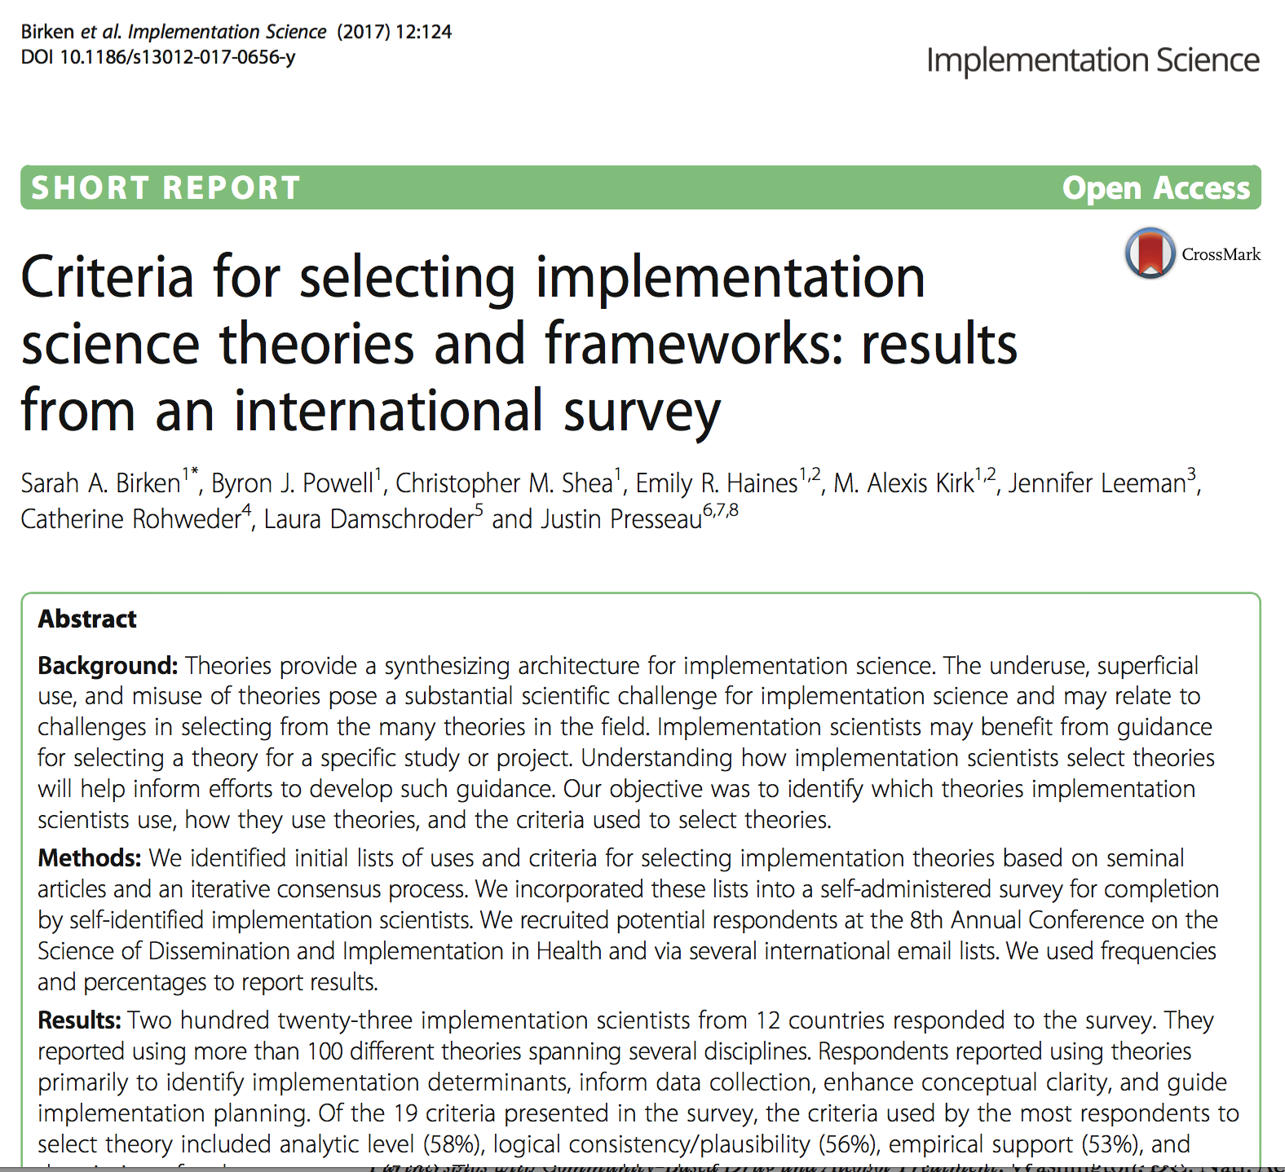
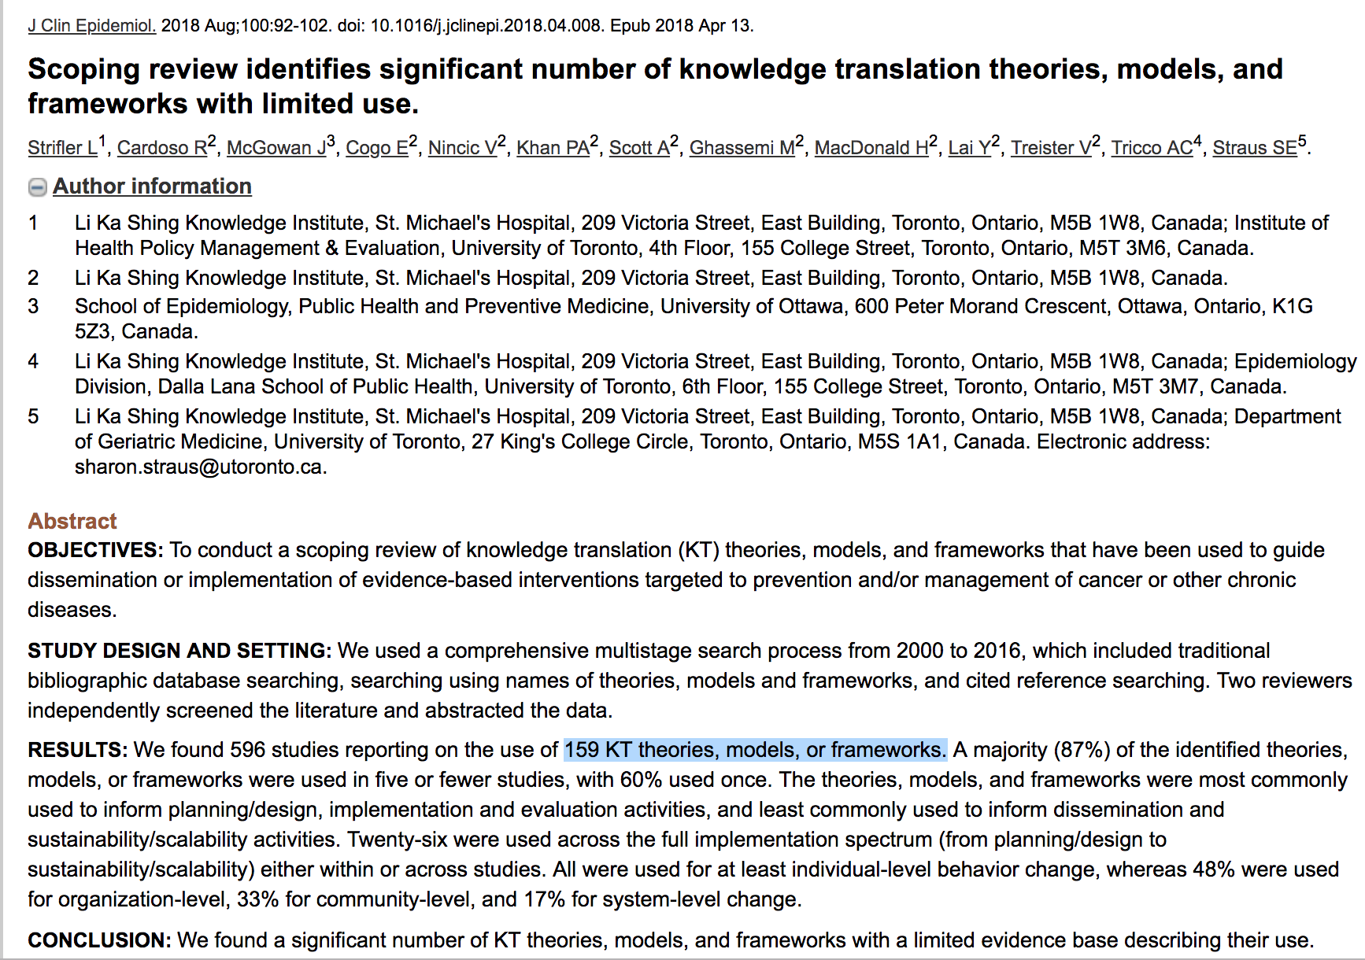
Wealth of existing TMFs for DIS:
  - 61 models with research focus (Tabak et al., 2012)
  25+ models with practitioner/clinician focus (Mitchell at al., 2010)
  33 models from a UK perspective (Wilson et al. 2010)
  100 + used in an international sample (Birken et al. 2017)
  159 KT theories, models, or frameworks (Strifler et al. 2018)
  More publications with diverse models from sub-areas (e.g., de-implementation, community engagement, etc)
Notes:
Could remove

Slide 7
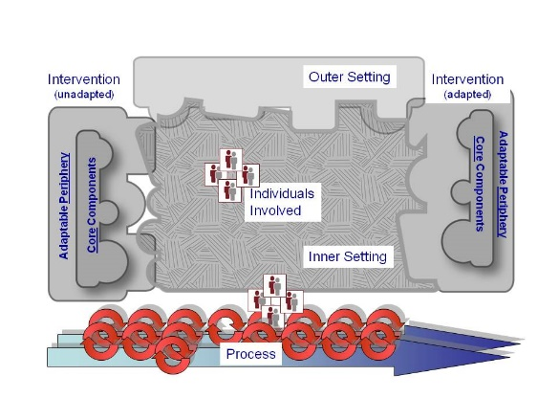
Healthy Equity Implementation Framework
Consolidated Framework for Implementation Research (CFIR)
Practical, Robust Implementation and Sustainability Model (PRISM)
Diffusion of Innovations
Community-Academic Partnership Model
Notes:
Could remove

Slide 8

Notes:
Could remove

Slide 9
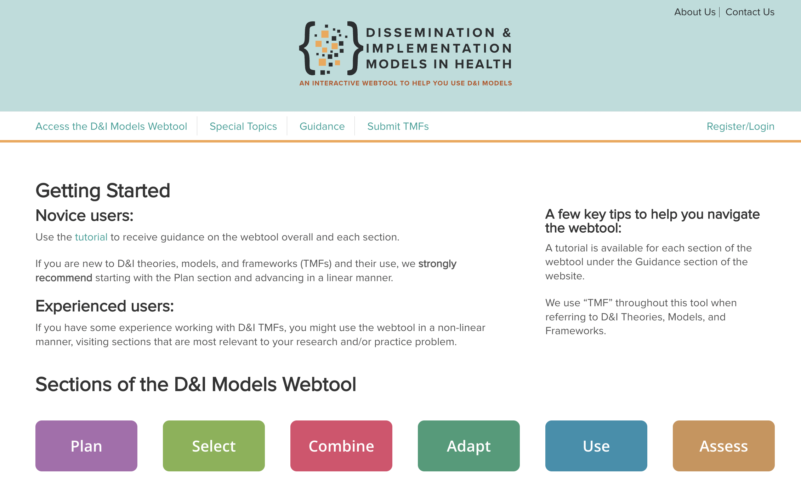
https://dissemination-implementation.org/index.aspx
Notes:
Could remove or add at the end?

Slide 10
Public Health Need Thought Exercise
Implementing an evidence-based weight management program
(or health inequity reduction program or COVID-19 vaccine) story
Even if 100% effective ... is only so good as how and whether:
It is adopted widely, including in low resource settings
Local implementation staff choose to deliver it
It can be implemented consistently with quality
It reaches intended recipients, including those at the highest risk/the most need receive it
It can be maintained and/or sustained
If we assume 70% success for each step above…
Glasgow RE, Vogt TM, Boles SM. Am J Public Health. 1999;89(9):1322.
Glasgow RE, et al. Frontiers Public Health 2019 7:64. doi: 10.3389/fpubh.2019.00064
www.re-aim.org
Notes:
Start here????

Slide 11
Impact
Adopted
Implemented
Maintained/Sustained
.7
X
.7
X
.7
X
.7
X
.7
Delivered
Reached
What is the moral of this story?
Overall population benefit to target population = 17%

Slide 12

Ultimate Impact of an Insurance-sponsored Weight Management Program in West Virginia
Dissemination step | Concept | % Impacted
8.8% of Weight Management sites participated | Adoption | 8.80%
5.9% of members participated | Reach | 0.52%
91.4% program components implemented | Implementation | 0.47%
43.8% of participants showed weight loss | Effectiveness | 0.21%
21.2% individuals maintained benefit (individual) ??% of Weight Management sites continued delivering the program | Maintenance | 0.04%
¹Abildso CG, Zizzi SJ, Reger-Nash B. Evaluating an Insurance-Sponsored Weight Management Program With the RE-AIM Model, West Virginia, 2004-2008. Preventing Chronic Disease Public Health Research,Practice, and Policy. 2010. 7(3).
Notes:
Disconnect between those who would benefit from an evidence-based therapy and who do actually benefit from it
81% of smokers did not receive assistance
Percent of adults 65 years and over who received an influenza vaccination during the past 12 months
Also variation by geographical regions, rural/urban, comorbidity status, type of provider, race/ethnicity, gender, etc.
EVIDENCE ON WHAT???

Slide 13
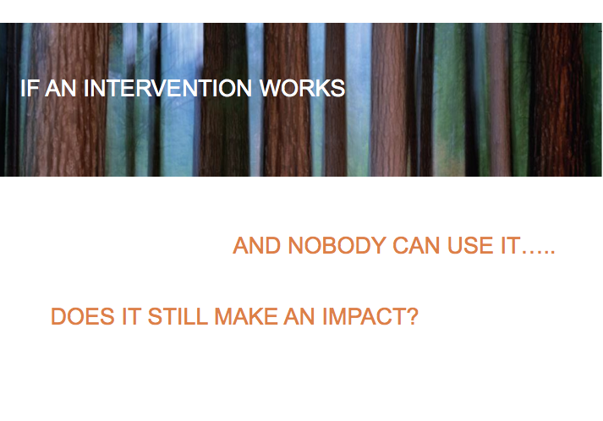

Slide 14
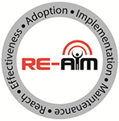
RE-AIM Intervention(s) Goal with equity ‘baked in’:
  Develop and translate research and practice-based interventions that can:
  be adopted and delivered broadly including in lower resource settings,
  have the ability for sustained and consistent implementation at a reasonable cost including in lower resource settings,
  reach large numbers of people especially those who can most benefit,
  produce replicable and long-lasting behavior changes for all and especially for those with highest need.
www.RE-AIM.org

Slide 15
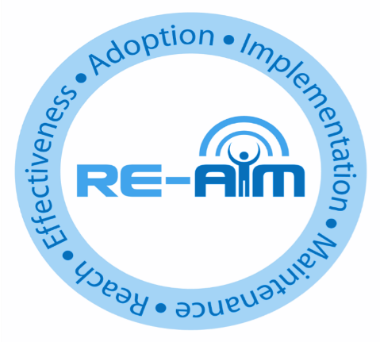
Overview and Evolution of RE-AIM
Addressing These Issues of Population Health was Initial Purpose of RE-AIM Framework and Outcomes
www.re-aim.org
Developed in 1999 - before implementation science was recognized as a field

Slide 16
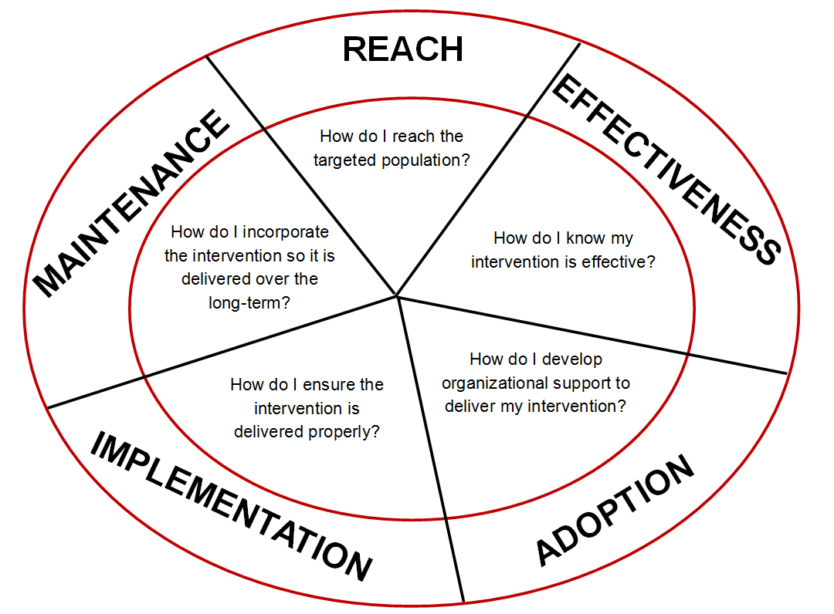
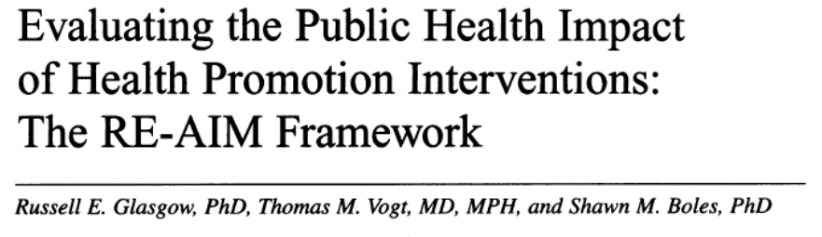
Purpose and History of the RE-AIM Framework
Commentary published in 1999
First used to evaluate prevention and health behavior change programs
Intended to facilitate translation of research to practice, policy, and real-world application
Balance internal and external validity, and emphasizes representativeness and equity
Individual (RE) and Multi-level setting (AIM) factors - community, organization, staff
Ultimate Impact depends on all elements (reach x effectiveness, etc.)
Glasgow RE et al. RE-AIM at 20. Frontiers Public Health. 2019: 7: 64
Glasgow et al. Amer J Public Health. 1999; 89: 1322-1327
www.re-aim.org

Slide 17
Pragmatic Use of RE-AIM - What is Feasible?
RE-AIM Dimension | Key Pragmatic Priorities to Consider and Answer
Reach (Individual Level) | WHO is (was) intended to benefit and who actually participates or is exposed to the ‘program’ or policy?
Effectiveness (Individual Level) | WHAT is (was) the most important benefit you are trying to achieve and what is (was) the likelihood of negative outcomes?
Adoption (Setting Levels) | WHERE is (was) the program or policy applied WHO applied it?
Implementation (Setting Levels) | HOW consistently is (was) the program or policy delivered? HOW will (was) it be adapted? HOW much will (did) it cost? WHY will (did) the results come about?
Maintenance (Individual and Setting Levels) | WHEN will (was) the program become operational; how long will (was) it be sustained (setting level); and how long are the results sustained (individual level)?
Glasgow RE & Estabrooks, P. Preventing Chronic Disease, 2018; 15: E02

Slide 18
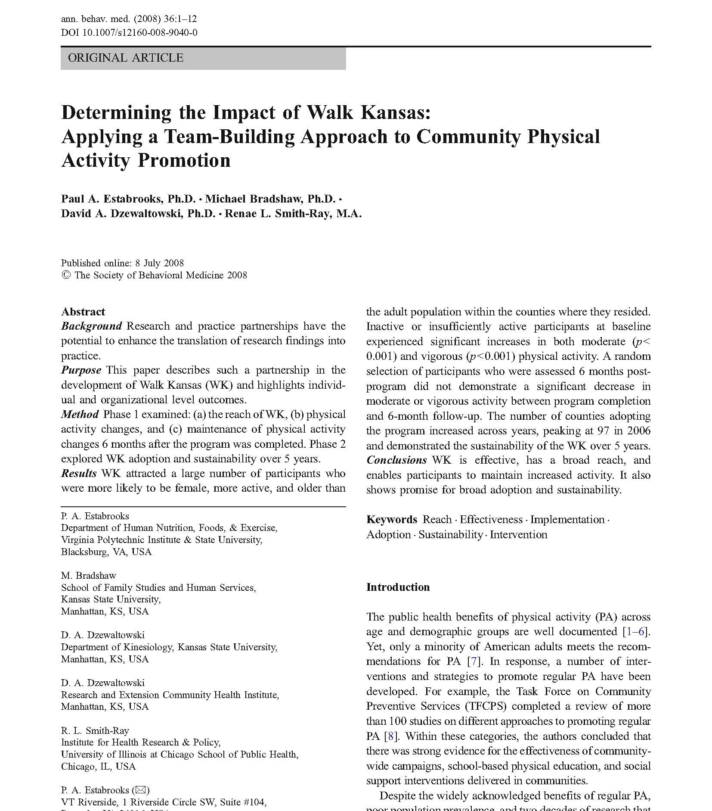
An example of using RE-AIM for evaluation

Slide 19

Design: Quasi-experimental trial (n=5911) in cooperative extension system
Priority population: Adults with no contraindications for moderate PA
Intervention: 8-week group dynamics program with group goals, self-monitoring, and feedback via 9 weekly newsletters
Control: Participants served as own control
Estabrooks et al. Determining the Impact of Walk Kansas. ABM, 2008, 36: 1-12
Notes:
This slide illustrates background information about research on the impact of Walk Kansas.
The research design was a quasi-experimental trial in a statewide cooperative extension system.
The target population was adults with no contraindications for engaging in moderate intensity physical activity.
The intervention was an 8-week group dynamics program with group goals, self-monitoring, and feedback via 9 weekly newsletters.
Finally, participants served as their own controls.

Slide 20
REACH
Glasgow R and Estabrooks P, Preventing Chronic Disease, 2018
Notes:
For each of the RE-AIM dimensions, there is a technically correct definition and a “who, what, where, how, and when” question to guide pragmatic use.
The first dimension is Reach which refers to the absolute number, proportion, and representativeness of individuals who are willing to participate in a given initiative, program, or intervention. For reach, the key pragmatic priority to consider is WHO is or was intended to benefit and actually participate or be exposed to the intervention?

Slide 21
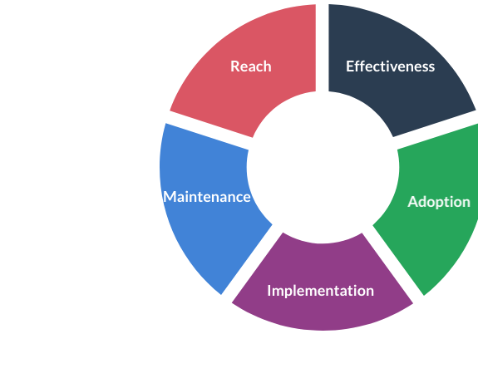
5911 adults participated in Walk Kansas
590,372 adults in participating counties
1% of eligible population
Participants more likely to be:
Women
Older
Meeting PA recommendations
Estabrooks et al. Determining the Impact of Walk Kansas. ABM, 2008, 36: 1-12
Notes:
Let’s start by looking at Reach. To calculate reach, researchers divided the number of adults who participated in the program (which was 5911) with the total number of adults in participating counties (which was 590,372). This calculation showed that the program reached 1% of the eligible population. In addition, researchers described representativeness and found that participants were more likely to be women, older, and meeting physical activity recommendations compared to the general population.

Slide 22
Technical Definition
The impact of an initiative on outcomes, including potential negative effects, quality of life, and economic outcomes.
EFFECTIVENESS
Glasgow R and Estabrooks P, Preventing Chronic Disease, 2018
Notes:
The second dimension of RE-AIM is Effectiveness, which is the impact of an initiative, program, intervention, or policy on important outcomes, including potential negative effects, quality of life, and economic outcomes. The key pragmatic consideration is WHAT is or was the most important benefit you are trying to achieve and what is or was the likelihood of negative outcomes?

Slide 23
Per week
Inactive:
+ 177 min
Insufficiently active:
+ 107 min
Estabrooks et al. Determining the Impact of Walk Kansas. ABM, 2008, 36: 1-12
Notes:
In terms of effectiveness, researchers found that previously inactive participants increased their physical activity by 177 minutes per week—that’s an increase of nearly 3 hours per week. In addition, insufficiently active participants increased their physical activity by 107 minutes per week.

Slide 24
Technical Definition
The absolute number, proportion, and representativeness of settings and agents willing to initiate a program.
Glasgow R and Estabrooks P, Preventing Chronic Disease, 2018
Notes:
The third dimension of RE-AIM is adoption which is defined as the absolute number, proportion, and representativeness of settings and intervention agents who are willing to initiate a program. Pragmatically, the question for adoption is Where is the program applied and who applied it?

Slide 25
105 eligible counties.
Year 1: 48 counties participated.
By year 5: +41 counties participated.
Initially, counties with agents not meeting PA recommendations were less likely to adopt.
Estabrooks et al. Determining the Impact of Walk Kansas. ABM, 2008, 36: 1-12
Notes:
For adoption, there were 105 counties that could have adopted the program.
In year 1, 48 counties adopted the program.
By year 5, an additional 41 counties adopted the program.
In the initial year, counties with extension agents who were not meeting PA recommendations were less likely to adopt the program.

Slide 26
Technical Definition
Agents’ fidelity to the intervention protocol, including adaptations, time, and cost.
Glasgow R and Estabrooks P, Preventing Chronic Disease, 2018
Notes:
The fourth dimension of RE-AIM is implementation. At the setting level, implementation refers to the intervention agents’ fidelity to the various elements of an intervention’s protocol. This includes consistency of delivery as intended, adaptations made, and the time and cost of the intervention. The key pragmatic considerations are How consistently is or was the program or policy delivered? How will or was it be adapted? How much will it cost? And why did will or did the results come about?

Slide 27
No data reported but refers to consistent delivery across counties.
Could have reported:
- % of intervention materials /newsletters delivered/received
- % of classes completed
- Cost/resources needed
- Fidelity/adaptations
Estabrooks et al. Determining the Impact of Walk Kansas. ABM, 2008, 36: 1-12
Notes:
In this study, researchers did not explicitly report implementation data. In this study, implementation refers to consistent delivery across counties.

Slide 28
Technical Definition
The extent to which a program becomes institutionalized at the setting level or sustained at an individual level.
Glasgow R and Estabrooks P, Preventing Chronic Disease, 2018
Notes:
The last dimension of RE-AIM is maintenance which is defined as the extent to which a program or policy becomes institutionalized or part of the routine organizational practices and policies. Maintenance in the RE-AIM framework also has referents at the individual level based on sustained changes and long-term outcomes. The key pragmatic consideration for maintenance is When will (or did) the initiative become operational and how long are the results sustained at the setting level and individual level?

Slide 29
Individual Level:
Sustained an increase of moderate PA
6 months after program was complete.
Setting Level:
Sustained delivery for subsequent 4 years.
Estabrooks et al. Determining the Impact of Walk Kansas. ABM, 2008, 36: 1-12
Notes:
Researchers measured maintenance at the individual level and the setting level.
At the individual level, researchers found that previously inactive and insufficiently active participants sustained an increase of moderate physical activity of 134 and 101 minutes per week 6 months after the program was completed, respectively.
At the setting level, researchers found that all counties that adopted the program in the initial year sustained delivery for the subsequent 4 years. Each county that adopted the program in years 2-4 also delivered the program in subsequent years,

Slide 30
Community Physical Activity Program Results
Reach: 590,327 Adults in participating counties; 5911 participated (1% of eligible population); participants were more likely to be women, older, and more likely to be meeting physical activity recommendations when compared to the general population
Effectiveness: Previously inactive and insufficiently active participants increased moderate physical activity by 177 and 107 minutes per week, respectively.
Adoption: 48 of 105 counties adopted in first year of delivery, 41 additional counties adopted by year 5 of delivery. In initial year, counties with extension agents who were not meeting PA recommendations were less likely to adopt.

Slide 31
Results (continued)
Implementation: No data reported but refers to consistent delivery across counties.
Maintenance Individual Level: Previously inactive and insufficiently active participants sustained an increase of moderate physical activity of 134 and 101 minutes per week 6 months after the program was completed, respectively.
Maintenance Setting Level: All counties that initiated the program in the initial year sustained delivery for the subsequent 4 years. Each adopting county in years 2-4, delivered the program in subsequent years.

Slide 32
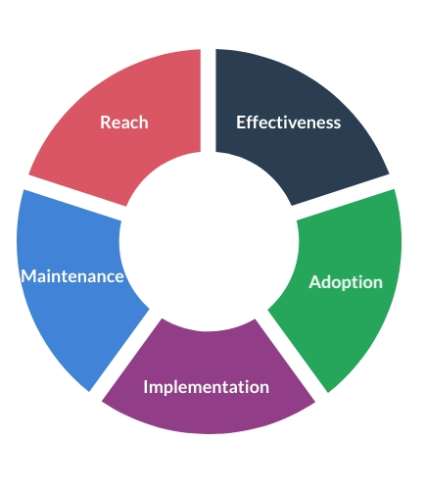
RE-AIM SPECIAL CONSIDERATIONS
Reach is always measured at the individual, end-beneficiary level (e.g., veterans, patients, community members)
  When the denominator is not available, some other strategies can be used to report on Reach
Adoption includes adoption at the delivery agent (provider/implementer/etc.) and setting (clinic, county, etc.) levels
Implementation can be measured in multiple ways and include consideration for the implementation of both the intervention, program, policy and the implementation strategy
Maintenance can be not relevant from a measurement perspective at early stages but can always be planned/designed for and discussed in these terms
Notes:
The goals of RE-AIM intervention and implementation is to develop and translate programs that can:
Be adopted, adapted, and delivered broadly.
Have the ability for sustained and consistent implementation at reasonable cost.
Reach large numbers of people, especially those who can most benefit.
Produce replicable and long-lasting change, including implementation outcomes and population outcomes.
Now that we’ve reviewed the purpose and goals of RE-AIM, we’ll look at each dimension.

Slide 33
REACH
Glasgow R and Estabrooks P, Preventing Chronic Disease, 2018
Notes:
For each of the RE-AIM dimensions, there is a technically correct definition and a “who, what, where, how, and when” question to guide pragmatic use.
The first dimension is Reach which refers to the absolute number, proportion, and representativeness of individuals who are willing to participate in a given initiative, program, or intervention. For reach, the key pragmatic priority to consider is WHO is or was intended to benefit and actually participate or be exposed to the intervention?

Slide 34
Overview of PRISM
Context is Everything
Context is multi-level and dynamic - not just places, but also history and relationships
Addressed through PRISM extension of RE-AIM Outcomes: “RE-AIM in context”
Nilsen P, Bernhardsson S. Context matters in implementation science: BMC Health Serv Res. 2019;19(1):189.
Shelton, RC et al. An extension of RE-AIM….Front Public Health 2020 8:134
Chambers, D et al. The dynamic sustainability framework. Implement Sci. (2013) 8:117.

Slide 35
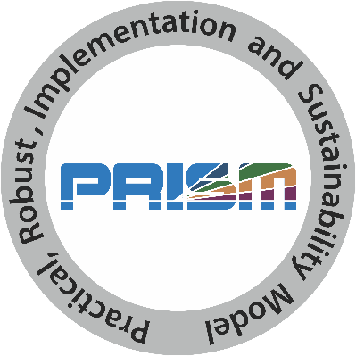
What is PRISM?
Practical, Robust Implementation and Sustainability Model
Contextually expanded RE-AIM
Has been used as a:
  Determinant framework
  Process framework
  Implementation framework
  Evaluation framework
Feldstein, AC, & Glasgow, RE. PRISM for integrating research findings into practice. Jt Comm J Qual Patient Saf. (2008) 34:228–43. doi: 10.1016/S1553-7250(08)34030-6

Slide 36
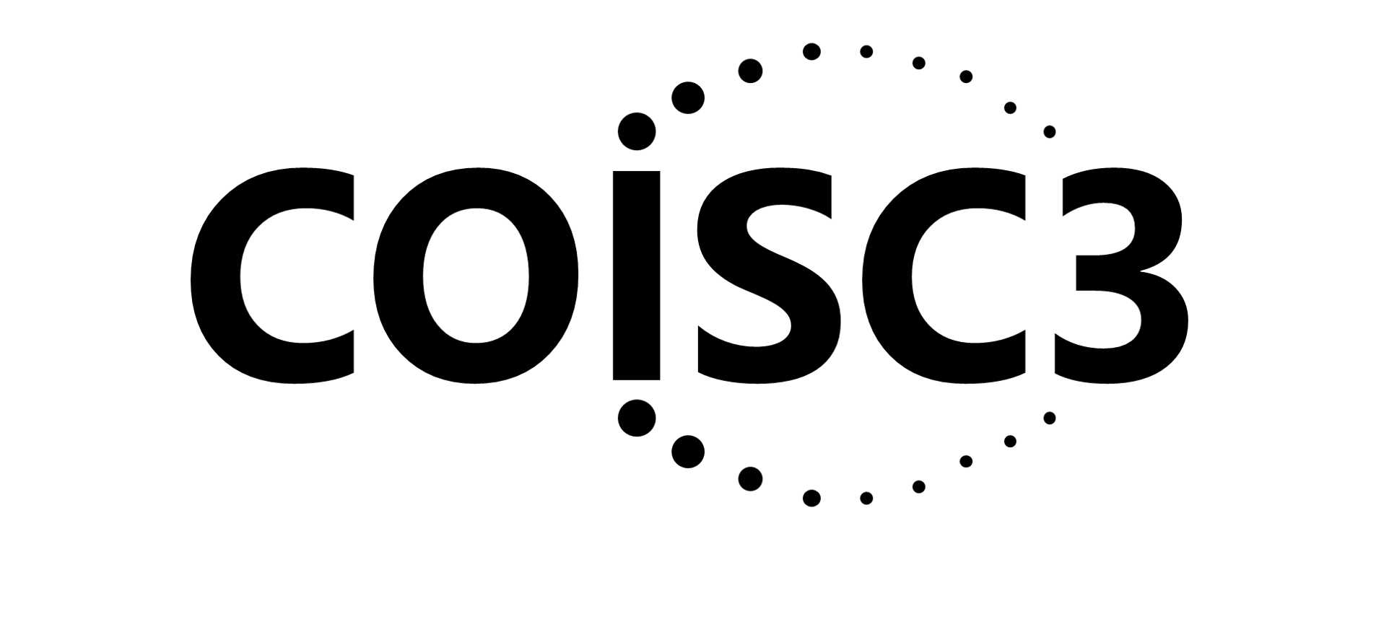
Feldstein AC, Glasgow RE. A practical, robust implementation and sustainability model (PRISM) for integrating research findings into practice. Jt Comm J Qual Patient Saf. 2008 Apr;34(4):228-43.
PRISM CONTEXTUAL DOMAINS
RE-AIM
OUTCOMES

Slide 37
REPEAT AFTER ME…
PRISM contains RE-AIM (they are not different or competing frameworks)
PRISM contains RE-AIM (is the contextually expanded RE-AIM)
PRISM Includes RE-AIM

Slide 38
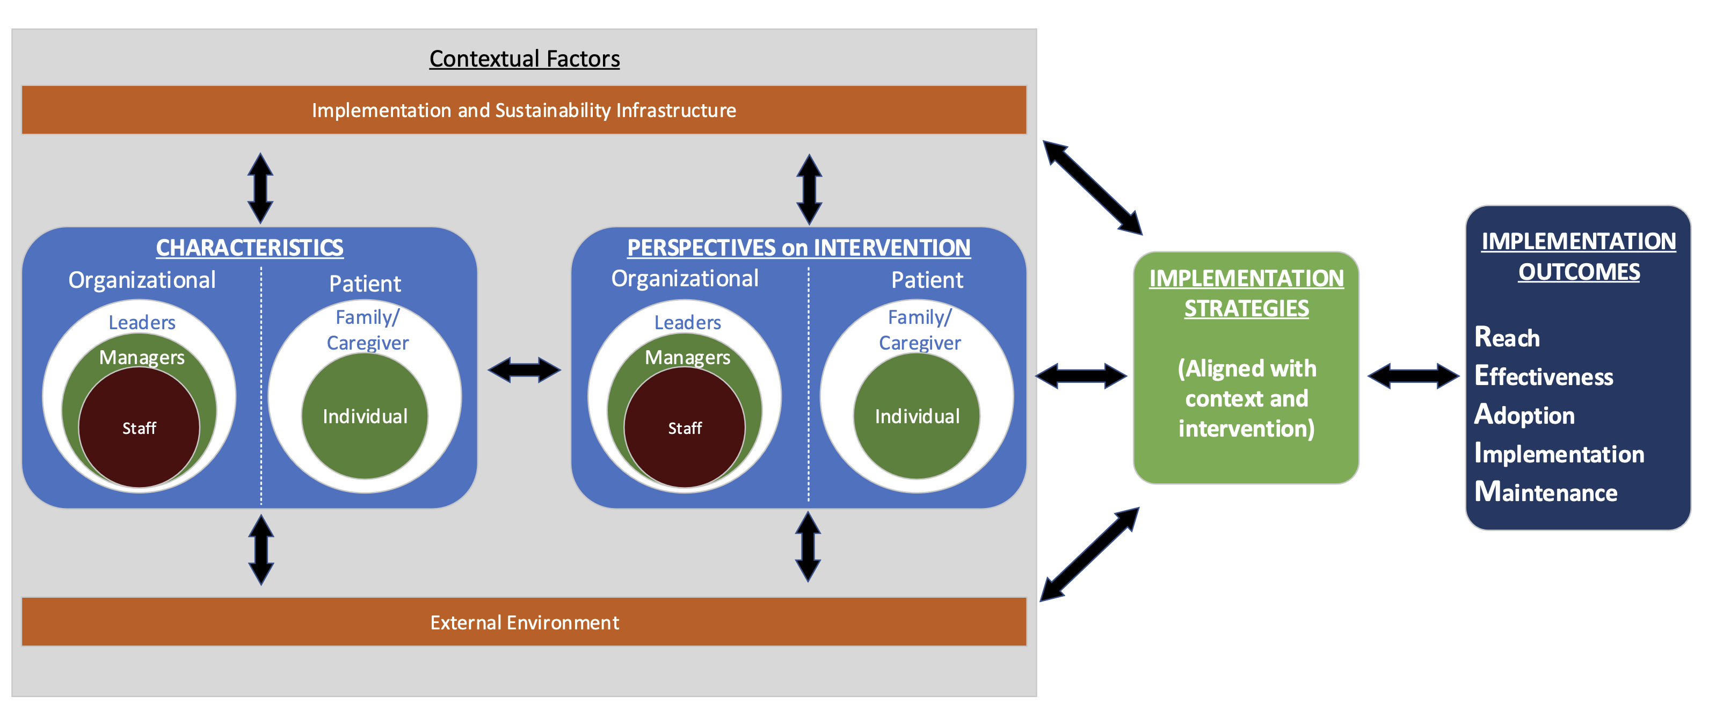

Slide 39
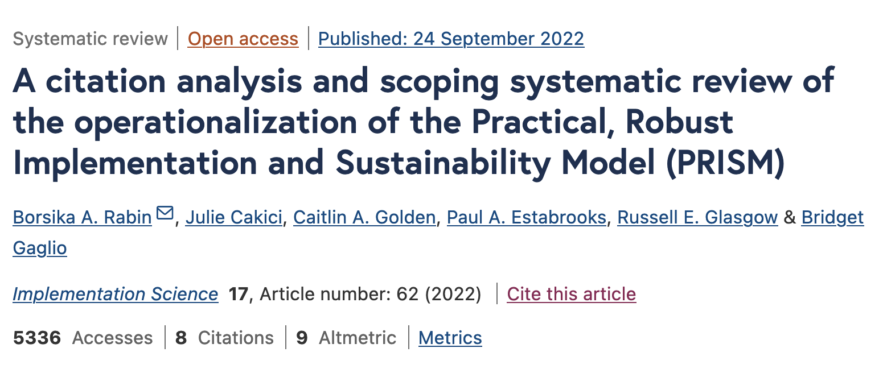
Original reference: Feldstein, AC, & Glasgow, RE. PRISM for integrating research findings into practice.
Jt Comm J Qual Patient Saf. (2008) 34:228–43. doi: 10.1016/S1553-7250(08)34030-6
Notes:
PRISM has been primarily used in outpatient clinical settings and in the US
It has been used to study a variety of issues and conditions using a wide range of experimental designs and often using mixed methods
Most studies have reported on half or more of the PRISM domains and over half of the studies reported on at least 5 of the 6 domains
Most frequently assessed were Organizational perspectives on the Program/Intervention, and Implementation and Sustainability Infrastructure
PRISM contextual components were most frequently operationalized using qualitative methods
Implementation and Maintenance were most reported RE-AIM outcomes

Slide 40

Common Misconceptions
1. Only for evaluation
2. Only quantitative or qualitative
3. Mandates that all dimensions are used and equally important
4. Does not address context or determinants
See video of Dr. Holtrop discussing: re-aim.org/resources-and-tools/recommended-re-aim-slides/

Slide 41
New(er) applications for RE-AIM and PRISM
Health equity
    Iterative application

Slide 42
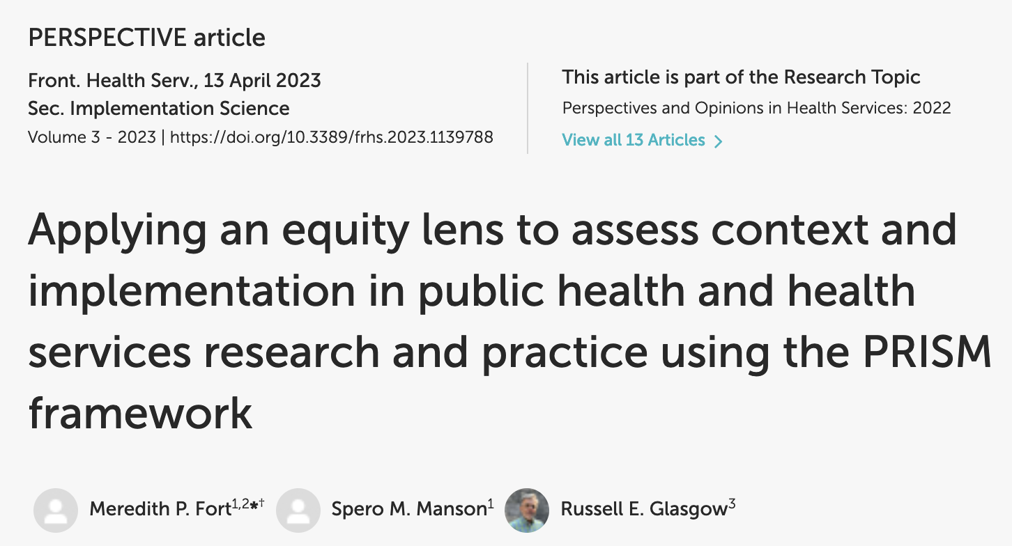

Slide 43

How Can PRISM (and other D&I Science Frameworks) Help Address Health Equity?
Broaden Focus on All Steps and Outcomes Necessary for Population and Equity Impact
Focus Attention on Issues of Representation and Representativeness
Address Systems Issues and Unintended Consequences
Understand Context and Guide Tailoring and Adaptation to Context and Population
Develop practical, contextually and population relevant methods and resources
Adapted from Fort M, Manson S, & Glasgow R. Applying PRISM via a health equity lens. Frontiers in Health Services 2023
Notes:
External Validity/Pragmatic Criteria, Often Ignored
Participant representativeness
Setting and staff representativeness
Multi-level context
Adaptation/change in intervention and implementation strategies
What outcomes for whom over what time period
Reasons for participation and drop out
Bottom line: What works for whom, under what conditions, for what outcomes, how much does it cost

Slide 44
How PRISM (and RE-AIM Outcomes) Address Equity Issues
PRISM Contextual Factors
Multi-level/Multi-sector Perspectives on Intervention
External Environment– Drivers of Equity
Implementation and Sustainability Infrastructure (Capacity)
Multi-level Partner Characteristics
Intervention, Program, or Policy
Implementation Strategies
RE-AIM Outcomes
Reach
Effectiveness
Implementation
Adoption
Maintenance

Slide 45
How PRISM (and RE-AIM Outcomes) Address Equity Issues
PRISM Contextual Factors
Multi-level/Multi-sector Perspectives on Intervention
External Environment– Drivers of Equity
Implementation and Sustainability Infrastructure (Capacity)
Address Context
Many Perspectives
Represented
Multi-level Partner Characteristics
Co-create and Adapt to align with community priorities
Intervention, Program or Policy
Planning to ensure equity is addressed
Implementation Strategies
Interactions among outcomes
RE-AIM Outcomes
Equity/ Representativeness across outcomes
Iterative Adaptations
Reach
Effectiveness
Implementation
Adoption
Maintenance
Unintended Consequences
Cost and Feasibility

Slide 46

ADOPTION
# and type of settings that participate
Tailor to and engage leaders, stakeholders, and address history
RE-AIM Equity Outcomes
Cascade
FIXES
Make implementation simple, low cost and burden, and provide support
IMPLEMENTATION
Consistently deliver intervention and resources with quality
Multiple and diverse tailored promotion channels and increased access
REACH
(equity)
# and type of citizens and families that participate
Utilize evidence-based resources and strategies; make data-based adaptations
EFFECTIVENESS
(equity)
# and type of citizen and families that benefit
(on what outcomes)
Provide ongoing feedback, support
and resources for implementation
Example actions to prevent or minimize ‘drop off’ and inequities at each step
MAINTENANCE
Long-term implementation and effectiveness

Slide 47
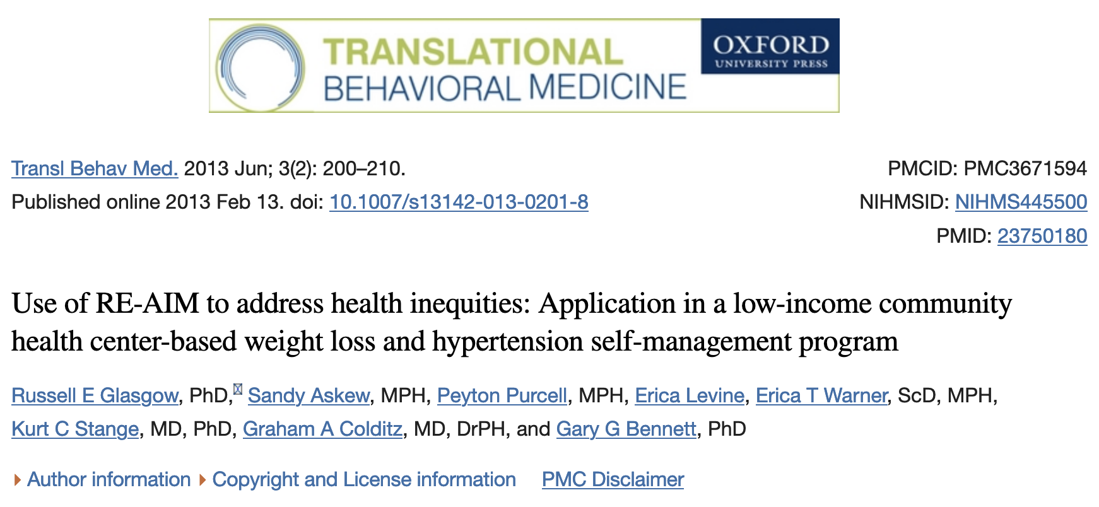

Slide 48
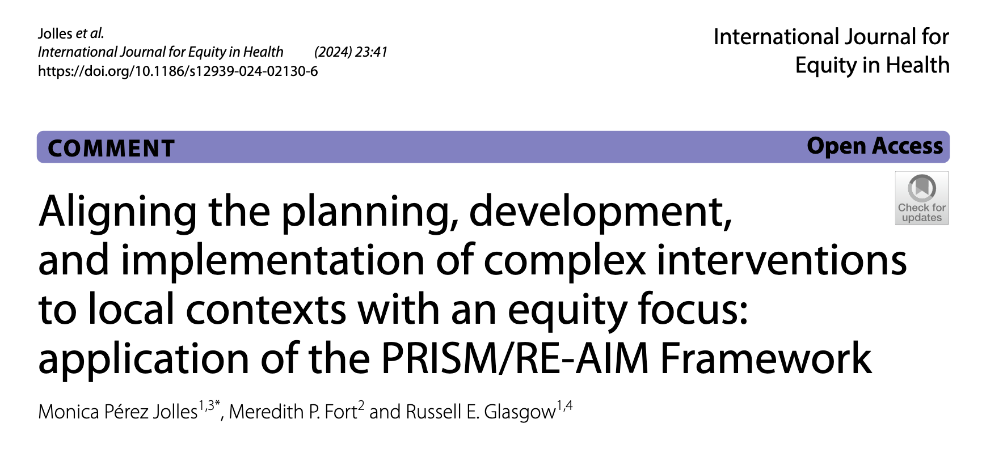
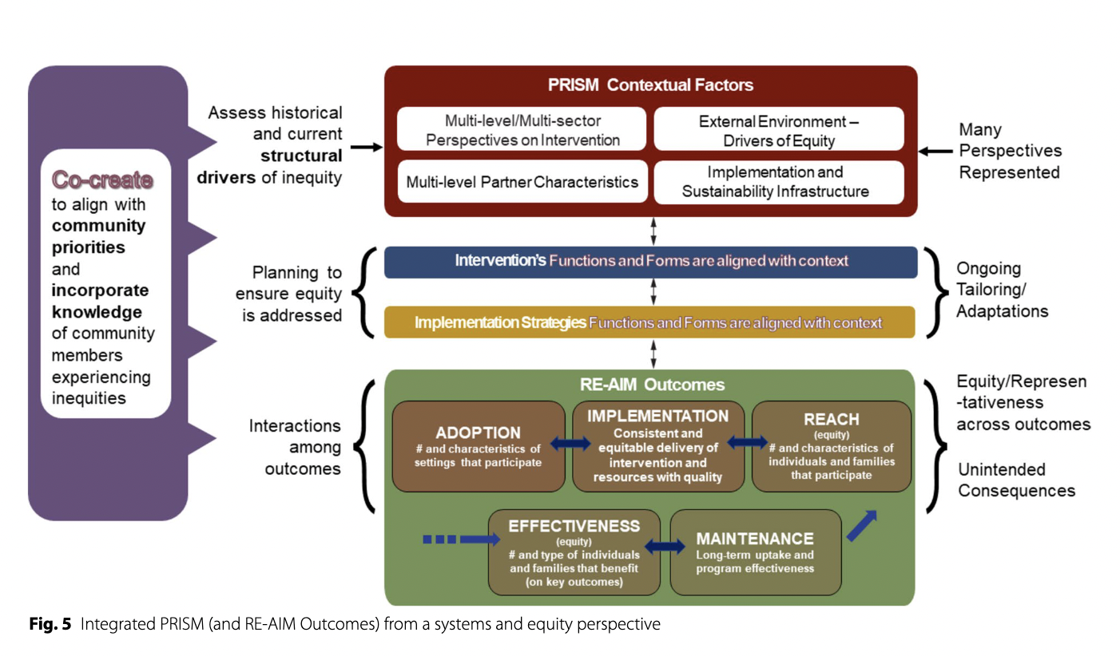

Slide 49
The Need for Speed:
Rationale for Iterative RE-AIM/PRISM
D&I frameworks are often cited
  But frequently NOT used throughout a project lifecycle
  Almost always for planning or evaluation
RE-AIM and PRISM have been used most for evaluation, but also successfully for planning and implementation
Neither RE-AIM or PRISM nor most other D&I models have been used iteratively to guide adaptations at key points
A major limitation to D&I models and methods is that they are much slower than needed by partners
Glasgow, RE .... & Rabin B. Making implementation science more rapid. (2020) Frontiers Public Health. 8: 194

Slide 50
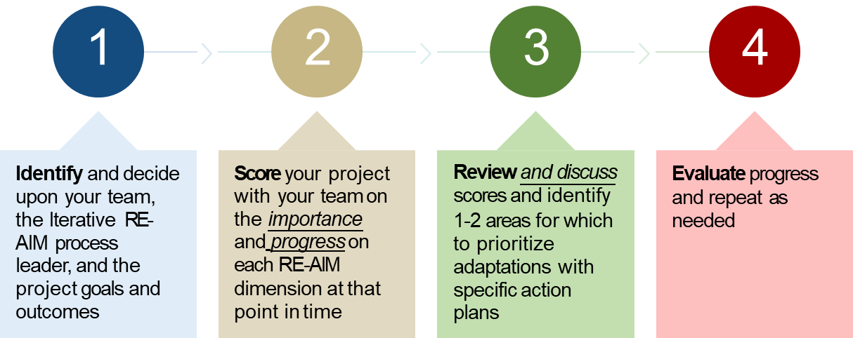
How do you use iterative RE-AIM/PRISM?

Slide 51
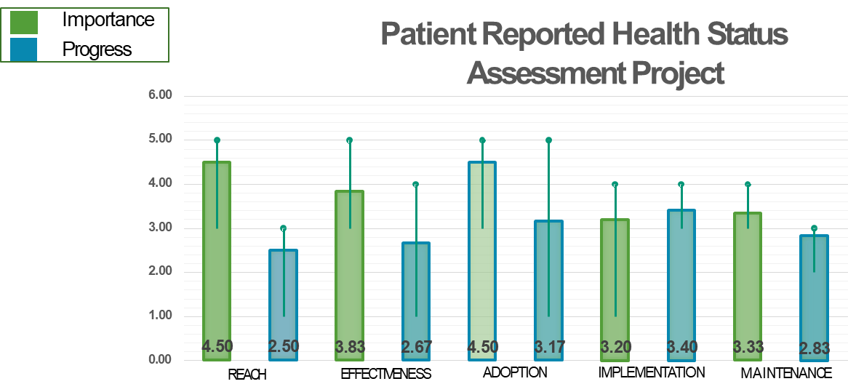
Sample “Gap” Analysis

Slide 52
Iterative RE-AIM/PRISM:
Key Findings, Challenges, Next Steps
Key Findings
Feasible and applicable across different projects, content areas and teams
Challenges
Limited by frequency and quality of data, especially when few or no ‘objective data’
Next Steps
Applying in 1) global health hypertension and 2) hospital lung ultrasound projects
Method works to promote team discussion, reflection and action planning
Exploring number of iterative sessions and level of facilitation needed
Use real-time EHR data and biweekly meetings for rapid iterations
Finding a way to integrate PRISM issues
Developed web-based version (using PRISM)
Glasgow, RE .... & Rabin B. Making implementation science more rapid. (2020) Frontiers Public Health. 8: 194

Slide 53
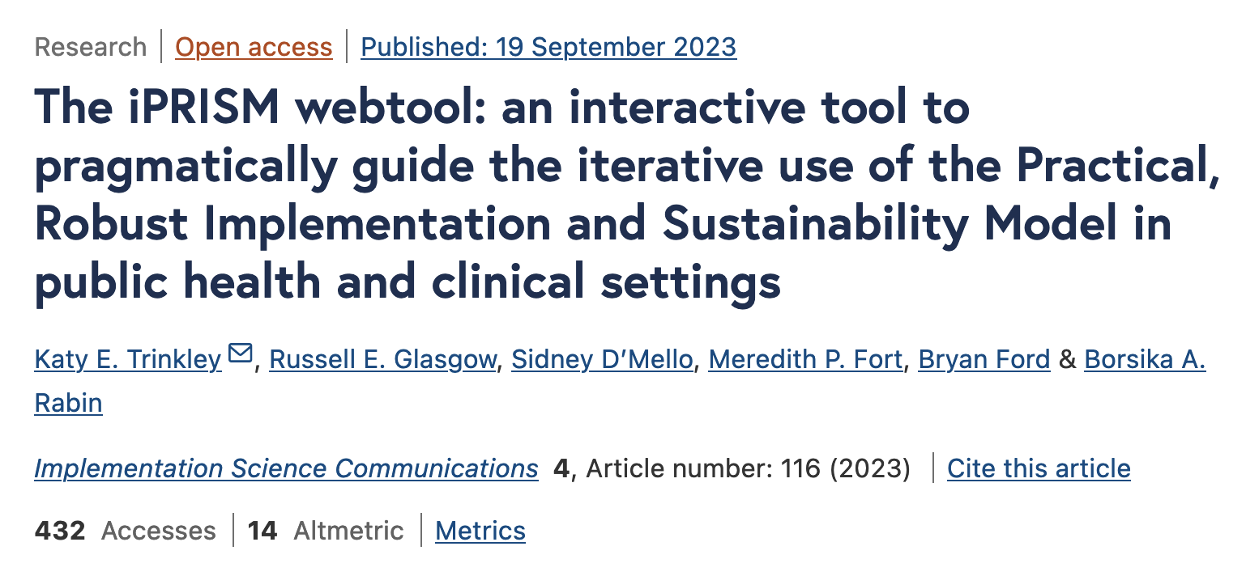
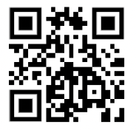
Most Recent: Iterative PRISM webtool
To increase accessibility and use by diverse groups
Use for (choice of): planning, guiding implementation/adaptations, or sustainment
Automated, real time data collection, analysis and feedback
Trinkley et al. The iPRISM webtool. Implementation Science Communications (2023) 4:116 https://doi.org/10.1186/s43058-023-00494-4
Trinkley KT, et al. Acad Med. 2022;97:1447 (primary care & cardiology decision aid)
Maw A, et al. Implement Sci Commun. 2022;3:89 (hospital based EHR dashboard)
prismtool.org
Notes:
Simplify implementation science - using PRISM
For diverse researchers and implementation teams
Support rapid learning health systems
Guide and prompt users to iteratively
Assess context
Align project with context
Assess progress on key outcomes
Develop feasible and impactful strategies/adaptations
Create action plans

Slide 54
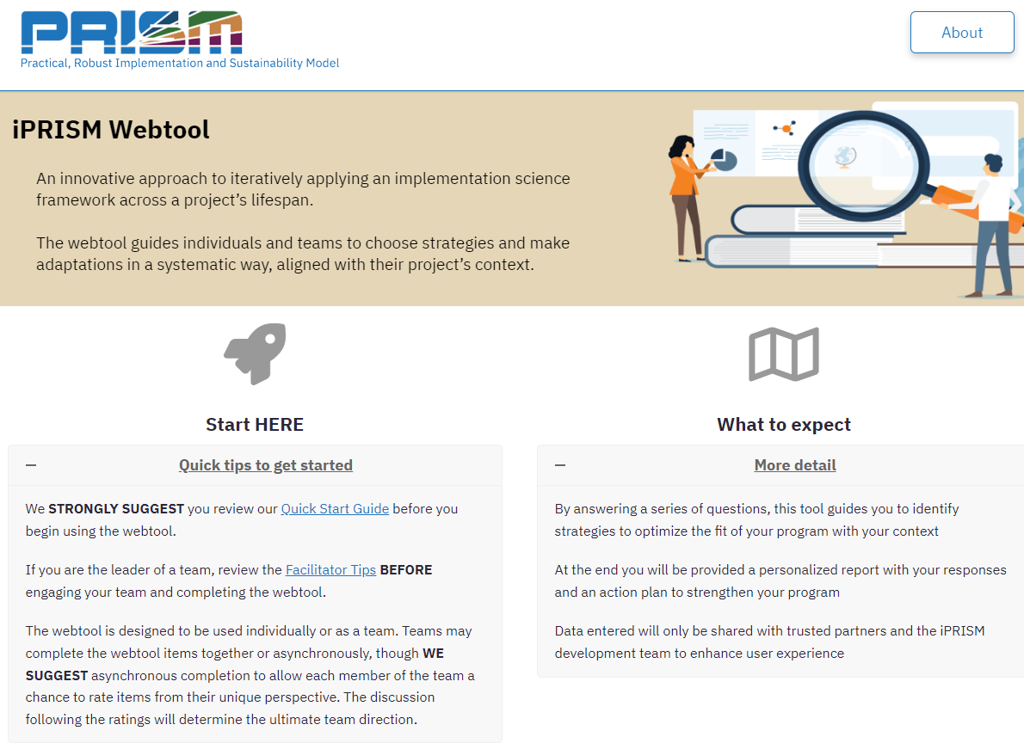

Slide 55
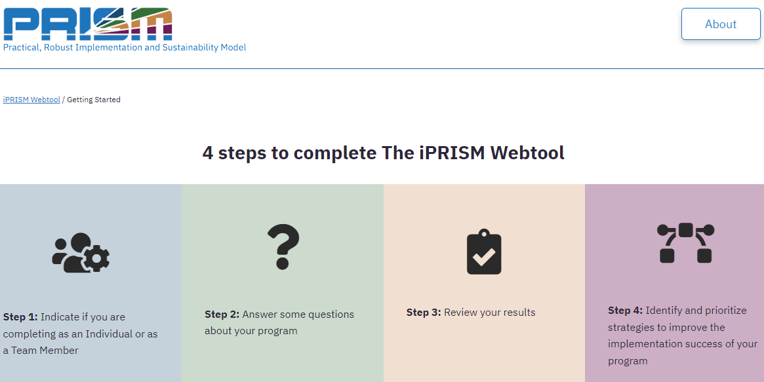

Slide 56
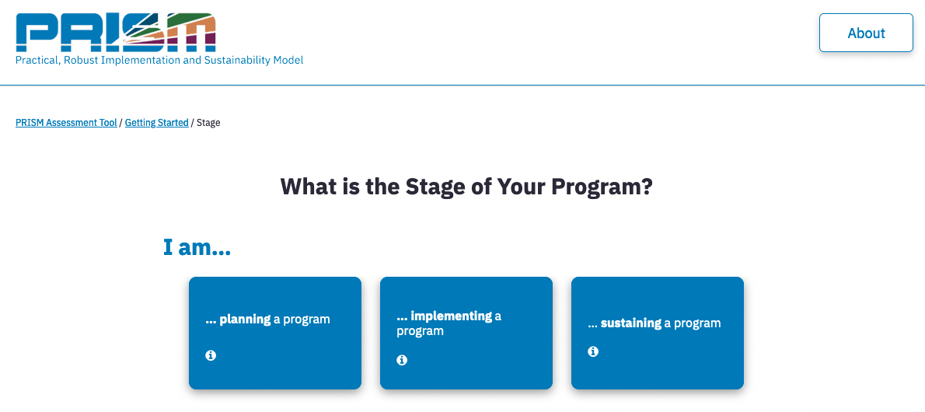

Slide 57
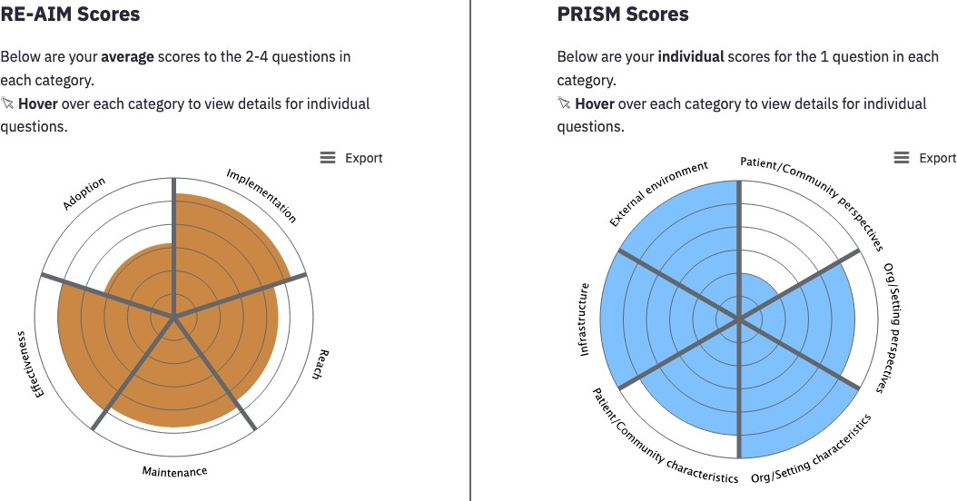



Graphical display of responses

Slide 58

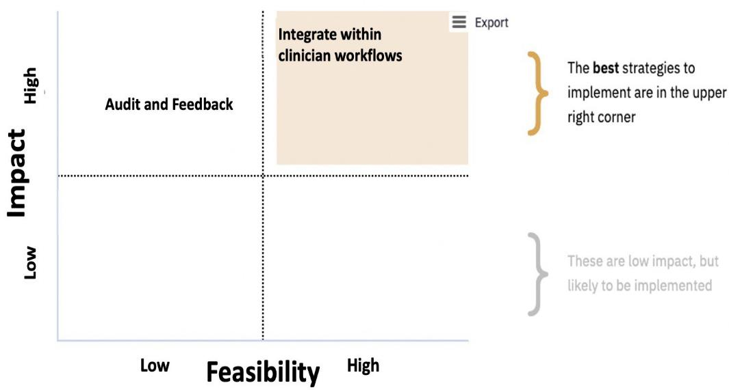
Prioritize strategies
Prismtool.org

Slide 59

Evolution of RE-AIM -> PRISM: Lessons Learned
Among the most widely used TMFs.
Often recommended by funders.
Expanded the original model to focus on adaptions and sustainability.
Emphasize qualitative methods to understand “how” and “why.”
Capture costs.
Understand and address health equity issues.
Encourage pragmatic and iterative use.
Package for use by non-researchers.
Integrate with other models.
Glasgow et al. RE-AIM Planning and Evaluation Framework: Adapting to New Science and Practice with a 20-Year Review. Front Public Health. 2019;7:64.

Slide 60
Future Directions for RE-AIM and PRISM
Research and Practice:
Development and validation of more quantitative survey measures of PRISM, especially those that meet pragmatic and the PAPERS criteria.
  Standardized PRISM and RE-AIM outcomes survey items and examples of mixed methods research will be available soon the re-aim.org website.
For pragmatic use it is not necessary to use all PRISM components or to use PRISM at all program time points (i.e., pre-implementation, implementation, sustainment).
  When not feasible, authors should briefly and transparently state why certain components were not used or why PRISM was only used at one time point
Investigation of relationships within and between PRISM domains, RE-AIM outcomes, and other implementation and service outcomes
  .

Slide 61

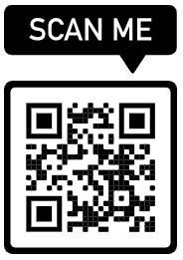
Brief explainer videos
FAQ’s and examples
Guidance on application
Searchable list of 700+ article abstracts
Calculators, checklists, tools
Recommended slides
Webinars, upcoming events, blogs
Additional Resources at www.re-aim.org
Also chapters on PRISM and RE-AIM in Per Nilsen et al’s forthcoming book
Glasgow et al (2019). RE-AIM Planning and Evaluation Framework: 20-Year Review. Front Public Health, 7, 64. doi:10.3389
Holtrop et al. (2021) Understanding and applying the RE-AIM framework J Clinical Translat Sci, page 1 of 10. doi: 10.1017/cts.2021.789
Special issue Front Public Health- 13 articles https://www.frontiersin.org/research-topics/10170/

Slide 62
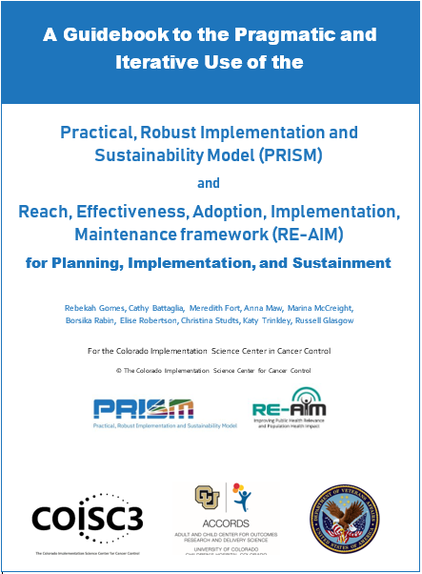
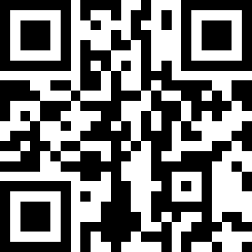
Purposes:
Briefly discuss key conceptual issues in PRISM and RE-AIM
Provide guidance, examples, and recommendations for pragmatic use of these frameworks
Provide survey items for different project phases and tables of strategies to enhance RE-AIM outcomes
https://tinyurl.com/4fmvf7kr
© COISC3 2023

Slide 63
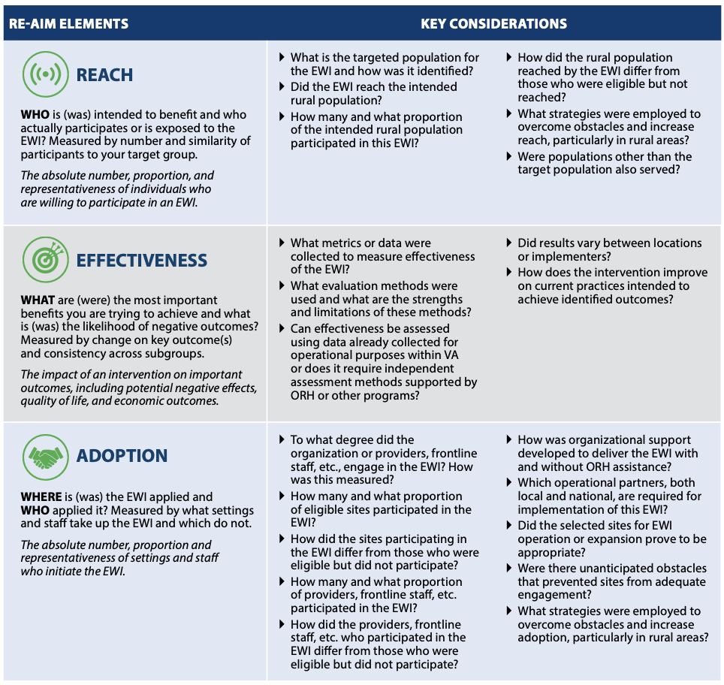
Center for the Evaluation of Enterprise-wide Initiatives (CEEWI) VA Office of Rural Health

Slide 64
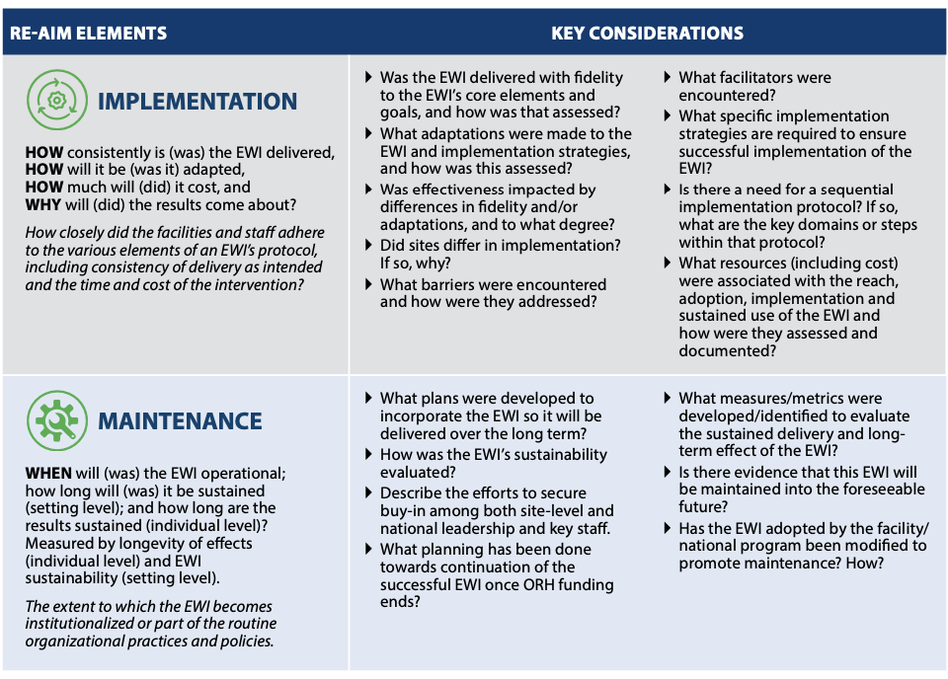
Center for the Evaluation of Enterprise-wide Initiatives (CEEWI) VA Office of Rural Health

Slide 65
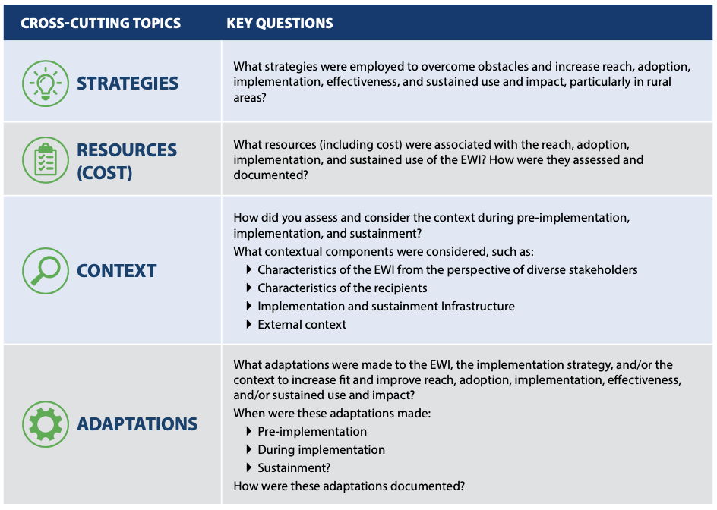
Center for the Evaluation of Enterprise-wide Initiatives (CEEWI) VA Office of Rural Health

Slide 66
Thank you

