Slide 1


16th Annual Conference on the Science of Dissemination and Implementation in Health
ADVANCING D&I SCIENCE BY ADDRESSING DYNAMIC CHANGES IN CONTEXT AND FIT
The RE-AIM Consortium

Slide 2

Welcome to the workshop!

Slide 3
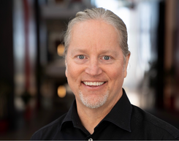




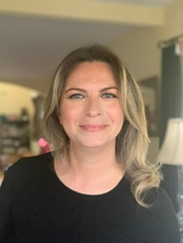

Who we are
Paul Estabrooks
Russ Glasgow
Samantha Harden
Marcia Ory
University of Utah
University of Colorado Anschutz Medical Campus
Virginia Tech
Texas A&M
Emiliane Lemos Pereira
Borsika Rabin
Katy Trinkley
University of Nebraska Medical Center
University of California San Diego
University of Colorado Anschutz Medical Campus

Slide 4
Today’s Agenda
1-4:30PM
Intros and Overview
Mapping
C-S-M-O
Addressing Dynamic DIS Planning and Iteration Challenges through Advances in PRISM/RE-AIM
Pre-implementation planning using PRISM/RE-AIM tools
Applying PRISM/RE-AIM tools
Using PRISM/RE-AIM to address and facilitate dynamic evolution across time and context
Applying PRISM/RE-AIM tools

Slide 5


17-24 year lag time
RIGHT TURN ON RED
Let’s think about evolution for a moment

Slide 6
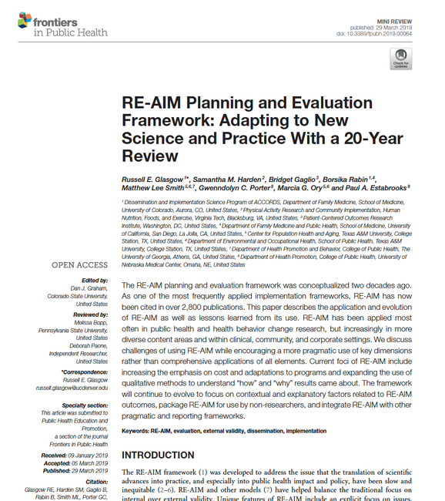
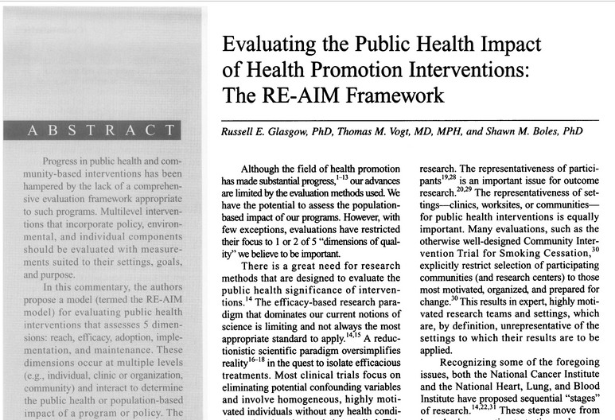
Frameworks, just like everything else, evolve.

Slide 7

Pair & Share
UNEXPECTED EVOLUTION IN YOUR CONTEXT
Share with a neighbor (or group of neighbors) one unexpected way the context in which you are working has evolved since you started your project

Slide 8
Participants will gain an appreciation of how the dynamic nature of context and fit influences all aspects of C-S-M-O relationships.
Participants will apply intervention and strategy mapping processes and new tools to delineate primary C-S-M-O relationships.
Participants will be able to specify iterative approaches to address dynamic change across C-S-M-O relationships during the phases of project (a) planning, (b) implementation, and (c) sustainment using the PRISM framework.
OBJECTIVES:
NORTH STAR
Our Goals

Slide 9
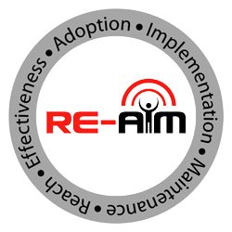

RE-AIM and PRISM guide users to plan, implement, evaluate, and sustain programs with contextual factors in mind, increasing equity and public health relevance
REAL WORLD IMPACTS
re-aim.org
prismtool.org

Slide 10
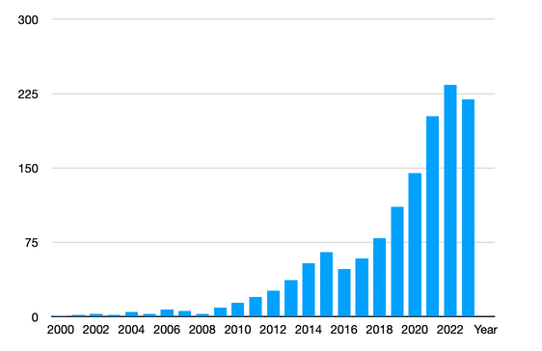
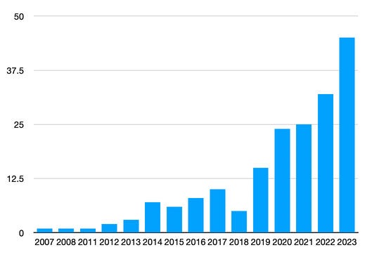
RE-AIM and PRISM are an integrated framework developed to improve the adoption and sustainable implementation of evidence-based interventions in a wide range of health, public health, educational, community, and other settings.
Number of RE-AIM Publications Over Time
Number of PRISM Publications Over Time

Slide 11
A Brief Introduction to Mapping
Context, Strategy, Mechanism, and Outcome Relationships
Setting
Infrastructure
Decision Makers
Implementors
Beneficiaries
Reach
Effectiveness
Maintenance
Adoption
Implementation
Sustainment
Institutionalization
Policy Development

Slide 12

Dissemination & Implementation Science (DIS)
The scientific study of the strategies and mechanisms by which scientific evidence is disseminated and implemented in community or clinical settings to improve outcomes for a specified population.
Estabrooks, 2023; Estabrooks, Brownson, Pronk, 2018; Brownson et al., 2015

Slide 13
What is DIS all about?
Understanding the context related to evidence-based intervention (EBI) dissemination, implementation, and sustainment.
Designing strategies to improve EBI dissemination, implementation, and sustainment that fit within a given context.
Using conceptual models or theories to map strategies to underlying mechanisms of organizational and individual change.
Documenting the relationship between strategies, mechanisms, and outcomes to produce generalizable knowledge.

Slide 14
  Context

Slide 15
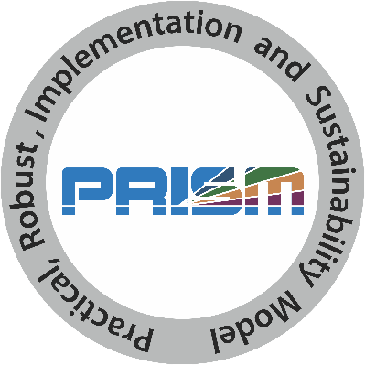

Slide 16
  Strategies

Slide 17
Dissemination & implementation Strategies
  Train and educate
  Interactive facilitation
  Evaluate and iterate
  Adapt and tailor EBI to context
  Infrastructure changes
  Financial incentives
  Develop stakeholder interrelationships
  Engage consumers
Advance Health Equity?
Powell et al 2015; Balis, Houghtaling, Harden, 2022
Notes:
Start with the end in mind

Slide 18
  Mechanisms

Slide 20

Multi-leveled System
External Environment
Community
Culture
Management Support
Leadership
Incentives
Communication structure
Job Descriptions
Performance Data
Infrastructure
Decision Support
Shared Goals & Cooperation
Sustainability Planning
Facilitation Processes
Adaptability
Expectation for Sustainability
Decision Makers
Implementors
Competing Demands
Characteristics
Capacity
Beneficiaries
Beliefs
Knowledge
Beneficiaries
Reach
Effectiveness
Maintenance
Implementers
Adoption
Implementation
Sustainment
Decision Makers
Institutionalization
Policy Development
Estabrooks, 2023; Feldstein & Glasgow, 2008

Slide 21
Multi-leveled Systems
External Environment
ACROSS LEVELS PERCEPTIONS OF THE EBI CONTRIBUTE TO CEDI OUTCOMES
Community
Infrastructure
Compatibility
Decision Makers
Relative Advantage
Implementors
Complexity
Beneficiaries
Observability
Reach
Effectiveness
Maintenance
Trialability
Adoption
Implementation
Sustainment
Robustness
Institutionalization
Policy Development
Estabrooks, 2023; Feldstein & Glasgow, 2008

Slide 22
  Outcomes

Slide 23
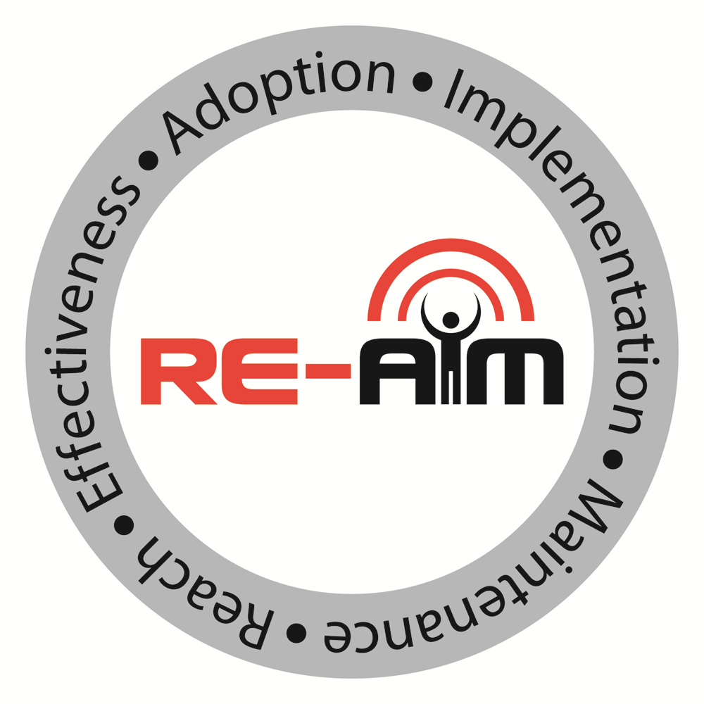
Dissemination & implementation Outcomes
  Acceptability
  Adaptation
  Adoption
  Appropriateness
  Costs
  Feasibility
  Fidelity
  Penetration
  Sustainability
Glasgow et al, 1999; Proctor et al, 2011; Reilly et al, 2020
Notes:
Start with the end in mind

Slide 24
D&I Outcomes To Advance Health Equity
  Differential
    Reach
    Effectiveness
    Adoption
    Implementation
    Maintenance
    Representativeness
  Adaptation
    Cultural
    Contextual
Glasgow et al, 1999; Proctor et al, 2011; Reilly et al, 2020
Notes:
Start with the end in mind

Slide 25
  Mapping the CoSMOs!

Slide 26

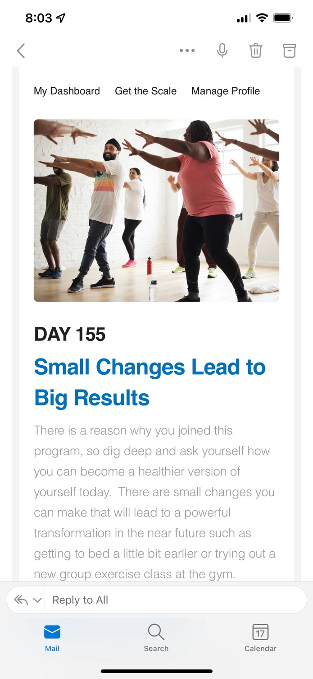
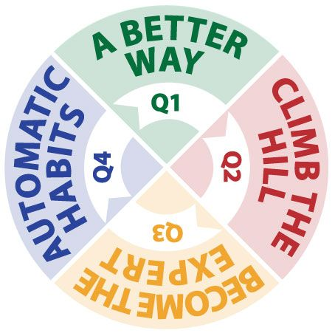
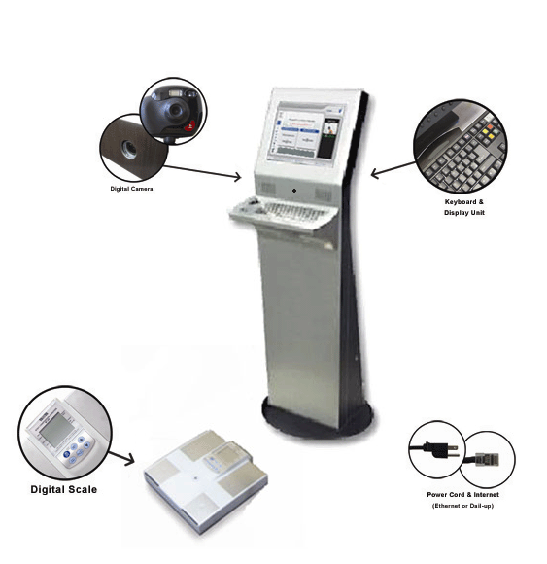

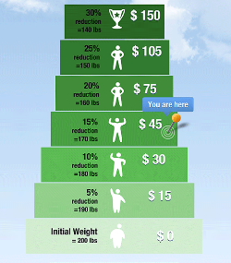

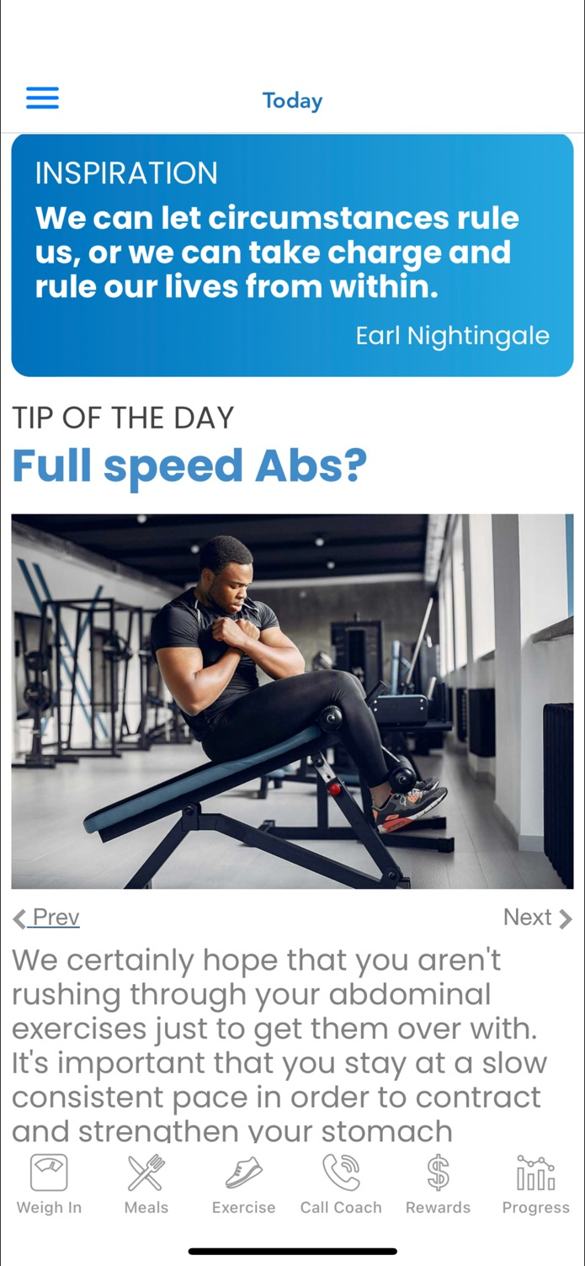
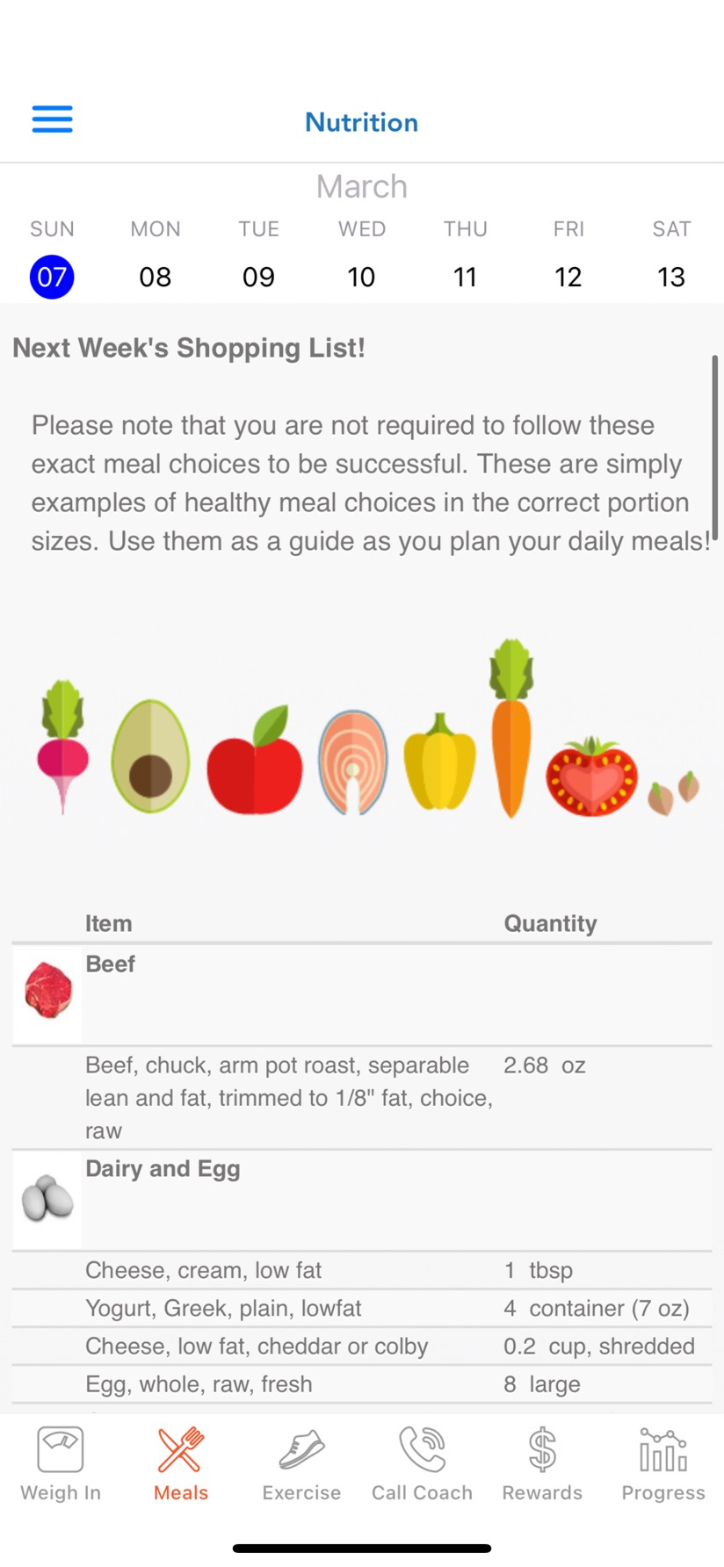
Multi-Leveled Strategies Applied to a Worksite Weight Loss EBI
Patent Pending
External Support and Set Up
HealthSpot
Weigh Station
Financial Incentives
for weight loss
EBI
Almeida et al., 2015; Estabrooks et al., 2016
Notes:
26

Slide 27
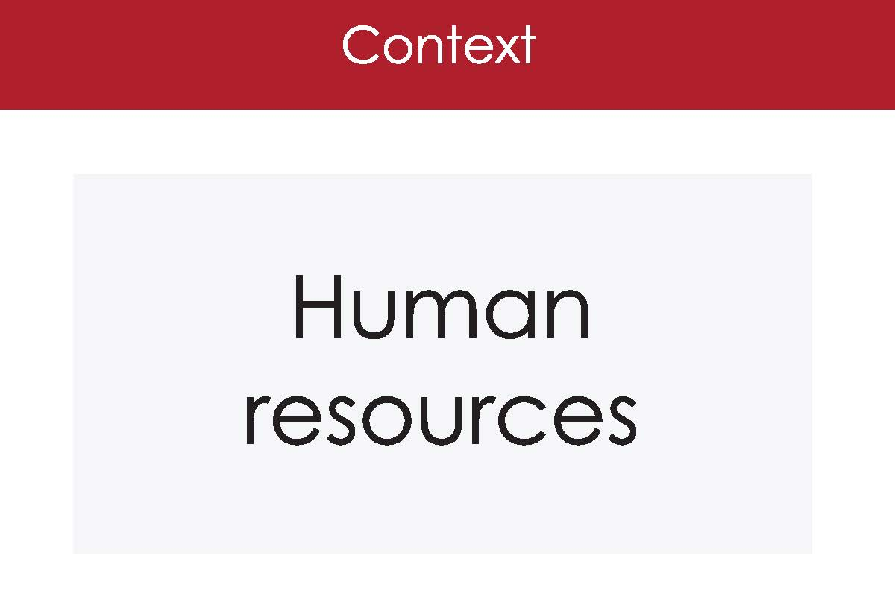
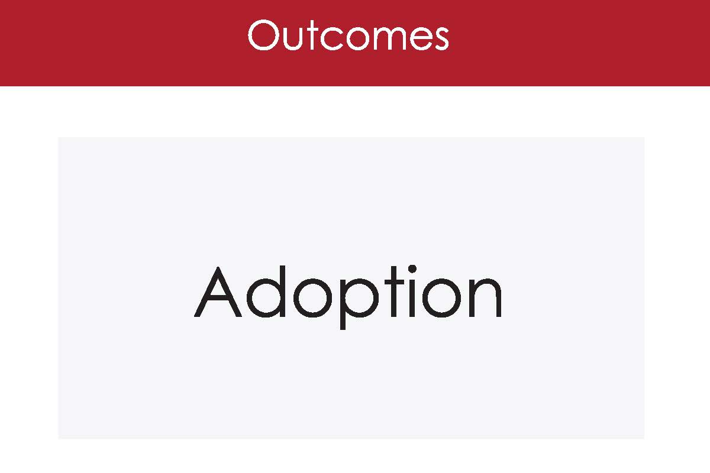
Evidence-Based Intervention
Almeida et al., 2015; Estabrooks et al., 2016
Notes:
27
Both this and next example are good….
May only have time for one…. THAT COULD BE USED THRUGHOUT AS THE STANDARD/DEFAULT EXAMPLE?

Slide 28
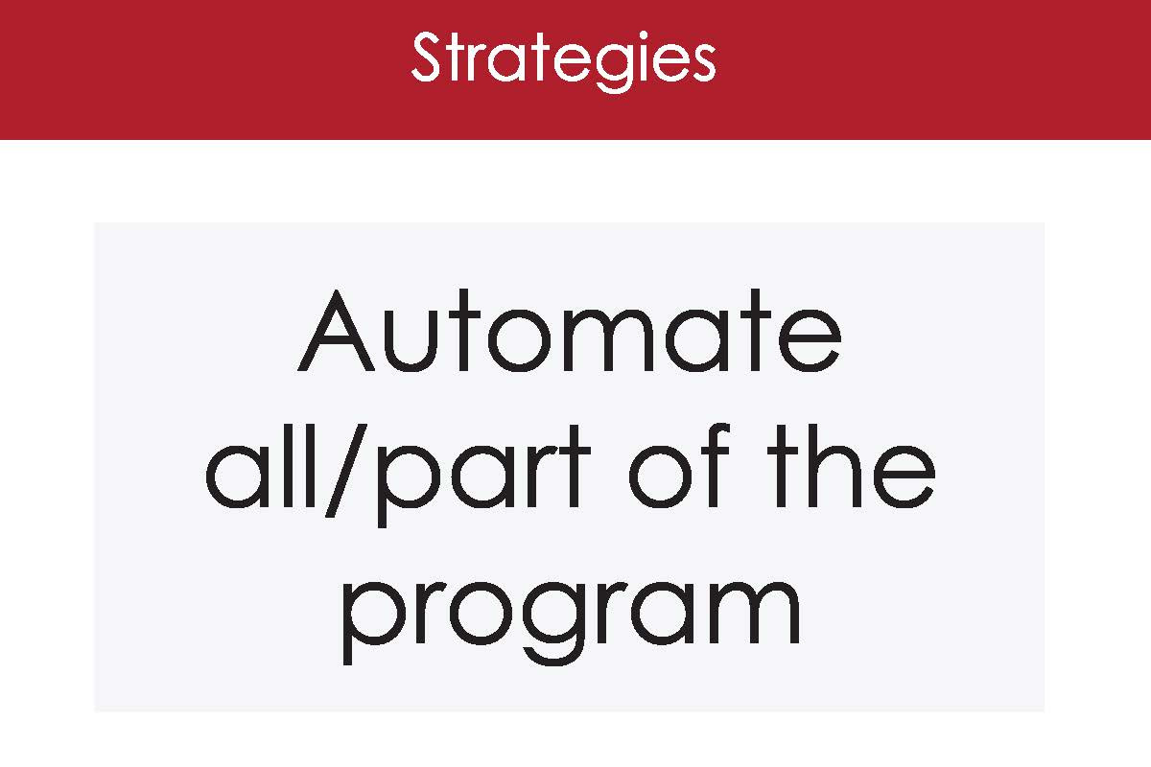
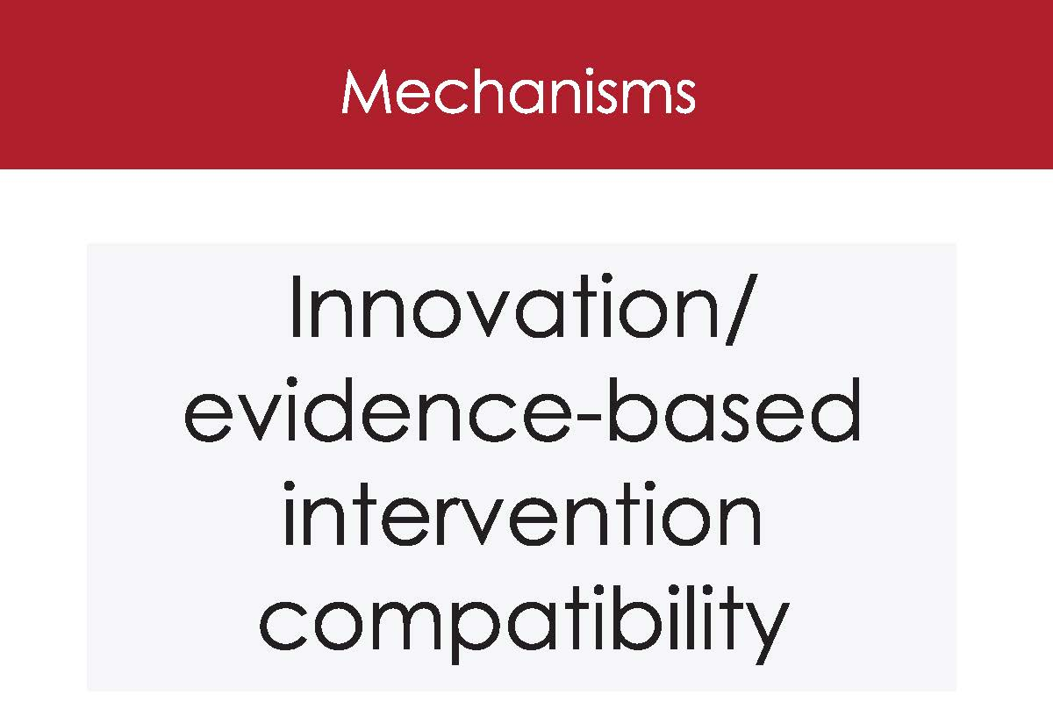
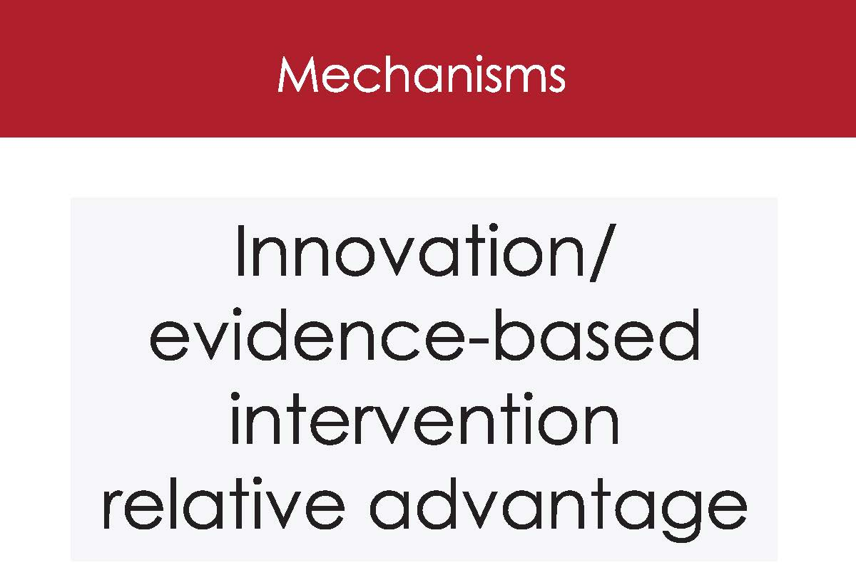
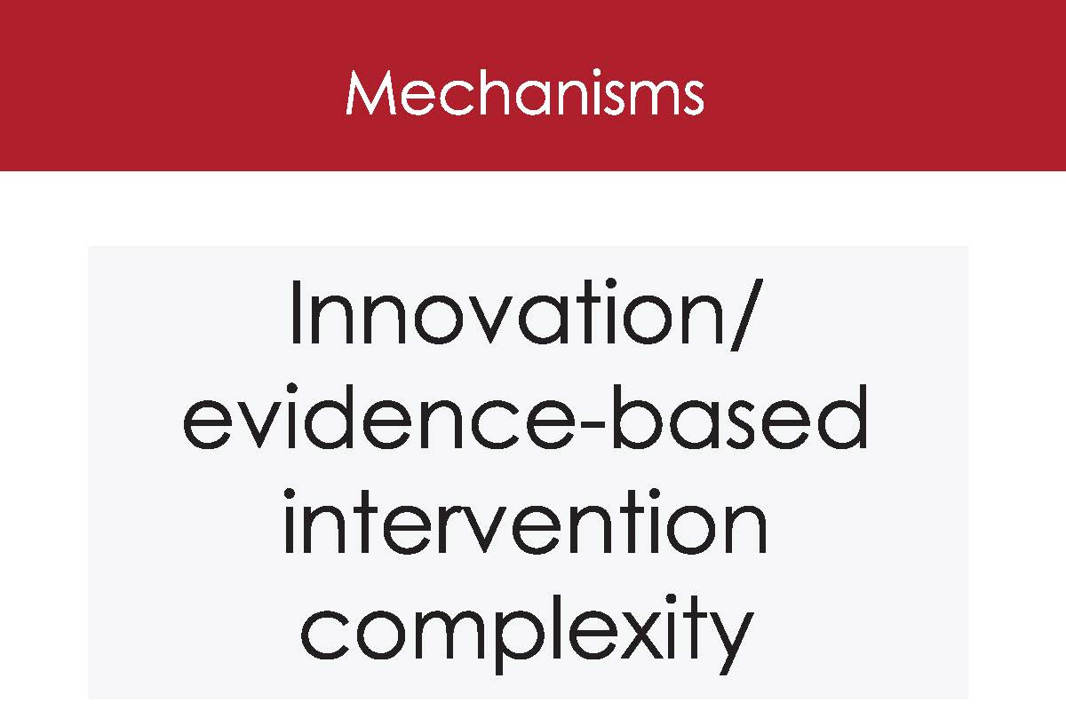
Evidence-Based Intervention
Almeida et al., 2015; Estabrooks et al., 2016
Notes:
28
Both this and next example are good….
May only have time for one…. THAT COULD BE USED THRUGHOUT AS THE STANDARD/DEFAULT EXAMPLE?

Slide 29
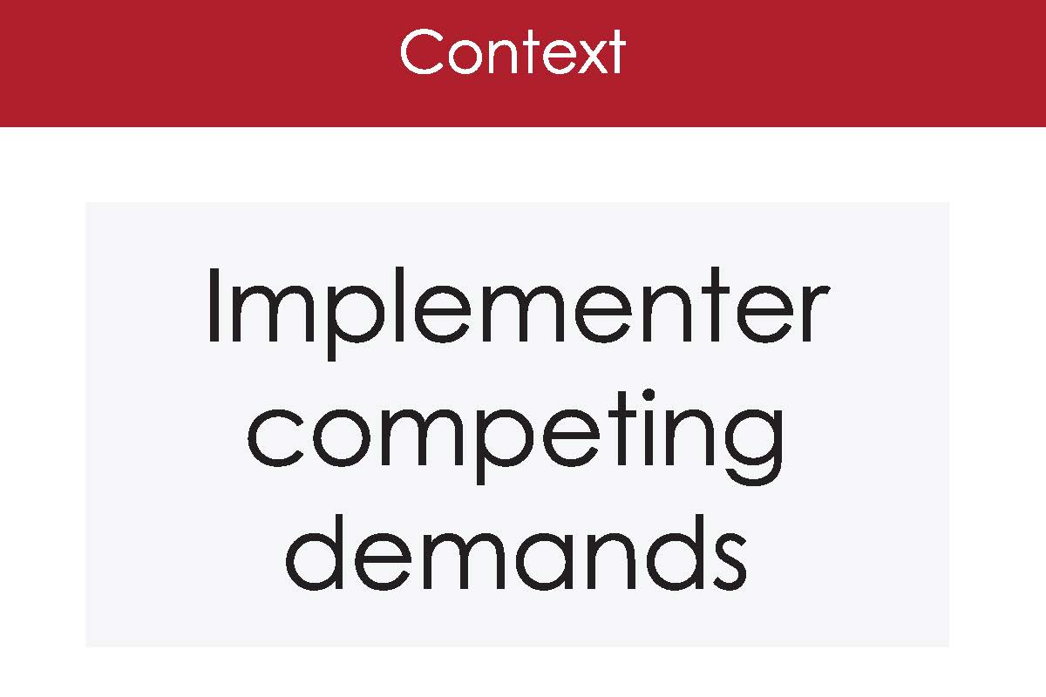
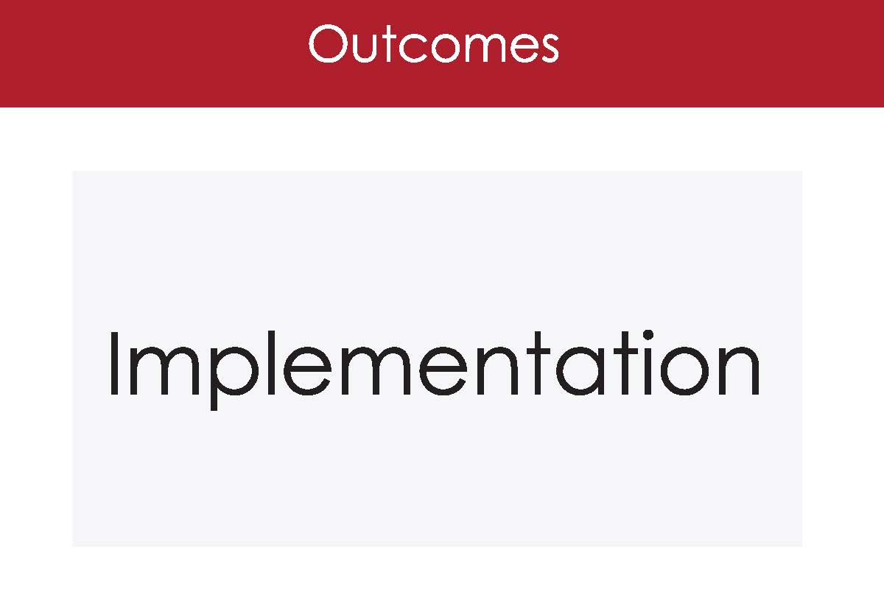
Evidence-Based Intervention
Almeida et al., 2015; Estabrooks et al., 2016
Notes:
29
Both this and next example are good….
May only have time for one…. THAT COULD BE USED THRUGHOUT AS THE STANDARD/DEFAULT EXAMPLE?

Slide 30
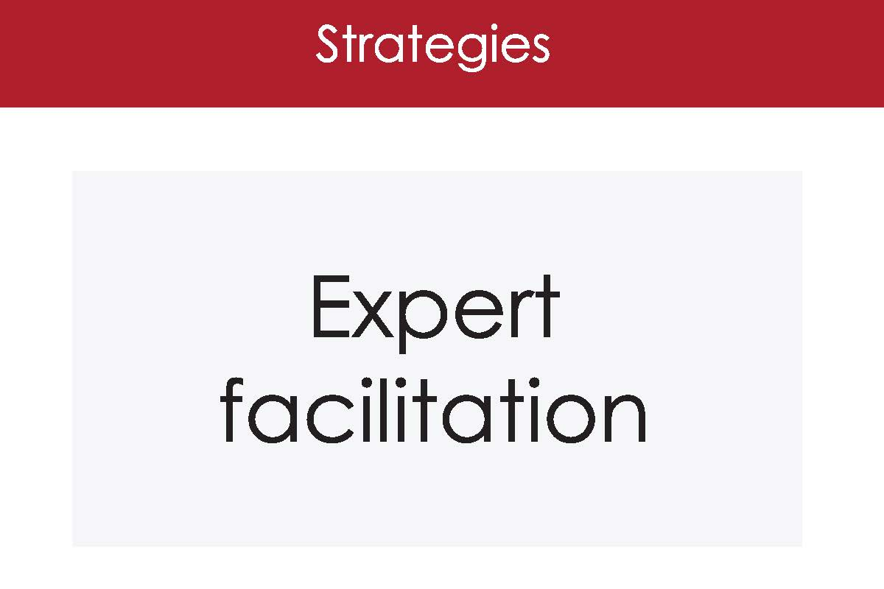
Evidence-Based Intervention
Almeida et al., 2015; Estabrooks et al., 2016
Notes:
30
Both this and next example are good….
May only have time for one…. THAT COULD BE USED THRUGHOUT AS THE STANDARD/DEFAULT EXAMPLE?

Slide 31
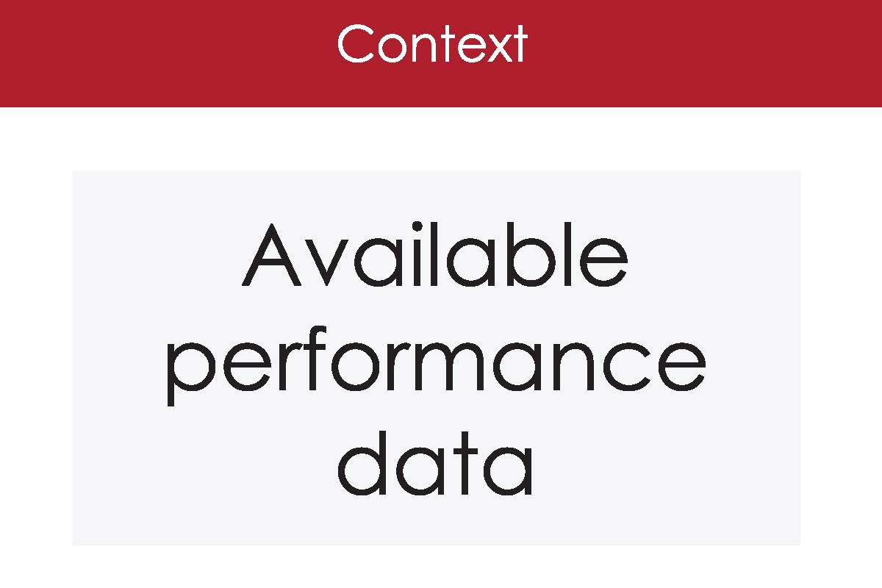
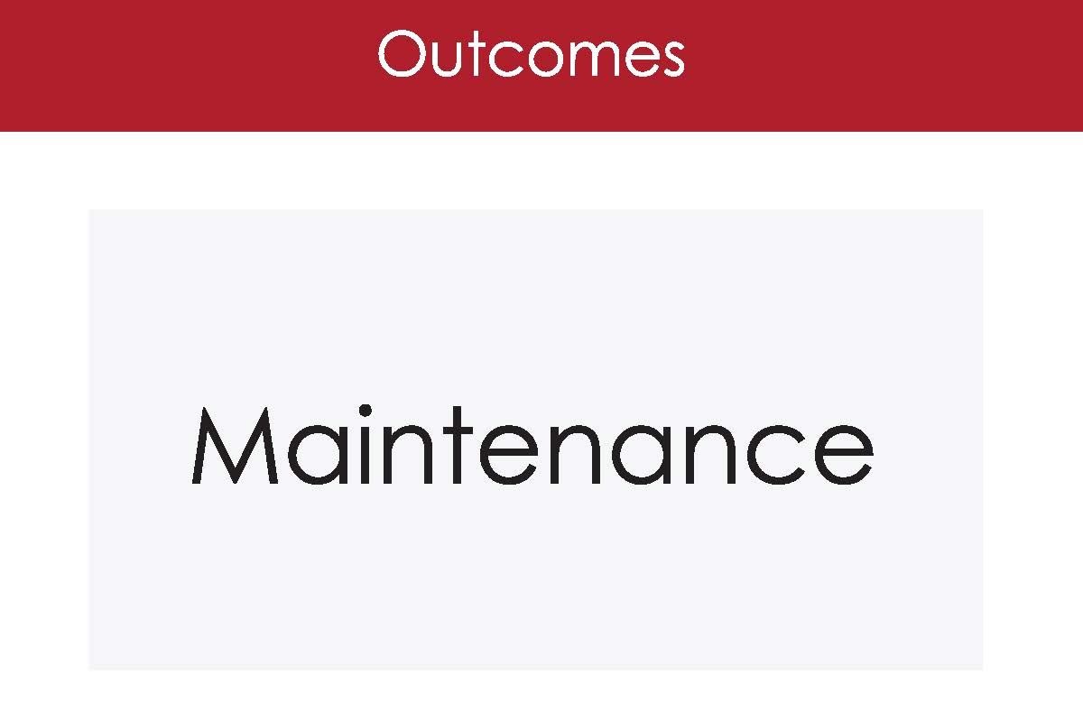
Evidence-Based Intervention
Almeida et al., 2015; Estabrooks et al., 2016
Notes:
31
Both this and next example are good….
May only have time for one…. THAT COULD BE USED THRUGHOUT AS THE STANDARD/DEFAULT EXAMPLE?

Slide 32
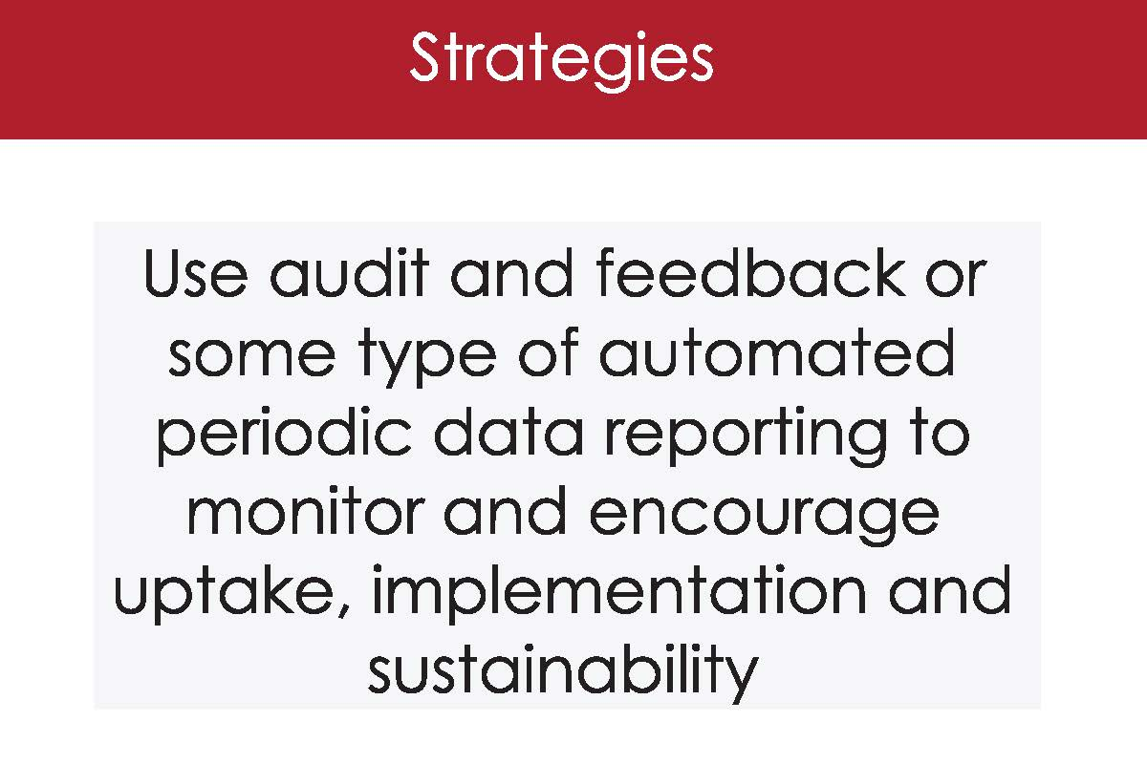
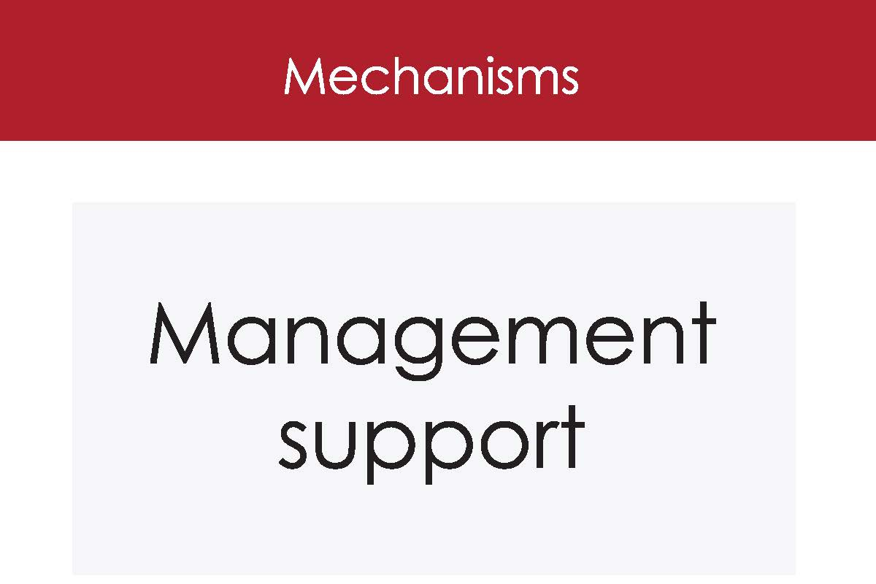
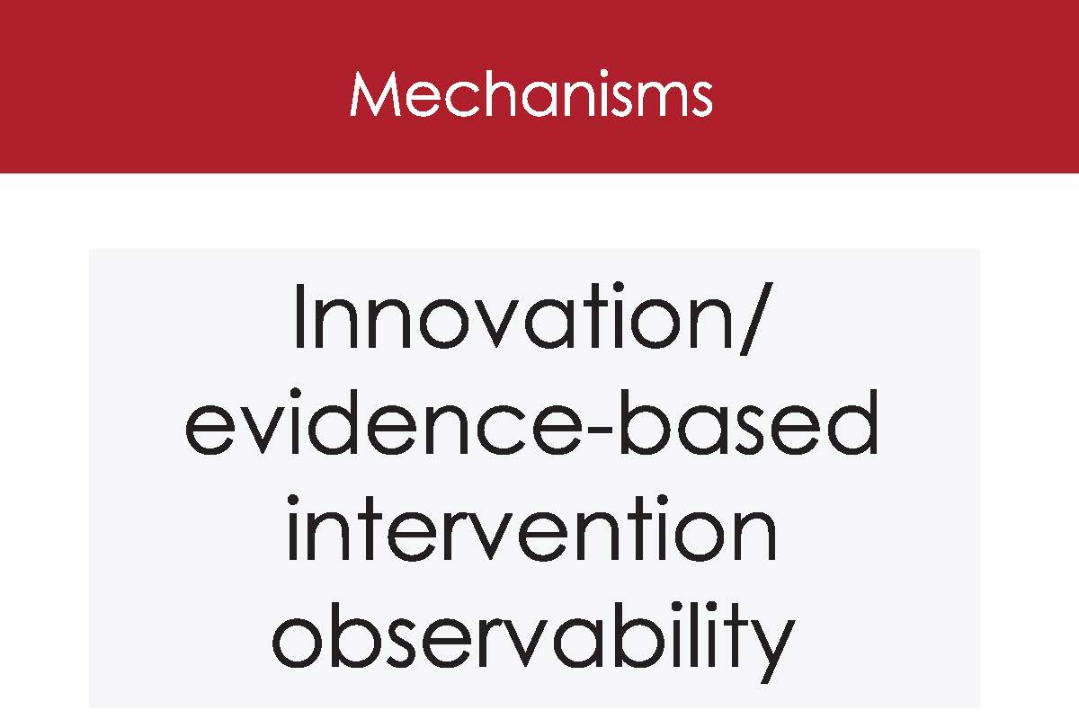
Evidence-Based Intervention
Almeida et al., 2015; Estabrooks et al., 2016
Notes:
32
Both this and next example are good….
May only have time for one…. THAT COULD BE USED THRUGHOUT AS THE STANDARD/DEFAULT EXAMPLE?

Slide 33
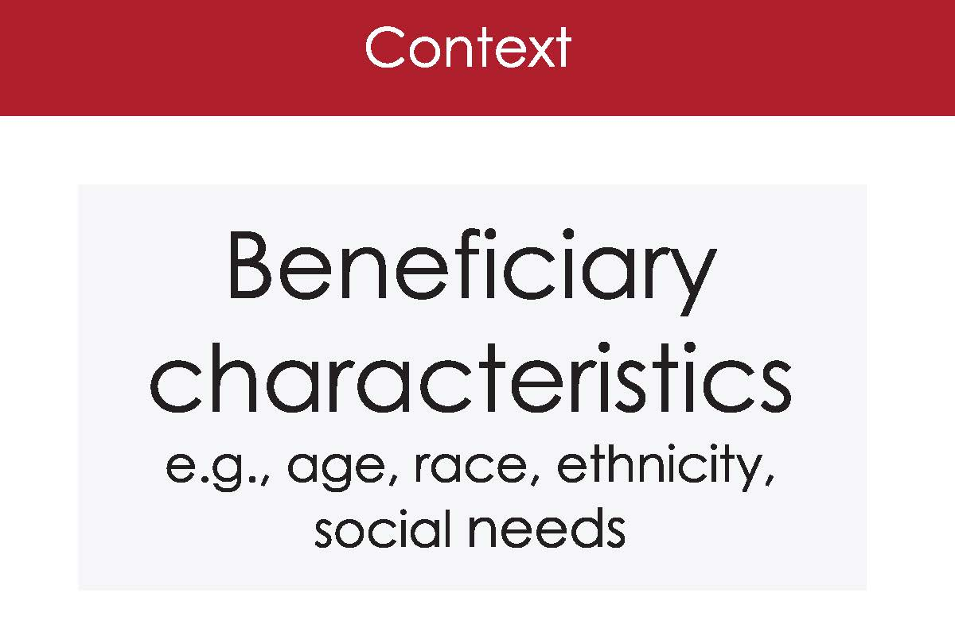
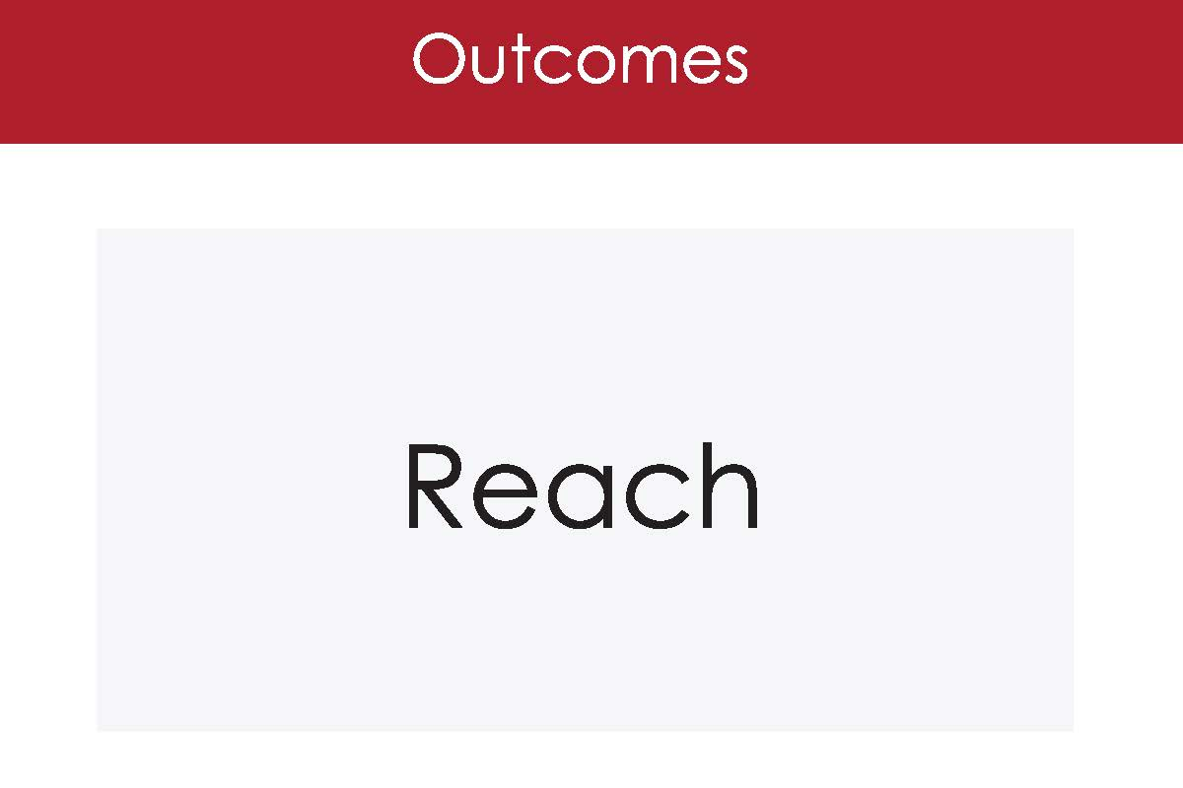
Evidence-Based Intervention
Almeida et al., 2015; Estabrooks et al., 2016
Notes:
33
Both this and next example are good….
May only have time for one…. THAT COULD BE USED THRUGHOUT AS THE STANDARD/DEFAULT EXAMPLE?

Slide 34
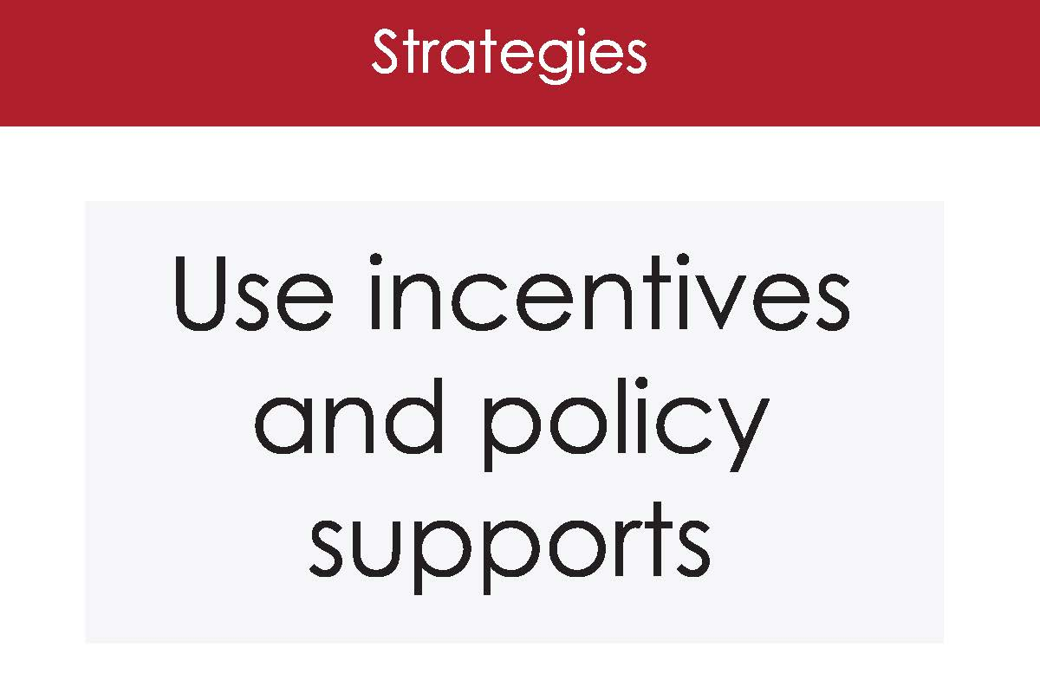
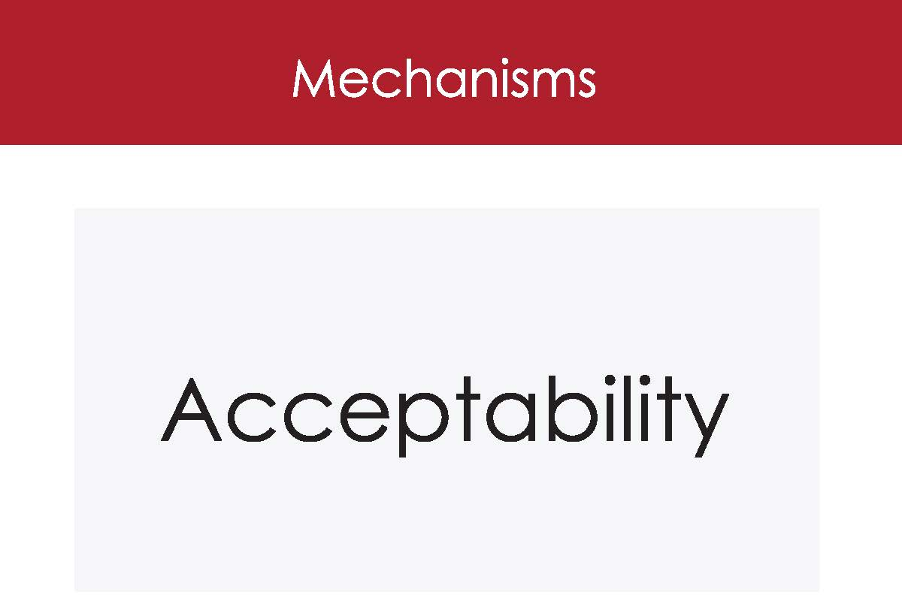
Evidence-Based Intervention
Almeida et al., 2015; Estabrooks et al., 2016
Notes:
34
Both this and next example are good….
May only have time for one…. THAT COULD BE USED THRUGHOUT AS THE STANDARD/DEFAULT EXAMPLE?

Slide 35
  Mapping & Logic Models

Slide 36
Figure 1. Building Health Families Implementation Research Logic Model
Determinants
Implementation Strategies
Mechanisms
Outcomes
-No childhood obesity interventions in rural/micropolitan areas
-Few evidence-based approaches designed for rural implementation
+ existing adaptation of for rural/micropolitan areas
+evidence of adaptation success
+Turn-key program package
Fund & Contract (A)
Identify communities with strong partnerships across organizations and a priority to address childhood obesity.
↑ incentive for adoption (A)
Identify communities ready for implementation (A,D)
↑ mandate for adoption (A)
Adoption: (A, B, C, D, E)
Number of communities that agree to deliver BHF
Number of BHF Cohorts initiated
Innovation
↑ perceptions of the innovation (BHF); relative advantage, complexity etc. (A, B, E)
↑ recipient knowledge and self-efficacy (B, E)
Facilitation & ↑ capacity (C, D, E)
Packaged Implementation Blueprint
Building Healthy Families Online Training Resources and Program Package (B)
Referral processes (C)
Reach (BHF participants) (B,C)
Number, Proportion, Representativeness
+High rates of childhood obesity in micropolitan/rural areas
+Organizational prioritization of childhood obesity
-Limited external contextual drivers (lack of incentives; coverage)
Context
Implementation (A-E)
BHF fidelity (competence X adherence)
Cost
Action Learning Collaborative
Network weaving (D)
Consultee-centered training (E)
Sustainability action planning (F)
↑ Facilitation processes (D,E,F)
↑ Collaboration and team-work (D)
↑ systems-engagement (D, E, F)
↑receptivity to change (D, E)
Sustained changes in context, innovation perceptions, facilitation, and recipient capacity (F)
-Difficult to identify implementation team with multi-disciplinary expertise within a
single rural organization or community.
-Need for high levels of collaboration across community systems to support recruitment and implementation.
Maintenance (BHF Program) (F):
Number of communities offer 3rd Cohort
Cost
Recipients
Evidence-Based Intervention
Building Health Families Program (BHF): A adaptation of Epstein’s Traffic Light Diet for delivery in rural settings.
12 weekly, 90 minutes sessions for families; 4 Relapse prevention refresher sessions; Follow-up at 3, 6, 12 months
Core content includes physical activity, nutrition, and behavioral strategies for families.
Mechanisms
Effectiveness
Reduced BMI z-score at 3 & 6 months
Parent weight loss at 3 & 6 months
Maintenance of effect:
BMI z-score at 12 months
Parent weight loss maintenance at 12 months
-Lack of local brokers
to support collaboration across systems
-Few opportunities for cross community partnerships or shared learning
-Lack of local process to support adoption, implementation, and sustainability.
+CAB BHF
Attendance
↑ Physical activity
↑ Healthful eating
Goal Attainment
↑ Self-Regulation
Facilitation
Note: Implementation strategies are labeled alphabetically. Matching letters in Mechanisms and Outcomes columns demonstrate hypothesized pathways of strategy effects.
Notes:
Slide 4 is for publication.
Notes for CG and GP—1) review the figure to ensure the language aligns with the paper text and CDC supplement approved language. 2) fix font for consistency (currently some boxes are arial and some Calibri)

Slide 37
Primary Implementation Barriers |  | Implementation Strategies to Address Barriers |  | Mechanisms |  | Outcomes
No Sustainable Process to Identify and Enroll Eligible Families for Participation |  | Population Health Management with Automated Patient Text Message Outreach |  | ↑ Family Awareness of BHF ↑ Systems integration ↑ Ease of enrollment |  | ↑Reach (BHF participants) Number, Proportion, Representativeness of Low-Income Families in Rural and Micropolitan Communities
 |  |  |  | ↑ Clinical community coordination ↑ Ease of enrollment
 |  | Community Implementation Team Proactive Follow-Up
 |  |  |  | ↑ Family motivation to enroll
 |  | Repeated Opportunities for Enrollment
Lack of Availability of FHWP Materials to Support Implementation |  | Building Healthy Families Online Training Resource and Program Package |  | ↑ perceptions of the innovation ↑ recipient (community implementation team) access to resources |  | ↑ Adoption 4-8 communities that agree to, and begin, delivery of BHF
 |  | Building Healthy Families Program Kit
Variability of Potential BHF Implementation Team Expertise that could Reduce Program Effectiveness |  | Building Healthy Families Online Training Resource and Program Package |  | ↑ Implementation team capacity ↑ Implementation knowledge ↑ Implementation self-efficacy ↑ perceptions of the innovation |  | ↑ Implementation BHF fidelity and implementation quality |  | ↑ Effectiveness & Maintenance of Effects Reduced Weight Status for Family Members with Obesity
Difficulty In Convening Community Implementation Teams For Initial Training And Ongoing Support |  | Building Healthy Families Action Learning Collaborative |  | ↑ Facilitation processes ↑ Collaboration and team-work ↑ systems-engagement ↑receptivity to change Sustained ↑ in context, innovation perceptions, facilitation, and recipient capacity |  | ↑ Maintenance Sustained delivery into a second year of cohorts
An overview of the Building Healthy Families (BHF) implementation barrier, strategy, mechanism, & outcome pathway using iPARIHS contextual factors & RE-AIM Outcomes

Slide 38
What to Watch for as the session progresses
  How best to characterize context.
  Look for C-S-M-O relationships.
  Don’t be constrained by simplicity but look for the most practical in your project and ideas.
  Watch for strategies that are based on project temporality—planning, adopting, implementing, sustaining and consider how C-S-M-O relationships may change based on project phase.
  Consider overlaps and try and reconcile them (e.g., when is an incentive structure a contextual factor vs an implementation strategy?)
Notes:
Start with the end in mind

Slide 39



Everything you wanted to know about PRISM/RE-AIM Russell E. Glasgow, PhD

Slide 40
(General overview to set stage for exercises and personalizing C-S-M-O)
- Brief remaining issues and Q&A on RE-AIM
- Newer developments on iterative RE-AIM
- PRISM Context and RE-AIM outcomes
- Health equity implications
RE-AIM to PRISM: the critical importance of context, dynamism, and adaptation

Slide 41

Evolution of RE-AIM -> PRISM: Lessons Learned
One of the most widely used frameworks.
Often recommended by funders.
Expanded the original model to focus on adaptions and sustainability.
Emphasize qualitative methods to understand “how” and “why.”
Capture costs.
Understand and address health equity issues.
Encourage pragmatic and iterative use.
Package for use by non-researchers.
Integrate with other models.
Glasgow et al. RE-AIM Planning and Evaluation Framework: Adapting to New Science and Practice with a 20-Year Review. Front Public Health. 2019;7:64.

Slide 42
Why Should You Cost Your Implementation?
C-S-M-O
Often the first and key question potential adopting settings will ask
Decision-makers want to know what it will cost them to implement
Is itself a key outcome- both Proctor et al. and RE-AIM outcomes
Cost is a key determinant of adoption, implementation (success and adaptations, sustainment and dissemination
Increasingly required in proposals
More and more costing guidance, resources, and examples
  - visit our exhibit or go to https://tinyurl.com/ISCosting
Pragmatic Research
Eisman, A. et al. (2021) 16:75 https://doi.org/10.1186/s13012-021-01143-x

Slide 43
Adaptations Happen
(and can be bad or good, even necessary)
C-S-M-O
Evaluating complex interventions: Confronting and guiding
(vs. ignoring and suppressing) heterogeneity and adaptation
Brian S. Mittman, PhD Oct. 2018
Department of Research and Evaluation, Kaiser Permanente Southern California
**Also see PCORI Methods Guidance; and ADAPT Guidance (Moore et al. BMJ 2021;374:n1679)

Slide 44
Types of Adaptations – Cultural; Resources; AND Local:
ALL WITH AND DRIVEN BY MULTI-LEVEL PARTNERS
C-S-M-O
Focus of Adaptation | Timing of Adaptation (point in the project)
 | Planning | During | Sustainment- Dissemination
Intervention
Implementation Strategy
Setting
RE-AIM and PRISM can help guide adaptations
Rabin BA, et al. Systematic, multimethod assessment of adaptations across four diverse health systems interventions. Front Public Health. 2018;6(APR). https:// doi. org/ 10. 3389/ FPUBH. 2018. 00102.
Notes:
Russ

Slide 45
Acknowledging and Addressing Dynamism

Slide 46


The Need for Speed: Rationale for Iterative RE-AIM
C-S-M-O
D&I frameworks including RE-AIM are often cited
  But frequently NOT used throughout a project lifecycle
  Almost always for planning or evaluation
RE-AIM has been used most for evaluation, but also successfully for planning
RE-AIM (or PRISM) and most other D&I models have very infrequently been systematically used iteratively to guide adaptations at key points
A major limitation to D&I models and methods is that they are much slower than needed by partners to be relevant to learning health systems
Glasgow, RE .... & Rabin B. Making implementation science more rapid. (2020) Frontiers Public Health. 8: 194

Slide 47
Goals of Iterative RE-AIM Studies
C-S-M-O
To develop a pragmatic, replicable iterative RE-AIM implementation strategy bundle to inform mid-course corrections
To use this audit and feedback implementation strategy bundle based on RE-AIM to help implementation teams guide adaptations
To provide a conceptual and data-based process to help implementation teams reflect upon progress, set priorities, and develop action plans
To test this process across 5 different VA health services research projects (on pain, care transitions, cardiac care, rural health)
Glasgow, RE .... & Rabin B. Making implementation science more rapid. (2020) Frontiers Public Health. 8: 194

Slide 48
How do you use iterative RE-AIM?
C-S-M-O
Identify and decide upon your team, the Iterative RE-AIM process leader, and the project goals and outcomes
1
Score your project with your team on the importance and progress on each RE-AIM dimension at that point in time
2
Review and discuss scores and identify 1-2 areas for which to prioritize adaptations with specific action plans
3
Evaluate progress and repeat as needed
4

Slide 49
RE-AIM Assessment Rating Form
C-S-M-O
Please rate each question below regarding the importance of and the need to enhance each RE-AIM dimension in your project. Use your best estimate to provide a 1-5 rating for each item even if you are not sure or do not feel you have quite enough information.
REACH (to eligible Veterans)
How Important is Reach to this project, at this time? | How satisfied are you with Progress to date on Reach?
1 = not important | 1 = not satisfied
2=somewhat important | 2=somewhat satisfied
3= important | 3= satisfied
4=moderately important | 4=moderately satisfied
5 = extremely important | 5 = extremely satisfied
Comments:

Slide 50










Sample “Gap” Analysis
C-S-M-O
Importance
Progress
Patient Reported Health Status Assessment Project
6.00
5.00
4.00
3.00
2.00
1.00
4.50
2.50
3.83 2.67
EFFECTIVENESS
4.50 3.17
ADOPTION
3.20 3.40
IMPLEMENTATION
3.33
2.83
0.00
REACH
MAINTENANCE

Slide 51
Iterative RE-AIM: Key Findings, Challenges,
Next Steps
Key Findings
Feasible and applicable across different projects, content areas and teams
Challenges
Limited by frequency and quality of data
Next Steps
This works to promote team discussion, reflection and action planning
Use real-time EHR data and biweekly meetings for rapid iterations
Finding a way to integrate PRISM context issues
Develop a webtool version (using all of PRISM)
Identifying the number of iterative sessions and level of facilitation needed
Glasgow, RE Battaglia C et al. Front Health Serv. 2022;2:959565. doi:10.3389/frhs.2022.959565

Slide 52
Everything You Wanted to Know about RE-AIM …..but Were Afraid to Ask

Slide 53

Overview of PRISM
C-S-M-O
Context is Everything
Context is multi-level and dynamic - not just places, but also history and relationships (trust, etc.)
Addressed through PRISM extension of RE-AIM Outcomes: “RE-AIM in context”
Nilsen P, Bernhardsson S. Context matters in implementation science: BMC Health Serv Res. 2019;19(1):189.
Shelton, RC et al. An extension of RE-AIM….Front Public Health 2020 8:134
Chambers, D et al. The dynamic sustainability framework. Implement Sci. (2013) 8:117.

Slide 54
What is PRISM?
C-S-M-O
Practical, Robust Implementation and Sustainability Model
Contextually expanded RE-AIM
Has been used as a:
  Determinant framework
  Process framework
  Implementation framework
  Evaluation framework
Includes constructs that can be applied to:
  Context
  Strategies
  Mechanisms of change
  Outcomes

Slide 55
Feldstein AC, Glasgow RE. A practical, robust implementation and sustainability model (PRISM) for integrating research findings into practice. Jt Comm J Qual Patient Saf. 2008 Apr;34(4):228-43.
PRISM CONTEXTUAL DOMAINS
RE-AIM
OUTCOMES
Notes:
I’d cut this one.

Slide 56
REPEAT AFTER ME……….
PRISM contains RE-AIM (they are not different or competing frameworks)
PRISM contains RE-AIM (is the contextually expanded RE-AIM)
PRISM Includes RE-AIM
Notes:
Haha, this made me laugh, but I think you could cut it and previous slide and go right from 13 to 16

Slide 57
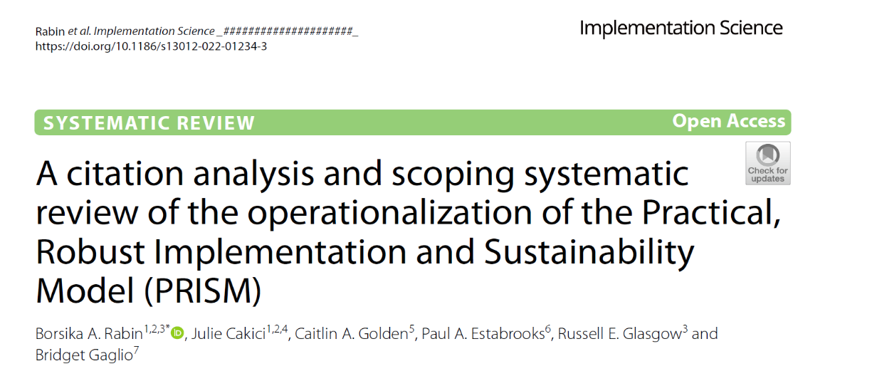
Original PRISM reference: Feldstein, AC, & Glasgow, RE. PRISM for integrating research findings into practice.
Jt Comm J Qual Patient Saf. (2008) 34:228–43. doi: 10.1016/S1553-7250(08)34030-6

Slide 58
Key Findings
PRISM has been primarily used in outpatient clinical settings and in the US
It has been used to study a variety of issues and conditions using a wide range of experimental designs and often using mixed methods
Most studies have reported on half or more of the PRISM domains and over half of the studies reported on at least 5 of the 6 domains
  Most frequently assessed were Organizational perspectives on the Program/Intervention, and Implementation and Sustainability Infrastructure
PRISM contextual components were most frequently operationalized using qualitative methods
Implementation and Maintenance were most reported RE-AIM outcomes
Notes:
Borsika

Slide 59
Rabin et al (2022): Selected recommendations for research and practice
﻿﻿﻿Report on how PRISM is used with different types of implementation partners, in multi-sector research, in low-resource settings and global health
﻿﻿﻿Revise PRISM terminology to make it more user-friendly and relevant to the context of the implementation practice - for example changing terms such as
'patients' or 'recipients.
﻿﻿﻿Flexible, pragmatic use of PRISM domains, outcomes and stages of research
﻿﻿﻿Develop and validate quantitative pragmatic measures of PRISM constructs
﻿﻿﻿Develop and conduct usability evaluations of interactive PRISM tools and resources
Rabin et al Citation review of PRISM literature. Implement Sci. 2022;17(1):62.

Slide 60
How Can PRISM (and other D&I Science Frameworks) Help Address Health Equity?
Broaden Focus on All Steps and Outcomes Necessary for Population and Equity Impact
Focus Attention on Issues of Representation and Representativeness*
Address Systems Issues and Unintended Consequences
Understand Context and Guide Tailoring and Adaptation to Context* and Population
Methods and tools: Integrate with other frameworks including those on equity

Slide 61
PRISM figure (newly imagined)
C-S-M-O
PRISM Contextual Factors
Multi-level/Multi-sector
Perspectives on Intervention
External Environment – (Structural Drivers of Equity)
Multi-level Partner Characteristics
Implementation and Sustainability Infrastructure
Intervention, Program or Policy
Implementation Strategies
RE-AIM Outcomes
Reach
Effectiveness
Adoption
Implementation
Maintenance

Slide 62
How PRISM (and RE-AIM Outcomes) Address Equity Issues
PRISM Contextual Factors
Multi-level/Multi-sector
Perspectives on Intervention
External Environment – Drivers of Equity
Many Perspectives Represented (Mechanisms)
Address Context
Implementation and Sustainability Infrastructure
Multi-level Partner Characteristics
Fit and Co-creation
Intervention, Program or Policy
Planning to ensure equity is addressed
Implementation Strategies
Interactions among outcomes
RE-AIM Outcomes
Equity/ Representativeness across outcomes
Reach
Effectiveness
Adaptation
Adoption
Implementation
Maintenance
Unintended Consequences
Cost and Feasibility
Fort MP, Manson SM and Glasgow RE (2023). Applying an equity lens… Front. Health Serv. 3:1139788. doi10.3389/frhs.2023.1139788
Notes:
Edited to bold where content and mechanisms may be (mechanisms more that perspectives, but changes in perspectives can be mechanisms). Made Strategies and Outcomes bigger font ☺

Slide 63
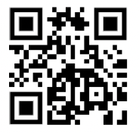
Most Recent: Iterative PRISM
(via personal facilitation or web-based tool)
To increase accessibility and use by diverse groups
Use for (choice of): Planning; guiding implementation/adaptations, or sustainment
Automated, real time data collection issues on, analysis and feedback
Over to Dr. Ory for additional attention to key RE-AIM-PRISM Resources and further C-S-M-O issues in planning
** Trinkley et al. The iPRISM webtool. Implementation Science Communications (2023) 4:116 https://doi.org/10.1186/s43058-023-00494-4
prismtool.org
Notes:
This could be transition… maybe have a slide before it to highlight Marcia’s next part of the workshop and introduce the guide here, and then also tease Katy’s iPRISM activity that will help with mapping when they get to the strategy selection—using either RE-AIM outcomes or PRISM context & mechanisms.

Slide 64
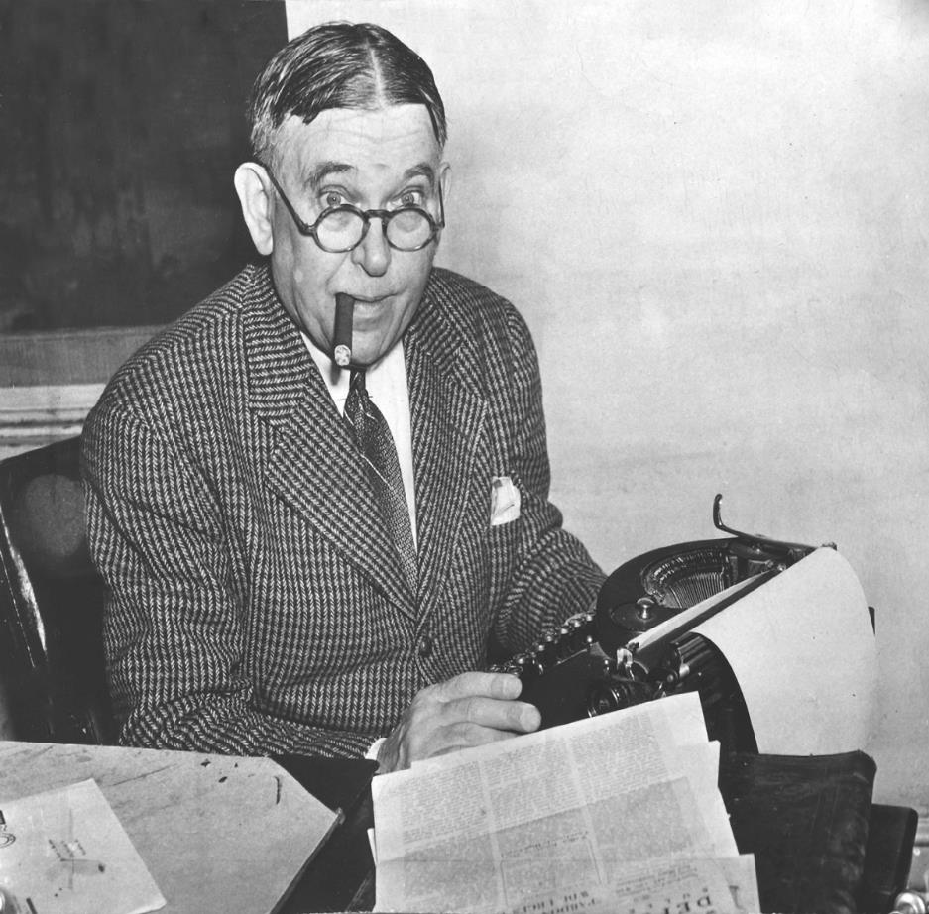
And Remember:
All Models (and Methods) Are Wrong…
Some Are Useful
“To every complex question,
there is a simple answer…
and it is wrong.”
~H. L. Mencken

Slide 65

Questions and Comments

Slide 66

A Whirlwind Tour through
Re-AIM PRISM Resources and
International Case example
16th Annual D&I Conference
December 2023
Marcia G. Ory, PhD, MPH
School of Public Health

Slide 67
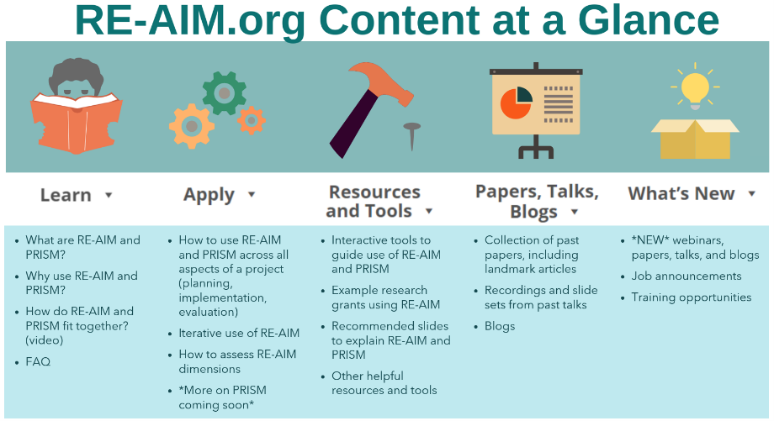

Slide 68
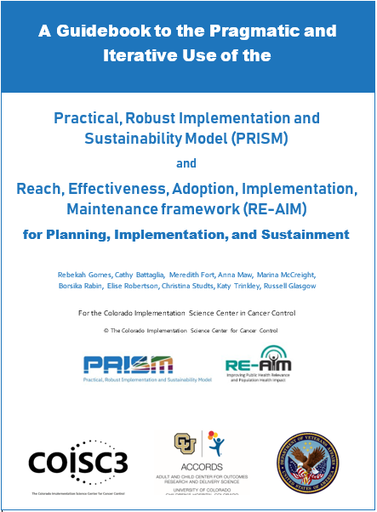
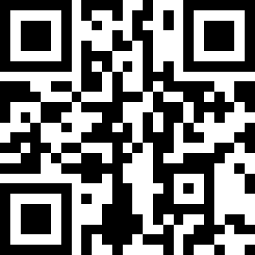
Purposes:
Briefly discuss key conceptual issues in PRISM and RE-AIM
Provide guidance, examples, and recommendations for pragmatic use of these frameworks
Provide survey items for different project phases and tables of strategies to enhance RE-AIM outcomes
https://tinyurl.com/4fmvf7kr
© COISC3 2023

Slide 69
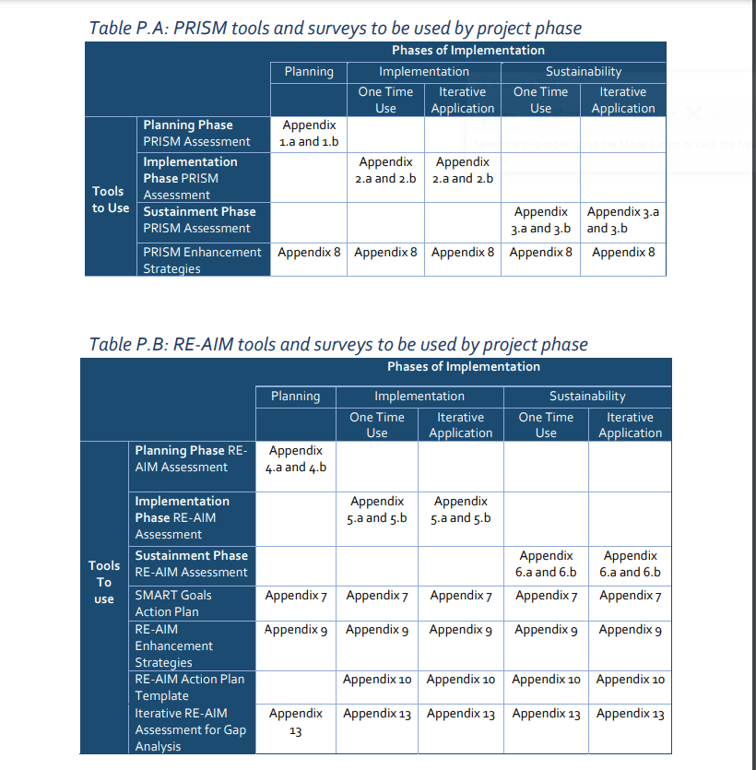
Guidebook Roadmap
Appendices reflect tools that provide a list of questions and templates for each implementation stage

Slide 70
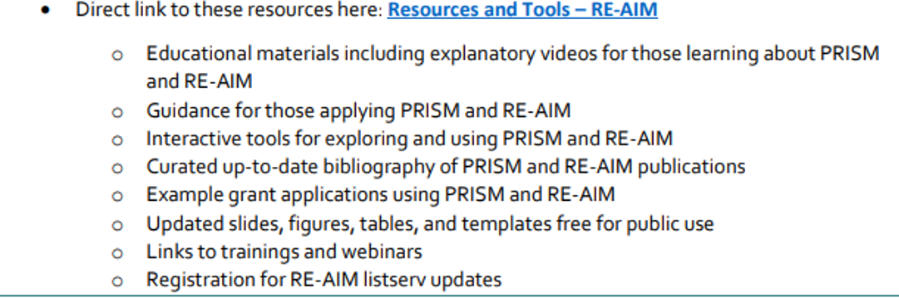
RE-AIM Resources and Tools
WWW.RE-AIM.org

Slide 71
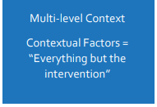
Context as Critical
Context is important for understanding, evaluating, and influencing the how, why and degree of impact a project’s implementation and the effectiveness it has on the target population
Context is often described as “everything but the intervention”
It encompasses the interdependent, multisectoral, multilevel, dynamic environment within which a project is implemented

Slide 72
Case Example:
Ukrainian Trauma Care Training Program
How to introduce D&I concepts and methods into this training activity using PRISM-REAIM framework
Fogarty International Center 5-year Grant
Work collaboratively with Ukrainian researchers and clinicians
Introduce Evidence-based Trauma Care
Select trainees representing diverse settings and clinical experiences
Design in-country, continuous online supervision and instruction, and US based intensive training
Building Research Capacity for Implementation of Outcomes Research and Evidence-Based Trauma Care after Mass Violence, in Ukraine

Slide 73
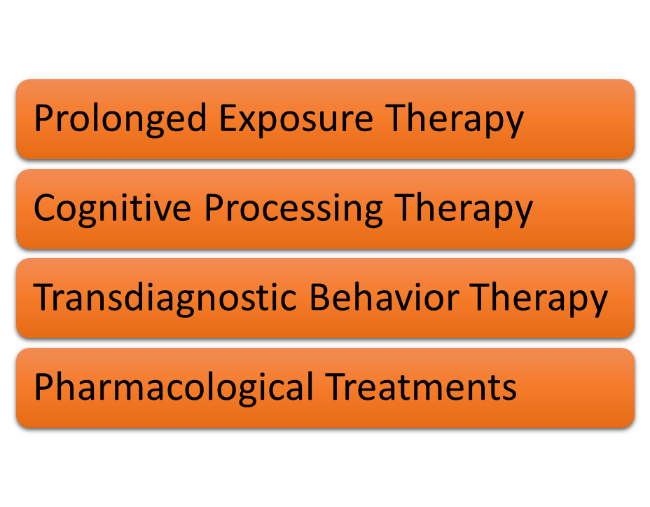
Case Example:
Ukrainian Trauma Care Training Program
Selecting Evidence-Based Programs
Context for Implementation
Barriers and Facilitators
Strategies for Implementation

Slide 74
The Context
Active war zone
Population traumatized
A stagnant healthcare system
Stretched healthcare resources
Stressed healthcare workers
Limited attention to mental health
Limited trained workforce
No familiarity with D&I Science
Despite Challenges
A passion to do something
Strategy to ameliorate the situation
International Training Grant
Training and Infrastructure Support

Slide 75

What are Special issues of implementation in areas with mass violence?
Common Barriers
Mass disruptions
Limited resources
Fragmented health care across the continuum of care
Lack of mental health care professionals and training in EBIs
Lack of standardized protocols for trauma care
Transitory nature of populations in need
Community attitudes regarding seeking mental health care
How do barriers affect each Re-AIM Element
Notes:
Three different barrier buckers—society, health care and population (patients)

Slide 76

Enhancement Strategies/Facilitators
Understanding cultural perspectives and community context
Developing practice and research capacity for EBIs
Strengthening the work force
Working within existing clinical/community services and programs
Imagining new delivery personnel and modalities
Creating opportunities for community engagement and support
How do strategies impact each Re-AIM element?

Slide 77
Scenario 1
Assessing the Setting
What is your target setting?
Who do you need to talk to get buy-in?
What are the barriers and facilitators in your setting?
Who is your target audience?
What is the match between intervention, setting, and population?
What strategies can help you successfully implement chosen EBIs
Understanding
the context

Slide 78
Scenario 2: Implementing your Practice
Who will deliver the evidence-based practice?
How will you assess treatment adherence and implementation?
Which therapy will you chose and why?
What are the critical elements of the evidence-based practice?
What resources are needed to implement the evidence-based practice?
What adaptations will need to be considered?
How would you go about implementing your evidence-based practice?

Slide 79
How to ensure reach and equity?
Make mental health services part of routine care
Have trained personnel throughout country
Designate three settings: military, academic, and public health services
Ensure mental health services available at no or low cost
Build workforce capacity through train-the-trainer approaches
Expand clinical and community partnerships referral networks

Slide 80
Highlights from Immediate Post-Assessment Feedback
They are aware of many barriers to be faced in terms of societal conditions and norms, health care system, and patients themselves
Most likely to try to implement at least 1 EBI—and already engaged in follow-up supervision
They can articulate strategies for overcoming barriers at different levels
They can identify resources needed to implement the evidence-based practice
They understand the mismatch between EBIs and settings and need to consider and document adaptations

Slide 81

Public Health Mantra
Engage your community (defined broadly) in all aspects of the planning, implementation, and sustainment process

Slide 82

Review of Key Points applying PRISM-RE-AIM Constructs
Understand context- including history and resources
Partner with multi-level partners with vested interests
Create meaningful equitable engagement and co-creation (or refinement) that continues across phases
Brainstorm initial strategies and estimate their impact
Plan and design for implementation feasibility, equitable outcomes; and sustainability
Have realistic expectations of dynamic context requiring constant monitoring and adaptation
Implementation planning is key to intervention success and sustainment

Slide 83

The iPRISM webtool
An interactive, visual webtool to guide the pragmatic and iterative use of PRISM

Slide 84
Purpose - iPRISM webtool
Simplify implementation science - using PRISM
  For diverse researchers and implementation teams
  Support rapid learning health systems
Guide and prompt users to iteratively
  Assess context
  Align project with context
  Assess progress on key outcomes
  Develop feasible and impactful strategies/adaptations
  Create action plans
Systematic, consistent approach
www.prismtool.org
Trinkley et al. Implement Sci Comm. 2023;4:116
Maw et al. Implement Sci Commun. 2022;3:89
Notes:
With PRISM in mind, the purpose of the iPRISM webtool is….we know it is hard for those that are not as immersed in IS to figure out how to apply it….

Slide 85
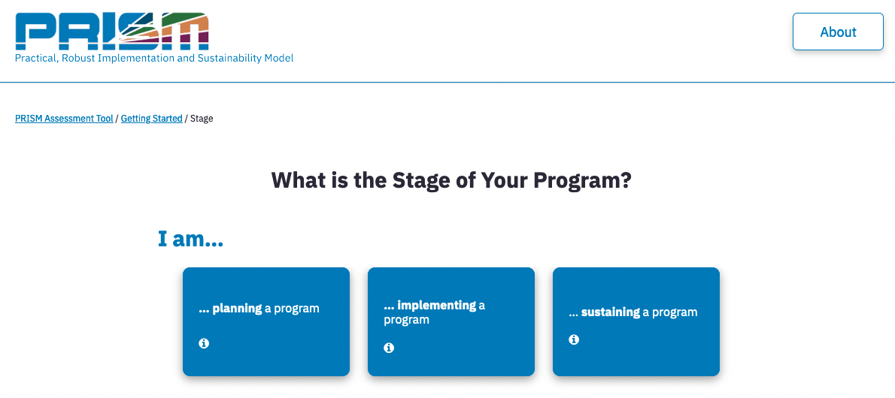
Notes:
tailored to the stage of implementation. Before a user answers the questions, they are asked which stage they are in, which then prompts the correct quesitons

Slide 86
21 assessment questions
Operationalize PRISM’s context domains and outcomes
  6 PRISM questions
  15 RE-AIM questions
Prioritize equity
  Representation of perspectives
  Representativeness of outcomes
www.prismtool.org
Rabin et al. Implement Sci. 2022;17:62
Notes:
And irrespective of the stage, there are 21 questions total

Slide 87
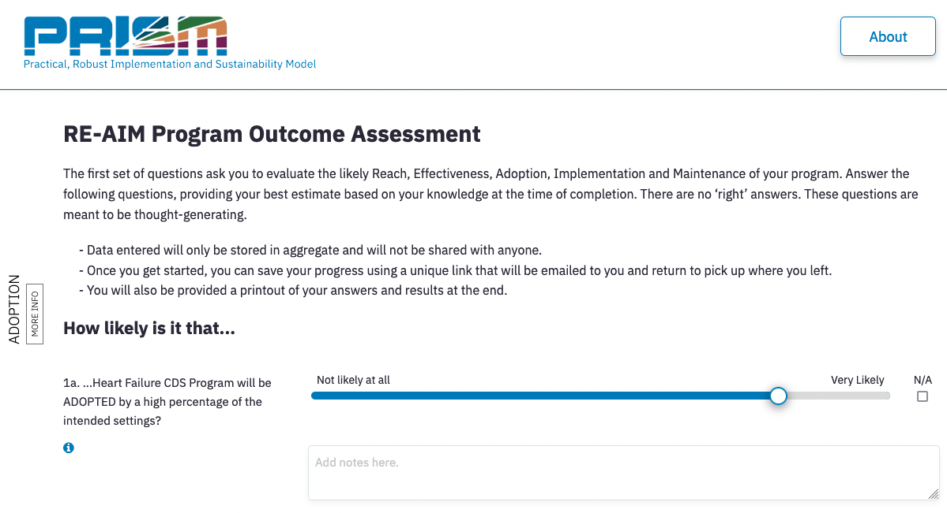
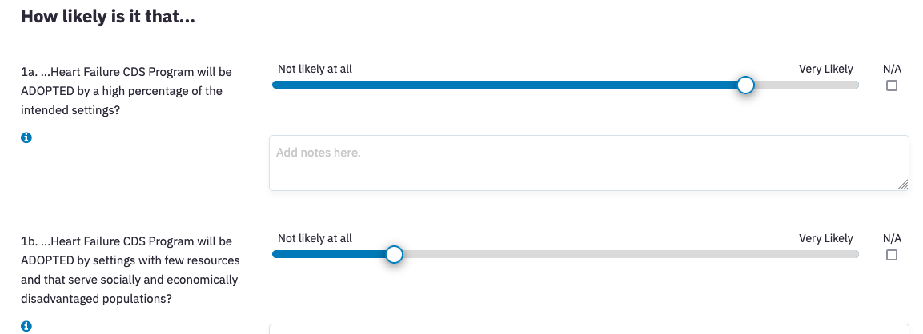
Notes:
Here is an example of 2 RE-AIM questions

Slide 88
Notes:
I want to point out that the webtool is pretty dynamic and one really basic example of this is that it autopopulates based on the name of your program. This is one small feature that helps simplify the process for users by removing jargon of program, policy or intervnetion

Slide 89
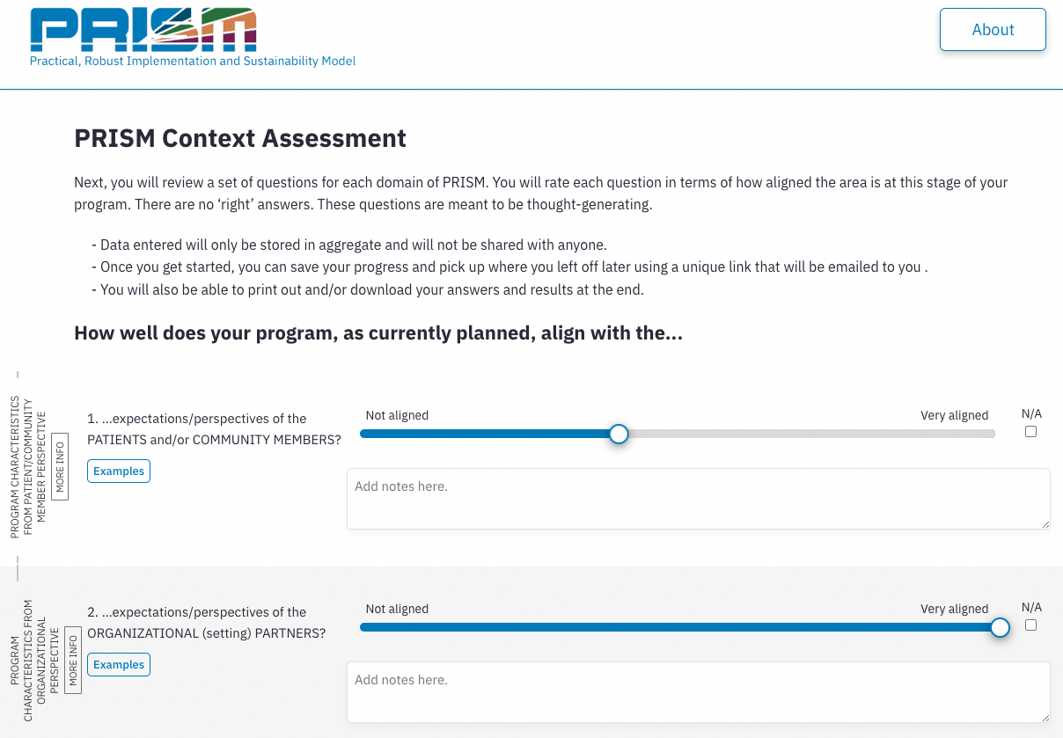

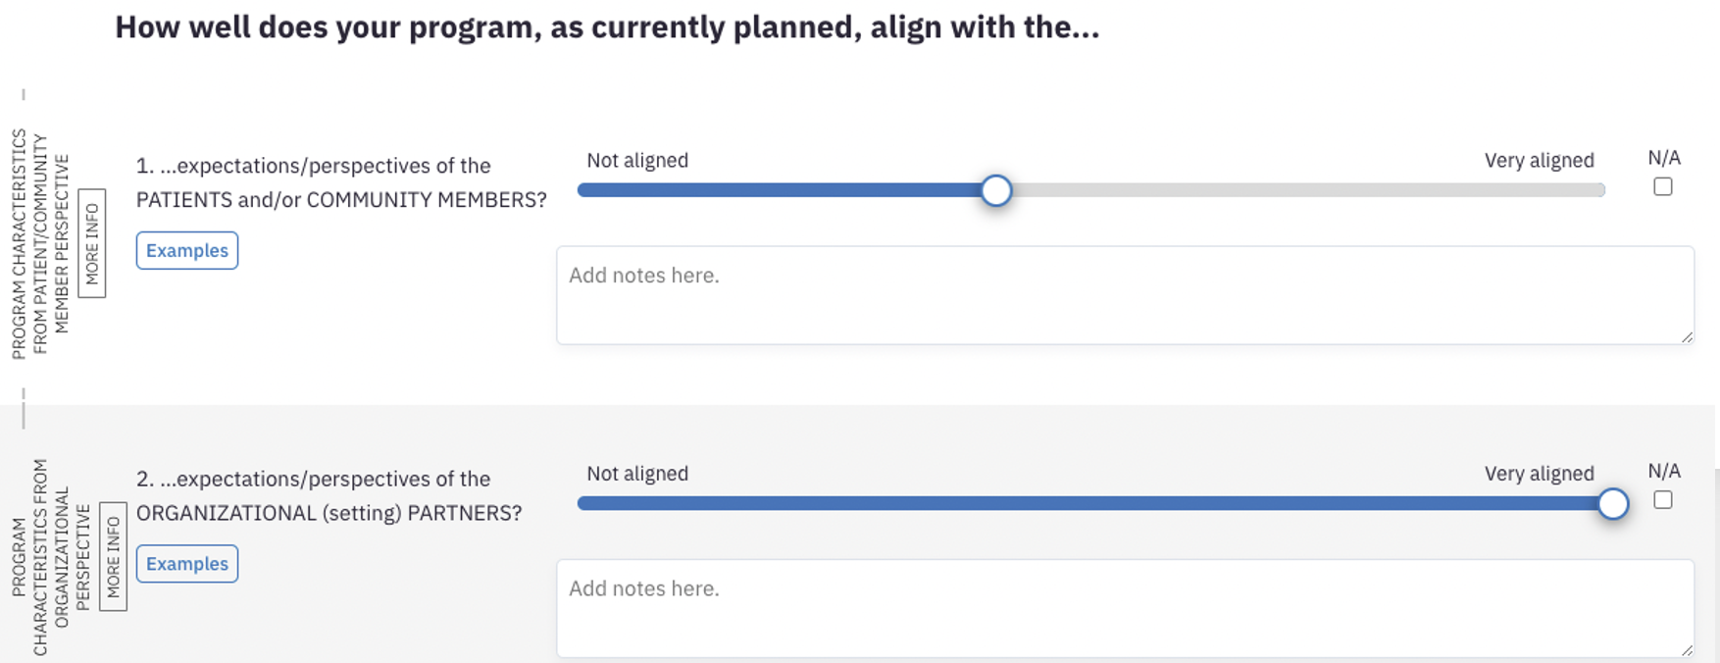
Notes:
Quick flash – PRISM Qs are the same

Slide 90
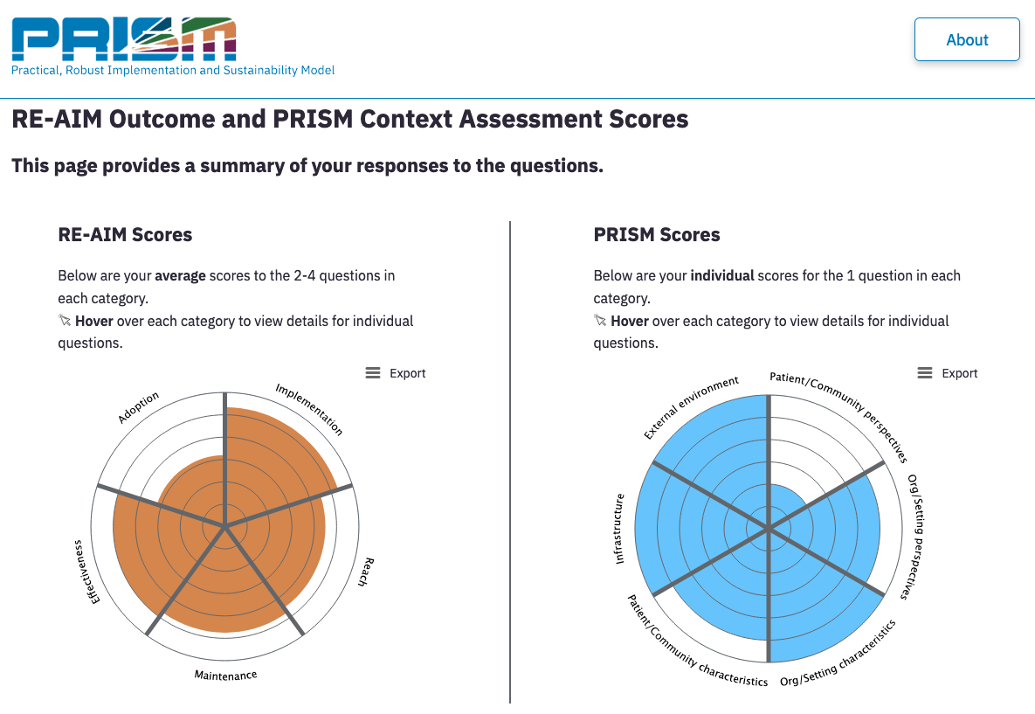
Graphical display of responses
*For individuals

Slide 91
Graphical display of responses
Quickly identify areas to improve misalignment and impact

Slide 92

Graphical display of responses
Notes:
Different people interpret information differently….

Slide 93

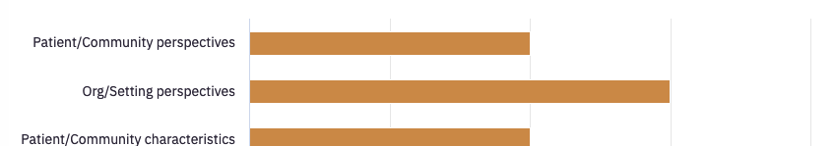

Alternative views

Slide 94

Other features
Embedded education - tailored to different audiences/expertise
  Video
  Examples
  Links out
  Info buttons
  Quick start guides
Ability to export results
  Individuals
  Teams
English and Spanish
Up next - In part 2:
  Prompts to identify, rate and prioritize strategies/adaptations
  Action plan template
Notes:
The education is key to ensuring the webtool can be used by experts and non-experts in D&I

Slide 95
Now let’s apply iPRISM – Part 1
www.prismtool.org

Slide 96
Using iPRISM Part 1
Setting the stage (~3 min)
Do you have your own project? Write down the core elements and some basic outcomes or details from your teams’ discussions or the extant literature
Do you need a project example? We have provided an example school-based project that you can read through
>>
www.prismtool.org
Tip: Use a browser other than safari

Slide 97

Using iPRISM Part 1 – 20 min
With your project in mind, follow these steps
  (Or using the school-based project)
  Review quick start guide
www.prismtool.org
Tip: Use a browser other than safari

Slide 98
Using iPRISM Part 1 – 20 min
With your project in mind, follow these steps
  (Or using the school-based project)
  Review quick start guide
  Access the webtool and complete prompts
    Select ‘team’
    Enter a name + ‘test’ (e.g., Diabetes campaign test)
www.prismtool.org
Tip: Use a browser other than safari
Notes:
Having them select team just so they can see how this works first hand – they will actually be completing as an individual thought

Slide 99

Using iPRISM Part 1 – 20 min
With your project in mind, follow these steps
  (Or using the school-based project)
  Review quick start guide
  Access the webtool and complete prompts
    Select ‘team’
    Enter a name + ‘test’ (e.g., Diabetes campaign test)
  Stop when you see your scores (step 4)
    Save so you can return later today
www.prismtool.org
Tip: Use a browser other than safari
Notes:
Click for animation to flash button for emphasis

Slide 100
Using iPRISM Debrief
With your table
  What ‘ahas’ did you have?
  What context factors were rated most/least aligned?
  What RE-AIM outcomes were rated most/least likely for success?
www.prismtool.org

Slide 101
Now let’s apply iPRISM – Part 2
Quick walk through of webtool
www.prismtool.org

Slide 102
Based on your ‘scores’ you then…
…implementation strategies/adaptations
Identify
Rate
Prioritize

Slide 103

Team summary view
Notes:
If you were working with a team, you’d review and discuss the team summary, which looks a bit like this….

Slide 104
Graphical display of responses
*For individuals
Notes:
But for the purposes of today, you are only looking at your individual results

Slide 105




Notes:
There is an option to click to see examples as well

Slide 106
Notes:
There is an option to click to see examples as well

Slide 107


Notes:
Just to quickly flash

Slide 108
Audit and feedback
Integrate within clinician workflow

Slide 109

*Equitable/representativeness of impact

Slide 110

Prioritize strategies

Slide 111



Wrapping up
Once you select you will longer be able to return/edit
→Don’t forget to come back and iterate!!

Slide 112
Using iPRISM Part 2 – 15 min
With your project in mind
(Or using the school-based project)
  Return to where you stopped
  Review your ‘scores’
  Follow the remaining prompts
    Identify, rate and prioritize feasible and impactful strategies
      To improve alignment and outcomes
      Focus on sustainability and equity
      Integrate issues presented by Dr. Rabin
  4. If you have time - Develop action plan
www.prismtool.org

Slide 113
Using iPRISM Debrief – 10 min
Large group
  What strategies did you select?
  What did you NOT prioritize because ‘juice wasn’t worth the squeeze’?
  How might use the webtool with your team (other partners)?
  When will you revisit the tool (iterate)?
www.prismtool.org
Notes:
Samantha, I am wondering if we should remove the table discussion completely. I am wondering how helpful the table discussions will be if they are all working on different projects – I imagine 1 person would easily consume the entire time just explaining their project…
Should we scrap completely and replace with large group discussion/questions?

Slide 114


User-centered methods
Iterative partner engagement
  >20 individuals and teams
  English and Spanish speakers
  Diverse settings, users and programs
  With and without implementation science expertise
Used prototypes of varying fidelity
Refined
  Purpose, interface, flow
  Assessment questions – Makes PRISM actionable
Maguire M. Int J Hum Comput Stuf. 2001;55:587
Notes:
We can delete the hidden slides, but am wondering if Qs may come up and would be good to keep…

Slide 115



Team use
Team members complete asynchronously
  Using team code
Automated report summarizes responses
  Means and distribution of responses
Meet to discuss results
  Develop action plans

Slide 116
Intended uses
Across settings, types of users and projects
  Healthcare and community issues
  English and Spanish speakers
Each phase of implementation
Iteratively
Planning
Implementation
Sustainment
Notes:
And consistent approach

Slide 117
Use to date
Accessed 2,776 times
48 states
31 countries
Examples
of projects:
FQHC partnership for social needs documentation
Global pediatric sepsis deterioration
Physical therapy EHR alert
Total worker health occupational safety
English
Spanish
English
Spanish

Slide 118
Our partners
Our partners
Our partners
Purpose of this session:
Overview
Overview of four case vignettes about the use of PRISM to improve the alignment of context and program/strategy fit
Provide
Provide detailed overview of one case vignette
Address
Address any questions

Slide 119
Project name PI Funder | Intervention/ Strategy/Setting/ Population | iPRISM use # of times Timing | + PRISM use | More information
eScreening J. Pittman VA HSR&D | eScreening technology/Multi-component strategy/Veterans | Once Mid-implementation | PRISM survey PRISM interviews | doi: 10.1186/s43058-021-00142-9 Pittman, Wed 10:30
Young worker R. Guerin NIOSH | Occupational Safety and Health training/ | Twice Pre-implementation | PRISM interviews | Book chapter in Nilsen (in press)
CRC screening Martinez/Gupta/ Roesch NCI UH3CA233314 | CRC screening uptake and abnormal follow-up/underserved communities in San Diego County | Twice Pre-implementation, mid-implementation | PRISM interviews | doi: 10.1016/j.cct.2023.107353
CO-CREATE-Ex Laurent/Stadnick/ Rabin NIH U01MD018308 | COVID-19 testing uptake/underserved communities in San Diego County | Once Pre-implementation | PRISM barriers survey | doi: 10.1186/s13012-023-01306-y Stadnick, Tue 8 AM

Slide 120





CO-CREATE-Ex: Community-driven optimization of COVID-19 testing to reach and engage underserved areas for testing equity

Slide 121
Our partners
  The Global Action Research Center: Non-profit, social change organization committed to environmental, social, and health justice
  San Ysidro Health: Second largest Federally Qualified Health Center in San Diego County
  University of California San Diego: Researchers spanning across fields of public health, implementation science, health equity, child and maternal health, clinical psychology, data science, infectious disease (Nicole Stadnick, Louise Laurent, Marva Seifert, and many others)

Slide 122
PRIOR WORK
Overarching goal: To co-create a sustainable, community-engaged COVID-19 testing program that is flexible to address emerging public health guidance/priorities.
Phase 1-2 (CO-CREATE)—completed
  Prospective, non-randomized intervention (co-created testing program) design offered at 1 clinic
  Primarily Latino/a/x, Spanish-speaking community near the US-Mexico border
  >24,000 tests performed (>13,000 unique participants)
  Trusted sources of public health information and social determinants of health were significant contributors
  Top reasons for testing: getting early treatment; knowing I will not spread COVID-19 to friends, family and others
Salgin et al, 2023; Lomeli et al, 2023; Stadnick et al., 2022

Slide 123

Co-CREATE-Ex Study Aims
To evaluate the impact of our testing strategies to optimize COVID-19 rapid testing among underserved, Latino communities in Central and South San Diego.
To refine our strategies and outcome metrics for COVID-19 rapid testing.

Slide 124

CO-CREATE-EX BRIEF OVERVIEW
Phase III (CO-CREATE-Ex)—ongoing
  Roll-out optimization implementation (ROIO) of 3 strategies across 4 clinics
    Phase 1 walk-up testing
    Vend-a-kit (self-service vending machines)
    Promotora-guided health counseling
  3 strategies prioritized using implementation mapping with the study’s Community and Scientific Advisory Board
Funding: U01MD018308-01

Slide 125

Community and Scientific Advisory Board
  13 members who are:
    Patient advocates
    Clinical staff and administrators
    Public health researchers
    Policy partners
    County Public Health Department ambassador
  Meet every 2-3 months
  Guided by Appreciative Inquiry, facilitated by the Global ARC
  Members are compensated $100 for each meeting

Slide 126

Clinic Sites
Notes:
Borsika

Slide 127

Proposed ROIO

Slide 128

Key steps in assessing fit for the CO-CREATE-Ex program
One round of PRISM assessment with clinical and administrative partners:
  Introduction to explain process and answer questions
  Complete survey questions using survey link sent via email
  Meet to review survey results and make action plans
Develop PRISM barrier survey and administer before each roll out with clinical and community partners
Address concerns before roll out

Slide 129

CO-CREATE-Ex Program Flow

Slide 130
PRISM CONTEXTUAL DOMAINS
RE-AIM OUTCOMES

Slide 131
What is the PRISM assessment? Why is it helpful?
How well does this program fit your site?
The same program that is effective in one site may not be in another - different contexts
The Practical, Robust Implementation and Sustainability Framework (PRISM) can be used to identify areas where there are opportunities for better alignment with context and develop strategies to achieve this.
PRISM
includes RE-AIM outcomes
specifies key contextual factors that influence these outcomes

Slide 132
Two sets of questions:
How likely is it that… - FOCUS ON MAXIMIZING IMPACT
14 items with comment box
Example items:
How likely is it that the CO-CREATE-Ex program will REACH a high percentage of patients and community members?
1 Not at all likely - 2 - 3 - 4 - 5 - 6 Very likely
How well does it align… - FOCUS ON MAXIMIZING ALIGNMENT
6 items with comment box
Example items:
How well does CO-CREATE-EX, as currently planned, align with the expectations and perspectives of the SYH patients and community members?
1 Not aligned - 2 - 3 - 4 - 5 - 6 Very aligned
Notes:
FIX number of items after we finalized survey!!

Slide 133
PRISM FIT
Average score: 4.65
How well does the CO-CREATE-Ex program, as currently planned, align with….
❈
❈
Scale 1-6 with 1=not aligned and 6=very aligned
Notes:
Scale 1-6 – indicate number of Nas in the frequency bars

Slide 134

COMMENTS
PRISM FIT Q1: How well does the CO-CREATE-Ex program, as currently planned, align with the expectations and perspectives of San Ysidro Health patients and nearby community members?
I believe it is aligned. SY Health patients expect to have all their medical needs met. That includes having a way to receive COVID testing and results. Other community members are thankful the service is available.
Current Co-Create testing has been well received by patients and community members. They would like to see continued access to COVID testing at our clinic sites. Change will be increased use of technology which may be challenging for patients.
I think this transition phase is important as patients understand we are shifting from pcr to antigen, but I don't know how much they know or are expecting self-service vending machines. Our population historically does not use our patient kiosks, as they are low tech, so it will be interested to see their reactions and feedback.
The program is well designed and aligned with needs of our population.
Notes:
Organize by question/construct – 1 slide per construct

Slide 135
PRISM Barrier Inventory: Pre-Launch
Instructions: Please rate each barrier's likelihood of impacting the implementation success of the CO-CREATE-Ex program at [INSERT CLINIC NAME]. Use the scale of (0) Not a barrier to (4) Very significant barrier.
The CO-CREATE-Ex program is not tailored to my clinic site.
Older community members have low technology comfort and will have difficulty using the vending machines.
Older community members do not currently use the SY Health clinic kiosks, so they are unlikely to use vending machines.
Community members prefer face-to-face interaction.
Few community members will want to access COVID-19 tests after clinic hours.
Community members are hesitant to join research studies or provide consent when they don't fully understand.
Community members will not want to use the vending machine to get a COVID-19 test if they have other, free sources to receive them.
…
31. Other barrier:

Slide 136
Our partners
Our partners
Our partners
Key take aways
iPRISM can be successfully used across diverse settings, topic areas, populations, study designs
iPRISM can be used to emphasize health equity
iPRISM can be used alone or in combination of other techniques/strategies to increase alignment between context and program
iPRISM can be used once or multiple times
Timing for use for iPRISM can depend on the needs and priorities of a project – not always longitudinal but longitudinal use can have added benefits
How iPRISM is operationalized within each project needs to align with the priorities and resources available in the project

Slide 137
Questions and Comments

