Slide 1
Implementation Strategies Adapted for Communities: Enhancing Health Equity Through a New Compilation
Laura E. Balis, PhD

Slide 2
Our Team + Funding
Whitney Clausen, MPH
Gretchen Swanson Center for Nutrition
Bailey Houghtaling, PhD, RDN
Gretchen Swanson Center for Nutrition
Hannah Lane, PhD
Duke University
Laura E. Balis, PhD
Gretchen Swanson Center for Nutrition
Emiliane Pereira, MPH
University of Nebraska Medical Center
Gabriella Maria McLoughlin, PhD
Temple University
Samantha M. Harden, PhD
Virginia Tech
Marilyn Wende, PhD
University of Florida
This work was supported by the National Institutes of Health, National Cancer Institute, Consortium for Cancer Implementation Science, project 172721.0.009.01.001.

Slide 3
Overview
Research to practice gap
Impacts on health equity
Implementation strategies
New community setting compilation

Slide 4
Research to Practice Gap
Health equity =
the attainment of the highest level of health for all people
17 years
Research
Practice
(Balas & Boren, 2000; Morris et al., 2011)

Slide 5
The program’s supposed to be four weekly classes, but that’s too much driving… I combined it all into a Saturday workshop.
They asked me to teach this class, but no one showed up.
We used to do that program and I think it worked, but it cost too much to continue.
I had this great food rescue program going, but the delivery drivers didn’t want to pick up the produce.
I’ve never heard of the physical activity guidelines, so how am I supposed to follow them?

Slide 6
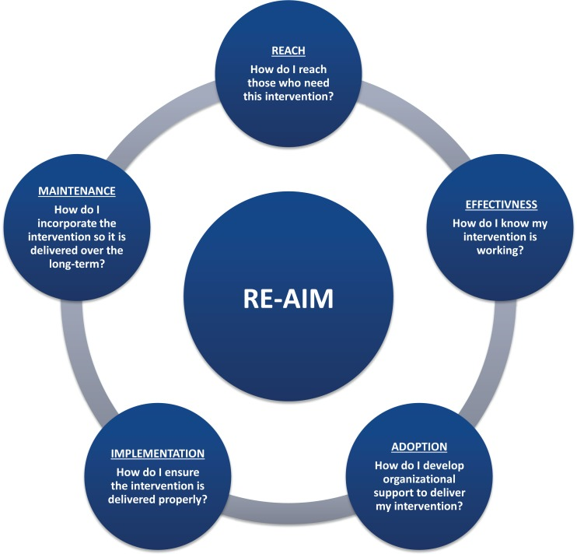
(Ory et al., 2015; re-aim.org)

Slide 7
Effectiveness: 100%
Adoption: 50%
Competing demands
Burdensome programs
Implementation: 50%
Poor fit
No implementation support
Reach: 50%
Participation barriers
Limited promotion
Maintenance: 50%
Lower resources
Lower capacity
6%
(Glasgow et al., 2019; re-aim.org)

Slide 8
Intervention-Generated Inequalities
(Lorenc et al., 2013; Hall et al., 2016)

Slide 9
Implementation Strategies
17 years
Research
Practice
(Balas & Boren, 2000; Morris et al., 2011)

Slide 10
Non-scientific implementation science language
The intervention/practice/innovation is THE THING
Implementation strategies are THE STUFF we do to try to help people/places do the thing
(Curran, 2020)

Slide 11
Support System
“The Stuff”
Delivery System
“The Thing”
Priority Population
(Wandersman et al., 2008)

Slide 12
(Waltz et al., 2015)

Slide 13
Educational settings
Social service organizations
Non-clinical public health settings
City planning and transportation
Faith-based organizations
Workplaces
Recreational, sport, and other community venues
(Mazzucca et al., 2021)

Slide 14
Natural settings: where people learn, live, work, play, pray, and shop
(American College of Sports Medicine, 2016)

Slide 17
(Waltz et al., 2015)

Slide 18
Implementation Strategy | Definition
Intervene with priority population to enhance uptake and adherence | Develop strategies with end-users to encourage and problem solve around adherence
Make billing easier | Make it easier to bill for the evidence-based program
Obtain and use priority population and support network feedback | Develop strategies to increase end-user feedback on the implementation effort
Change liability laws | Participate in liability reform efforts that make implementers and staff (delivery agents, volunteers, paraprofessionals) more willing to deliver the evidence-based intervention.

Slide 19
Methods
Qualitative study
Researchers and practitioners
Emic approach
Purposive and snowball sampling

Slide 20
Screening criteria
Manage or coordinate evidence-based interventions delivered by staff or volunteers
Conduct community-engaged research to integrate evidence-based interventions
Outcomes: physical activity, nutrition, or tobacco use patterns/practices

Slide 21
Semi-Structured Interview Questions
Adoption
What challenges have you experienced in getting staff or delivery settings to agree to deliver these interventions?
Effectiveness
Once the interventions were underway, were there any challenges with evaluation?
Maintenance
Were you able to measure long-term impacts on community members’ health?
Were you able to continue delivering these interventions after the initial implementation period?
Implementation
Reach
Did you experience challenges in ensuring that these interventions were delivered with fidelity to the core components?
Once these interventions were implemented, did you have any challenges in recruiting the priority population?
What about challenges with the resources required to deliver these interventions?

Slide 22
Analysis
Rapid deductive approach
Coding matrix
Two coders
Saturation checks
(Hamilton, 2013; Finley et al., 2022; Guest et al., 2020)

Slide 23
Interviewee Characteristics (N=18)
Variable | n (%)
Participant Type
Researcher | 10 (56)
Practitioner | 8 (44)
Intervention Levels
Interpersonal or Individual | 5 (27)
Policy, Systems, and Environment | 3 (17)
Both | 10 (56)
Intervention Outcomes
Physical Activity | 3 (17)
Tobacco | 2 (11)
Nutrition | 1 (6)
Multiple | 12 (67)
Variable | n (%)
Setting (n=35)
Non-Clinical Public Health | 11 (31)
Education | 10 (29)
Faith-Based | 5 (14)
Recreation/Sport | 3 (8)
Social Services | 2 (6)
City Planning & Transportation | 2 (6)
Workplaces | 2 (6)

Slide 24
ISAC: Implementation Strategies Adapted for Communities
Implementation Strategy | Definition | Example
Provide ongoing technical assistance | Offer or bring in external experts to provide capacity-building, coaching, and assistance | Offer periodic calls and on-demand technical assistance so implementers feel like they have a place to go for any barrier that comes up
Change adaptable program components | Tailor the program to meet the needs of the priority population or setting | Test delivering a program developed for face-to-face delivery through Zoom
Engage community members | Seek community input and/or share information about the intervention | Hold focus groups with residents to understand views of built environment in the city and important destinations (e.g., church, shopping) that could be linked
Leverage funding sources | Access new funding, use creative or untraditional funding sources, or combine funding sources | Seek funding for youth (vs. older adult) outcomes for an intergenerational program to align with funders' priorities
Leverage program champions | Identify and train staff and volunteers with high readiness | Give internal program champions additional training, including how to advocate for and navigate the program
Conduct pragmatic evaluation | Evaluate success through methods that fit the program, personnel, and setting | Choose single-items measures and adapt them for the delivery setting
Meet community partners’ needs | Understand what partner organizations want; develop or tailor programs to meet needs | Spend time developing the program with partner organizations (e.g., churches) so it fits the setting and is realistic to implement

Slide 25
 | Individuals | Inner Setting / Organization | Outer Setting / Environment | Intervention | Implementation Process
Provide ongoing technical assistance
Change adaptable program components
Engage community members
Leverage funding sources
Leverage program champions
Conduct pragmatic evaluation
Meet community partners’ needs

Slide 26
 | Reach | Effectiveness | Adoption | Implementation Cost | Implementation Fidelity | Maintenance
Provide ongoing technical assistance
Change adaptable program components
Engage community members
Leverage funding sources
Leverage program champions
Conduct pragmatic evaluation
Meet community partners’ needs

Slide 27
Implementation Strategies by RE-AIM Dimension
Adoption
n=46
Implementation
n=35
Reach
n=26
Effectiveness
n=17
Maintenance
n=17

Slide 28
Link social determinants with health outcomes
Build equity into all policies
Use equity-relevant metrics
Study what is already happening
Integrate equity into models
Design and tailor implementation strategies
Connect systems and sectors outside of health
Engage organizations, internally and externally
Build capacity for equity
Focus on equity in dissemination efforts
(Brownson et al., 2021)

Slide 29
Select relevant implementation strategies
Label as implementation strategies
Build the evidence base
Improve intervention delivery and reduce health disparities

Slide 30
Panel Discussion

