Slide 1




Implementation Science Seminar Series
October 17th, 2023
“Integrating Physical Activity Intervention in Real-World Settings: An Introduction to ISAC (Implementation Strategies Adapted for Communities)”
Laura Balis, PhD
Research Scientist
Gretchen Swanson Center for Nutrition
Please note: This seminar is being recorded
Cite: U54GM115677
AdvanceCTR.org

Slide 2
Integrating physical activity interventions in real-world settings
An introduction to ISAC: Implementation Strategies Adapted for Communities
Laura E. Balis, PhD

Slide 3






PhD: Human Nutrition, Foods, and Exercise
BS: Public Health Education and Health Promotion
MS: Health and Human Performance

Slide 4



About Us
Founded in 1973, the Gretchen Swanson Center for Nutrition is a national nonprofit research institute providing expertise in measurement and evaluation to help develop, enhance and expand programs focused on healthy eating and active living, improving food security and healthy food access, promoting local food systems and applying a health equity lens across all initiatives. The Gretchen Swanson Center works nationally and internationally, partnering with other nonprofits, academia, government and private foundations to conduct research, evaluation and scientific strategic planning.
Connect with us:
Website: www.centerfornutrition.org
LinkedIn: Gretchen Swanson Center for Nutrition
Twitter: GretchenSwanson

Slide 5
Agenda
Research to practice gap
ISAC implementation strategies
Barrier-strategy matching
Real-world examples

Slide 6





Research to Practice Gap
17 years
Research
Practice
(Balas & Boren, 2000; Morris et al., 2011)

Slide 7



The program’s supposed to be four weekly classes, but that’s too much driving… I combined it all into a Saturday workshop.
They asked me to teach this class, but no one showed up.
We used to do that program and I think it worked, but it cost too much to continue.
I had this great food rescue program going, but the delivery drivers didn’t want to pick up the produce.
I’ve never heard of the physical activity guidelines, so how am I supposed to follow them?

Slide 8
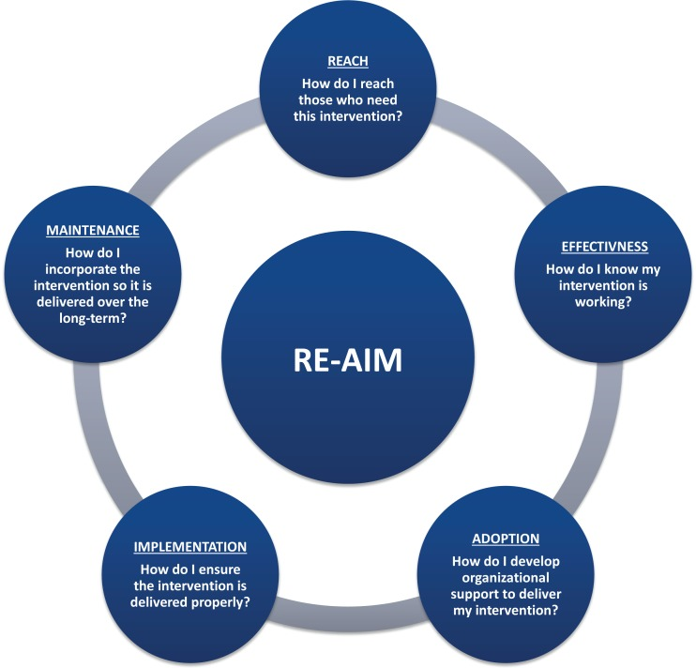
(Ory et al., 2015; re-aim.org)

Slide 9
Effectiveness: 100%
Adoption: 50%
Implementation: 50%
Reach: 50%
Maintenance: 50%
6%
(Glasgow et al., 2019; re-aim.org)

Slide 10
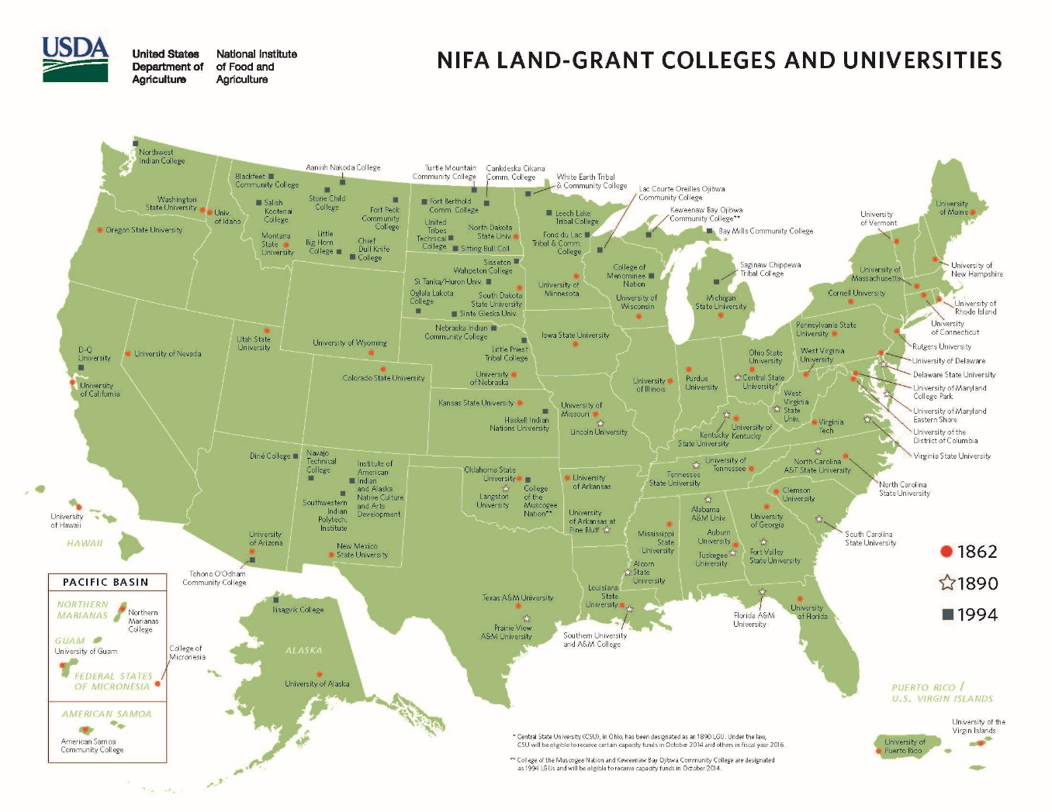

Slide 11
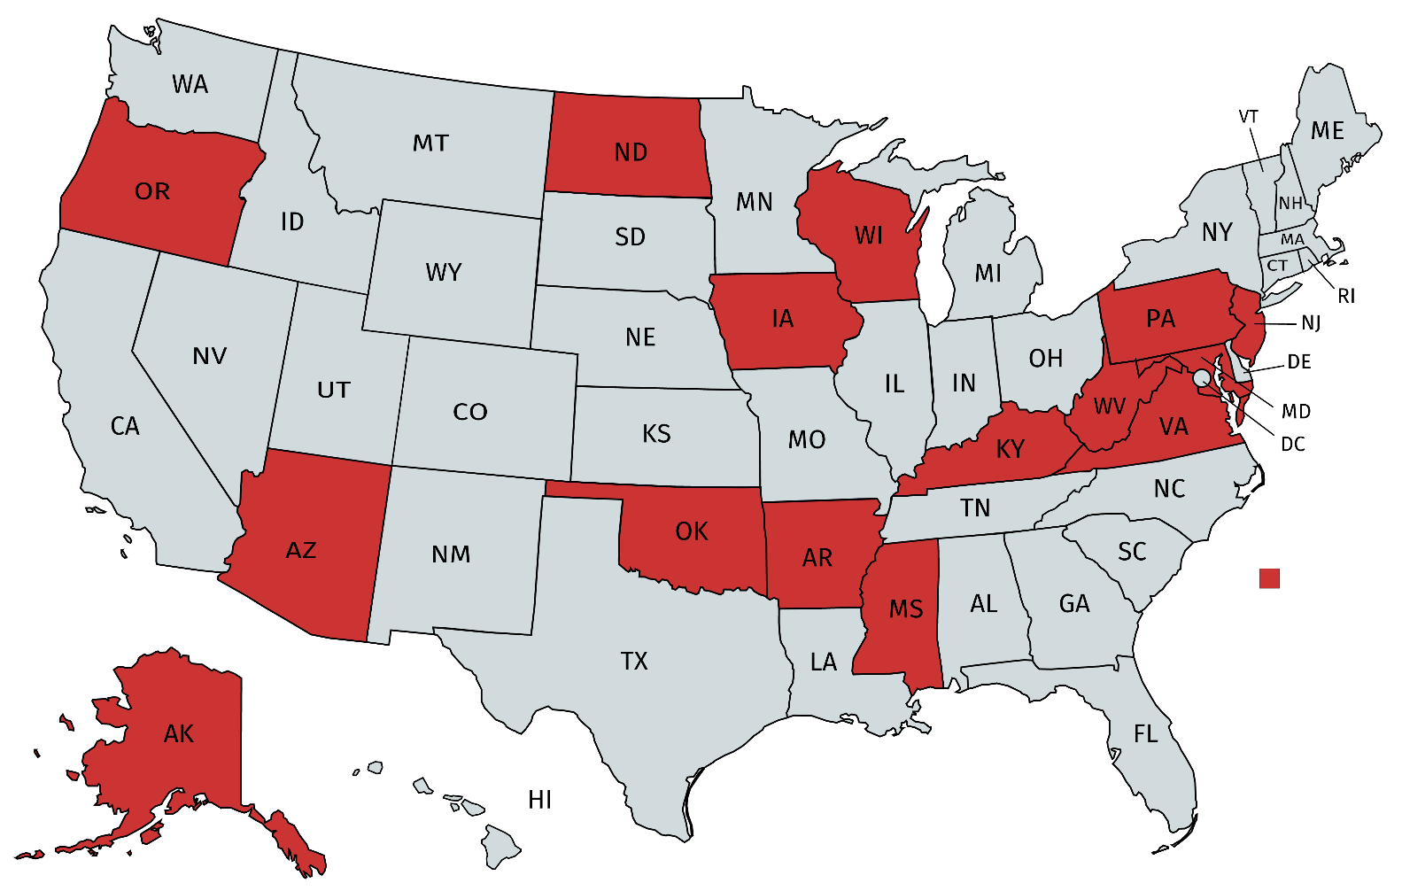
Locations of Extension-delivered
older adult physical activity programs
(Balis et al., 2018)

Slide 13
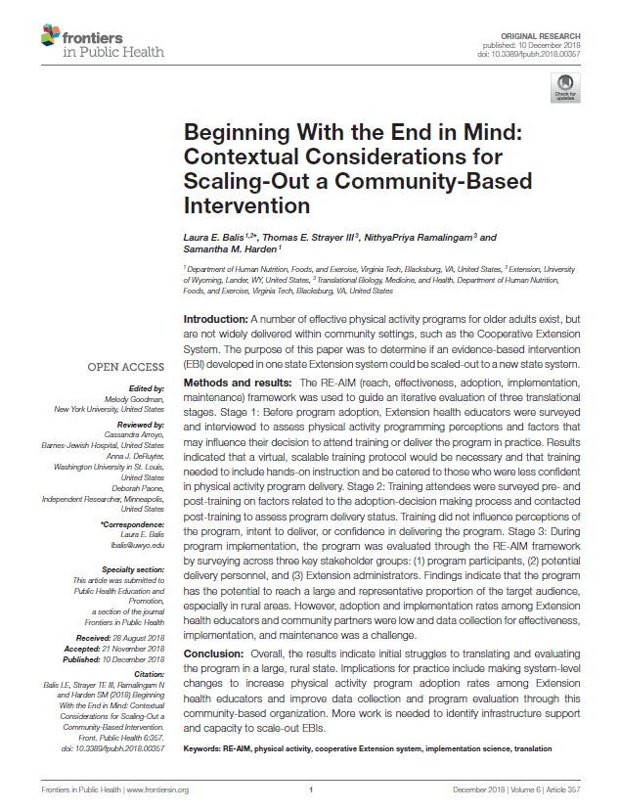
Capture perceptions of Extension Educators who could deliver the program in practice
Understand delivery personnel’s adoption-decision making process
Evaluate program through
RE-AIM framework
(Balis et al., 2018)

Slide 14
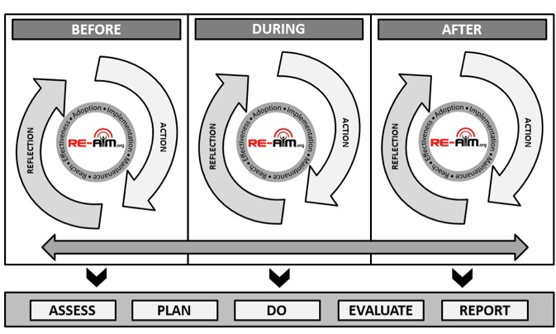
(Harden et al., 2018)

Slide 15
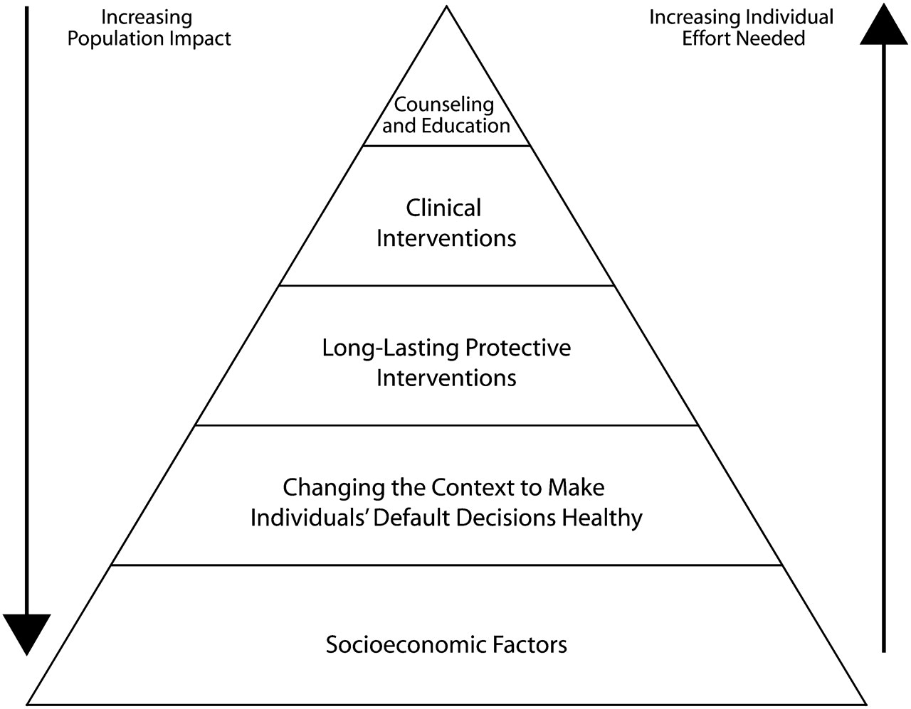
(Frieden, 2010)

Slide 16
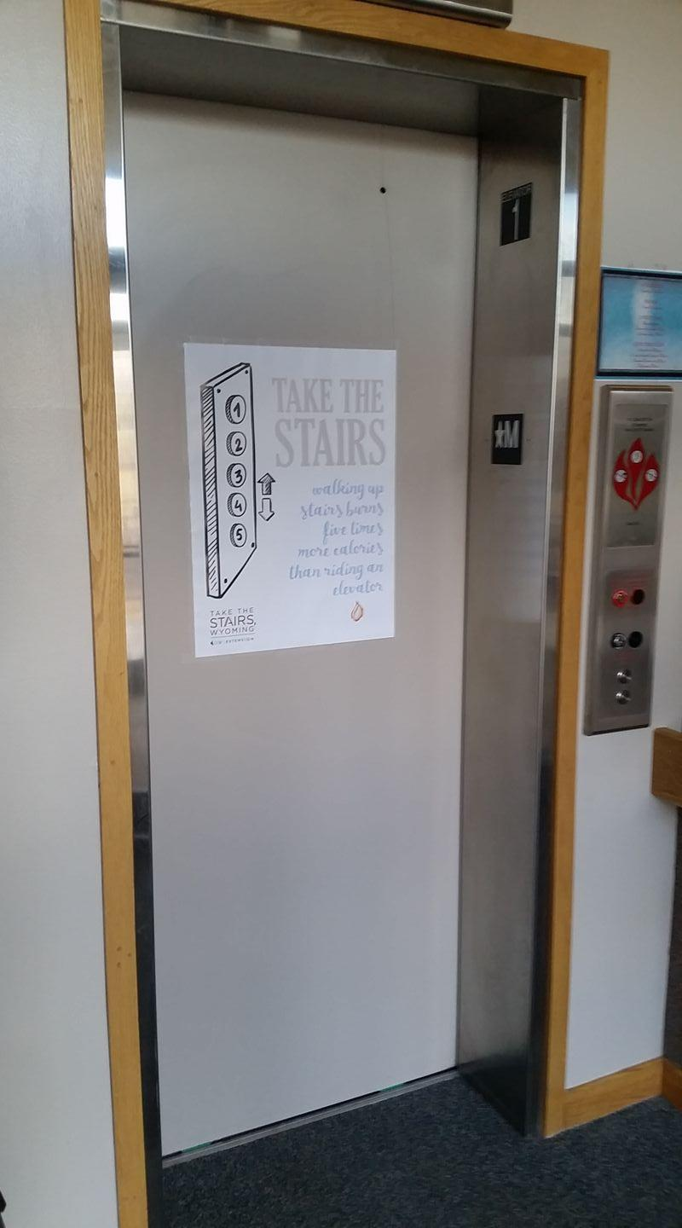
Evaluate point of decision prompt stairway posters delivered through Extension
Purpose
Observational design of all RE-AIM dimensions
Methods

Slide 17
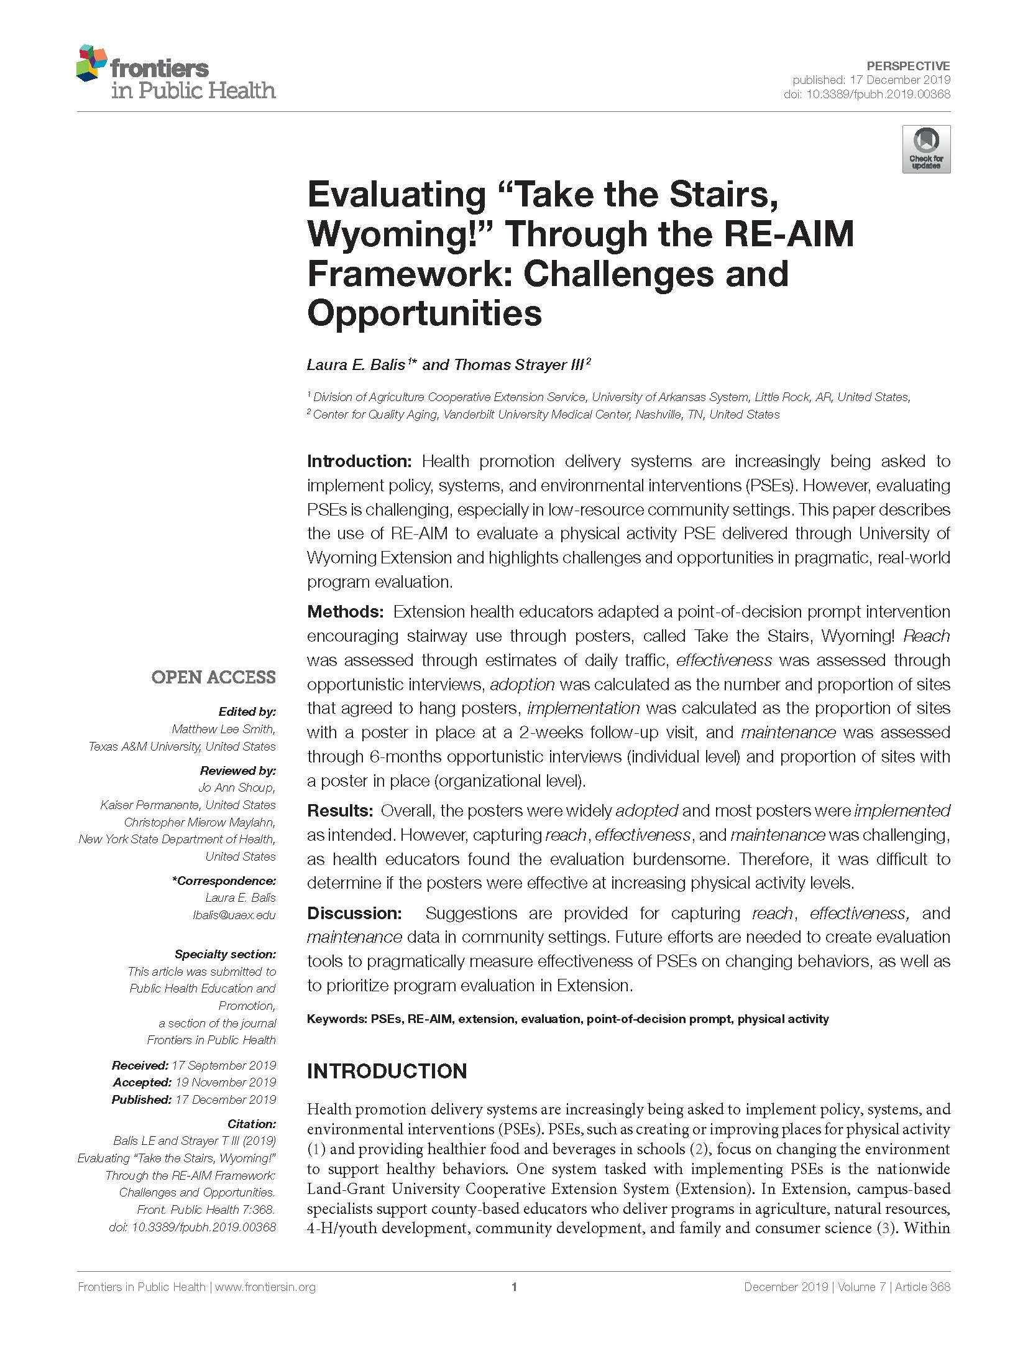


Slide 18

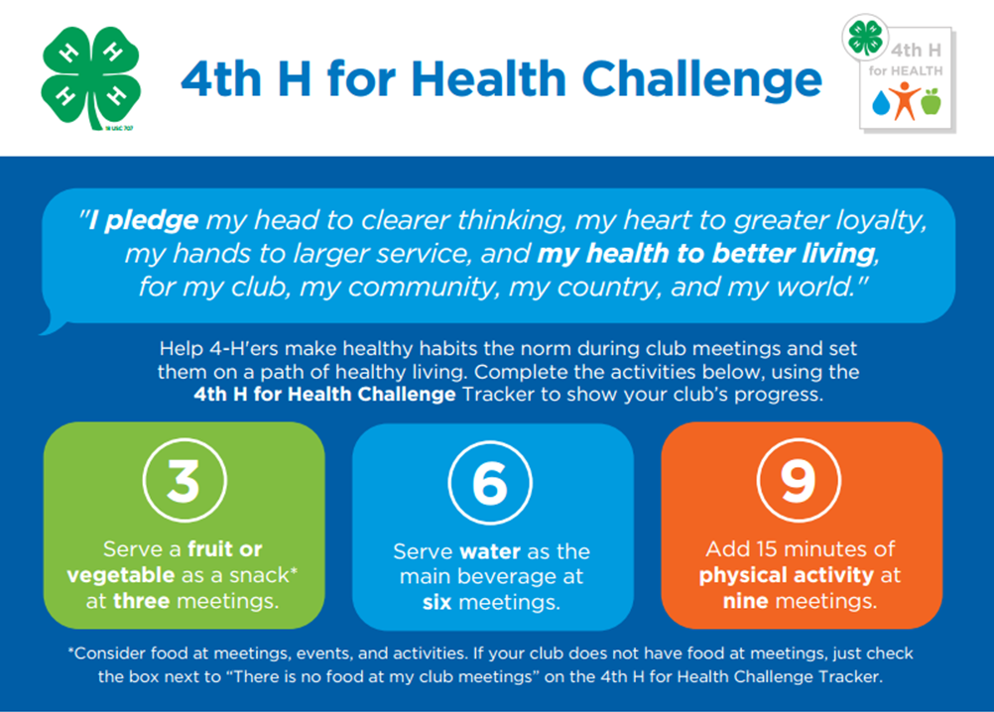

Slide 19
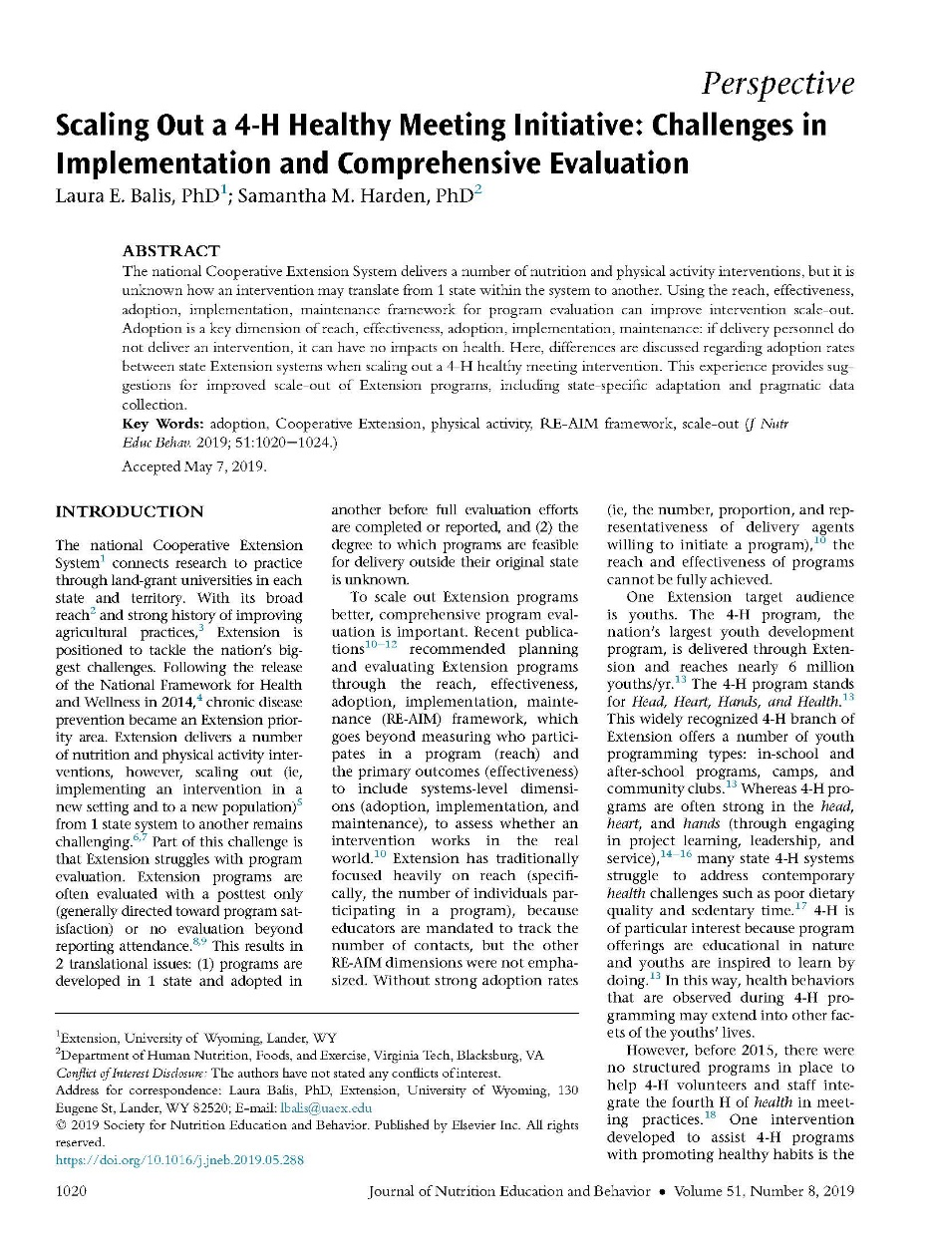
(Balis & Harden, 2019)

Slide 20
Effectiveness: 100%
Adoption: 50%
Competing demands
Burdensome programs
Implementation: 50%
Poor fit
No implementation support
Reach: 50%
Participation barriers
Limited promotion
Maintenance: 50%
Lower resources
Lower capacity
6%
(Glasgow et al., 2019; re-aim.org)

Slide 21

Intervention-Generated Inequalities
(Lorenc et al., 2013; Hall et al., 2016)

Slide 22

Implementation Strategies
17 years
Research
Practice
(Balas & Boren, 2000; Morris et al., 2011)

Slide 23
Non-scientific implementation science language
The intervention/practice/innovation is THE THING
Implementation strategies are THE STUFF we do to try to help people/places do the thing
(Curran, 2020)

Slide 24
Support System
“The Stuff”
Delivery System
“The Thing”
Priority Population
(Wandersman et al., 2008)

Slide 25
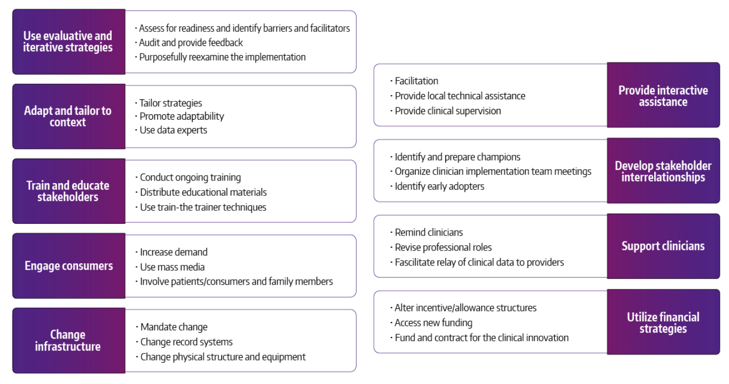
(Waltz et al., 2015)

Slide 26
Educational settings
Social service organizations
Non-clinical public health settings
City planning and transportation
Faith-based organizations
Workplaces
Recreational, sport, and other community venues
(Mazzucca et al., 2021)

Slide 27
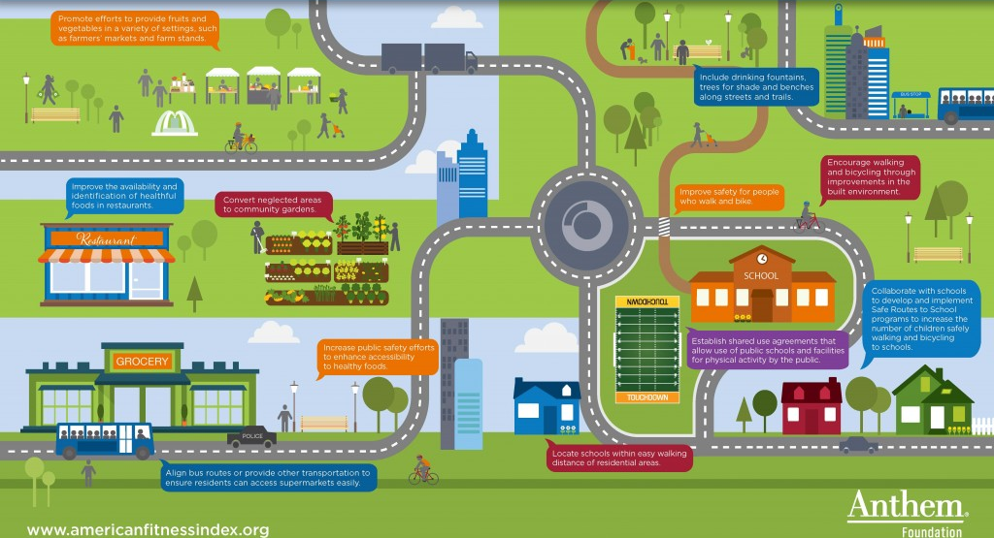
Natural settings: where people learn, live, work, play, pray, and shop
(American College of Sports Medicine, 2016)

Slide 29
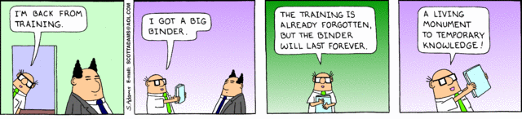

Slide 30
(Waltz et al., 2015)

Slide 31
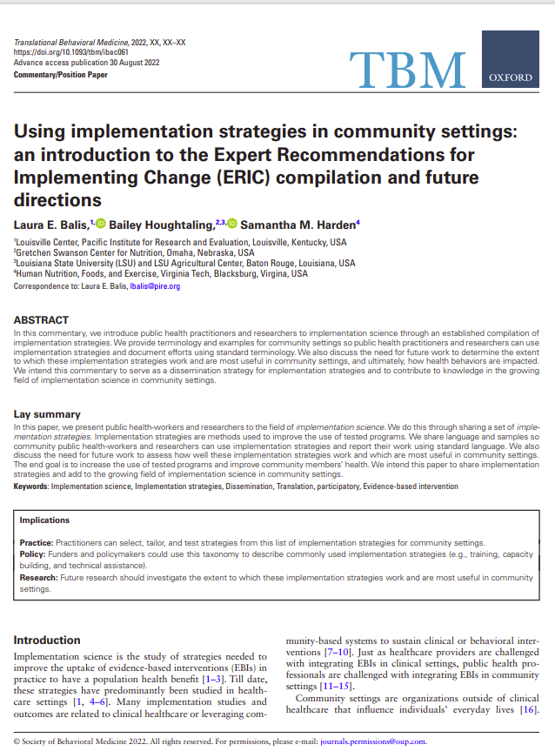
Implementation Strategy | Definition
Intervene with priority population to enhance uptake and adherence | Develop strategies with end-users to encourage and problem solve around adherence
Make billing easier | Make it easier to bill for the evidence-based program
Obtain and use priority population and support network feedback | Develop strategies to increase end-user feedback on the implementation effort
Change liability laws | Participate in liability reform efforts that make implementers and staff more willing to deliver the evidence-based intervention.

Slide 32
Our Team + Funding
Whitney Clausen, MPH
Gretchen Swanson Center for Nutrition
Bailey Houghtaling, PhD, RDN
Gretchen Swanson Center for Nutrition
Hannah Lane, PhD
Duke University
Laura E. Balis, PhD
Gretchen Swanson Center for Nutrition
Emiliane Pereira, MPH
University of Nebraska Medical Center
Gabriella Maria McLoughlin, PhD
Temple University
Samantha M. Harden, PhD
Virginia Tech
Marilyn Wende, PhD
University of Florida
This work was supported by the National Institutes of Health, National Cancer Institute, Consortium for Cancer Implementation Science, project 172721.0.009.01.001.

Slide 33
Methods
Qualitative study
Researchers and practitioners
Emic approach
Purposive and snowball sampling

Slide 34
Eligibility criteria
Manage or coordinate evidence-based interventions delivered by staff or volunteers
Conduct community-engaged research to integrate evidence-based interventions
Outcomes: physical activity, nutrition, or tobacco use patterns/practices

Slide 35
Semi-Structured Interview Questions
Adoption
  What challenges have you experienced in getting staff or delivery settings to agree to deliver these interventions?
Implementation
  Did you experience challenges in ensuring that these interventions were delivered with fidelity to the core components?
  What about challenges with the resources required to deliver these interventions?
Reach
  Once these interventions were implemented, did you have any challenges in recruiting the priority population?
Effectiveness
  Once the interventions were underway, were there any challenges with evaluation?
Maintenance
  Were you able to measure long-term impacts on community members’ health?
  Were you able to continue delivering these interventions after the initial implementation period?

Slide 36
Analysis
Rapid deductive approach
Coding matrix
Two coders
Saturation checks
(Hamilton, 2013; Finley et al., 2022; Guest et al., 2020)

Slide 37
Interviewee Characteristics (N=18)
Variable | n (%)
Participant Type
Researcher | 10 (56)
Practitioner | 8 (44)
Intervention Levels
Interpersonal or Individual | 5 (27)
Policy, Systems, and Environment | 3 (17)
Both | 10 (56)
Intervention Outcomes
Physical Activity | 3 (17)
Tobacco | 2 (11)
Nutrition | 1 (6)
Multiple | 12 (67)
Variable | n (%)
Setting (n=35)
Non-Clinical Public Health | 11 (31)
Education | 10 (29)
Faith-Based | 5 (14)
Recreation/Sport | 3 (8)
Social Services | 2 (6)
City Planning & Transportation | 2 (6)
Workplaces | 2 (6)

Slide 38
ISAC: Implementation Strategies Adapted for Communities
Implementation Strategy | Definition | Example
Provide ongoing technical assistance | Offer or bring in external experts to provide capacity-building, coaching, and assistance | Offer periodic calls and on-demand technical assistance so implementers feel like they have a place to go for any barrier that comes up
Change adaptable program components | Tailor the program to meet the needs of the priority population or setting | Test delivering a program developed for face-to-face delivery through Zoom
Engage community members | Seek community input and/or share information about the intervention | Hold focus groups with residents to understand views of built environment in the city and important destinations (e.g., church, shopping) that could be linked
Leverage funding sources | Access new funding, use creative or untraditional funding sources, or combine funding sources | Seek funding for youth (vs. older adult) outcomes for an intergenerational program to align with funders' priorities
Leverage program champions | Identify and train staff and volunteers with high readiness | Give internal program champions additional training, including how to advocate for and navigate the program
Conduct pragmatic evaluation | Evaluate success through methods that fit the program, personnel, and setting | Choose single-items measures and adapt them for the delivery setting
Meet community partners’ needs | Understand what partner organizations want; develop or tailor programs to meet needs | Spend time developing the program with partner organizations (e.g., churches) so it fits the setting and is realistic to implement

Slide 39
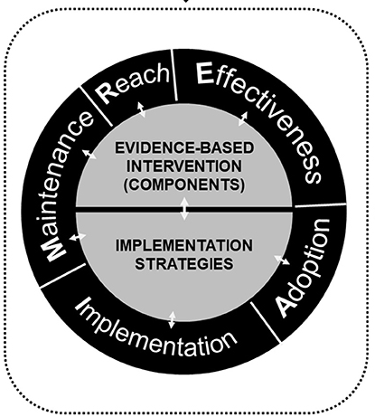
Implementation Strategies by RE-AIM Dimension
Adoption
  n=46
Implementation
  n=35
Reach
  n=26
Effectiveness
  n=17
Maintenance
  n=17

Slide 40
What’s next?
Select relevant implementation strategies
Label as implementation strategies
Build the evidence base
Improve intervention delivery and reduce health disparities

Slide 41

 | Reach | Effectiveness | Adoption | Implementation Cost | Implementation Fidelity | Maintenance
Provide ongoing technical assistance
Change adaptable program components
Engage community members
Leverage funding sources
Leverage program champions
Conduct pragmatic evaluation
Meet community partners’ needs

Slide 42
 | Individuals | Inner Setting / Organization | Outer Setting / Environment | Intervention | Implementation Process
Provide ongoing technical assistance
Change adaptable program components
Engage community members
Leverage funding sources
Leverage program champions
Conduct pragmatic evaluation
Meet community partners’ needs

Slide 43
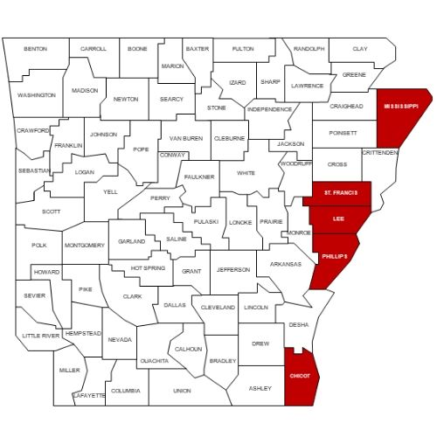
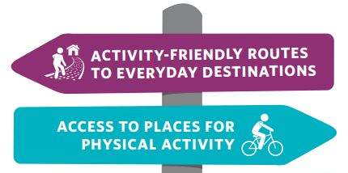
CDC High Obesity Program

Slide 44
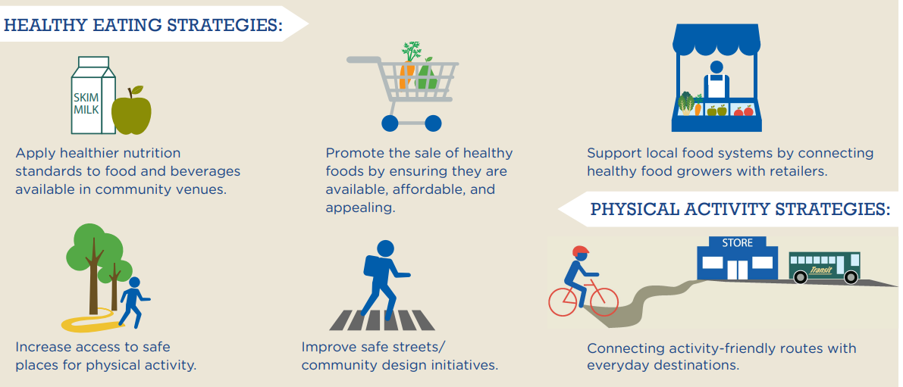
CDC High Obesity Program

Slide 45
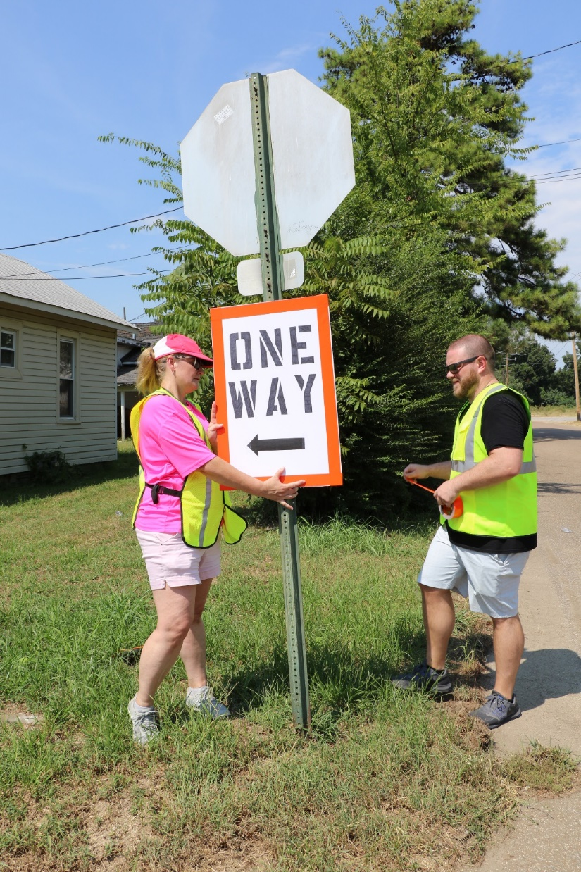
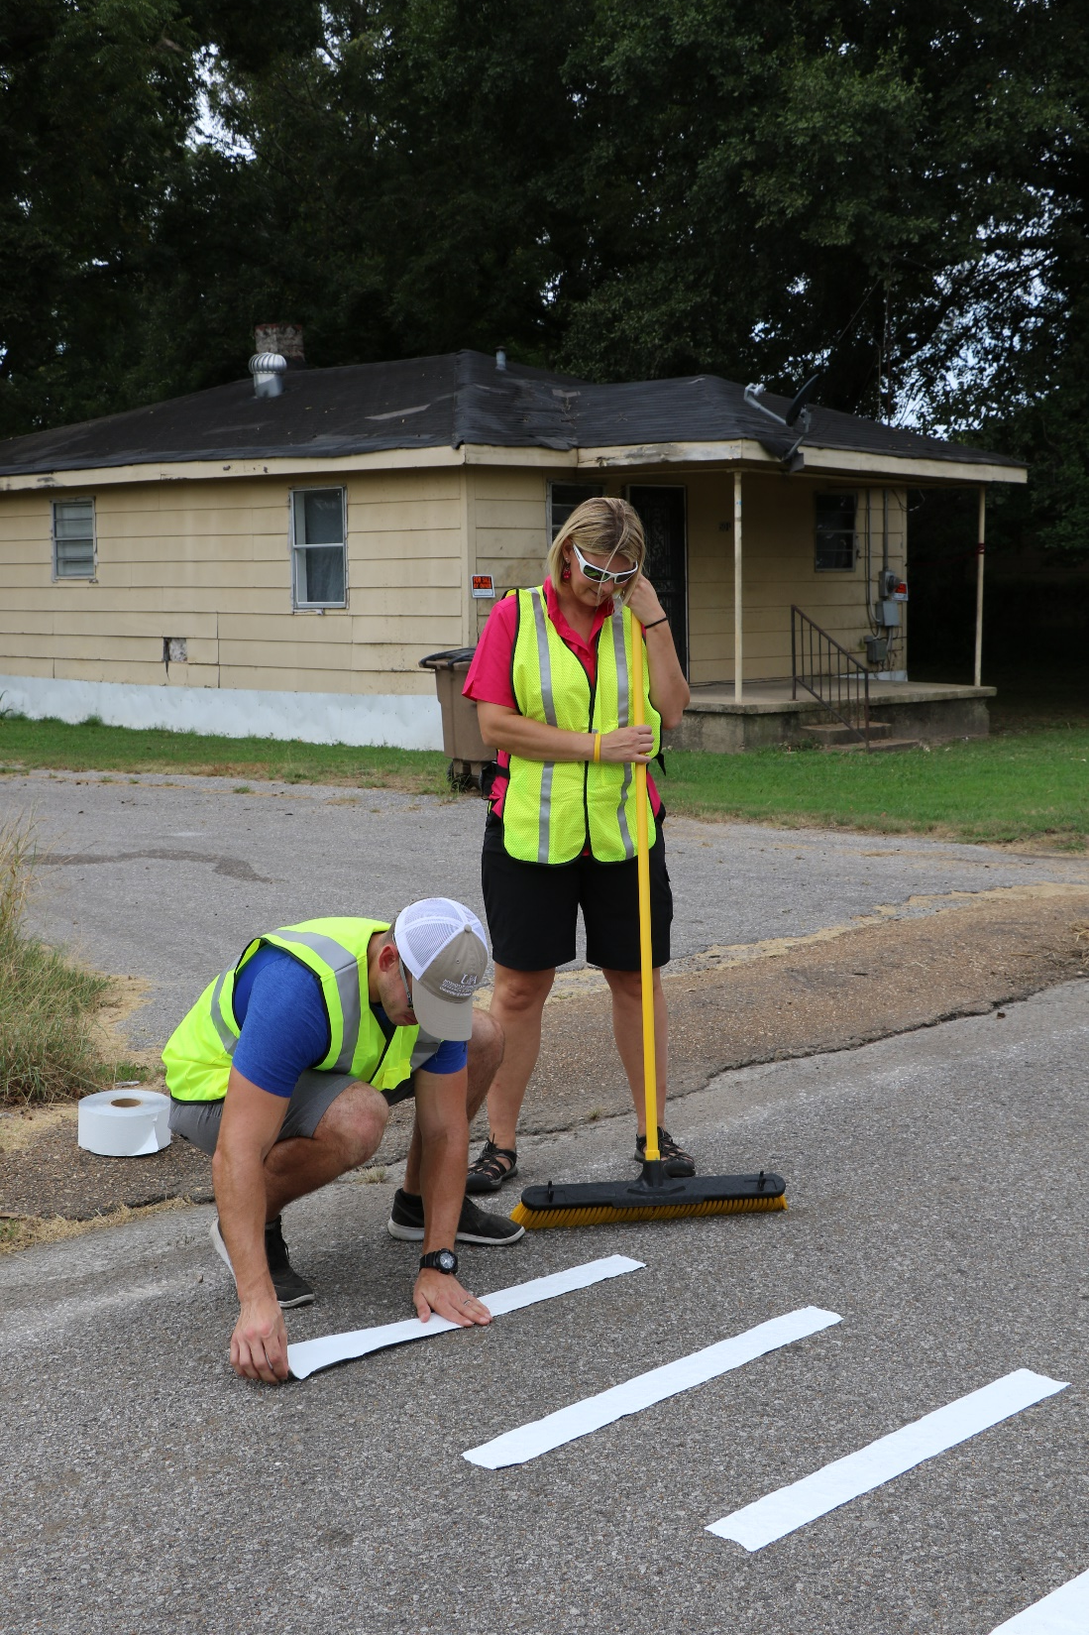

Slide 46
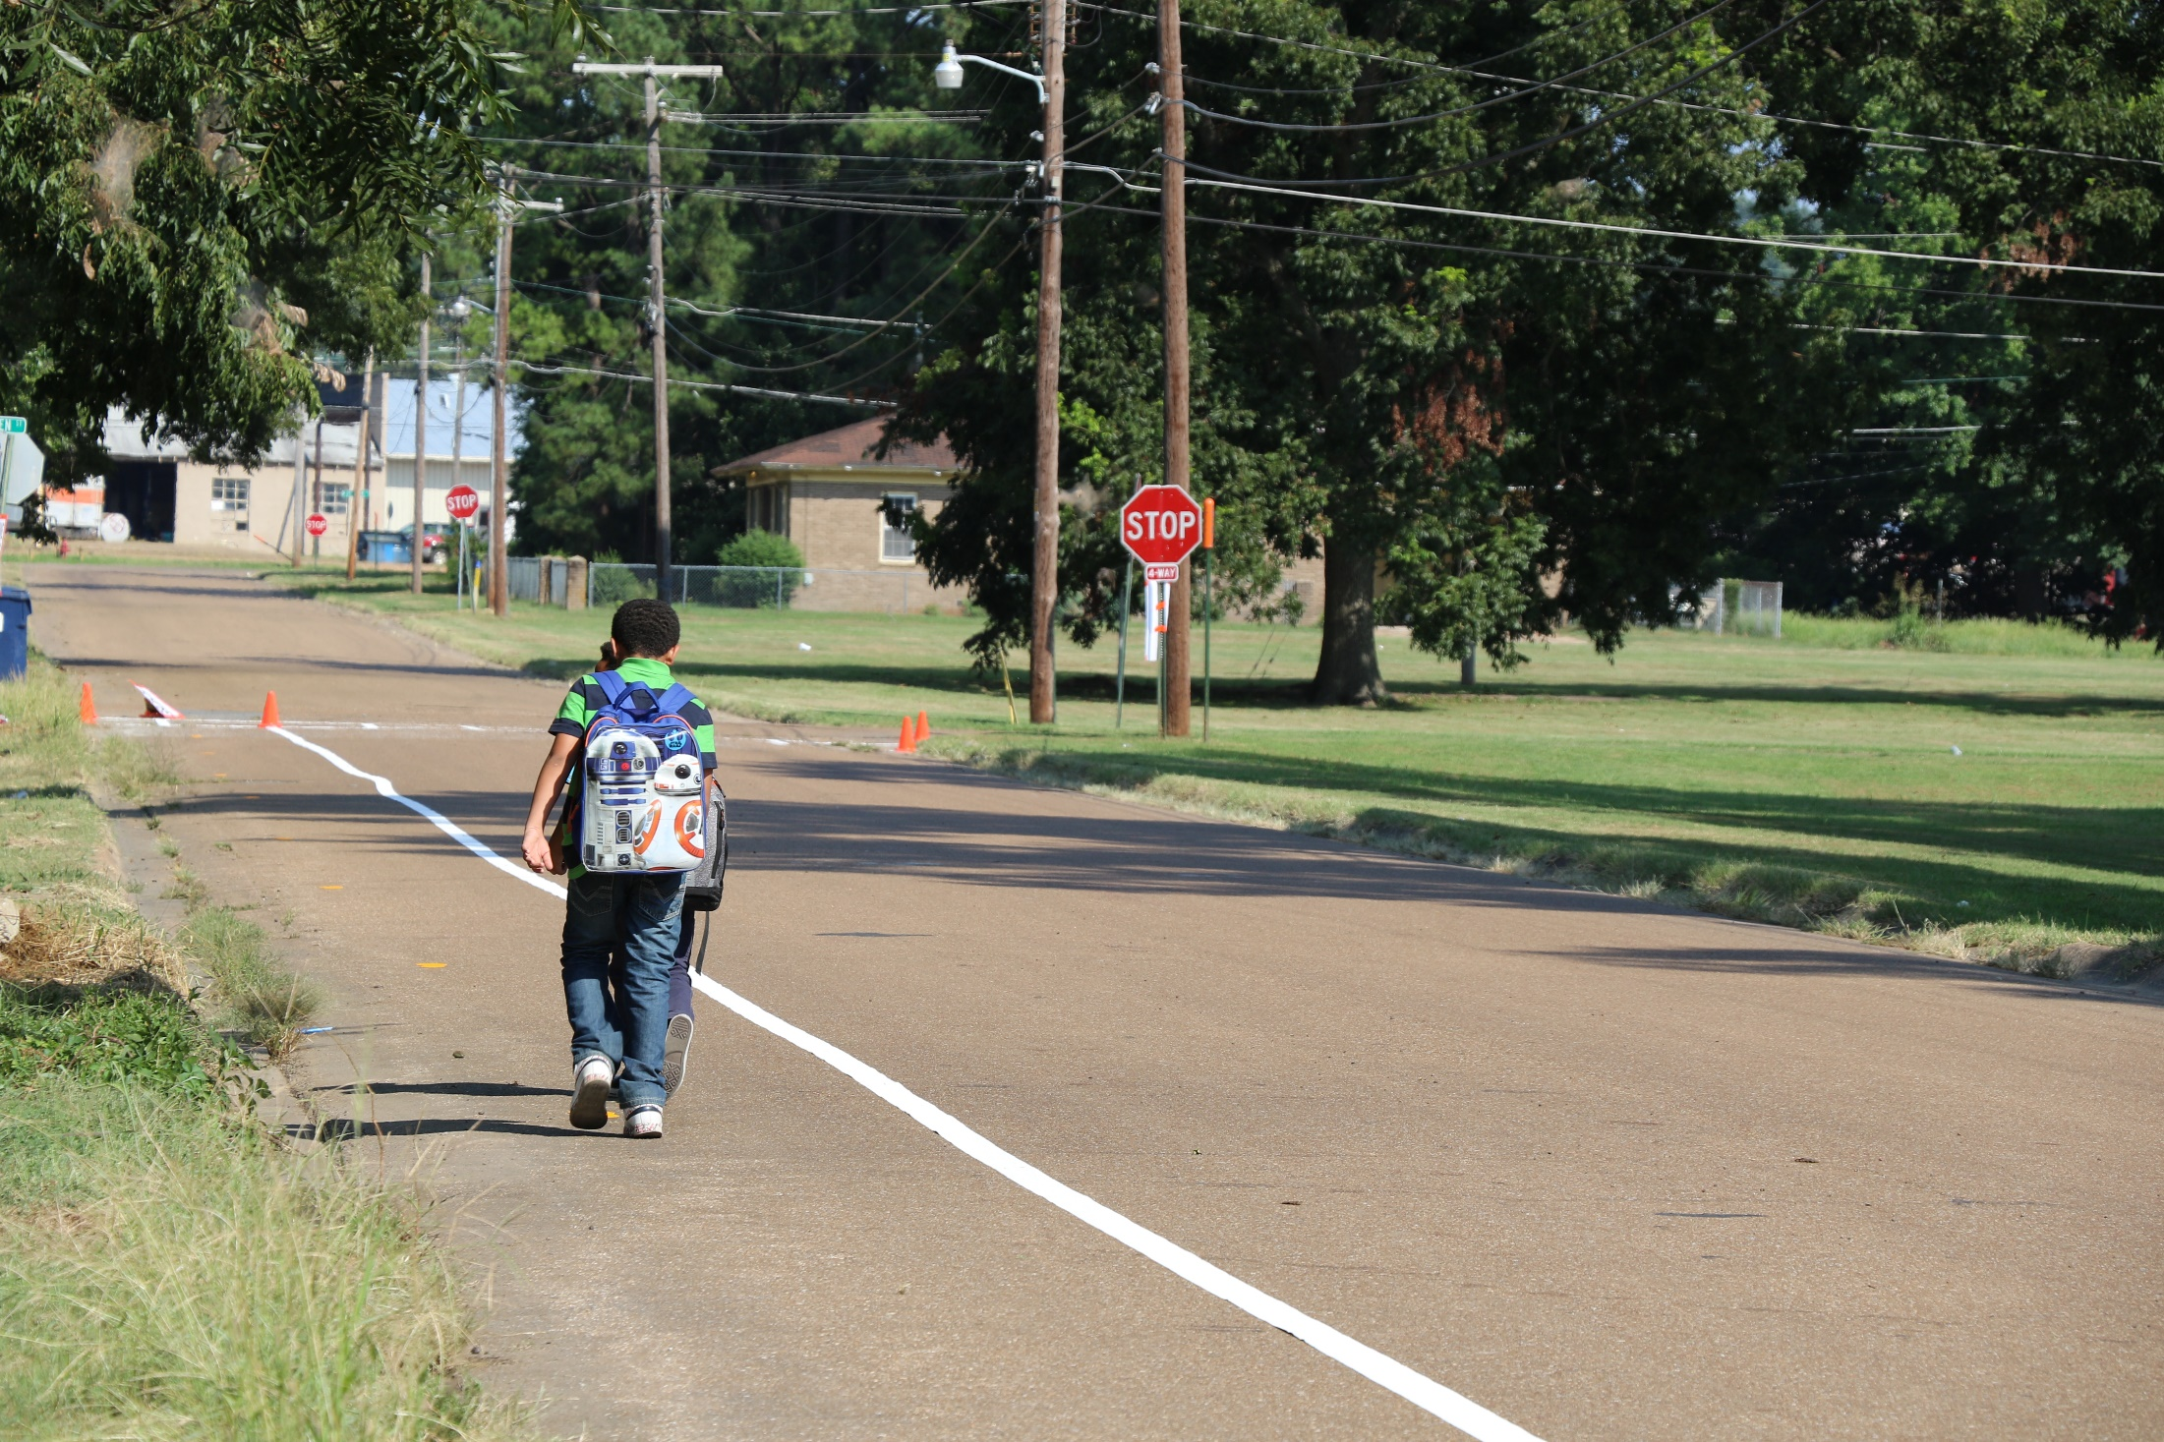

Slide 47
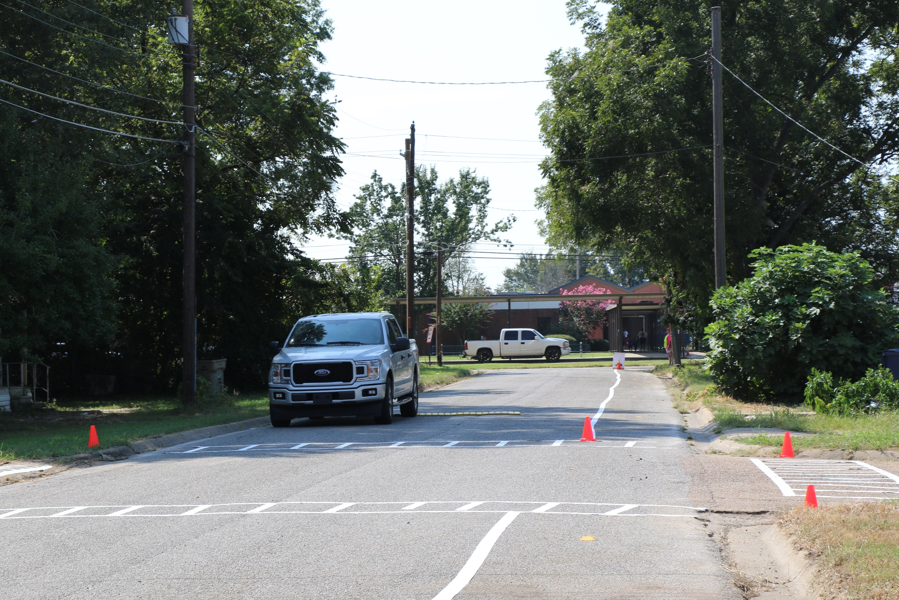

Slide 49
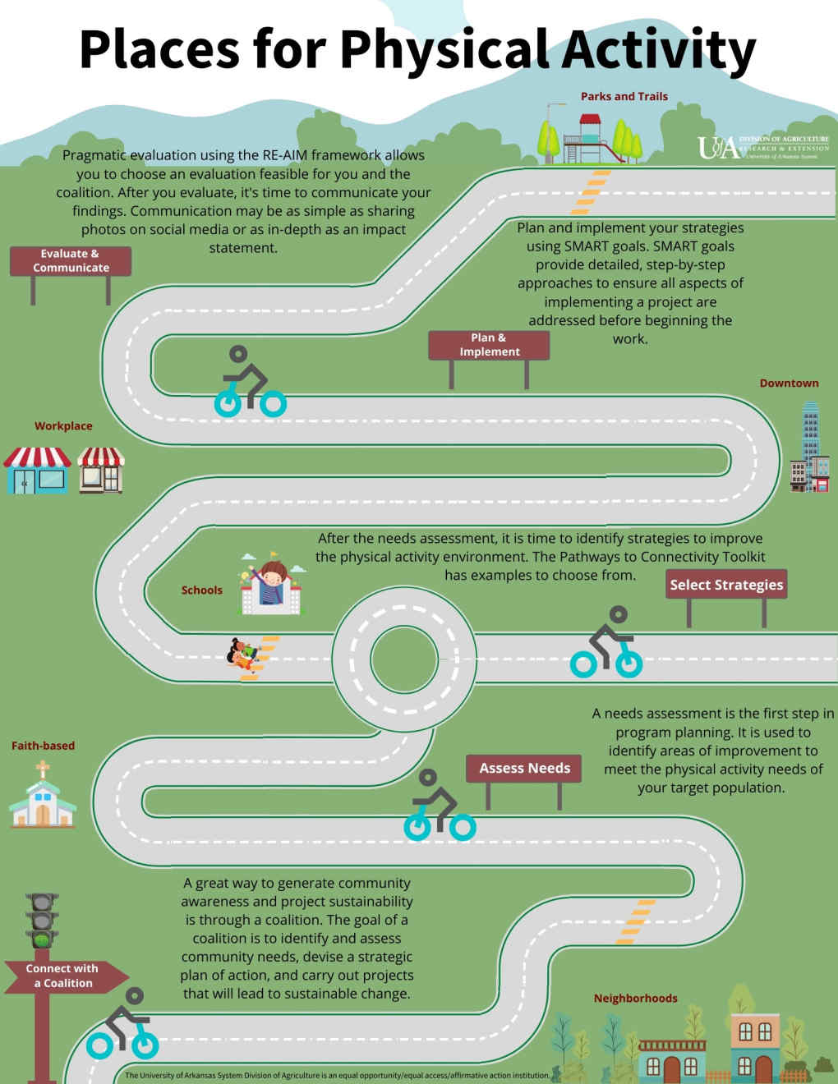

Slide 50
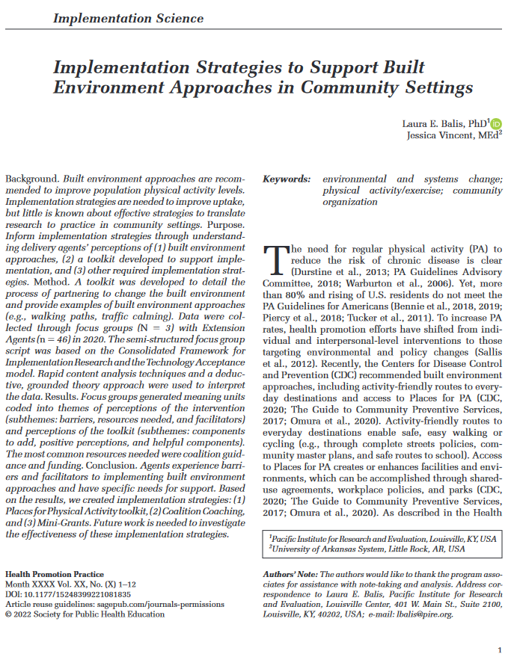
Understand perceptions of:
Built environment interventions
Other support needed
Pathways to Connectivity Toolkit
Purpose
Methods
Virtual focus groups with delivery agents
(Balis and Vincent, 2022)

Slide 51
Perceptions of built environment approaches (meaning units)
My struggle is the coalition right now.
Coalition guidance (n=50)
Funding (n=11)
Prompts (n=8)
I think funding is the biggest barrier. Especially now.
Organizational changes (n=4)
Expert assistance (n=3)
(Balis and Vincent, 2022)

Slide 52
Determinants
Implementation Strategies
Mechanisms
Outcomes
Intervention Characteristics
Implementation
Inner Setting
Outer Setting
Service
Characteristics of Individuals
Clinical/Patient
Process
(Smith et al., 2020)

Slide 53
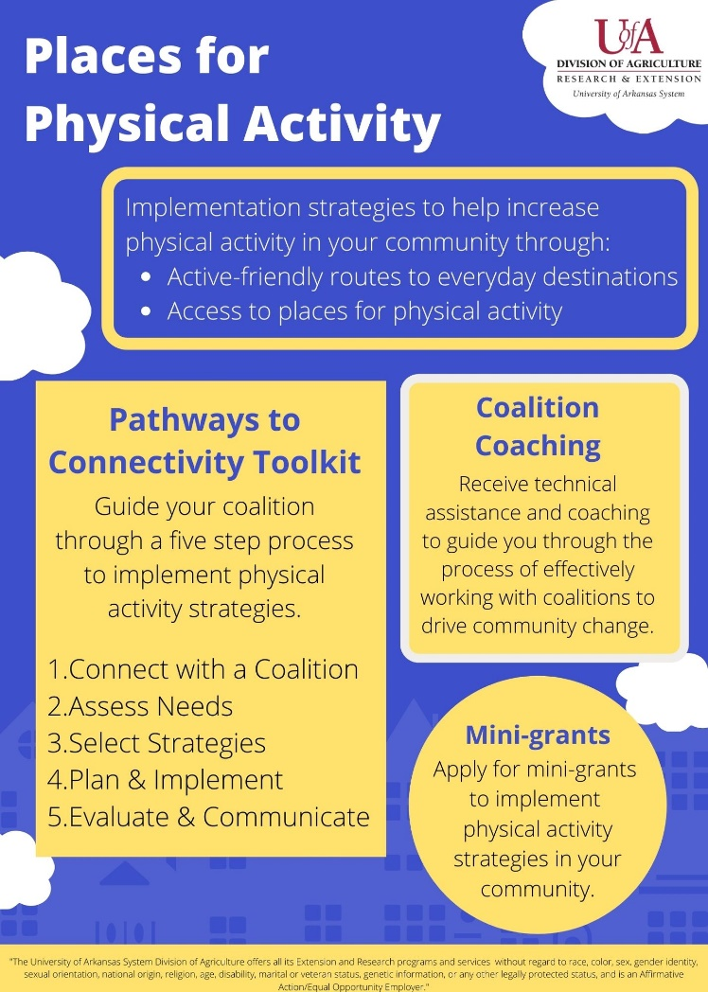
Community coalitions
Coalition Coaching
Funding
Mini-Grants
Expert assistance
Toolkit

Slide 55
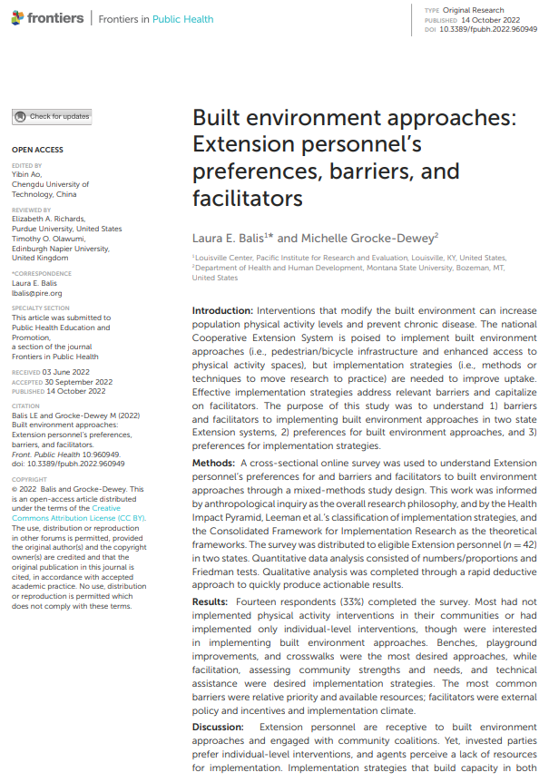
Barriers and facilitators to built environment approaches
Interest in specific implementation strategies
Interest in implementing specific built environment interventions

Slide 56
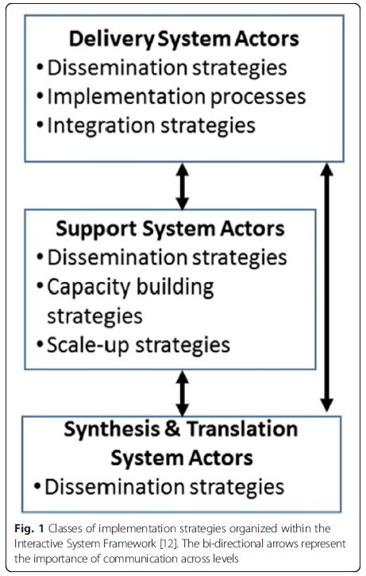
Barriers and facilitators to built environment approaches
Interest in specific implementation strategies
Interest in implementing specific built environment interventions
(Leeman et al., 2017)

Slide 57
Micro-level built environment approach | Mean (+SD)
Benches (e.g., along a walking/biking path) | 9.0 (+3.14)
Playground improvements | 8.0 (+3.96)
Crosswalks or mid-block crossings | 7.1 (+3.48)
Bike racks | 6.9 (+3.54)
Shared use agreements (e.g., permission to use school or HOA facilities) | 6.9 (+4.15)
Painted intersections (to slow traffic and promote walking) | 6.7 (+2.49)
Lighting along streets or walking/biking paths | 6.6 (+3.48)
Safe routes to school | 6.5 (+2.75)
Park improvements | 5.8 (+3.11)
Pedestrian signs (e.g., wayfinding signs with distance/time to walk/bike to destinations) | 5.1 (+3.68)
Landscaping or beautification projects (e.g., downtown cleanup, planting trees, adding art) | 5.0 (+3.42)

Slide 58
Barriers
Relative priority
Available resources (time, personnel)
Cost
Assess for readiness and identify barriers/facilitators
Conduct local consensus discussions
Develop resource-sharing agreements
Build a coalition
Increase demand
Conduct local needs assessment
Facilitators
External policy & incentives
Implementation climate

Slide 59



Implementation strategies | Mean (+SD)
Facilitation | 5.9 (+1.75)
Assessing community strengths and needs | 5.6 (+2.22)
Technical assistance | 5.2 (+2.11)
Adapting built environment approaches | 5.1 (+2.25)
Educational materials | 4.8 (+2.27)
Training | 3.7 (+2.05)
Engaging community members | 3.2 (+1.67)
New funding (e.g., mini-grants) | 2.6 (+1.44)
Access new funding
Assess for readiness and identify barriers/facilitators
Conduct local consensus discussions
Develop resource-sharing agreements
Build a coalition
Increase demand
Conduct local needs assessment

Slide 60





Barriers
Access new funding
Relative priority
Available resources (time, personnel)
Cost
Assess for readiness and identify barriers/facilitators
Conduct local consensus discussions
Develop resource-sharing agreements
Facilitators
External policy & incentives
Implementation climate
Increase demand
Conduct local needs assessment

Slide 61
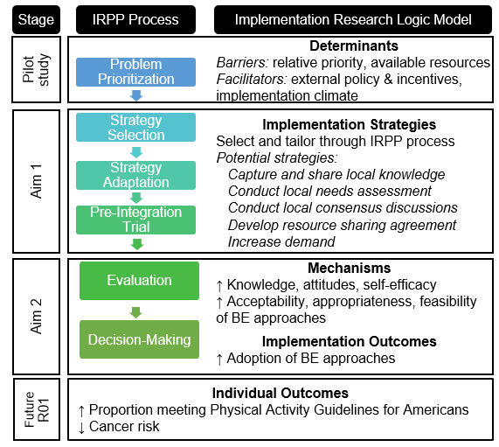

Slide 62
Questions

Slide 63
Thank You for Attending.
Survey to follow. Please share your feedback about today’s seminar.
Up Next:
“Who Gets a Say? Novel Method to Improve Equity in the Implementation Process”
Ruben Martinez, PhD
Assistant Professor of the BRIDGE Program
Department of Psychiatry and Human Behavior, Brown University
Tuesday, October 24, 2023 | 12-1 p.m. ET
Register on advancectr.brown.edu/events-training/seminar-series
Cite: U54GM115677
AdvanceCTR.org

