Slide 1
Current and Future use of RE-AIM and its PRISM Expansion and their Application in Pragmatic Trials
Russell Glasgow, PhD
Research Professor, Department of Family Medicine and
Director, ACCORDS Dissemination and Implementation Science (D&I) Program University of Colorado Anschutz Medical Campus
https://bit.ly/2BnJzuk
June 20, 2024
Acknowledgments: Borsika Rabin, Katy Trinkley, Meredith Fort, Monica Perez Jolles, Amy Huebschmann, Jen Gabbard, Bryan Ford, and the other great researchers cited throughout this talk

Slide 2
Housekeeping
All participants will be muted
Enter all questions in the Zoom Q&A/chat box and send to Everyone
Moderator will review questions from chat box and ask them at the end
Want to continue the discussion? Associated podcast released about 2 weeks after Grand Rounds
Visit impactcollaboratory.org
Follow us on Twitter & LinkedIN:
https://www.linkedin.com/company/65346172

Slide 3
Learning Objectives
Upon completion of this presentation, you should be able to:
Describe key features of the RE-AIM framework and how it can be applied for pragmatic research
Discuss how the PRISM framework expands upon RE-AIM and how it is used to address health equity
Discuss the importance of adaptations and the issues involved with iterative adaptations during implementation

Slide 4
Plan for today
Issues in Pragmatic Trials
Overview and Evolution of RE-AIM
Newer Applications for RE-AIM: health equity, iterative application
Overview of PRISM
New and Future Directions for PRISM: context and accessibility
Example Application- Integrated social needs screening for multi-morbid patients
I have no disclosures or conflicts of interest related to this presentation

Slide 5
Issues in Pragmatic Trials
(Russ’s RE-AIM/PRISM perspective)
Co-creation and Engagement
Reach and Equity
Feasibility and Generalizability
Speed of research vs. practice
Costs
Adaptations
Integrating all the above while being practical; rigorous and ‘balanced’ on internal and external validity; and not creating unintended consequences

Slide 6
The 5 Rs to Enhance Pragmatism and Likelihood of Translation
Research that is:
Relevant
Rapid and Recursive
Redefines Rigor
Reports Resources Required
Replicable
Peek, C.J, et al. (2014). The 5 Rs: An Emerging Bold Standard for Conducting Relevant Research in a Changing World. Annals Of Family Medicine, 12(5), 447-55. doi:10.1370/afm.1688
deGruy, F.V, et al. (2015). A plan for useful and timely family medicine and primary care research. Family Medicine, 47(8), 636-42.

Slide 7
Too often, we have assumed, “If you publish it…”
Thought Exercise and Genesis of RE-AIM

Slide 8
Real World Impact of 100% Effective Intervention
Adopted by
Settings
Implemented
with quality
Maintained
.7
X
.7
X
.7
X
.7
X
.7
Delivered Effectively
by most staff
Reached those in need
What is the moral of this story?
Overall population benefit to target population = 17%

Slide 9
Overview and Evolution of RE-AIM
Addressing These Issues of Population Health was Initial Purpose of RE-AIM Framework and Outcomes
www.re-aim.org
Developed in 1999- before implementation science or pragmatic trials were recognized areas of research- IT HAS (AND WILL CONTINUE TO BE) EVOLVED

Slide 10
Purpose and History of RE-AIM Framework
Intended to facilitate translation of research to practice, policy and real-world application
Balance internal and external validity, and emphasizes representativeness and equity
Individual (RE) and Multi-level Setting (AIM) factors- community, organization, staff
Ultimate Impact depends on all elements (reach x effectiveness, etc.)
Glasgow RE et al. RE-AIM at 20. Frontiers Public Health. 2019: 7: 64 https://doi.org/10.3389/fpubh.2019.00064
Glasgow et al. Amer J Public Health. 1999; 89: 1322-1327
www.re-aim.org

Slide 11
Pragmatic Use of RE-AIM- What is Feasible?
RE-AIM Dimension | Key Pragmatic Priorities to Consider and Answer
Reach (Individual Level) | WHO is (was) intended to benefit and who actually participates or is exposed to the ‘program’ or policy?
Effectiveness (Individual Level) | WHAT is (was) the most important benefit you are trying to achieve and what is (was) the likelihood of negative outcomes?
Adoption (Setting Levels) | WHERE is (was) the program or policy applied WHO applied it?
Implementation (Setting Levels) | HOW consistently is (was) the program or policy delivered? HOW will (was) it be adapted? HOW much will (did) it cost? WHY will (did) the results come about?
Maintenance (Individual and Setting Levels) | WHEN will (was) the program become operational; how long will (was) it be sustained (setting level); and how long are the results sustained (individual level)?
Glasgow RE & Estabrooks, P. Preventing Chronic Disease, 2018; 15: E02. https://doi.org/10.5888/pcd15.170271

Slide 12
Why Should You Cost Your Implementation?
Often the first and key question potential adopting settings will ask
Decision-makers want to know what it will cost them to implement
Is itself a key outcome- both Proctor et al. and RE-AIM outcomes
Cost is a key determinant of adoption, implementation (success and adaptations, sustainment and dissemination
Increasingly required in proposals
More and more costing guidance, resources, and examples
Pragmatic Research
Eisman, A. et al. (2021) 16:75 https://doi.org/10.1186/s13012-021-01143-x
Cronin, et al.(2024). Implementation costing guide. https://bit.ly/2BnJzuk

Slide 13
Adaptations Happen (and can be bad or good, even necessary)
Evaluating complex interventions: Confronting and guiding (vs. ignoring and suppressing) heterogeneity and adaptation
Brian S. Mittman, PhD Oct. 2018
Department of Research and Evaluation, Kaiser Permanente Southern California
**Also see PCORI Methodology Guidance; and ADAPT Guidance (Moore et al. BMJ 2021;374:n1679)

Slide 14
Adaptation – the deliberate or accidental (i.e., drift) modification of the program (or implementation strategies), including:
deletions or additions (enhancements) of components
refinements in the nature of included components
adjustments in the manner/intensity of the administration of program components (called for in the program manual, curriculum or core components analysis)
cultural and other modifications due to local circumstances
Moore G. et al. BMJ 2021;374:n1679 http://dx.doi.org/10.1136/bmj.n1679
Miller C. et al. The FRAME-IS. Implementation Science (2021) 16:36 https://doi.org/10.1186/s13012-021-01105-3

Slide 15
Types of Adaptations – Cultural; Resources; AND Local: ALL WITH AND DRIVEN BY MULTI-LEVEL PARTNERS
Focus of Adaptation | Timing of Adaptation (point in the project)
 | Planning | During | Sustainment- Dissemination
Intervention
Implementation Strategy
Setting
RE-AIM and PRISM can help guide adaptations
Rabin BA, et al. Systematic, multimethod assessment of adaptations across four diverse health systems interventions. Front Public Health. 2018;6(APR). https:// doi. org/ 10. 3389/ FPUBH. 2018. 00102.
Notes:
Russ

Slide 16
New applications for RE-AIM
Health equity
Equity issues at each RE-AIM dimension
Prioritizing outcomes
Choosing strategies
Iterative application
Project lifecycle
Team summary, discussion, and action planning

Slide 17
Health Equity Issues at Each RE-AIM Dimension
RE-AIM Dimension | Disparity | Overall Impact
Reach | 30% | 70% benefit
Effectiveness | 0 (equal) | 70% benefit
Adoption | 30% | 49% benefit
Implementation | 30% | 34% benefit
Maintenance | 30% | 24% benefit

Slide 18
RE-AIM Equity Outcomes
Cascade
ADOPTION
# and type of settings that participate
IMPLEMENTATION
Consistently deliver intervention and resources with quality
REACH
(equity)
# and type of citizens and families that participate
EFFECTIVENESS
(equity)
# and type of citizen and families that benefit
(on what outcomes)
Equity issues and potential for drop-off,
loss of impact, and inequities at each step
MAINTENANCE
Long-term implementation and effectiveness
Perez Jolles, M, Fort, M, Glasgow, RE. (2024). International Journal for Equity in Health. 23:41 https://doi.org/10.1186/s12939-024-02130-6

Slide 19
ADOPTION
# and type of settings that participate
Tailor to and engage leaders, partners having multiple perspectives and address history
RE-AIM Equity Outcomes
Cascade
FIXES
Make implementation simple, low cost and burden, and provide support
IMPLEMENTATION
Consistently deliver intervention and resources with quality
Multiple and diverse tailored promotion channels and increased access
REACH
(equity)
# and type of citizens and families that participate
Utilize evidence-based resources and strategies; make data-based adaptations
EFFECTIVENESS
(equity)
# and type of citizen and families that benefit
(on what outcomes)
Provide ongoing feedback, support
and resources for implementation
Example actions to prevent or minimize ‘drop off’ and inequities at each step
MAINTENANCE
Long-term implementation and effectiveness
Perez Jolles, M, Fort, M, Glasgow, RE. (2024). International Journal for Equity in Health. 23:41 https://doi.org/10.1186/s12939-024-02130-6

Slide 20
The Need for Speed: Rationale for Iterative RE-AIM
D&I frameworks are often cited
But frequently NOT used throughout a project lifecycle
Almost always for planning or evaluation
A major limitation to D&I models and methods is that they are much slower than needed by partners
RE-AIM has been used most for evaluation, but also successfully for planning
Neither RE-AIM (or PRISM) nor most other D&I models have been used iteratively to guide adaptations at key points
Glasgow, RE .... & Rabin B. Making implementation science more rapid. (2020) Frontiers Public Health. 8: 194
Norton WE, et al. Advancing rapid cycle research....... JNCI: Journal of the National Cancer Institute. https://doi.org/10.1093/jnci/djad007

Slide 21
Key Functions of Iterative RE-AIM Strategy Bundle
Obtain independent input and perspectives from each team member; then summarize results in visual displays
Team analyzes, reflects on, and discusses progress and priorities a that time point*
Specify 1–2 team RE-AIM priority areas and adaptations for next implementation period*
Implement and evaluate the delivery and impact of adaptations
Learn from iterations and repeat as appropriate over time
Glasgow RE, Battaglia C et al. Use of the RE-AIM framework to guide iterative adaptations: Applications, lessons learned, and future directions. Front Health Serv. 2022;2:959565. doi:10.3389/frhs.2022.959565

Slide 22
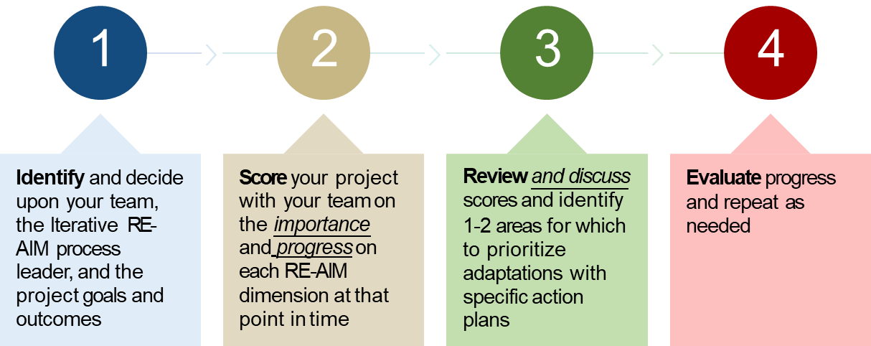
How do you use iterative RE-AIM?

Slide 23
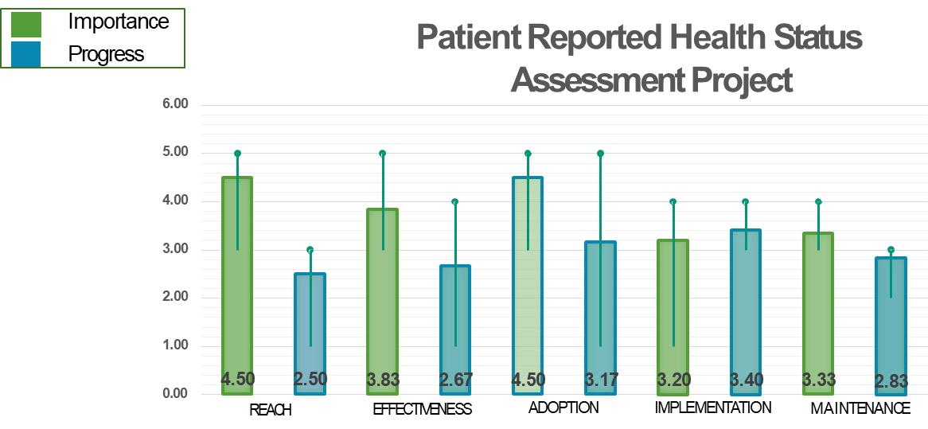
Sample “Gap” Analysis

Slide 24
RE-AIM
Purpose and Uses
Facilitate transparency and translation of research to include costs, adaptations
Balances internal and external validity, and emphasizes representativeness and equity
Multi-level:
Adoption vs. Reach
Representativeness on all RE-AIM dimensions
Ultimate Impact depends on all elements (reach x effectiveness, etc.)
Glasgow RE et al. RE-AIM at 20. Frontiers Public Health. 2019: 7: 64
Glasgow et al. Amer J Public Health. 1999; 89: 1322-1327

Slide 25
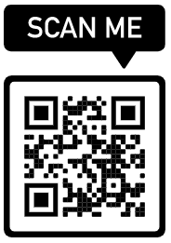
Also, chapters on PRISM and RE-AIM in new Nilsen 2024 book: Implem. Science: Theory and application
Brief explainer videos
FAQ’s and examples
Guidance on application
Searchable list of 700+ article abstracts
Calculators, checklists, tools
Recommended slides
Webinars, upcoming events, blogs
Additional Resources at www.re-aim.org
Glasgow et al (2019). RE-AIM Planning and Evaluation Framework: 20-Year Review. Front Public Health, 7, 64. doi:10.3389
Holtrop et al. (2021) Understanding and applying the RE-AIM framework J Clinical Translat Sci, page 1 of 10. doi: 10.1017/cts.2021.789
Special issue Front Public Health- 13 articles https://www.frontiersin.org/research-topics/10170/
Notes:
Russ- Nilsen book ref

Slide 26
Other Things You Wanted to Know About RE-AIM?

Slide 27
Application Challenges
Issue
Distinguishing Reach vs. Adoption
‘Denominator’ or characteristics of nonparticipants not known
How Addressed
Reach is at Individual (recipient) level
Adoption is at the Setting…AND the Staff/implementer levels
May not have reach measure in all projects; often have multiple adoption levels
Transparently report the recruitment or implementation situation
Provide both a conservative and an upper bound estimate (e.g., sensitivity analysis)
Use public or admin. records data to describe target population- e.g., census, employee or organizational data

Slide 28
Application Challenges
Issue
How to determine ‘Overall’ Outcome or total impact
Trouble determining representativeness
How Addressed
Convert each dimension measured to a 0-1 scale (or 1- 100) and multiply the results
During planning identify with and from stakeholders which RE-AIM outcomes are highest priority and make those primary
Compare ‘participants’ to either the overall intended population (e.g., all patients in EHR) or to those who decline
Identify a priori a small number of factors most likely to be related to key outcomes (e.g., SDOH, risk score, motivation)

Slide 29
Overview of PRISM
“Context is Everything”
Context is multi-level and dynamic - not just places, but also history and relationships (trust, etc.)
Addressed through PRISM extension of RE-AIM Outcomes: “RE-AIM in context”
Nilsen P, Bernhardsson S. Context matters in implementation science: BMC Health Serv Res. 2019;19(1):189.
Shelton, RC et al. An extension of RE-AIM….Front Public Health 2020 8:134
Chambers, D et al. The dynamic sustainability framework. Implement Sci. (2013) 8:117.

Slide 30
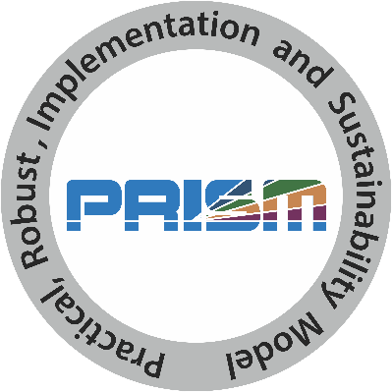
What is PRISM?
Practical, Robust Implementation and Sustainability Model
Contextually expanded RE-AIM
Has been used as a:
Determinant framework
Process framework
Implementation framework
Evaluation framework
Feldstein, A. C., & Glasgow, R. E. (2008). Jt. Commission J Qual Patient Safety, 34(4), 228-243. https://doi.org/https://doi.org/10.1016/S1553-7250(08)34030-6
Rabin et al. (2022). Implementation Science, 17(1). https://doi.org/10.1186/s13012-022-01234-3

Slide 31
PRISM figure (newly imagined)
PRISM Contextual Factors
Multi-level/Multi-sector
Perspectives on Intervention
External Environment – (Structural Drivers of Equity)
Multi-level Partner Characteristics
Implementation and Sustainability Infrastructure
Intervention, Program or Policy
Implementation Strategies
RE-AIM Outcomes
Reach
Effectiveness
Adoption
Implementation
Maintenance
Perez Jolles, M, Fort, M, Glasgow, RE. (2024). International Journal for Equity in Health. 23:41
Notes:
RUSS- consider logic model view- add ref

Slide 32
REPEAT AFTER ME……….
PRISM contains RE-AIM (they are not different or competing frameworks)
PRISM contains RE-AIM (is the contextually expanded RE-AIM)
PRISM Includes RE-AIM

Slide 33
Key Findings- Recent Citation Analysis Review
(180 articles – 32 made ‘integrated’ use)
PRISM has been primarily used in outpatient clinical settings and in the US
It has been used to study a variety of issues and conditions using a wide range of experimental designs and often using mixed methods
Most studies have reported on half or more of the PRISM domains
Most frequently assessed were Organizational perspectives on the Program/Intervention, and Implementation and Sustainability Infrastructure
PRISM contextual components were most frequently operationalized using qualitative methods
Implementation and Maintenance were most reported RE-AIM outcomes
Rabin et al. (2022). Implementation Science, 17(1). https://doi.org/10.1186/s13012-022-01234-3

Slide 34
Example applications for PRISM
Addressing Health Equity
Addressing Multiple Chronic Conditions
iPRISM Webtool for implementation teams and investigators

Slide 35
Use of the PRISM Framework to
Address Health Equity
Monica Perez Jolles, PhD
Meredith Fort, PhD
Russell E. Glasgow, PhD
Perez Jolles, M, Fort, M, Glasgow, RE. (2024). International Journal for Equity in Health. 23:41
https://doi.org/10.1186/s12939-024-02130-6
Fort, M., Manson, S, Glasgow, RE. (2023). Front. Health Serv. 3:1139788. doi10.3389/frhs.2023.1139788

Slide 36
How PRISM (and RE-AIM Outcomes) Address Equity Issues
PRISM Contextual Factors
Multi-level/Multi-sector
Perspectives on Intervention
External Environment – Drivers of Equity
Many Perspectives Represented
Address Context
Implementation and Sustainability Infrastructure
Multi-level Partner Characteristics
Fit and Co-creation
Intervention, Program or Policy
Planning to ensure equity is addressed
Implementation Strategies
Interactions among outcomes
RE-AIM Outcomes
Equity/ Representativeness across outcomes
Reach
Effectiveness
Adaptation
Adoption
Implementation
Maintenance
Unintended Consequences
Cost and Feasibility
Fort MP, Manson SM and Glasgow RE (2023). Applying an equity lens… Front. Health Serv. 3:1139788. doi10.3389/frhs.2023.1139788

Slide 37
How Can PRISM (and other D&I Science Frameworks) Help Address Health Equity?
Broaden Focus on All Steps and Outcomes Necessary for Population and Equity Impact
Focus Attention on Issues of Representation and Representativeness*
Address Systems Issues and Unintended Consequences
Understand Context and Guide Tailoring and Adaptation to Context* and Population
Methods and tools: Integrate with other frameworks including those on equity

Slide 38
Example: My Own Health Report System to Assess and Integrate Patient-Centered Multi-Risk Reduction Plans for Patients with Multiple Chronic Conditions
Goal: Evaluate a primary care based integrated assessment and feedback system to 1) provide integrated risk feedback and patient prioritized goal setting, 2) inform patient-provider interactions and action plans and c) deliver systematic follow-up
Setting and Population: Primary care patients with Type 2 diabetes and at least one other chronic condition having an annual wellness visit
Screening and Feedback: integrated into 8-12 minute web-based pre-visit assessment
Health Behaviors: Smoking, physical activity, eating patterns, substance use (tailored options)
Mental Health: depression, anxiety, quality of life, distress (tailored options)
Social Needs: Food insecurity, medication affordability, transportation, housing, (tailored options)
Real Time Feedback to Patients and Providers: Integrated risk and action planning summary; choice of or multiple modalities
Systematic Follow-up: testing automated nudges vs. live staff contact
A. Huebschmann and R. Glasgow (MPIs). Rapid and Rigorous Accelerator Initiative Award project, Univ. Colorado

Slide 39
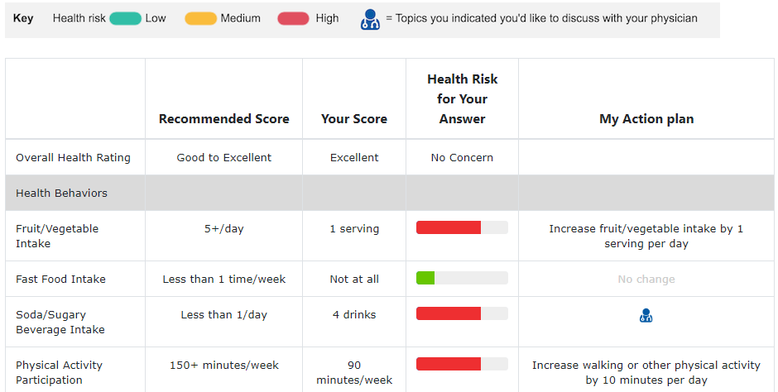
Figure 1. My Own Health Report (MOHR) intervention – what does it do?
Figure 1a. Core Functions*
Figure 1b. Example 1-page patient feedback display
1. Risk flagging – patients’ MOHR survey responses identify behavioral cancer risks and unmet social needs
*5 A’s model = “Ask”
2. Goal-setting – patients pick goals for what they are ready to address from multiple flagged cancer risks and unmet social needs
*5 A’s model = “Assess/Advise
This column:
Risk flagging
This column:
Goal-setting
3. Service linkage – arranged with clinician during index primary care visit – clinician provides appropriate referrals and clinic-specific resources needed for one’s goals
*5 A’s model = “Assist/Arrange”
*From 5 A’s model³⁴⁻³⁶: Function #1 = Ask; Function #2 = Assess/Advise; Function #3 , Assist/Arrange – see Table 2 for operationalization; Pwr
strategies (Table 3) of R² message and R² Navigation will be further opportunities for Assist/Arrange to occur
Notes:
Great slide- does not have on it ’want to discuss today’. column...... Probably fine as I like this slide

Slide 40
My Own Health Report: PRISM Contextual Factors in primary care application
Characteristics:
Staff/clinic: number and type (e.g., social workers, behavioral health)
Patients: # and severity of conditions; digital literacy; years with PCP
Perspectives:
Staff/clinic: workflow; history with behavior change; experience with technology; burn out
Patients: history with health behavior change; trust; family context; etc.
Implementation and Sustainability Infrastructure:
QI system; audit and feedback; responsible person; accountability; resources
External Environment:
Value based care criteria; Epic EHR constraints

Slide 41
Outcomes based on RE-AIM: Emphasis on equity on ALL dimensions below; mixed methods assessment
Reach: Proportion and characteristics of eligible patients who participate- why or why not
Effectiveness:
Completion of MOHR assessment and quality of pt-provider communication
# at-risk behaviors, mental health issues, and social needs improved (primary)
Completion of social needs referrals
Implementation:
Consistency of offering MOHR and prompting its discussion
Documentation of appropriate referrals
Adaptations made to process, timing, staff roles, recruitment, discussions, feedback provided
Costs of implementation, including staff training and supervision
Maintenance: Intent to maintain or adapt MOHR and iterative PRISM (next slide) after research evaluation period- why or why not

Slide 42
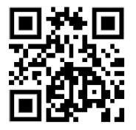
Most Recent: Web-based Iterative PRISM
To increase accessibility and use by diverse groups
Use for (across all or choice of): Planning; guiding iterative implementation/adaptations; or sustainment phases
Automated, real time data collection, analysis and feedback
Trinkley et al. The iPRISM webtool. Implementation Science Communications (2023) 4:116 https://doi.org/10.1186/s43058-023-00494-4
prismtool.org

Slide 43
Purpose
Simplify implementation science - using PRISM
For diverse researchers and implementation teams
Support rapid learning health systems
Web-based resource to Guide and prompt users to iteratively:
Assess context
Align project with context
Assess priorities and progress on key outcomes
Develop feasible and impactful strategies/adaptations
Create action plans
Trinkley KT, et al. Acad Med. 2022;97:1447 (primary care & cardiology decision aid)
Maw A, et al. Implement Sci Commun. 2022;3:89 (hospital based EHR dashboard)
prismtool.org

Slide 45
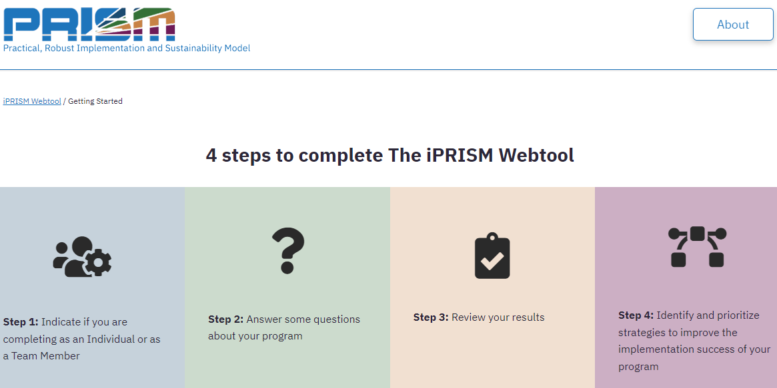

Slide 47
Graphical display of responses

Slide 48
Prioritize strategies
https://prismtool.org

Slide 49
Future Directions for PRISM Research and Practice
Quantitative survey measures for prism
Not necessary to use all PRISM components or every milestone
Investigate Relationships within and between PRISM, RE-AIM, and other outcomes

Slide 50
Evolution of RE-AIM -> PRISM: Lessons Learned
Systems Perspective.
Has Evolved and Expanded.
Expanded the original model to focus on adaptions and sustainability.
Emphasize qualitative methods to understand “how” and “why.”
Capture costs.
Understand and address health equity issues.
Encourage pragmatic and iterative use.
Package for use by non-researchers.
Integrate with other models.
Glasgow et al. RE-AIM Planning and Evaluation Framework: Adapting to New Science and Practice with a 20-Year Review. Front Public Health. 2019;7:64.

Slide 51
And Remember:
All Models (and Methods) Are Wrong…
Some Are Useful
“To every complex question,
there is a simple answer…
and it is wrong.”
~H. L. Mencken

Slide 52
Questions and Comments

Slide 53
Thank you
Russell E. Glasgow, PhD
russell.glasgow@cuanschutz.edu
https://bit.ly/2BnJzuk
Twitter: @RussGlasgow

Slide 54
Contextual Factors
Implementation and Sustainability Infrastructure
Implementation Outcomes
Reach
Effectiveness
Adoption
Implementation
Maintenance
Implementation Strategies
(aligned with context and intervention)
Characteristics
Perspectives on Intervention
Organizational
Patient
Organizational
Patient
Leaders
Family/
Caregiver
Leaders
Family/
Caregiver
Managers
Managers
Staff
Individual
Staff
Individual
External Environment

Slide 55
TITLE: Rapid, Rigorous, Patient-centered Program (R2P2)
 | Partner Engagement | Aim 1: Design Intervention & Strategy | Aim 2: Implement & Test | Aim 3: Sustain, Scale, & Disseminate
Timeline | Pre-project-2 months | 0-6 months | 6-18 months | 18-24 months
Meta-goals for the AAI center. What are our key research questions to inform the field? | What is the most efficient way to meaningfully engage partners? Which perspectives are essential? What is the right balance of partners? How do we assess time, cost and quality of engagement? | How rapidly can we design the intervention? Where can we speed up without losing rigor? What training and resources are required for rapid design? How to best enhance equitable access and impact? | How to rapidly assess and address dynamic context? What pragmatic designs can be done efficiently? How to rapidly produce meaningful and equitable results? What are efficient ways to record and analyze adaptations? | How do we develop, evaluate, and adapt key sustainment messages? How do we communicate replication costs? What organization and individual influencers will help most to disseminate?
Key objectives for this phase of the project | Ensure engagement of the essential perspectives/users in all phases of the project. | Rapidly and iteratively design the intervention and implementation strategies. | Conduct a moderate-sized pragmatic study assessing implementation and patient-centered outcomes. | Develop a dissemination strategy and sustainability plan
Required elements or functions for all projects (will take different forms, as appropriate to project) | Invite multi-perspective partner group Select and implement process for engagement Assess level and cost of engagement | Define Key functions of the intervention and implementation strategies and optional forms Develop a logic model including context, imp. strategies and outcomes Conduct an iterative, user-centered design process. | Design and conduct a pragmatic trial that assesses the following: RE-AIM Implementation outcomes (RE-AIM) including costs Context and adaptations Pt. centered impact | Design a social marketing campaign Develop sustainment guidance materials for participating settings and adaptation guide for new sites. Assess uptake of the intervention.

Slide 56
Rapid and Rigorous Accelerator Program Specific Aims
Rapidly and rigorously Design a host of tools to improve the patient-centeredness of care.
Rapidly and rigorously Implement & Test interventions in real-world settings using pragmatic research- across multiple projects, problems, and settings.
Rapidly and rigorously Disseminate and Sustain project delivery and outcomes.
University of Colorado Anschutz Accelerator Initiative Award 2024-2029

Slide 57
Equity Issues in Evidence-Based Research: Evidence on What? (take home point)
External Validity/Pragmatic Criteria, Often Ignored
Participant representativeness
Setting and staff representativeness
Multi-level context
Adaptation/change in intervention and implementation strategies
What outcomes for whom over what time period
Reasons for participation and drop out
Bottom line: What works for whom, under what conditions, for what outcomes, how much does it cost
Notes:
Bavkground

Slide 58
Common Misconceptions
1. Only for evaluation
2. Only quantitative or qualitative
3. Mandates that all dimensions are used and equally important
4. Does not address context or determinants
See video of Dr. Holtrop discussing: re-aim.org/resources-and-tools/recommended-re-aim-slides/

Slide 59
PRISM Contextual Factors
Multi-level/Multi-sector
Perspectives on Intervention
External Environment –
Structural Drivers of Inequity
Multi-level Partner Characteristics
Implementation and Sustainability Infrastructure
Intervention, Program, or Policy
Implementation Strategies
RE-AIM Outcomes
Reach
Effectiveness
Adoption
Implementation
Maintenance

Slide 60
Comparison of Two Different Types of Programs
Glasgow et al 1999

Slide 61
Resource Sheet 2- Select strategies and specific evaluation questions
Dimensions for Dissemination | Questions to Ask of Potential Programs | Strategies to Enhance Future Translation and Dissemination
Reach (individual level) | What percentage of the target population would come in contact with your program? Will you reach the most in need? Will research participants reflect the targeted population? | Formative evaluation with potential users and nonusers Small-scale recruitment studies to enhance methods Identify and reduce participation barriers Use multiple channels of recruitment
Effectiveness (individual level) | Will the intervention likely affect key targeted outcomes? What unintended adverse consequences may occur? How will impact on quality of life be assessed? | Incorporate tailoring to individuals Reinforce messages via repetition, multiple modalities, social support and systems change Consider stepped care approaches Evaluate adverse outcomes and quality of life for program revision and cost-to-benefit analysis
Adoption (setting or organizational level) | What percentage of target settings and organizations will use the program? Do organizations include high-risk or underserved populations? Does program fit with organizational goals and capacities? | Conduct formative evaluation with adoptees and non-adoptees Recruit settings that have contact with the target audience Develop recruitment materials outlining program benefits and required resources Provide various cost options and customization of the intervention
Implementation (setting or organizational level) | Can different levels of staff successfully deliver the program? What proportion of staff within a setting will agree to program delivery? What is the likelihood that various components will be delivered as intended? | Provide delivery agents with training and technical assistance Provide clear intervention protocols Consider automating all/part of the program Monitor and provide staff feedback and recognition for implementation
Maintenance (individual and setting levels) | Does the program produce long-term individual behavior change? Will organizations sustain the program over time? What are characteristics of persons and settings showing maintenance? | Minimize level of resources required Incorporate “natural environmental” and community supports Conduct follow-up assessments and interviews to characterize success at both individual and setting levels Consider incentives and policy supports

Slide 62
Resource Sheet 2- Select strategies and specific evaluation questions
Dimensions for Dissemination | Questions to Ask of Potential Programs | Strategies to Enhance Future Translation and Dissemination
Reach (individual level) | What percentage of the target population would come in contact with your program? Will you reach the most in need? Will research participants reflect the targeted population? | Formative evaluation with potential users and nonusers Small-scale recruitment studies to enhance methods Identify and reduce participation barriers Use multiple channels of recruitment
Effectiveness (individual level) | Will the intervention likely affect key targeted outcomes? What unintended adverse consequences may occur? How will impact on quality of life be assessed? | Incorporate tailoring to individuals Reinforce messages via repetition, multiple modalities, social support and systems change Consider stepped care approaches Evaluate adverse outcomes and quality of life for program revision and cost-to-benefit analysis
Adoption (setting or organizational level) | What percentage of target settings and organizations will use the program? Do organizations include high-risk or underserved populations? Does program fit with organizational goals and capacities? | Conduct formative evaluation with adoptees and non-adoptees Recruit settings that have contact with the target audience Develop recruitment materials outlining program benefits and required resources Provide various cost options and customization of the intervention
Implementation (setting or organizational level) | Can different levels of staff successfully deliver the program? What proportion of staff within a setting will agree to program delivery? What is the likelihood that various components will be delivered as intended? | Provide delivery agents with training and technical assistance Provide clear intervention protocols Consider automating all/part of the program Monitor and provide staff feedback and recognition for implementation
Maintenance (individual and setting levels) | Does the program produce long-term individual behavior change? Will organizations sustain the program over time? What are characteristics of persons and settings showing maintenance? | Minimize level of resources required Incorporate “natural environmental” and community supports Conduct follow-up assessments and interviews to characterize success at both individual and setting levels Consider incentives and policy supports

Slide 63
Public Health Need Thought Exercise
Implementing A Dementia Screening (or Disparities Reduction) Program; or COVID-19 Vaccine) Story
Even if 100% effective...is only so good as how and whether:
It is adopted widely, including in low resource settings
Local stakeholders and delivery staff choose to deliver it
It can be implemented consistently with quality
It reaches intended recipients, including those at highest risk receive it
It can be maintained or sustained
If we assume 70% success for each step above…….
Glasgow RE, Vogt TM, Boles SM. Am J Public Health. 1999;89(9):1322.
Glasgow RE, et al. Frontiers Public Health 2019 7:64. doi: 10.3389/fpubh.2019.00064
www.re-aim.org

Slide 64
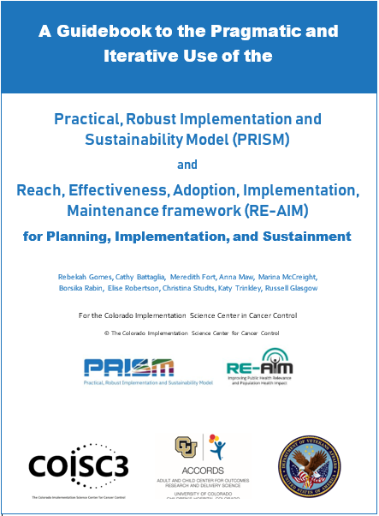
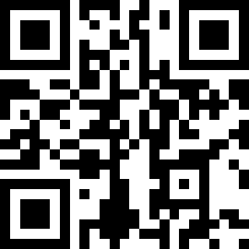
Purposes:
Briefly discuss key conceptual issues in PRISM and RE-AIM
Provide guidance, examples, and recommendations for pragmatic use of these frameworks
Provide survey items for different project phases and tables of strategies to enhance RE-AIM outcomes
https://tinyurl.com/4fmvf7kr
© COISC3 2023

